Slide 1
You’ve Got Documents! A MongoDB Jump Start
Steven Edouard | Developer Evangelist
Rami Sayar | Developer Evangelist

Slide 2
Course Topics
You’ve Got Documents! A MongoDB Jump Start
01 | Introduction to NoSQL Document Oriented Databases | 06 | Running MongoDB on a Cloud Ubuntu VM
02 | Getting Started With MongoDB Queries Part 1 | 07 |
03 | MongoDB Queries Part 2 | 08 |
04 | MongoDB Node.js and C# Language Drivers | 09 |
05 | MongoDB Advanced Data Processing | 10 |

Slide 3
02 | Getting Started With MongoDB & Queries
Steven Edouard | Developer Evangelist
Rami Sayar | Developer Evangelist

Slide 4
Module Overview
Running MongoDB on your local machine
Loading Bulk Data
The Interactive Shell & Queries Part I

Slide 5
Running MongoDB on Your Local Machine

Slide 6
MongoDB Binaries
The following binaries are installed onto your machine
mongod – The database process
mongo – The mongodb CLI
mongoimport – A data import utility

Slide 7
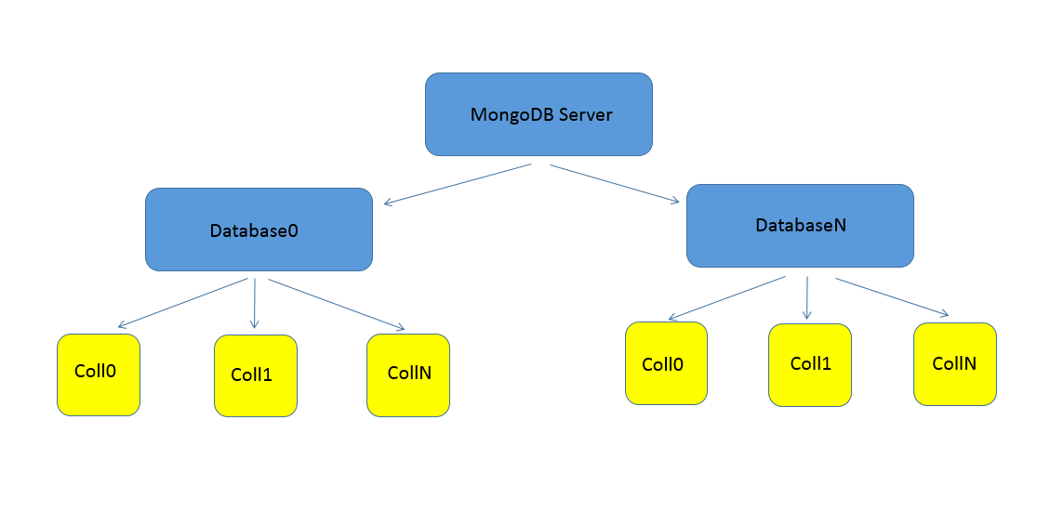
MongoDB Database Organization

Slide 8
Loading Bulk Data

Slide 9
Loading Test Data
Using mongoimport
Load bulk data from CSV or JSON files
Fastest way to load data into mongodb without having to write code

Slide 10
The Interactive Shell & Queries Part I

Slide 11
The MongoDB Interactive Shell
Used to directly administer MongoDB servers
Test out new queries
Its a lot like a javascript interactive shell

Slide 12
Collections
Containers for a group of Documents
Databases contain many of these
Akin to a ‘Table’ in a SQL Database

Slide 13
Queries
Use a Query Object to Fetch Requested Data
Resembles objects already in the database
Can also be used to Update or Delete data

Slide 14
Projections
Used to filter the data you want
Similar to what SELECT does in a SQL Query
Takes similar form of Query objects

