Slide 1
Computational Methods of Imaging Science – Final Project
Kaushik Dutta
Ryan Friedmann
Siqi Zhao

Slide 2
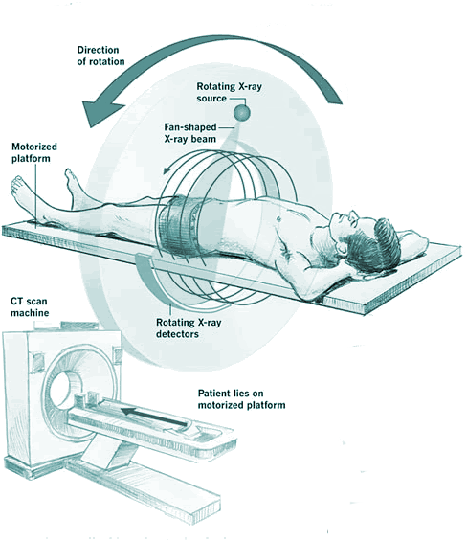
Basics of Computed Tomography
Computed Tomography is series of narrow beam x-rays taken at different angles around the patient
Generates cross-sectional i.e. 2D images of 3D organs
The intensity of the image is basically the attenuation of the xrays through the organ measured in Hounsfield Unit (HU)
Was invented by Godfrey Hounsfield in 1972

Slide 3
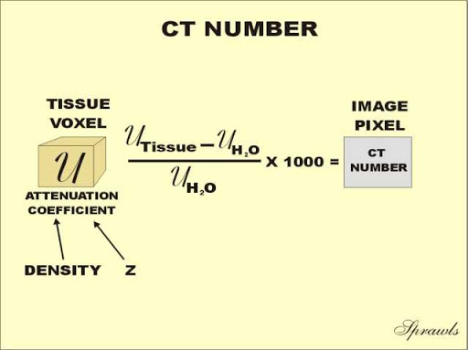
Steps for CT Image Formation
Setting up the scan parameters like angle of rotation, number of measurements
Image Display, storage and archival for analysis
Collection of raw data by rotation of the x-ray tube around the patient at specific intervals
Correction of raw data to remove effects of physical factors
Image Reconstruction from the raw projection data

Slide 4
Image Reconstruction
Image Reconstruction is the mathematical process that generates the tomographic images from x-ray projection data obtained at different angles around the patients
Algorithm uses the attenuation data measured by the detectors to systematically build the image for viewing and interpretation
Three types of reconstruction are used for CT
Analytic Algorithms ( like Filtered Backprojection)
Optimization based Reconstruction Algorithm ( like iterative algorithms)

Slide 5
Iterative Reconstruction
An iterative reconstruction technique starts with an assumption and compares this assumption with measured data to optimize the assumption in terms of the data
The method should be ideally iterated till the approximate reconstruction converges with the measured data, but usually iterated till a tolerance limit where the measure of error is within acceptable limits
Two types of iterative reconstructions :
Iterative Algebraic Reconstruction Method
Iterative Statistical Reconstruction Method

Slide 6
Advantages of Iterative Reconstruction
No need to formulate or find an analytical solution
Robust to changes in geometries with minor adaptations
Handles missing data implicitly
Allows incorporation of prior knowledge i.e. noise properties, image properties etc
So is Iterative Reconstruction used by the Commercial Scanners??
The answer is NO. Because it is computationally very intense, but now with advent of parallel computing using GPUs iterative techniques are possible.

Slide 7
Problem Formulation
We designed our problem CT reconstruction problem as an optimization problem
A is the Forward Operator that maps from object space to sinogram space
x is the flattened true image
d is the flattened sinogram data
λ is the regularization parameter
TV(x) is the total variation functional which updates the image at each iteration

Slide 8
Experimental settings
Size of the image = 256 X 256
Size of the Sinogram = Number of Rays X Number of Views
Number of Rays used in the Experiment = 512
Number of Views used = 540,270 and 90
The reconstructed image was compared to a reference image of 256 X 256 dimension
Size of the A matrix = (Number of Rays X Number of Views) X (Dimension of Image X Dimension of Image )

