Slide 1
Credit One Data Plan & Framework
By: Roxanna Fuentes

Slide 2
A written statement of the goal(s).
Our team will review Data One’s data to create a creative, empirically sound solution to better improve their services. We will do this by using methods from data analytics and data science to identify issues, define the problem within a data science framework and provide recommendations.

Slide 3
A well-defined data science process framework and the reasons you are proposing it.
We will deliver a BADIR Data Framework to review:
Business
Analysis Plan
Data Collection
Insights
Recommendations
This type of data framework will appeal to business stakeholders and provide valuable information for optional for partners.

Slide 4
Business Analysis Plan Data Collection Insights Recommendation
Business questions:
What is the stated business question?
How do we ensure our model is accurate and produces approvals that lead to the company’s success and partner satisfaction?
What is the intent underlying the question (e.g., what is the context, what is the impacted segment, and what are stakeholders’ current thoughts about the underlying reasons?
How can we better assess if a person should be approved or denied for credit?
What business considerations (e.g., stakeholders, timeline and cost) are likely to impact the analysis?
Partner/stakeholders trust
Resources for completion of analysis

Slide 5
Business Analysis Plan Data Collection Insights Recommendation
Analysis Plan:
What is the analysis goal?
Find the problem causing false positive results in the data.
What hypothesis are to be tested?
Are issues in the data causing false readings and analysis? For example, is the second header occupied in feature 1 causing our object type, mixed data?
What methodology(-ies) will you employ?
What is the project plan (timeline and milestones, risks, phasing, prioritization,…)?

Slide 6
Business Analysis Plan Data Collection Insights Recommendation
Data collection
From where can the data be obtained?
Credit One data is stored in MySQL database. In order to obtain it, we used Structured Query Language to query to database table and retrieve the data into a Pandas data frame.
How must the data be cleaned and validated?
Data Analysis methods such as: ensuring there is only one header, dropping duplicates, finding missing values, ensuring all the data can be converted to integers, and that it is validated for Python.
Insights:
What patterns do you see in the data?
Many were given high credit to those with low to no payment history that ended up in default. Higher education clients were given higher credit but didn’t mean they did not default.
Are each of the hypothesis proven or disprove?
How much confidence should stakeholders place in the results?
A lot of confidence should be given for this problem to be resolved with our analysis because many errors have been already identified without diving into our analysis.
How do you rank your findings in terms of quantified impact on the business?

Slide 7
Business Analysis Plan Data Collection Insights Recommendation
Recommendation:
How can you most effectively present the results of your analysis to your stakeholders (in terms they can understand and in alignment with information they’ll value)?
A visual presentation of important data findings will be presented with stakeholder’s backgrounds in mind. We will keep it simple and to the point and not dive deep in our data outputs, but the solutions and the next steps needed to improve the model.
Other items to be reviewed further is the data process will be:
Key insights with impact
Next Steps

Slide 8
Descriptions and location of related data sources.
Credit One data is stored in a MySQL database. In order to obtain it, we used Structured Query language to query to database table and retrieve the data into a Pandas data frame.

Slide 9
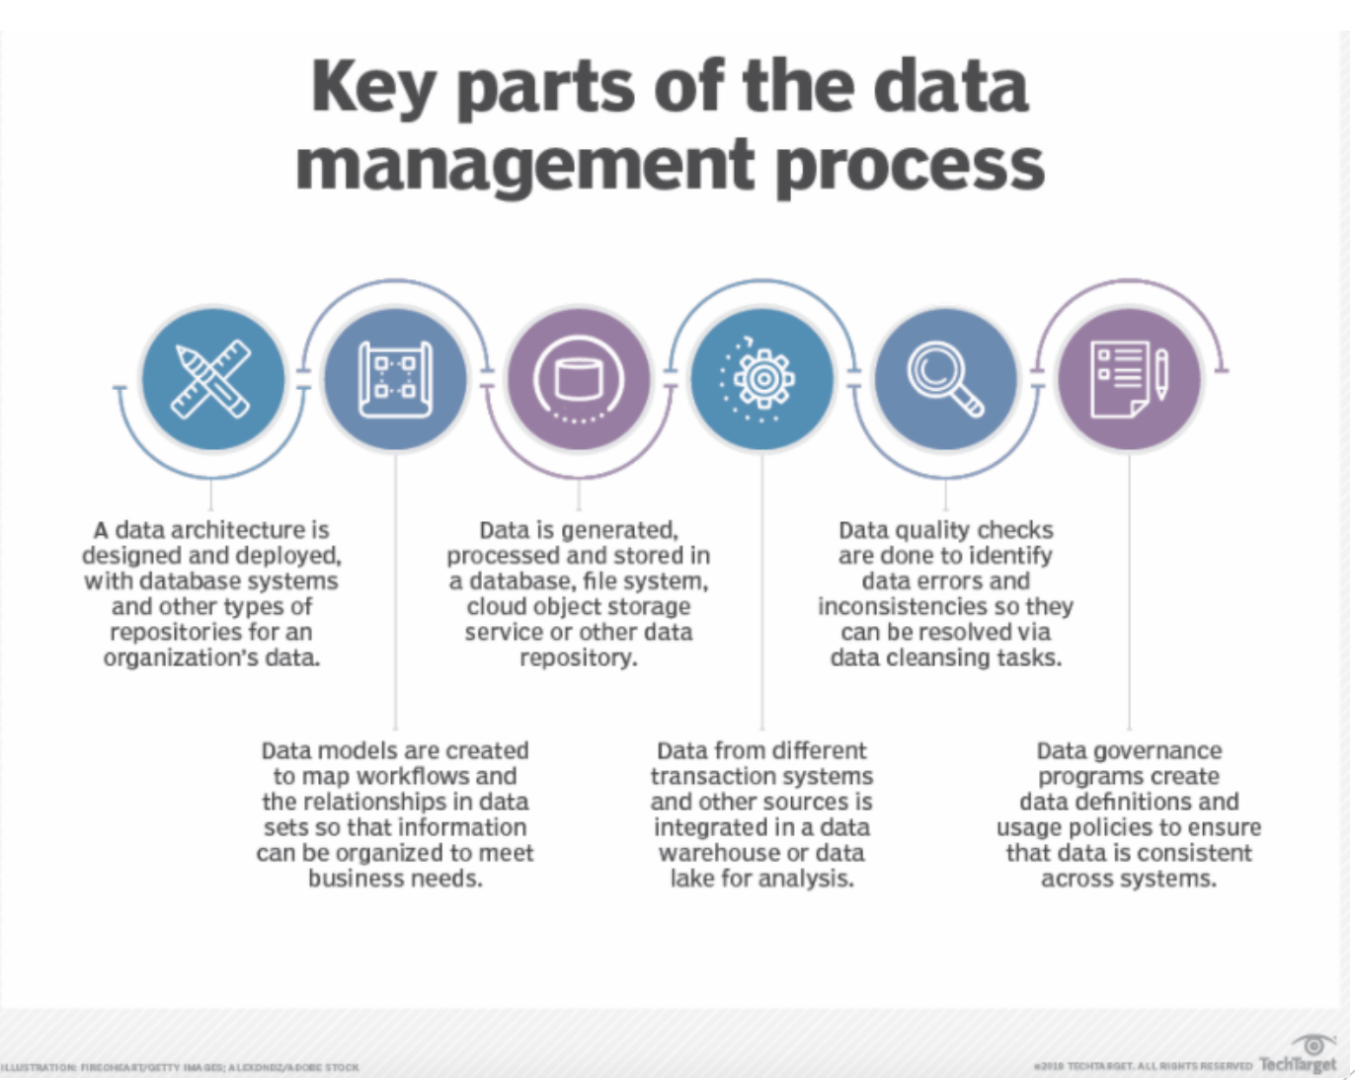
An explanation of how you will manage the data for the project.
The data will be managed by incorporating all key parts mentioned below:

Slide 10
Any known issues with the data and how you plan to address them.
Items found and Plan of Action:
Preprocessing in excel for simplicity.
Unique identifiers do not help in machine learning (will de deleting or masking)
(Machine learning will try to find a pattern in identifiers and can cause big issues in algorithms.)
Non-Numerical Values Found (Data will need to be converted to integers.)
Two Headers (Will be deleting)
Duplicates Found (All duplicates will be dropped/deleted.)
Missing information
Header in the middle of the data set needs to be deleted.

Slide 11
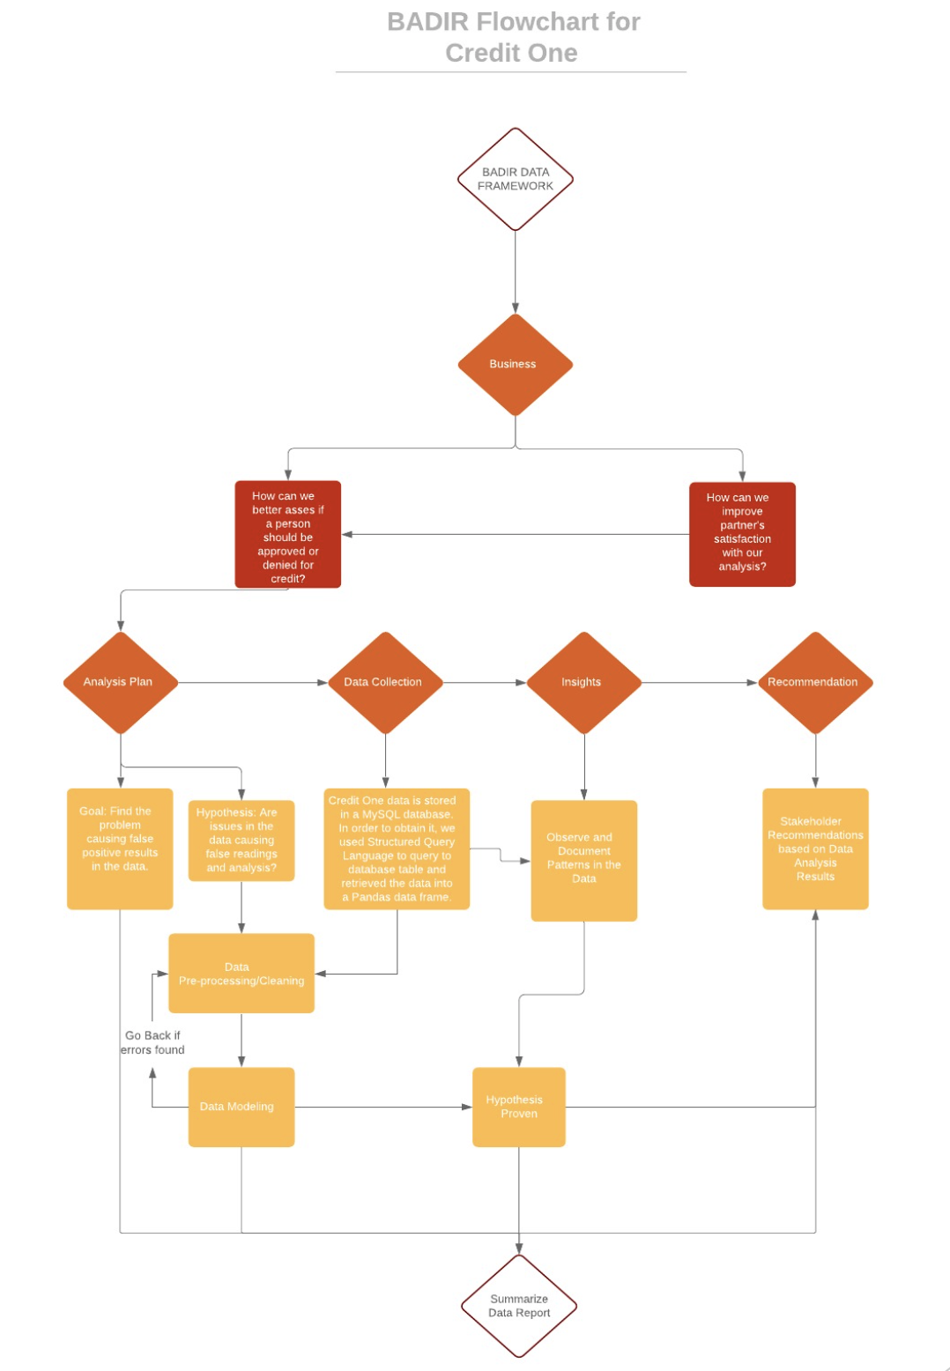
A flowchart visualizing the detailed process you will follow, annotated with any potential pitfalls you’ve identified and your proposed solutions to such pitfalls.

Slide 12
Any initial insights you can glean from your quick look at the data. (Recall that you were previously asked to recommend three management level decisions based on your initial analysis.)
Increasing the amount of data that is greater than 6 months to find stronger patterns in the data.
We’ve identified several error in the data. A further look into Credit One’s data fields is recommended.
Further recommendations and insight will be known as we dive into our data framework for analysis, but from a quick look it looks like the data has many errors creating bugs and inaccurate results.

Slide 13
Questions?
Thank You

