Slide 1
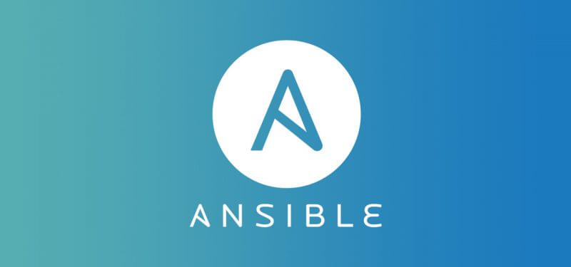

Lets get started

Slide 2

What are we going to see in this session?
Introduction to Ansible
What we do using Ansible ?
Why Ansible ?
Simple Scenario
Pull vs Push configuration tool
Common Ansible use cases
Ansible Architecture

Slide 3
Introduction to Ansible
Ansible was originally written by Michael DeHaan.
Ansible is an open source configuration management and orchestration utility.
Using this you can automate and standardize the configuration of remote hosts and virtual machines.
Ansible, Inc. was the company setup to commercially support and sponsor Ansible. Later it was acquired by RedHat in October 2015.

Slide 4

What we do using Ansible ?
IT Automation:
Instructions are written to automate the IT professional’s work.
Instructions can be executed in multiple remote hosts.
Configuration Management :
Consistency of all systems in Infrastructure is maintained.
Mainly used for patch management.
Automatic Deployments :
Applications are deployed automatically on variety of environments.

Slide 5

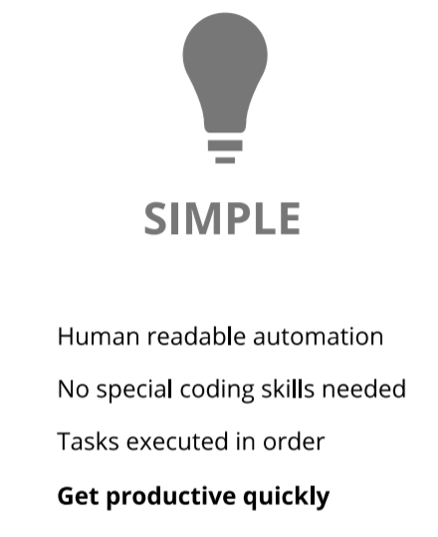
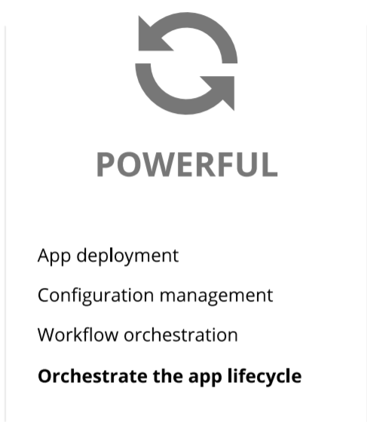
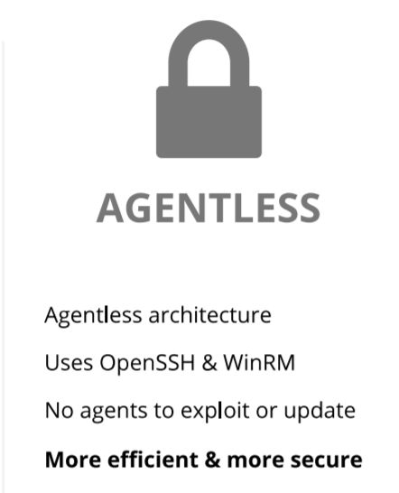
Why Ansible ?

Slide 6
Simple Scenario
Arun is a sys admin.
That’s easy !! Wouldn’t take much time either.
He must install Apache on 3 web servers & MySQL on two DB servers
Web Servers
But what if the number of Servers increased?
He is responsible for his company Infra
The same task must be repeated multiple times.
DB servers
Problem here is humans are prone to make errors.
This is where ansible comes to rescue.
Now Arun can work on more productive tasks rather then repetitive once
With ansible code written once for installation & it can be deployed multiple times

Slide 7

Pull Vs Push Configuration
Pull Configuration Tools :
In Pull based Tools, there will be a MASTER server where all the instructions are placed.
Master machine also has the information’s of client machines connected to it.
Then piece of software which also called as agent installed on all other target machines which will enable the communication between MASTER and SLAVE machines.
Push Configuration Tools :
This also has MASTER server which passes set of instructions to clients but major difference here is its doesn’t need any agent to be installed on SLAVES.
Here you are just achieving your job by simply pushing the changes to SLAVE machine and forcing it to restructure.

Slide 8
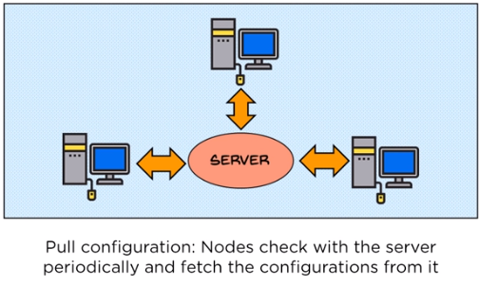
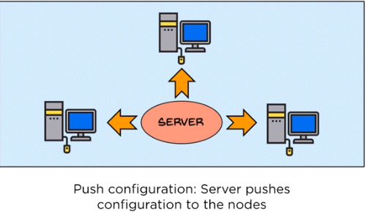
Cont.

Slide 9
Cont.
Any Guess what could be pull based mechanism tools?
Chef
Puppet
Disadvantage :
Whenever new machine comes into Environment you need install the agent on it to establish its communication to Master server.
When Master is upgraded with newer version all Client agents should be upgraded.
Ansible is push based mechanism Tools.

Slide 10
Common use case of Ansible
Provisioning
Configuration Management
Application Deployment
Security & Compliance
Orchestration

Slide 11
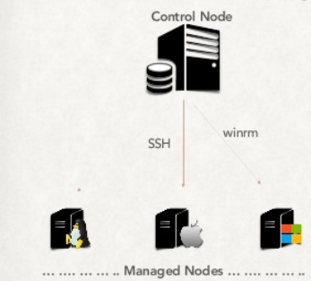
Ansible Architecture
Prerequisites to have Ansible in your Environment.
One control node to be installed with Ansible in any Linux flavor.
Managed Nodes can be with any OS, it can be LINUX, APPLE and WINDOWS.
Linux nodes and Mac nodes will be managed through SSH agent.
WINDOWS nodes will be managed to WINRM agent.

Slide 12
End of this topic !
Any questions?

