Slide 1


What are we going to see in this session?
Understanding Terraform HCL
Arguments & Blocks
Providers
Resource
Provisioner
Output
Terraform state
Terraform work flow
Introduction to variables
Terraform variable types
Terraform set
How to call declared variables
Most commonly used variable types

Slide 2
Understanding Terraform HCL
Terraform codes should be written in HCL [HashiCorp Configuration Language]
Let’s try to understand the terraform syntax and rules.
Terraform can only understand the files which are with [tf] extension.
example: main.tf

Slide 3
Argument & Blocks
Blocks : Blocks is a container for other contents.
block {
argument_1 = ”value”
argument_2 = ”value"
}
Arguments : An argument assigns a value to a particular name.
argument = “abc123”
The identifier before [=] sign is argument name & the expression after [=] sign is argument value.
The argument values can be
String
Number
Bool
List
Map

Slide 4
Providers
Providers are responsible for understanding and take care of API interactions and expose required resources.
As mentioned earlier TF supports many providers some samples are
AWS
provider "aws" {
}
Azure
provider "azurerm" {
}
VMware
provider "vsphere" {
}

Slide 5

Resources
After establishing the connection to providers what are we going to do? “We are going to utilize there resources”
In modern cloud world, someone will have these resource ready and you can utilize it on demand.
“ Hence resources means infrastructure components”
Resource ”resource_type” “resource_name” {
}

Slide 6
Provisioner
Using Provisioner you can do changes in instances.
Common uses cases are :
Copying some files to remote servers.
Executing script on newly created instances.
Inject bootstrapping to instances.
Clean up some thing before machine is destroyed

Slide 7
Output
Shows values that are highlighted after terraform applies.
This output is also maintained in terraform state file.

Slide 8
Terraform State
Terraform state stores status of your managed infrastructure & configuration.
This state is used by Terraform to map real world resources to your configuration, keep track of meta data and to improve performance of large scale infrastructure.
Terraform state is generally stored in a file locally named as “terraform.tfstate” but it can be also stored elsewhere which can work better in team environment..

Slide 9
Terraform work flow
Write : Author your code of how your infrastructure should be.
Validate: check syntax
Plan : Preview changes before apply
Apply : Provision your infrastructure.

Slide 10
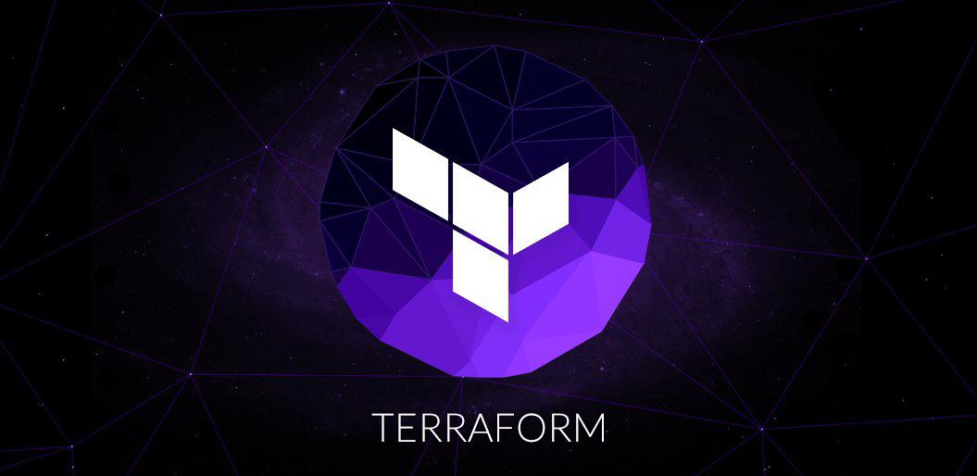
End of this topic !
Any questions?

