Slide 1
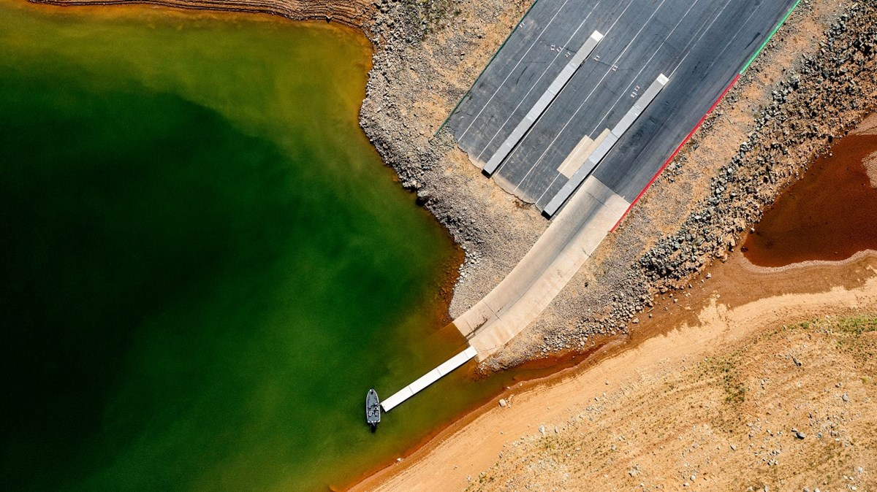

Water and Society: Water Resources Management and Policy in a Changing World (AGU 2023)
Mapping Vulnerabilities of the California Food-Energy-Water System under Paleo-Informed Extreme Hydroclimate Conditions
AUTHORS
Rohini S. Gupta^{1*}, Scott Steinschneider², Patrick M. Reed¹
¹Civil and Environmental Engineering, Cornell University
²Biological and Environmental Engineering, Cornell University
*Presenting author: rg727@cornell.edu
Lake Oroville, May 2021 (source: Noah Berger / AP photo)

Slide 2
Prominent Extremes and Economic Impacts
Introduction | Reservoir Risk | Groundwater Bank Risk | Water Delivery Risk | Conclusion
$1.7 Billion
$1.5 Billion
$1.1 Billion
AR- Driven Flood Event
AR- Driven Flood Event
AR- Driven Flood Event
1986-1992
2007-2009
2012-2016
2020-2022
Feb 11-20, 1986
Jan-Feb 2017
Dec 2022-Jan 2023
Drought
Drought
Drought
Drought
$1 Billion/Year
$1 Billion/Year
$10 Billion
>$1 Billion/Year

Slide 3
A holistic representation of risk to individual stakeholders is dependent on many interconnected factors.
Introduction | Reservoir Risk | Groundwater Bank Risk | Water Delivery Risk | Conclusion
Hydroclimatic
Factors
State of the System
Stakeholder
Attributes

Slide 4
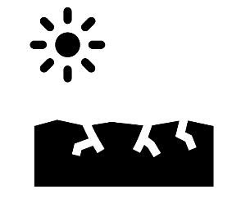

A holistic representation of risk to individual stakeholders is dependent on many interconnected factors.
Introduction | Reservoir Risk | Groundwater Bank Risk | Water Delivery Risk | Conclusion
Extreme Events Experienced
Hydroclimatic
Factors
Has the stakeholder experienced all possible magnitudes, frequencies, and sequences of extreme events?
State of the System
Stakeholder
Attributes

Slide 5

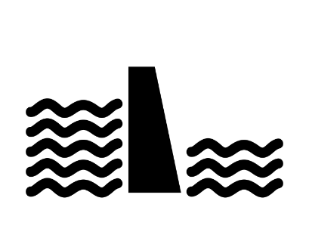
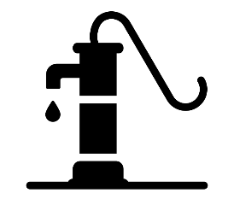
A holistic representation of risk to individual stakeholders is dependent on many interconnected factors.
Introduction | Reservoir Risk | Groundwater Bank Risk | Water Delivery Risk | Conclusion
v
Current policy, operating rules
Extreme Events Experienced
v
v
Hydroclimatic
Factors
Groundwater/ Reservoir Storage States
State of the System
Increased demands, changes to operating rules, prioritization of environmental flows? Are water reserves available or depleted?
Stakeholder
Attributes

Slide 6
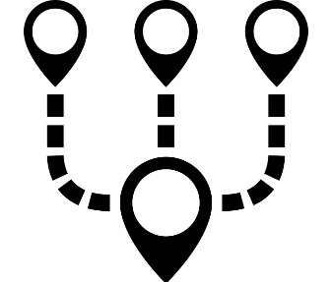
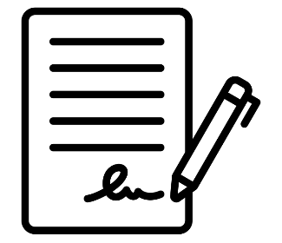
A holistic representation of risk to individual stakeholders is dependent on many interconnected factors.
Introduction | Reservoir Risk | Groundwater Bank Risk | Water Delivery Risk | Conclusion
v
Current policy, operating rules
Extreme Events Experienced
v
v
Hydroclimatic
Factors
Groundwater/ Reservoir Storage States
State of the System
Diversity of Water Sources
Stakeholder
Attributes
What water contracts does the stakeholder have? What is the priority of their water rights?
Water Rights

Slide 7
To comprehensively quantify risk to a complex system, you need:
Introduction | Reservoir Risk | Groundwater Bank Risk | Water Delivery Risk | Conclusion
A detailed model of the system (individual users, water rights, groundwater banking, conveyance)
A large ensemble of highly variable and temporally dynamic hydrology

Slide 8
To comprehensively quantify risk to a complex system, you need:
Introduction | Reservoir Risk | Groundwater Bank Risk | Water Delivery Risk | Conclusion
A detailed model of the system (individual users, water rights, groundwater banking, conveyance)
A large ensemble of highly variable and temporally dynamic hydrology

Slide 9

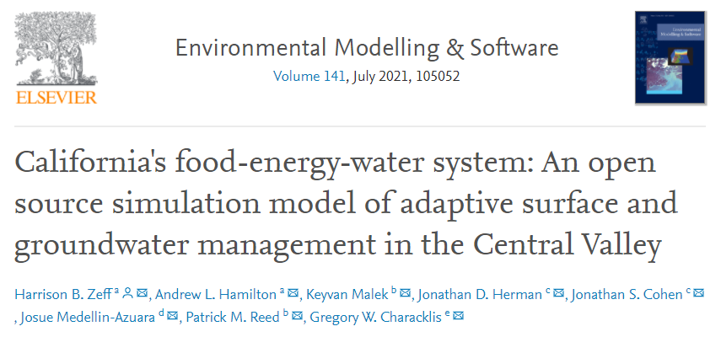
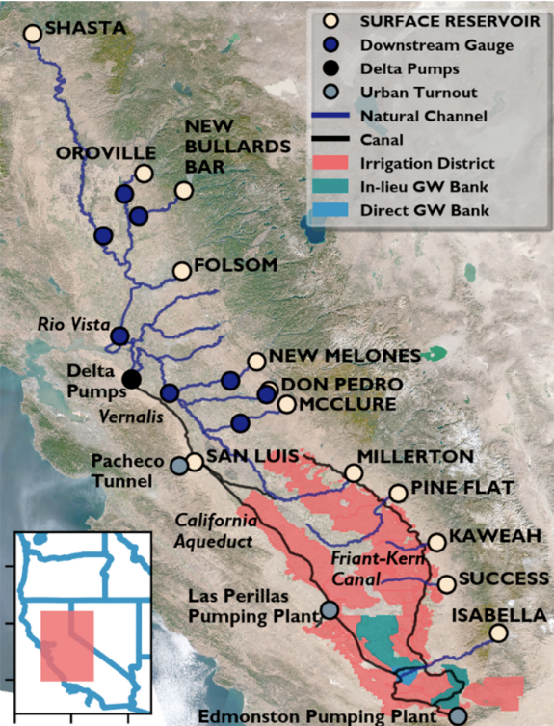
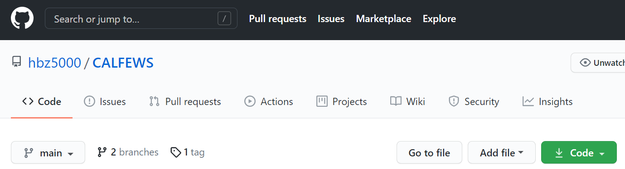
We have a highly resolved simulation model of CALFEWS.
Introduction | Reservoir Risk | Groundwater Bank Risk | Water Delivery Risk | Conclusion
Daily timescale operation of >1000 critical institutional and infrastructure elements
dams, water conveyance systems, groundwater banks, and water allocation decisions.
https://github.com/hbz5000/CALFEWS

Slide 10
To comprehensively quantify risk to a complex system, you need:
Introduction | Reservoir Risk | Groundwater Bank Risk | Water Delivery Risk | Conclusion
A detailed model of the system (individual users, water rights, groundwater banking, conveyance)
A large ensemble of highly variable and temporally dynamic hydrology

Slide 11
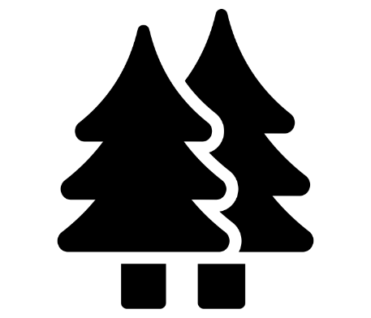
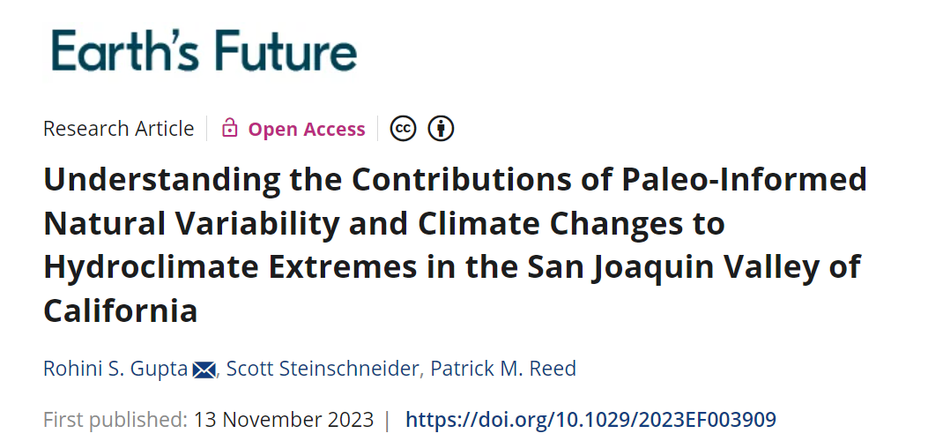


We have a large ensemble of 600-year daily streamflow traces for CALFEWS.
Introduction | Reservoir Risk | Groundwater Bank Risk | Water Delivery Risk | Conclusion
Tree-ring based reconstruction captures 600-years of natural variability, including megadroughts and pluvials.
Method provides multiple realizations of plausible weather conditioned on regional circulation patterns.

Slide 12
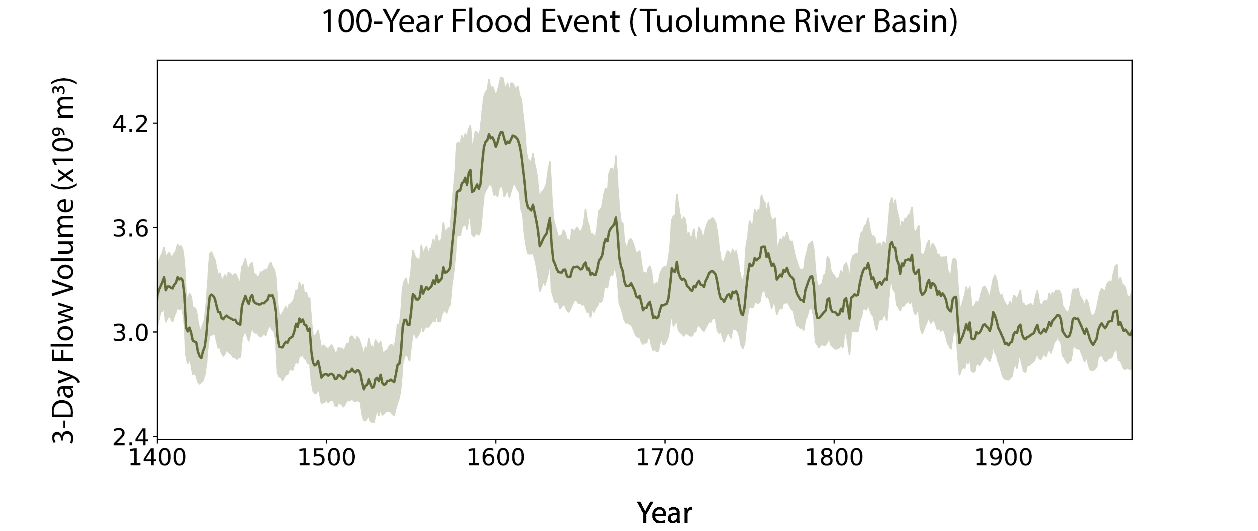
There is large non-stationarity in flood and drought extremes (even in the absence of anthropogenic climate changes).
Introduction | Reservoir Risk | Groundwater Bank Risk | Water Delivery Risk | Conclusion
A flood event that has a 1% chance of occurring on any given year

Slide 13
There is large non-stationarity in flood and drought extremes (even in the absence of anthropogenic climate changes).
Introduction | Reservoir Risk | Groundwater Bank Risk | Water Delivery Risk | Conclusion
The modern record underestimates flood (and drought) hazard

Slide 14
There is large non-stationarity in flood and drought extremes (even in the absence of anthropogenic climate changes).
Introduction | Reservoir Risk | Groundwater Bank Risk | Water Delivery Risk | Conclusion
4x capacity of Don Pedro
Reservoir (10 km³)

Slide 15
We isolate out a dynamic period from 1520-1640.
Introduction | Reservoir Risk | Groundwater Bank Risk | Water Delivery Risk | Conclusion
Late 1500s megadrought
Early 1600s
Pluvial

Slide 16
How vulnerable is the CALFEWS system under highly variable and dynamic paleo-informed hydrology from 1520-1640?
Introduction | Reservoir Risk | Groundwater Bank Risk | Water Delivery Risk | Conclusion

Slide 17

How vulnerable is the CALFEWS system under highly variable and dynamic paleo-informed hydrology from 1520-1640?
Introduction | Reservoir Risk | Groundwater Bank Risk | Water Delivery Risk | Conclusion
Groundwater
Banks
Contract
Deliveries
Reservoirs
We explore this vulnerability at multiple time scales and locations within the system

Slide 18
Reservoir Risk
Introduction | Reservoir Risk | Groundwater Bank Risk | Water Delivery Risk | Conclusion

Slide 19
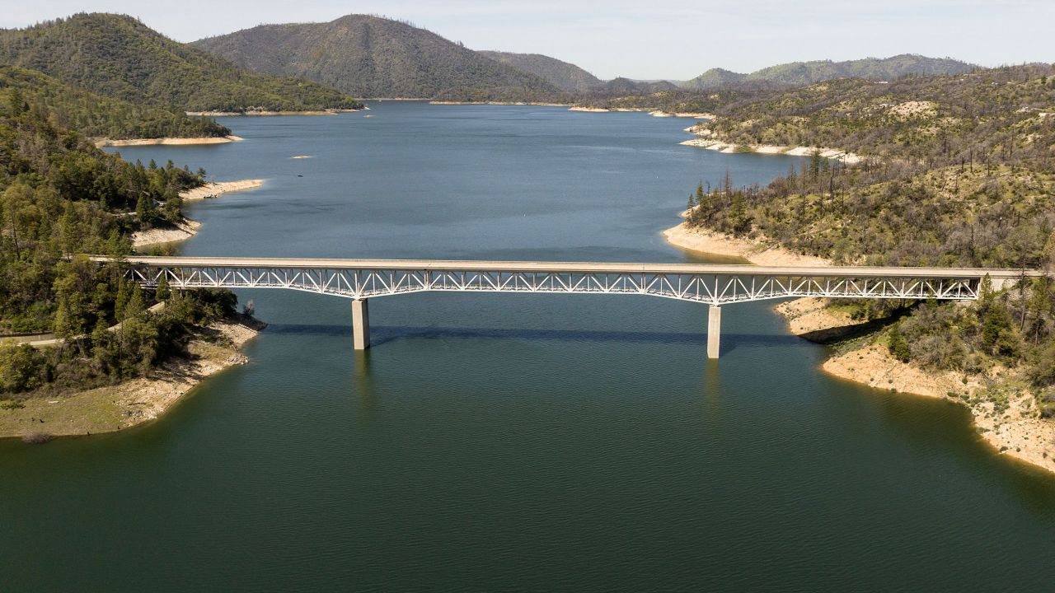
Lake Oroville
Source: Josh Edelson/AFP/Getty Images

Slide 20
Lake Oroville
Source: Josh Edelson/AFP/Getty Images

Slide 21
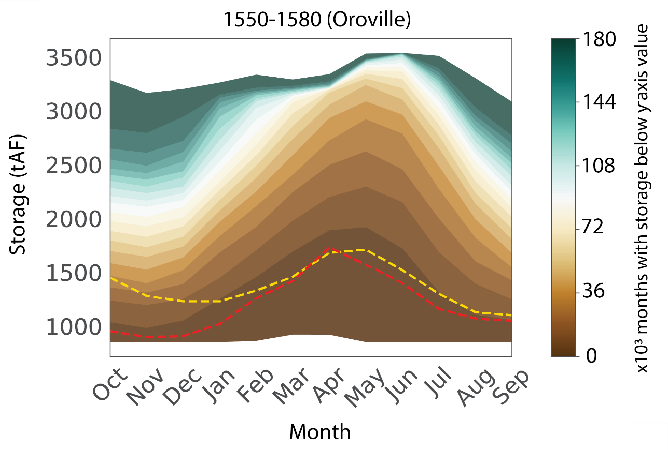
We capture a greater variation in monthly storage than modern drought periods.
Introduction | Reservoir Risk | Groundwater Bank Risk | Water Delivery Risk | Conclusion
Spread of monthly storages across 50, 30-year traces in the driest part of megadrought period

Slide 22
We capture a greater variation in monthly storage than modern drought periods.
Introduction | Reservoir Risk | Groundwater Bank Risk | Water Delivery Risk | Conclusion
Shading represents how many months we generate that have a storage less than the y -axis value

Slide 23
We capture a greater variation in monthly storage than modern drought periods.
Introduction | Reservoir Risk | Groundwater Bank Risk | Water Delivery Risk | Conclusion
Worst monthly storage observed under modern droughts are overlaid for comparison
2007-2009
2012-2016

Slide 24
We capture a greater variation in monthly storage than modern drought periods.
Introduction | Reservoir Risk | Groundwater Bank Risk | Water Delivery Risk | Conclusion
2007-2009
2012-2016
The megadrought traces lead to many instances (~18,000 months) where Oroville reaches dead pool in summer months which are important for irrigation.
Max Capacity= 3537 tAF Deadpool= 825 tAF

Slide 25
Groundwater Banks
Introduction | Reservoir Risk | Groundwater Bank Risk | Water Delivery Risk | Conclusion

Slide 26
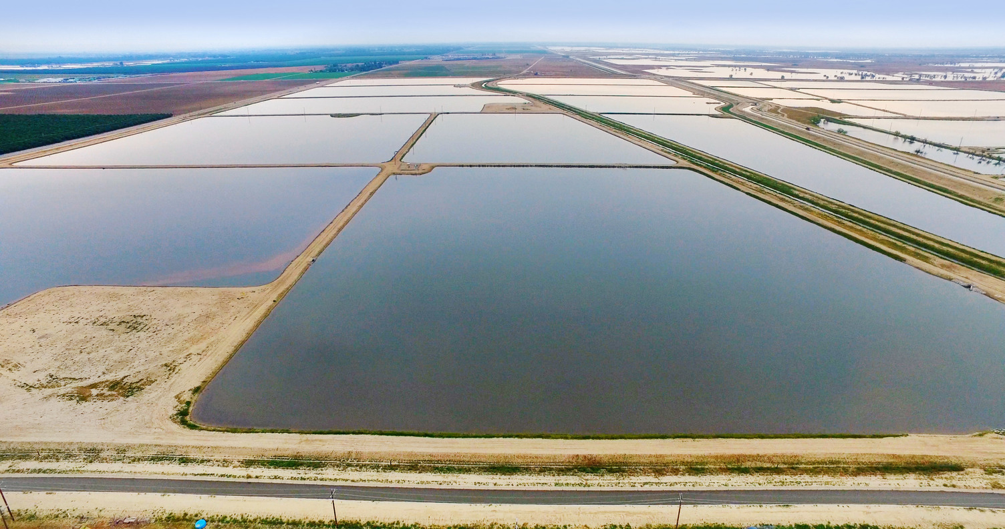
Source: Kern Fan Project, 2023
Kern Water Bank

Slide 27
Introduction | Reservoir Risk | Groundwater Bank Risk | Water Delivery Risk | Conclusion
Kern Water Bank
Almost three times the storage capacity of nearby Lake Isabella. (1.5 million acre-feet of water)
Water is stored underground during wet years and recovered during dry years for agricultural and municipal and industrial uses.

Slide 28
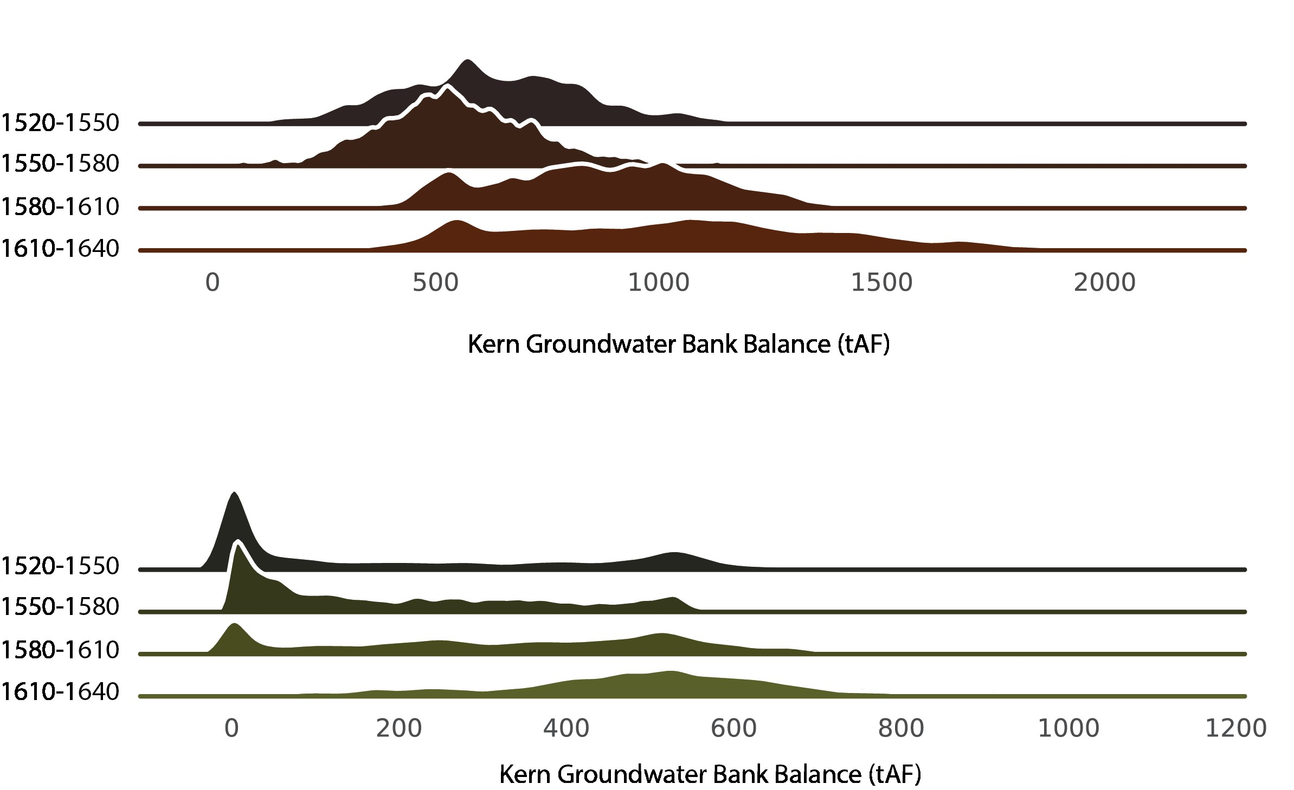
Introduction | Reservoir Risk | Groundwater Bank Risk | Water Delivery Risk | Conclusion
Kernel density plots of monthly groundwater bank balances
Largest Account Holder
Mega
drought
Pluvial
Smaller Account Holder
Mega
drought
Pluvial

Slide 29
Introduction | Reservoir Risk | Groundwater Bank Risk | Water Delivery Risk | Conclusion
Strong regime shift in mass of distribution from megadrought to pluvial period
Largest Account Holder
Mega
drought
Pluvial
Smaller Account Holder
Mega
drought
Pluvial

Slide 30
Introduction | Reservoir Risk | Groundwater Bank Risk | Water Delivery Risk | Conclusion
Risk during highly variable periods is not homogenous across users.
Largest Account Holder
Mega
drought
Pluvial
Smaller Account Holder
Mega
drought
Pluvial

Slide 31
Introduction | Reservoir Risk | Groundwater Bank Risk | Water Delivery Risk | Conclusion
Smaller account holder relies heavily on drawing groundwater during megadrought periods when surface water is reduced.
Largest Account Holder
Mega
drought
Pluvial
Smaller Account Holder
Mega
drought
Pluvial

Slide 32
Contract Deliveries
Introduction | Reservoir Risk | Groundwater Bank Risk | Water Delivery Risk | Conclusion

Slide 33
Water Contracts
Introduction | Reservoir Risk | Groundwater Bank Risk | Water Delivery Risk | Conclusion
Reservoir
Water Contract
Entitles owners to some amount of surface water that are associated with one or more reservoirs and withdrawals from canals and rivers.
San Luis (state)
San Luis (federal)
Millerton
Pine Flat
Kaweah
Success
Isabella
State Water Project
Central Valley Project/Exchange Contractors (senior)
Central Valley Project/Delta Division
Central Valley Project/Cross Valley Contractors
Central Valley Project/ Friant Division Class 1 (senior)
Central Valley Project/ Friant Division Class 2
Kings River Water Rights holder
Kaweah River Water Rights holders
Tule River Water Rights holders
Kern River Water Rights holders

Slide 34
Water Contracts
Introduction | Reservoir Risk | Groundwater Bank Risk | Water Delivery Risk | Conclusion
Reservoir
Water Contract
Entitles owners to some amount of surface water that are associated with one or more reservoirs and withdrawals from canals and rivers.
San Luis (state)
San Luis (federal)
Millerton
Pine Flat
Kaweah
Success
Isabella
State Water Project
Central Valley Project/Exchange Contractors (senior)
Central Valley Project/Delta Division
Central Valley Project/Cross Valley Contractors
Central Valley Project/ Friant Division Class 1 (senior)
Central Valley Project/ Friant Division Class 2
Kings River Water Rights holder
Kaweah River Water Rights holders
Tule River Water Rights holders
Kern River Water Rights holders

Slide 35
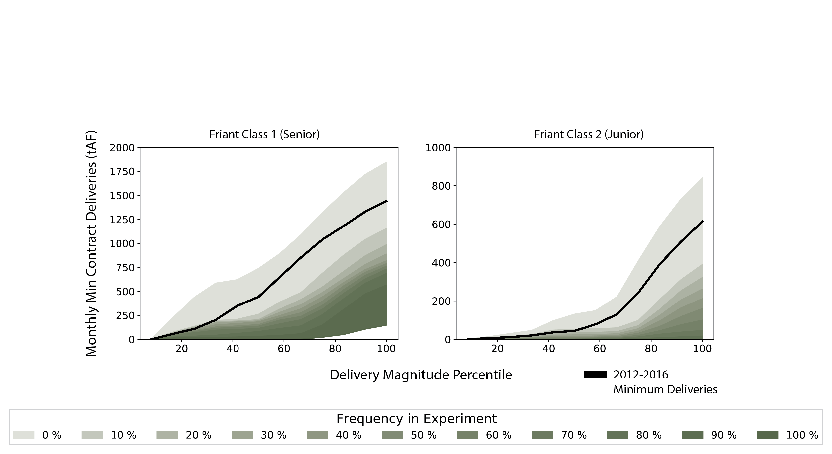
We capture a greater variation in monthly minimum contract deliveries than the worst modern drought.
Introduction | Reservoir Risk | Groundwater Bank Risk | Water Delivery Risk | Conclusion
The frequency at which deliveries of a specific magnitude are experienced during 1550-1580 megadrought period.

Slide 36
We capture a greater variation in monthly minimum contract deliveries than the worst modern drought.
Introduction | Reservoir Risk | Groundwater Bank Risk | Water Delivery Risk | Conclusion
Black line represents minimum monthly deliveries through 2012-2016 drought

Slide 37
We capture a greater variation in monthly minimum contract deliveries than the worst modern drought.
Introduction | Reservoir Risk | Groundwater Bank Risk | Water Delivery Risk | Conclusion
Shading represents the frequency at which deliveries of a specific magnitude are experienced in our megadrought traces (dark green= more common)

Slide 38
We capture a greater variation in monthly minimum contract deliveries than the worst modern drought.
Introduction | Reservoir Risk | Groundwater Bank Risk | Water Delivery Risk | Conclusion
We create many yearly traces that are characterized by lower deliveries than the worst deliveries seen in the modern day drought

Slide 39
Conclusion
Introduction | Reservoir Risk | Groundwater Bank Risk | Water Delivery Risk | Conclusion
1
A holistic representation of risk is important for stakeholders to be able to make well-informed decisions about risk-reducing investments.

Slide 40
Conclusion
Introduction | Reservoir Risk | Groundwater Bank Risk | Water Delivery Risk | Conclusion
1
A holistic representation of risk is important for stakeholders to be able to make well-informed decisions about risk-reducing investments.
We use a highly resolved simulation model + large paleo-driven hydrology ensemble to explore the bounds of risk at multiple tiers of the CALFEWS system.
2

Slide 41
Conclusion
Introduction | Reservoir Risk | Groundwater Bank Risk | Water Delivery Risk | Conclusion
1
A holistic representation of risk is important for stakeholders to be able to make well-informed decisions about risk-reducing investments.
We use a highly resolved simulation model + large paleo-driven hydrology ensemble to explore the bounds of risk at multiple tiers of the CALFEWS system.
2
We demonstrate that paleo-driven variability can create lower reservoir levels and water deliveries than those experienced in the worst modern droughts. Inequalities across users of groundwater banks and surface water contracts reflects system complexities.
3

Slide 42

Water and Society: Water Resources Management and Policy in a Changing World (AGU 2023)
Thank you! Questions?
This work is supported by the National Science Foundation Graduate Research Fellowship Program under Grant No. DGE-1650441. The views expressed in this presentation are those of the authors and do not necessarily reflect the views or policies of the National Science Foundation.
Lake Oroville, May 2021 (source: Noah Berger / AP photo)

Slide 43
Water and Society: Water Resources Management and Policy in a Changing World (AGU 2023)
Slide 2 References
Moore, Nancy Young, Ellen M. Pint, and Lloyd Dixon, Assessment of the Economic Impacts of California's Drought on Urban Areas: A Research Agenda. Santa Monica, CA: RAND Corporation, 1993. https://www.rand.org/pubs/monograph_reports/MR251.html.
Anderson, Lorena (2022) Last Year’s Drought Cost Ag Industry More than 1 Billion, Thousands of Jobs, New Analysis Shows (https://news.ucmerced.edu/news/2022/last-year%E2%80%99s-drought-cost-ag-industry-more-1-billion-thousands-jobs-new-analysis-shows)
Castleman, Terry (2023). California storm costs could add up to nation’s first billion-dollar disaster of 2023 (https://www.latimes.com/california/story/2023-01-10/california-storm-costs-could-add-up-to-nations-first-billion-dollar-disaster-of-2023)
Drought Cost California 1 Billion in 1991 (https://www.nytimes.com/1992/01/25/us/drought-cost-california-1-billion-in-1991.html)
Lake Oroville, May 2021 (source: Noah Berger / AP photo)

