Slide 1
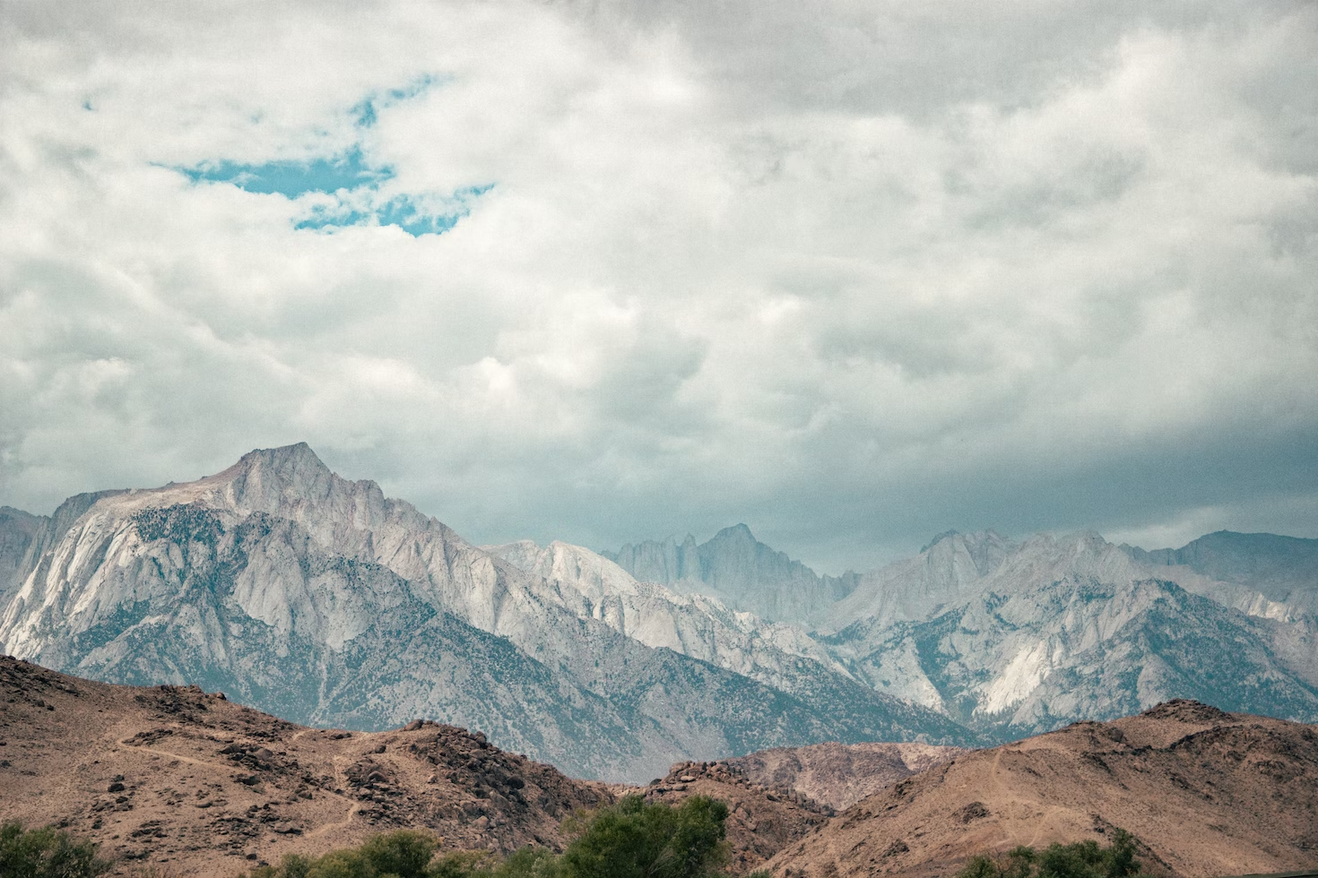

2022 DMDU Annual Meeting
Process-Rich Scenario Generation Enhances Exploratory Decision Support for Deeply Uncertain Hydroclimatic Extremes
AUTHORS
Rohini S. Gupta^{1*}, Scott Steinschneider², Patrick M. Reed¹
¹Civil and Environmental Engineering, Cornell University
²Biological and Environmental Engineering, Cornell University
*Presenting author: rg727@cornell.edu

Slide 2
Key Motivation
Introduction | Methods | Exploratory Uses| Case Study | Conclusion
1
Managing water systems in the Western US is extremely difficult due to extreme interannual volatility that characterizes the region’s hydroclimate.

Slide 3
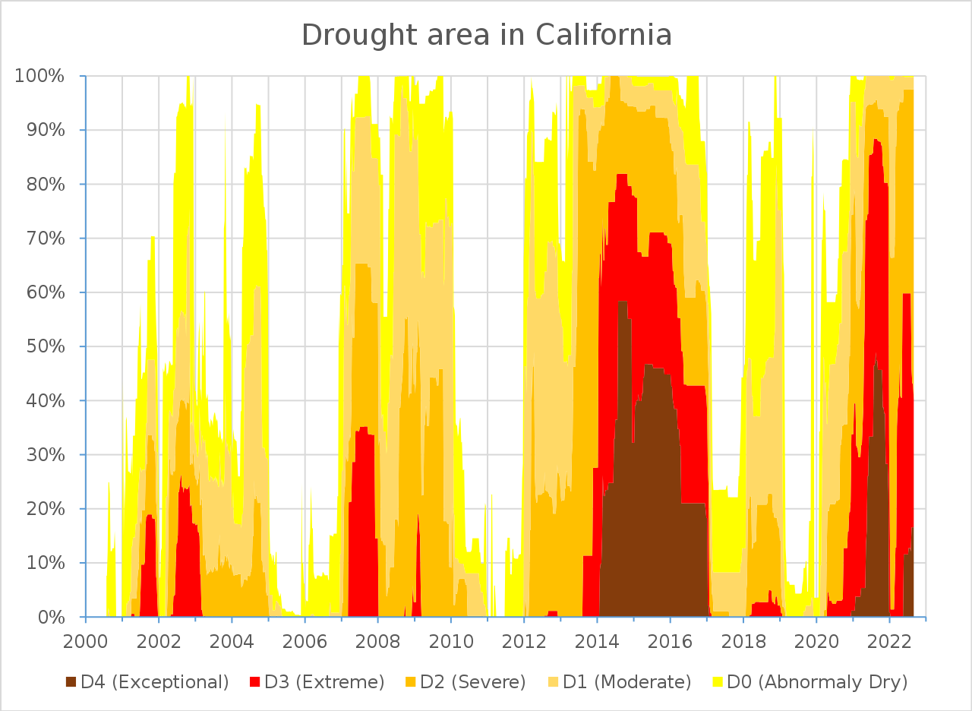
California experiences extreme hydroclimate volatility.
Introduction | Methods | Exploratory Uses| Case Study | Conclusion
U.S. Drought Monitor

Slide 4
California experiences extreme hydroclimate volatility.
Introduction | Methods | Exploratory Uses| Case Study | Conclusion
California has experienced multiple drought cycles in the last two decades.
U.S. Drought Monitor

Slide 5
California experiences extreme hydroclimate volatility.
Introduction | Methods | Exploratory Uses| Case Study | Conclusion
Each drought cycle has ended with an extreme atmospheric river driven event.
U.S. Drought Monitor

Slide 6
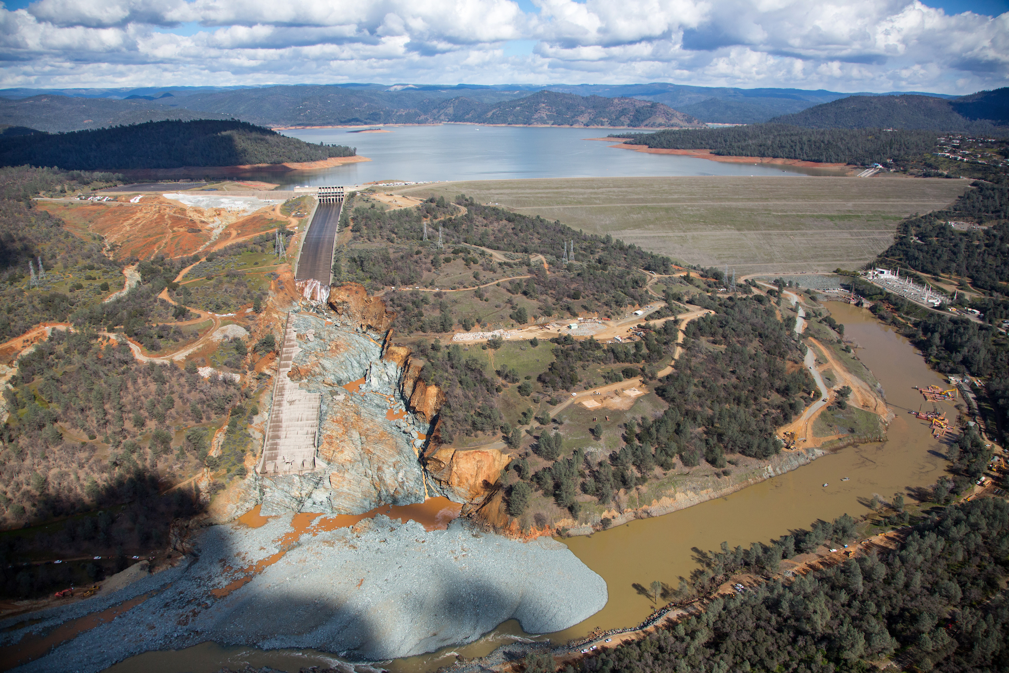
Oroville Dam Failure, 2017

Slide 7
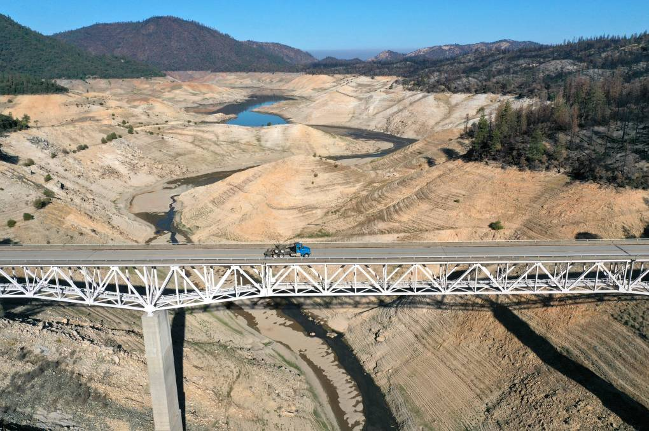

Lake Oroville, 2021

Slide 8
Key Motivation
Introduction | Methods | Exploratory Uses| Case Study | Conclusion
1
Managing water systems in the Western US is extremely difficult due to extreme interannual volatility that characterizes the region’s hydroclimate.
2
This volatility is in part driven by natural variability and extremes are being amplified by climate changes.

Slide 9
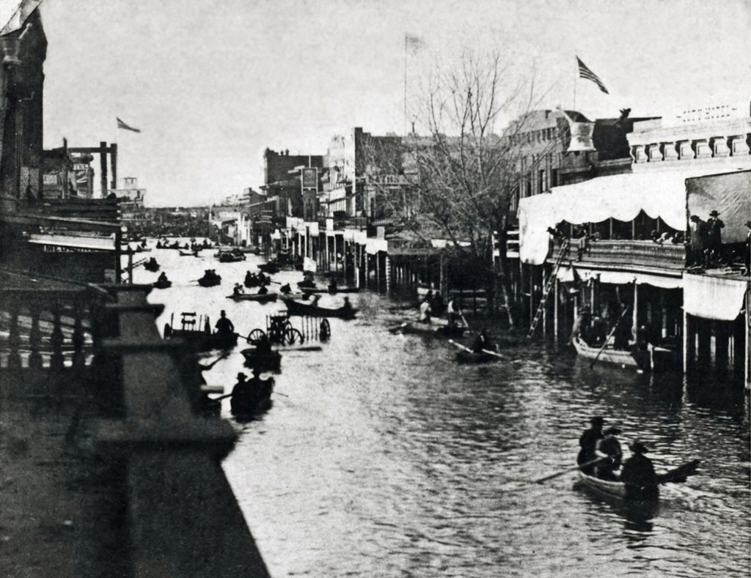
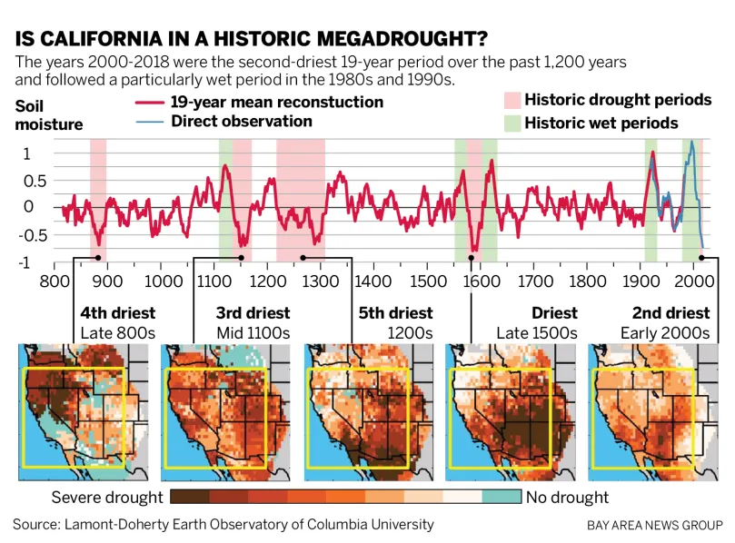
Natural variability can produce extreme events.
Introduction | Methods | Exploratory Uses| Case Study | Conclusion
Tree-ring reconstructions have revealed multiple persistent megadroughts over the past millennium.
The Great Flood of 1862- Turned the Sacramento and San Joaquin valleys into inland seas
Downtown Sacramento following the Great Flood of 1862. The city remained underwater for months, triggering a massive reconstruction project to raise the downtown area 10 to 15 feet. (San Bernadino Sun)

Slide 10
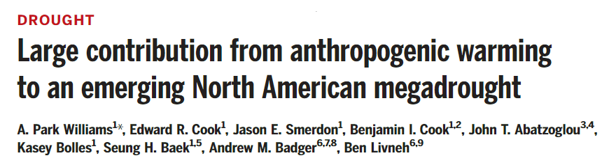
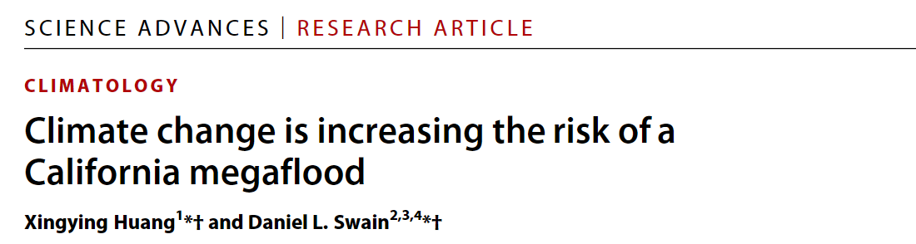
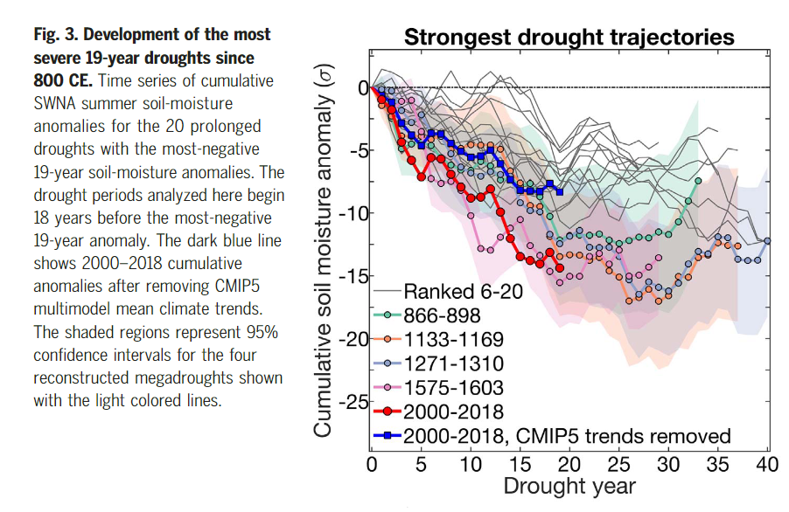
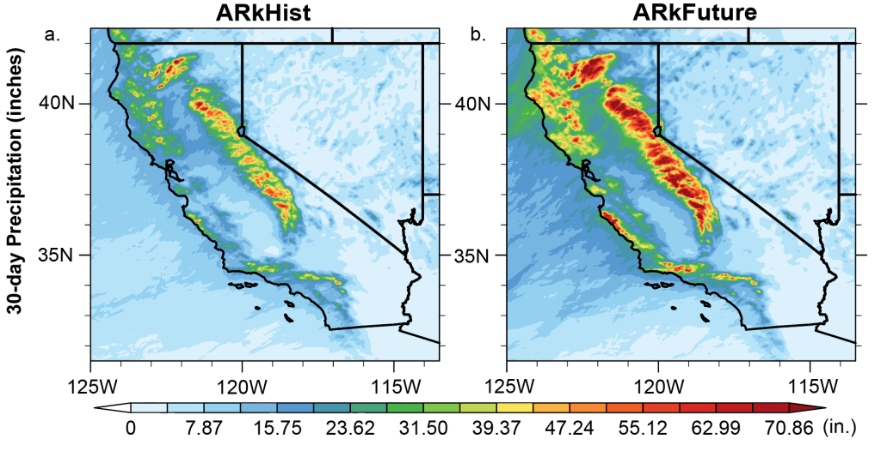
Climate changes can exacerbate extremes.
Introduction | Methods | Exploratory Uses| Case Study | Conclusion

Slide 11
Key Motivation
Introduction | Methods | Exploratory Uses| Case Study | Conclusion
1
Managing water systems in the Western US is extremely difficult due to extreme interannual volatility that characterizes the region’s hydroclimate.
2
This volatility is in part driven by natural variability and is being amplified by climate changes.
Robust planning and management of water systems in the region requires careful generation of states of the world that can capture both drivers effectively.
3

Slide 12
A common approach to generating physically plausible future SOWs is by using GCMs
Introduction | Methods | Exploratory Uses| Case Study | Conclusion
Top-Down
Global Climate Models
Downscale to
Regional
Global
Impact and Adaptation Options
Local

Slide 13
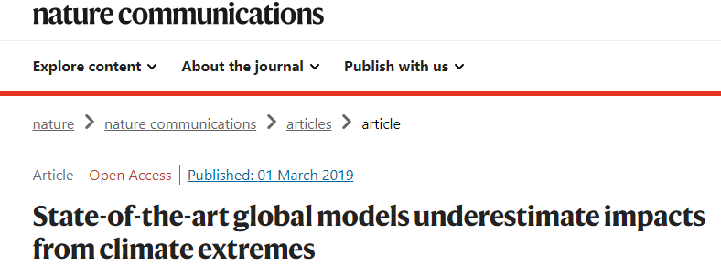
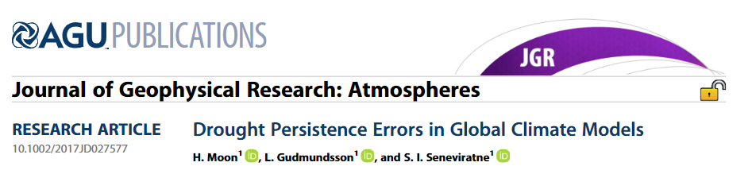
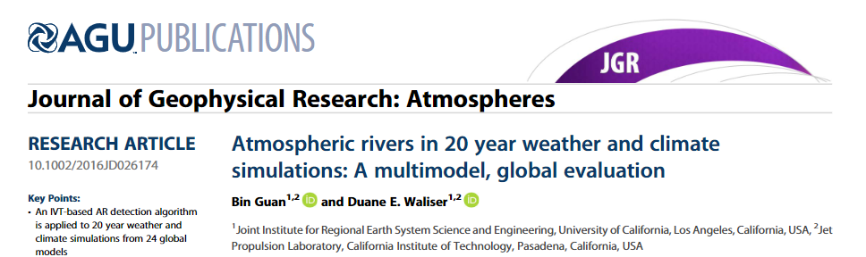
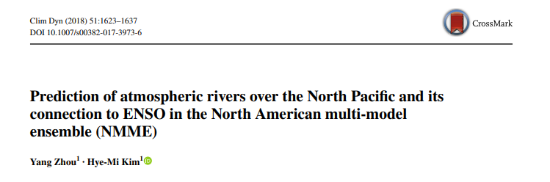
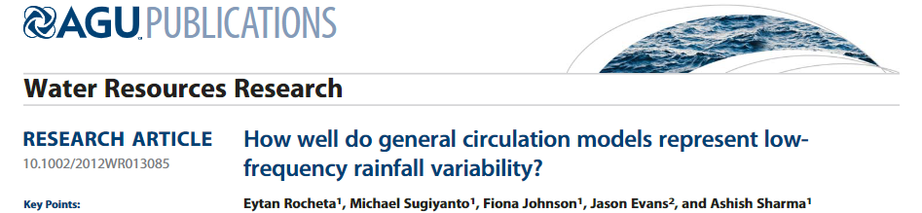
Gap: GCMs do not represent regional dynamics well.
Introduction | Methods | Exploratory Uses| Case Study | Conclusion

Slide 14
Stochastic tools paired with bottom-up approaches are more robust for conducting regional assessments.
Introduction | Methods | Exploratory Uses| Case Study | Conclusion
Top-Down
Global Climate Models
Downscale to
Regional
Global
Impact and Adaptation Options
Synthetic
generators conditioned on regional weather or streamflow
Local
Bottom-Up

Slide 15
Stochastic tools paired with bottom-up approaches are more robust for conducting regional assessments.
Introduction | Methods | Exploratory Uses| Case Study | Conclusion
Top-Down
Global Climate Models
Downscale to
Regional
Global
Models need to be:
Physically plausible
Extrapolate outside of historical record
Support inclusion of climate changes
Impact and Adaptation Options
Synthetic
generators conditioned on regional weather or streamflow
Local
Bottom-Up

Slide 16
Stochastic tools paired with bottom-up approaches are more robust for conducting regional assessments.
Introduction | Methods | Exploratory Uses| Case Study | Conclusion
Top-Down
Global Climate Models
Downscale to
Regional
Global
Gap: Availability of stochastic models with these characteristics are limited.
Impact and Adaptation Options
Synthetic
generators conditioned on regional weather or streamflow
Local
Bottom-Up

Slide 17



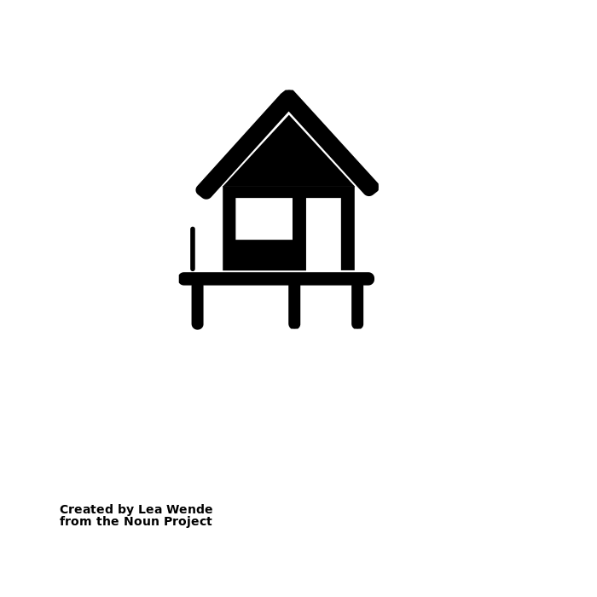

Important drivers will dictate how to manage for future extremes
Introduction | Methods | Exploratory Uses| Case Study | Conclusion
We propose a stochastic weather generator to develop plausible hydroclimate scenarios to inform DMDU that emphasize process and mechanistic understanding of extremes and best represent natural variability.
Driver
Natural Variability
Climate Change
Time Scale
Dynamic (and reversible) operations and adaptations to stabilize during swings
Prioritize: better seasonal forecasts, hedging contracts
Identify prominent climate change signals
Adjust design event estimates
Invest in long term inf
Action

Slide 18
We need a tool that will facilitate the assessments of interest.
Introduction | Methods | Exploratory Uses| Case Study | Conclusion
Stochastic weather generators need to:
Create physically plausible weather for the region
Support the ability to create climate change scenarios
Capture the range of natural variability in the weather system

Slide 19
We need a tool that will facilitate the assessments of interest.
Introduction | Methods | Exploratory Uses| Case Study | Conclusion
Stochastic weather generators need to:
Create physically plausible weather for the region
Support the ability to create climate change scenarios
Capture the range of natural variability in the weather system

Slide 20

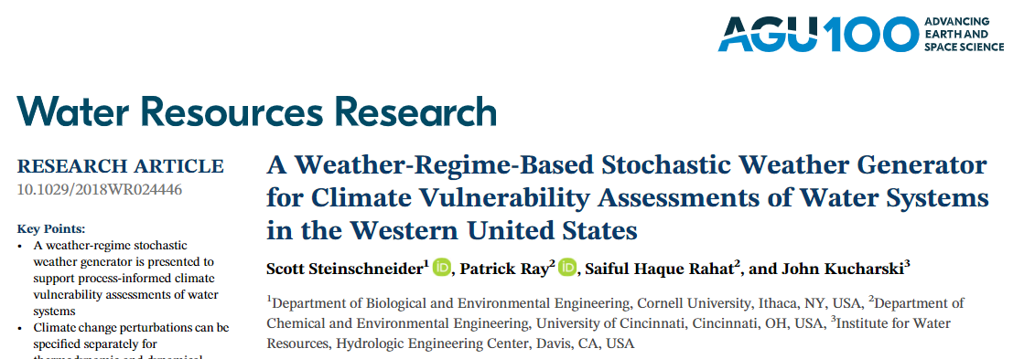
A weather regime based-stochastic weather generator allows the generation of physically plausible synthetic weather.
Introduction | Methods | Exploratory Uses| Case Study | Conclusion

Slide 21
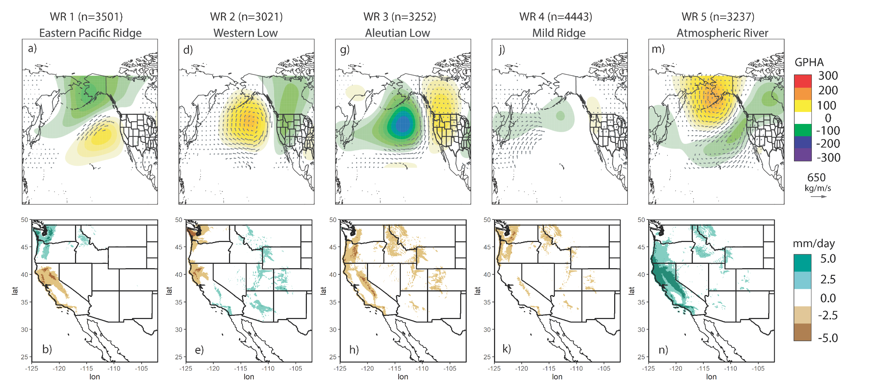
Weather regimes are large-scale persistent pressure patterns that influence regional weather.
Introduction | Methods | Exploratory Uses| Case Study | Conclusion
Pressure Pattern Anomalies
Precipitation Anomalies
Gupta, R.S., Steinschneider, S. & Reed, P.M. A multi-objective paleo-informed reconstruction of western US weather regimes over the past 600 years. Clim Dyn (2022). https://doi.org/10.1007/s00382-022-06302-4

Slide 22
Weather regimes are large-scale persistent pressure patterns that influence regional weather.
Introduction | Methods | Exploratory Uses| Case Study | Conclusion
Above average precipitation linked to atmospheric rivers
Gupta, R.S., Steinschneider, S. & Reed, P.M. A multi-objective paleo-informed reconstruction of western US weather regimes over the past 600 years. Clim Dyn (2022). https://doi.org/10.1007/s00382-022-06302-4

Slide 23
Weather regimes are large-scale persistent pressure patterns that influence regional weather.
Introduction | Methods | Exploratory Uses| Case Study | Conclusion
Drought Conditions
Gupta, R.S., Steinschneider, S. & Reed, P.M. A multi-objective paleo-informed reconstruction of western US weather regimes over the past 600 years. Clim Dyn (2022). https://doi.org/10.1007/s00382-022-06302-4

Slide 24
Weather regimes are large-scale persistent pressure patterns that influence regional weather.
Introduction | Methods | Exploratory Uses| Case Study | Conclusion
Spatially heterogeneous (dipole) conditions
Gupta, R.S., Steinschneider, S. & Reed, P.M. A multi-objective paleo-informed reconstruction of western US weather regimes over the past 600 years. Clim Dyn (2022). https://doi.org/10.1007/s00382-022-06302-4

Slide 25
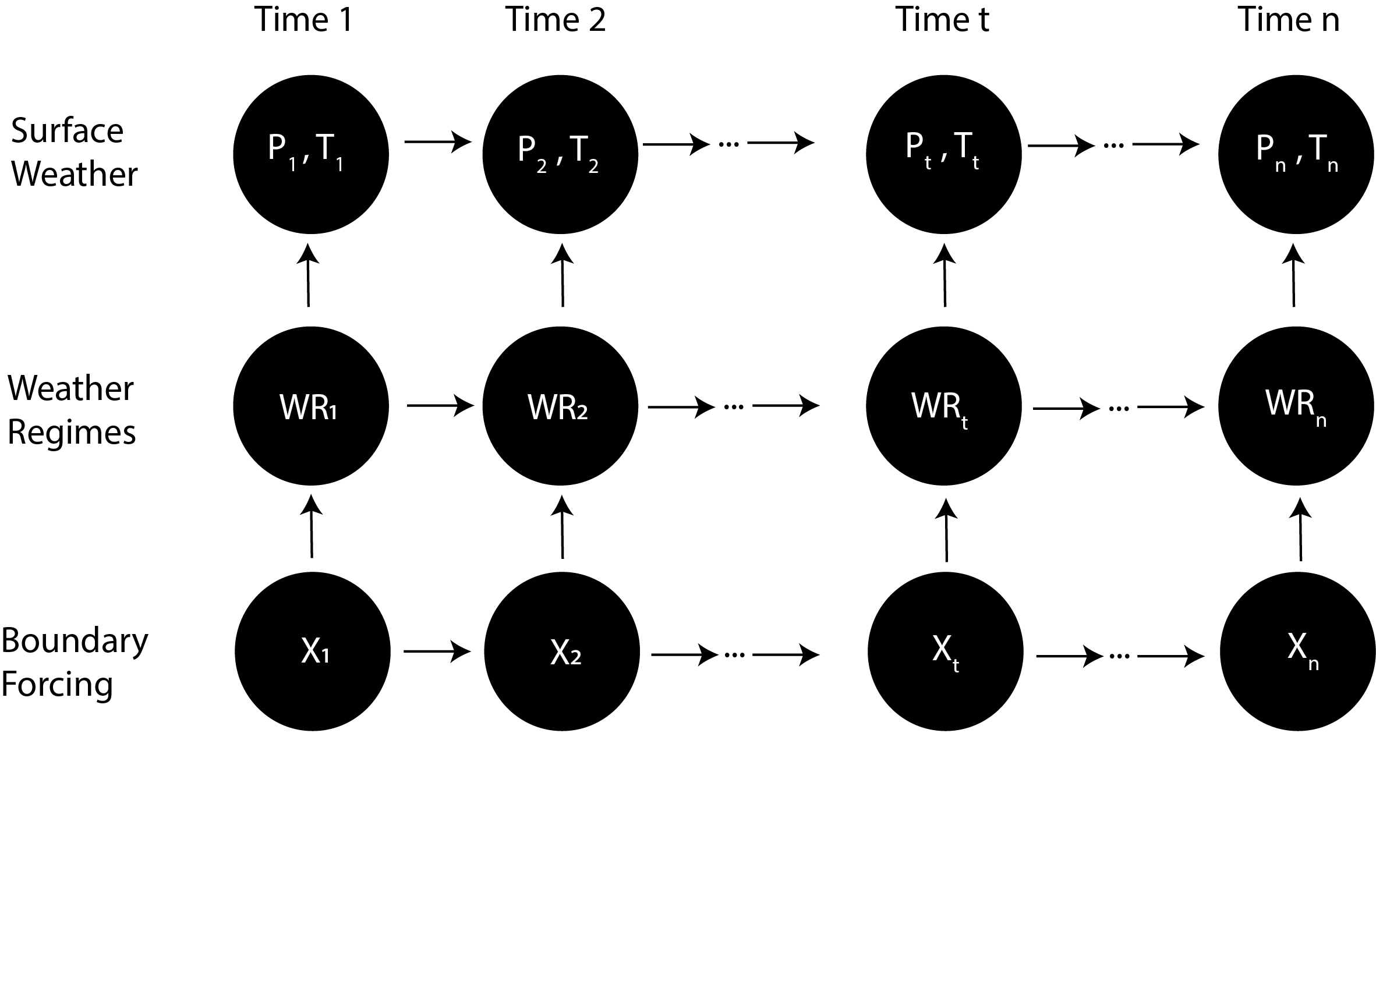
A weather regime based-stochastic weather generator allows the generation of physically plausible synthetic ensembles.
Introduction | Methods | Exploratory Uses| Case Study | Conclusion
Identify and simulate WRs which dictate daily large-scale atmospheric flow

Slide 26
A weather regime based-stochastic weather generator allows the generation of physically plausible synthetic ensembles.
Introduction | Methods | Exploratory Uses| Case Study | Conclusion
Simulate local weather conditioned on weather regimes by bootstrapping from historical record

Slide 27
A weather regime based-stochastic weather generator allows the generation of physically plausible synthetic ensembles.
Introduction | Methods | Exploratory Uses| Case Study | Conclusion
Hierarchical connection between WRs and local weather helps maintain complex space-time relationship

Slide 28
We need a tool that will facilitate the assessments of interest.
Introduction | Methods | Exploratory Uses| Case Study | Conclusion
Stochastic weather generators need to:
Create physically plausible weather for the region
Support the ability to create climate change scenarios
Capture the range of natural variability in the weather system

Slide 29
A weather regime based-stochastic weather generator allows the generation of physically plausible synthetic ensembles.
Introduction | Methods | Exploratory Uses| Case Study | Conclusion
Apply thermodynamic climate changes to the generated ensembles

Slide 30
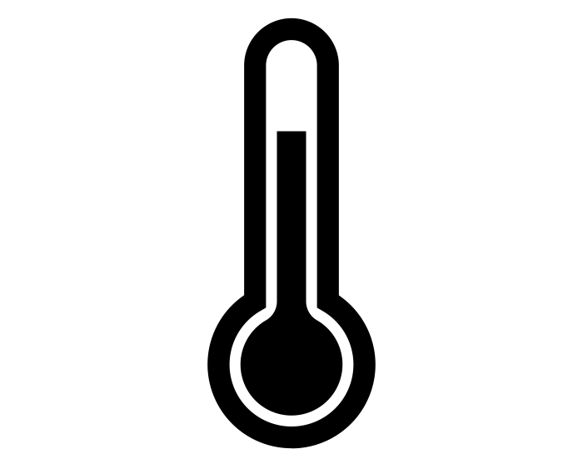

Thermodynamic climate changes can be applied post-generation.
Introduction | Methods | Exploratory Uses| Case Study | Conclusion
Temperature Trends
Precipitation Scaling
Scale upper and lower quantiles of precipitation distribution consistent with applied warming (0-14% per degree C)
Apply stepwise warming to each grid cell (0-4°C)

Slide 31
Thermodynamic climate changes can be applied post-generation.
Introduction | Methods | Exploratory Uses| Case Study | Conclusion
Temperature Trends
Precipitation Scaling
Scale upper and lower quantiles of precipitation distribution consistent with applied warming (0-14% per degree C)
Apply stepwise warming to each grid cell (0-4°C)
Can constrain ranges based on GCM projections or localized studies

Slide 32
We need a tool that will facilitate the assessments of interest.
Introduction | Methods | Exploratory Uses| Case Study | Conclusion
Stochastic weather generators need to:
Create physically plausible weather for the region
Support the ability to create climate change scenarios
Capture the range of natural variability in the weather system

Slide 33
The weather generator can accommodate boundary forcing that dictates weather regime evolution.
Introduction | Methods | Exploratory Uses| Case Study | Conclusion
The key to enhanced natural variability representation in generated weather lies in using appropriate boundary forcing.

Slide 34
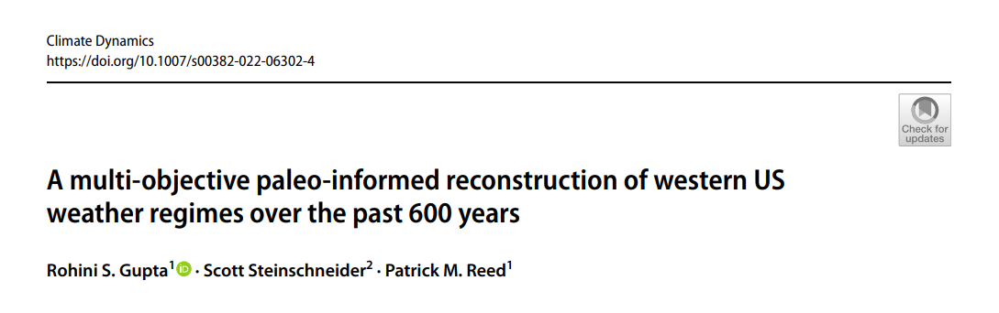
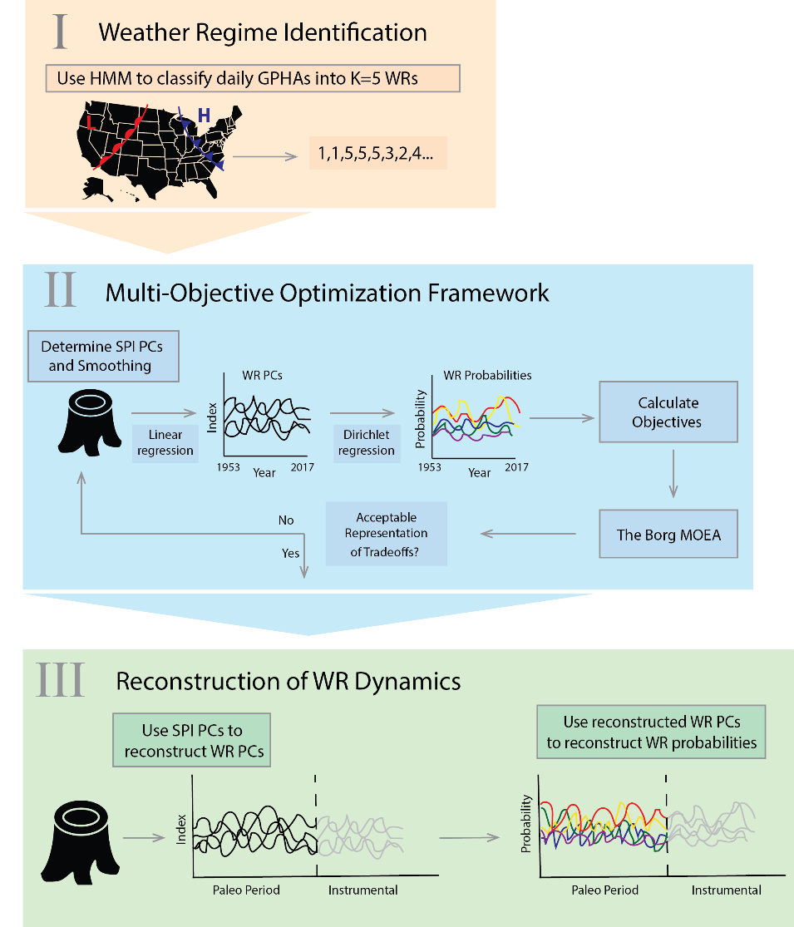

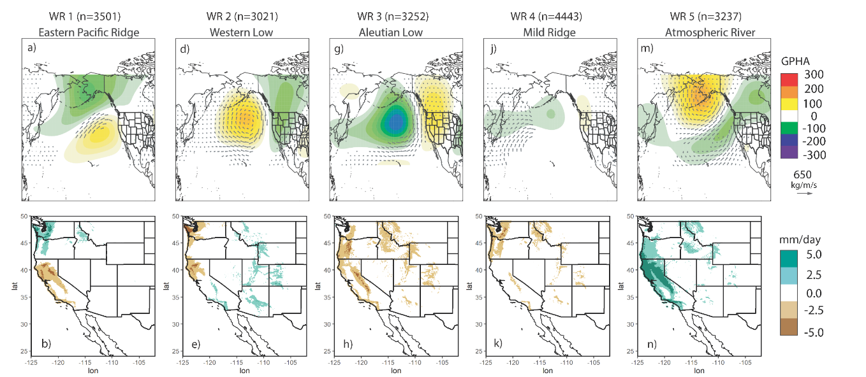
We reconstruct weather regime occurrence back to the year 1400 CE.
Introduction | Methods | Exploratory Uses| Case Study | Conclusion

Slide 35
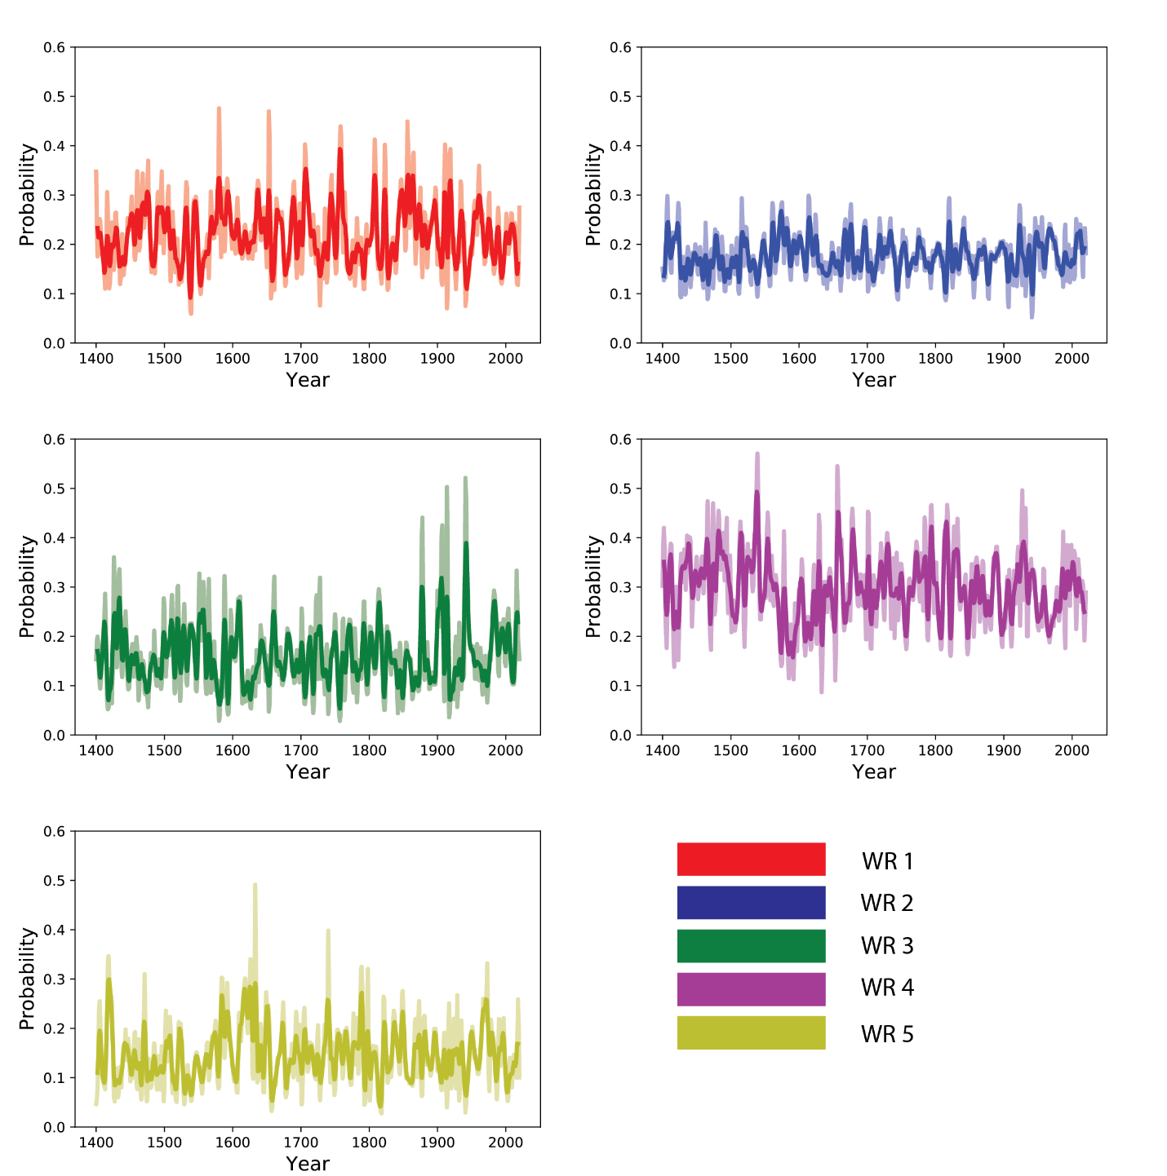
We demonstrate the variability in weather regime dynamics prior to the instrumental period.
Introduction | Methods | Exploratory Uses| Case Study | Conclusion
The extent of WR variability in the reconstruction extends well past what is observed during the instrumental period.
Gupta, R.S., Steinschneider, S. & Reed, P.M. A multi-objective paleo-informed reconstruction of western US weather regimes over the past 600 years. Clim Dyn (2022). https://doi.org/10.1007/s00382-022-06302-4

Slide 36
We demonstrate the variability in weather regime dynamics prior to the instrumental period.
Introduction | Methods | Exploratory Uses| Case Study | Conclusion
By conditioning our generator on the instrumental period, we are severely under-representing natural variability.
Gupta, R.S., Steinschneider, S. & Reed, P.M. A multi-objective paleo-informed reconstruction of western US weather regimes over the past 600 years. Clim Dyn (2022). https://doi.org/10.1007/s00382-022-06302-4

Slide 37
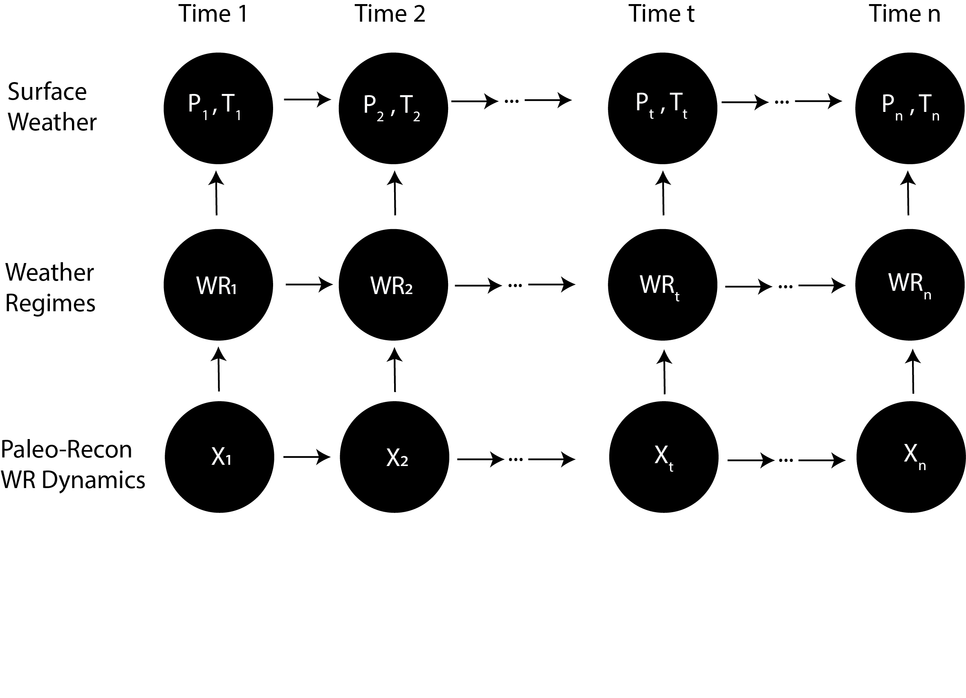
We use the reconstructed WR dynamics to drive the weather generator.
Introduction | Methods | Exploratory Uses| Case Study | Conclusion
This allows us to generate 600 years of daily precipitation and temperature through the extent of the reconstruction.

Slide 38
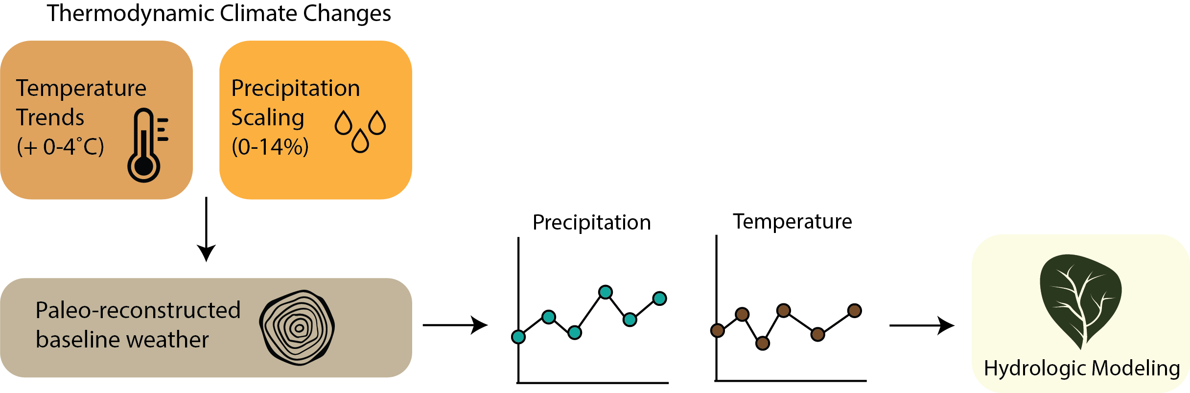
We then pair the generated weather with hydrologic models to get ensembles of streamflow for the region.
Introduction | Methods | Exploratory Uses| Case Study | Conclusion

Slide 39
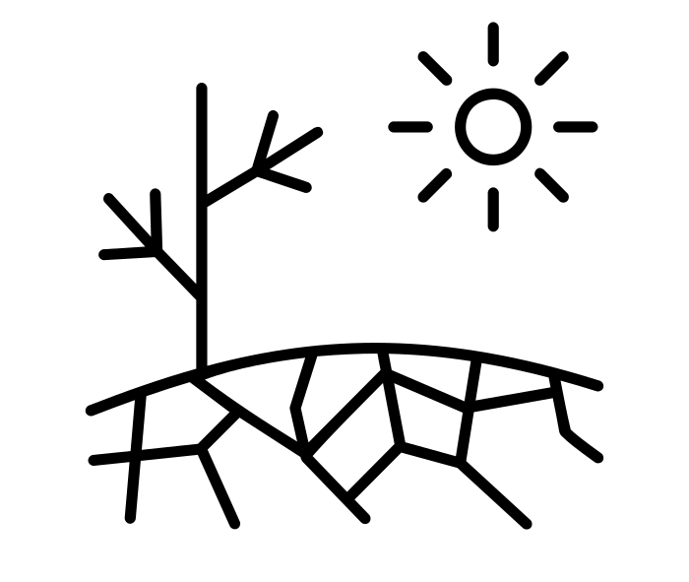

We generate flood and drought metrics from the hydrology ensembles.
Introduction | Methods | Exploratory Uses| Case Study | Conclusion
Drought
SSI-Index based metrics for occurrence, severity, and duration
Flood
Peak flows corresponding to 10-Yr and 100-Yr design events

Slide 40
Example Exploratory Uses
Introduction | Methods | Exploratory Uses | Case Study | Conclusion

Slide 41
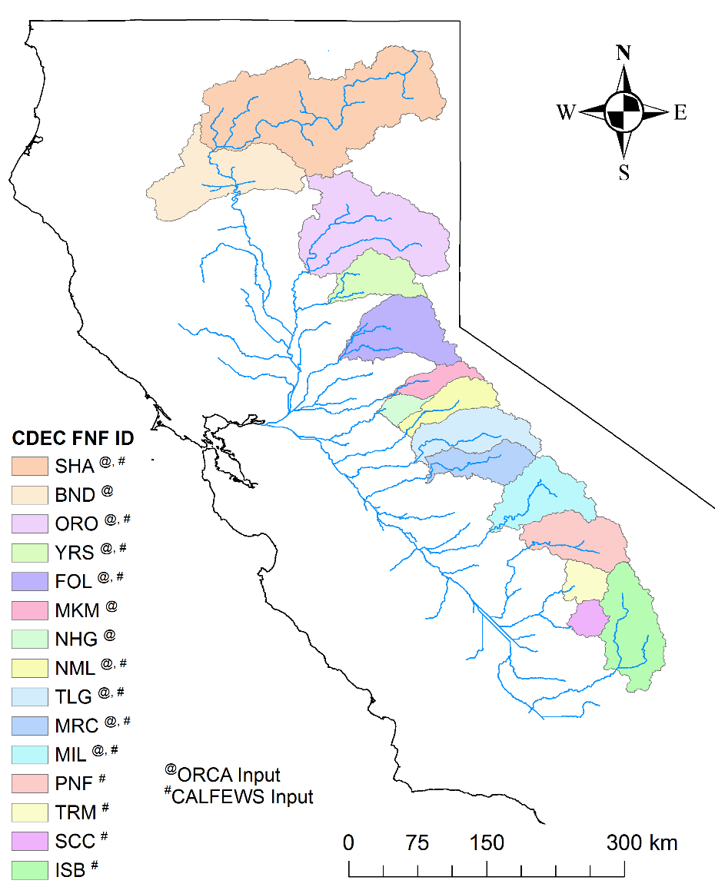
This tool creates SOWs that:
Introduction | Methods | Exploratory Uses | Case Study | Conclusion
1. Preserve spatial correlation across multiple sites and basins
Mechanism: Conditioning on synoptic scale WRs
Result: Allows for the creation of internally consistent multi-basin weather ensembles (currently conditioned on 15 watersheds in the Central Valley region)

Slide 42
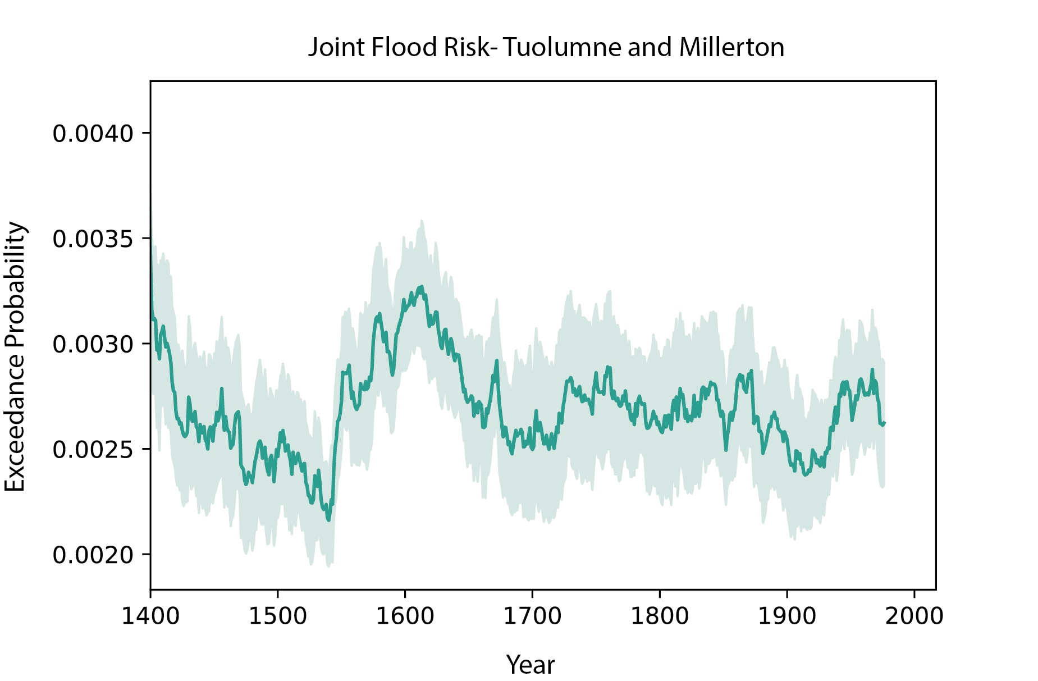
This tool creates SOWs that:
Introduction | Methods | Exploratory Uses | Case Study | Conclusion
2. Allow better assessment of compound risk to basins
Mechanism: Internally consistent weather generation
Result: Provides more robust way to characterize spatially compounding flood or drought risk which poses more serious water system management challenges

Slide 43
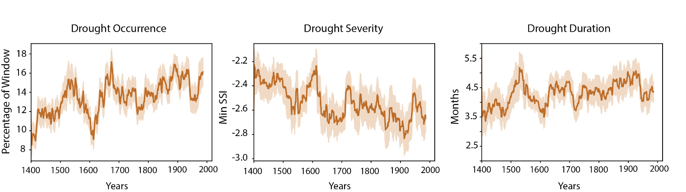
This tool creates SOWs that:
Introduction | Methods | Exploratory Uses | Case Study | Conclusion
3. Capture a wide range of natural variability
Mechanism: Incorporation of reconstructed WR dynamics
Result:
Paleo-reconstruction includes key megadrought (late 1500s) and paleo-flood periods (early 1600s)
Better representation of drought-flood pathways

Slide 44
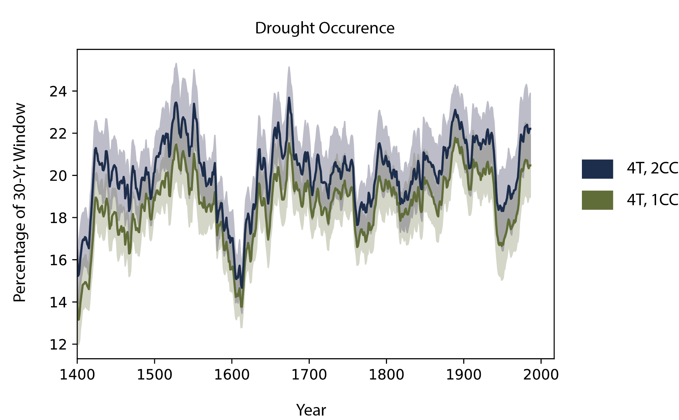
This tool creates SOWs that:
Introduction | Methods | Exploratory Uses | Case Study | Conclusion
4. Map how thermodynamic changes lead to changes in metrics of interest
Mechanism: Systematic layering of temperature trends or precipitation scaling
Result: Clearly delineate the effects of specific climate changes on metrics of interest

Slide 45
Example Case Study
Introduction | Methods | Exploratory Uses | Case Study | Conclusion

Slide 46
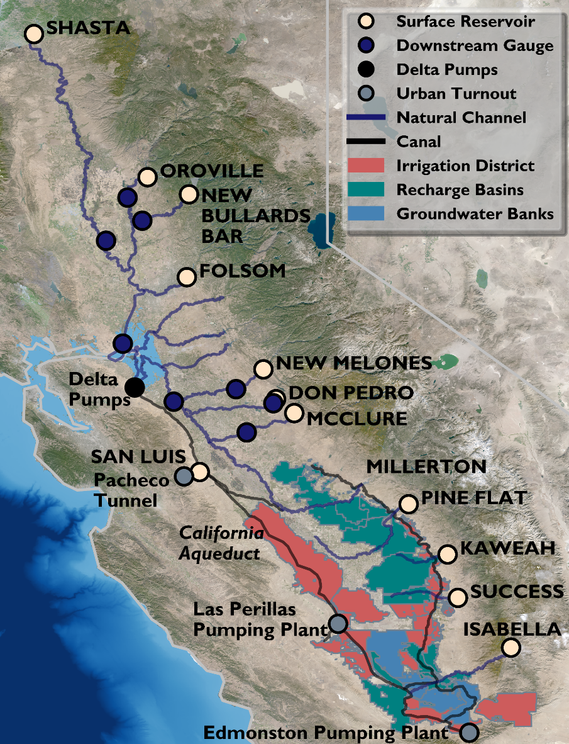
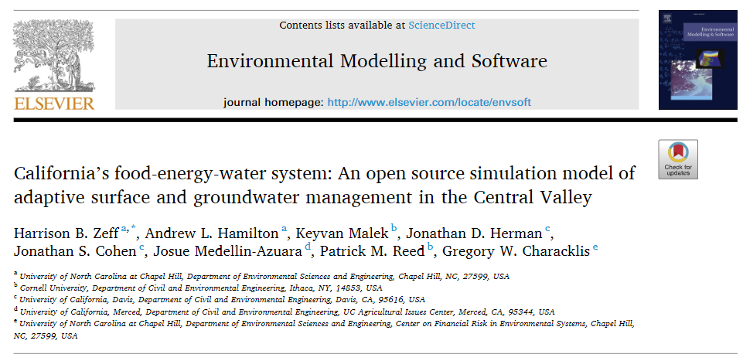
Ensembles from this study will be used to force California food-energy-water system model.
Introduction | Methods | Exploratory Uses | Case Study | Conclusion
Abstracts critical institutional and infrastructure elements (>1,000) that capture the complex dynamics of water balance for north-central California.
We provide inflow to the 12 main reservoirs

Slide 47
Conclusion
Introduction | Methods | Exploratory Uses | Case Study | Conclusion
1
Assessing the robustness of water resources systems in California to extremes requires careful generation of states of the world that capture plausible future hydroclimate.

Slide 48
Conclusion
Introduction | Methods | Exploratory Uses | Case Study | Conclusion
1
Assessing the robustness of water resources systems in California to extremes requires careful generation of states of the world that capture plausible future hydroclimate.
2
A weather-regime based stochastic weather generator allows the generation of physical plausible and internally-consistent (and climate change-informed) weather and streamflow for this region.

Slide 49
Conclusion
Introduction | Methods | Exploratory Uses | Case Study | Conclusion
1
Assessing the robustness of water resources systems in California to extremes requires careful generation of states of the world that capture plausible future hydroclimate.
2
A weather-regime based stochastic weather generator allows the generation of physical plausible and internally-consistent (and climate change-informed) weather and streamflow for this region.
3
Internally consistent weather generation provides a mechanism to explore challenging compound risk across basins and to characterize vulnerabilities to regional water systems.

Slide 50
DMDU Annual Meeting 2022
Thank you! Questions?
AUTHORS
Rohini S. Gupta^{1*}, Scott Steinschneider², Patrick M. Reed¹
¹Civil and Environmental Engineering, Cornell University
²Biological and Environmental Engineering, Cornell University
*Presenting author: rg727@cornell.edu

Slide 51
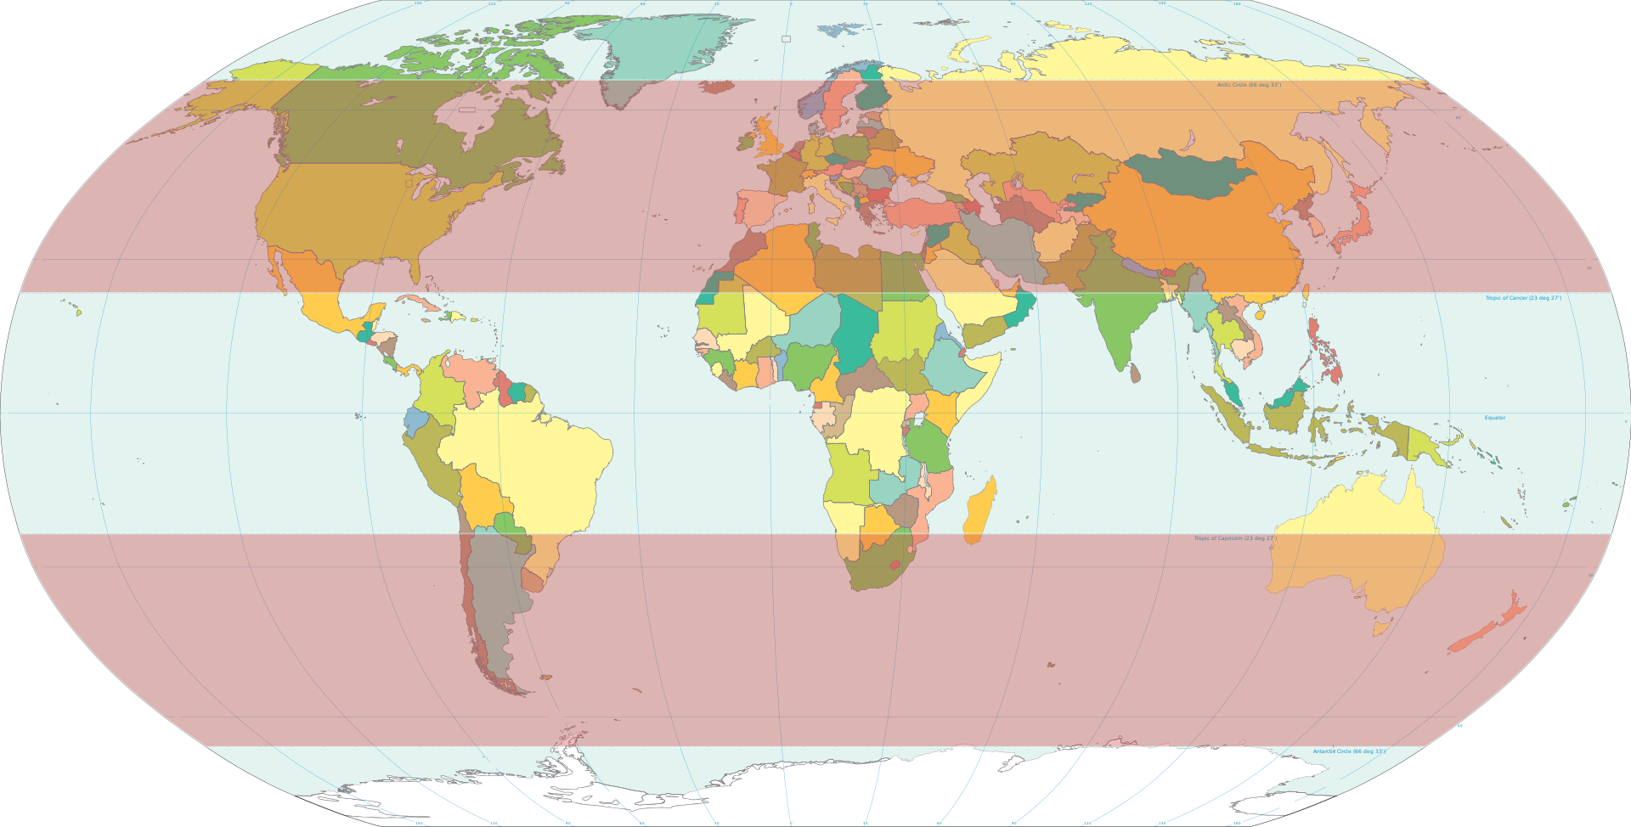
Mid-Latitudes
Introduction | Methods | Exploratory Uses | Case Study | Conclusion
Include subtropical and temperate zones

