Slide 1

MultiSector Dynamics Workshop (2023)
A Primer on LSTMs (with a Hydrology Twist)
Rohini S. Gupta
Civil and Environmental Engineering, Cornell University
10.3.2023

Slide 2
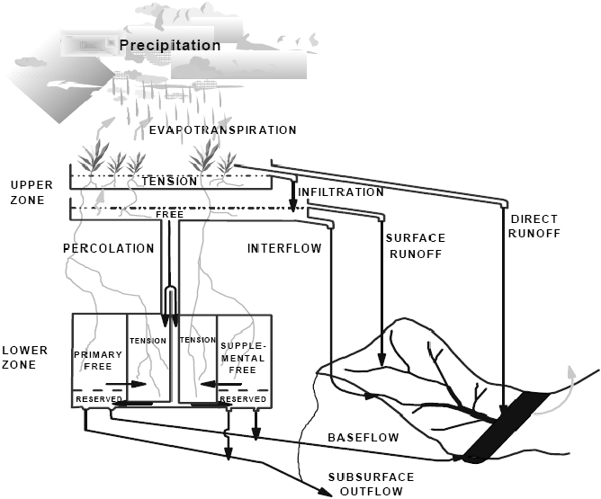
Let’s think about Rainfall-Runoff Modeling
Introduction | Into an LSTM | Applications
Process-Based Model
Uses precipitation, temperature, and catchment parameters pertaining to soil moisture states and relative permeability to estimate the amount of water that enters, is stored in, and leaves the basin.
Sacramento Soil and Moisture Accounting Model

Slide 3
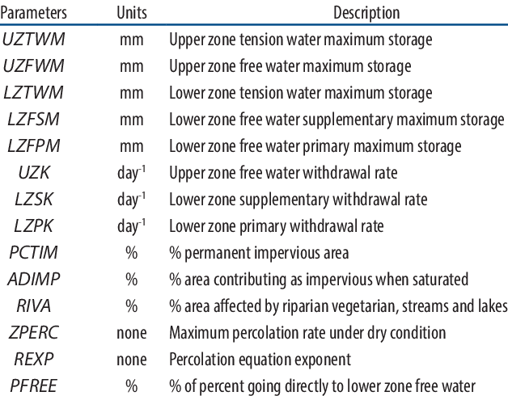
Let’s think about Rainfall-Runoff Modeling
Introduction | Into an LSTM | Applications
Requires: calibrating key parameters and knowledge of the basin

Slide 4
Black Box ML model
Introduction | Into an LSTM | Applications
Machine Learning Model
Output Data
Runoff
Input Data
Precipitation
Temperature
Catchment Calibration Parameters

Slide 5
Black Box ML model
Introduction | Into an LSTM | Applications
Machine Learning Model
Output Data
Runoff
Input Data
Precipitation
Temperature
Catchment Calibration Parameters
Specified calibration parameters are not necessary for the model to work.

Slide 6
Black Box ML model
Introduction | Into an LSTM | Applications
f(x)
Machine Learning Model
Output Data
Runoff
Input Data (x)
Precipitation
Temperature
Catchment Calibration Parameters
Machine learning models will find some function, f(x), that it learns from the training data that best maps your input to output (and inherently learn processes dictating runoff)

Slide 7
Black Box ML model
Introduction | Into an LSTM | Applications
Machine Learning Model
Output Data
Runoff
Input Data
Precipitation
Temperature
Catchment Calibration Parameters
Machine learning models can often outperform physical rainfall-runoff models
Not constrained by limited representation of catchment
Capture natural phenomena that can’t be defined mathematically

Slide 8
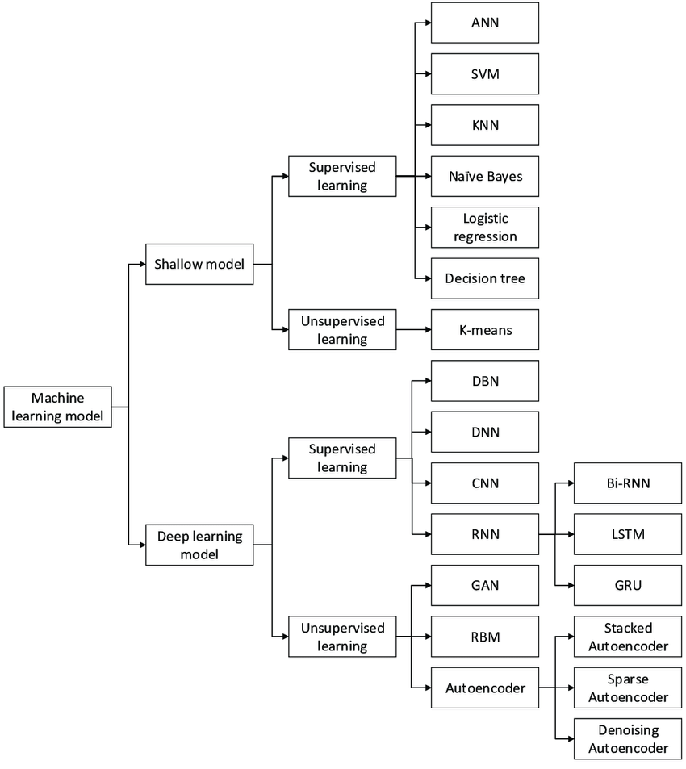
Examples of Candidate ML Models
Introduction | Into an LSTM | Applications

Slide 9
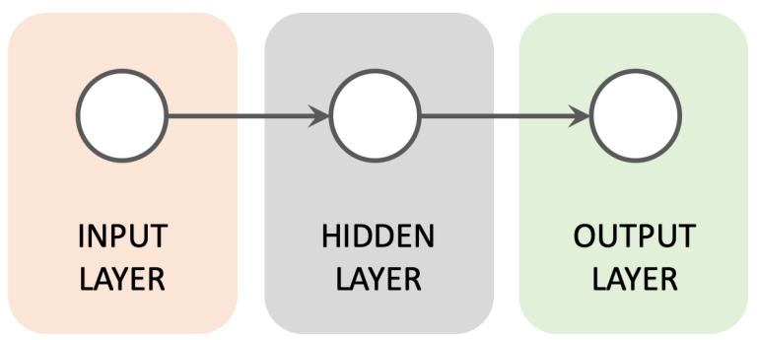
Feedforward Network
Introduction | Into an LSTM | Applications

Slide 10
Feedforward Network
Introduction | Into an LSTM | Applications
Information only travels forward (no feedback)
For time series analysis, any information about the sequential order of inputs is lost

Slide 11
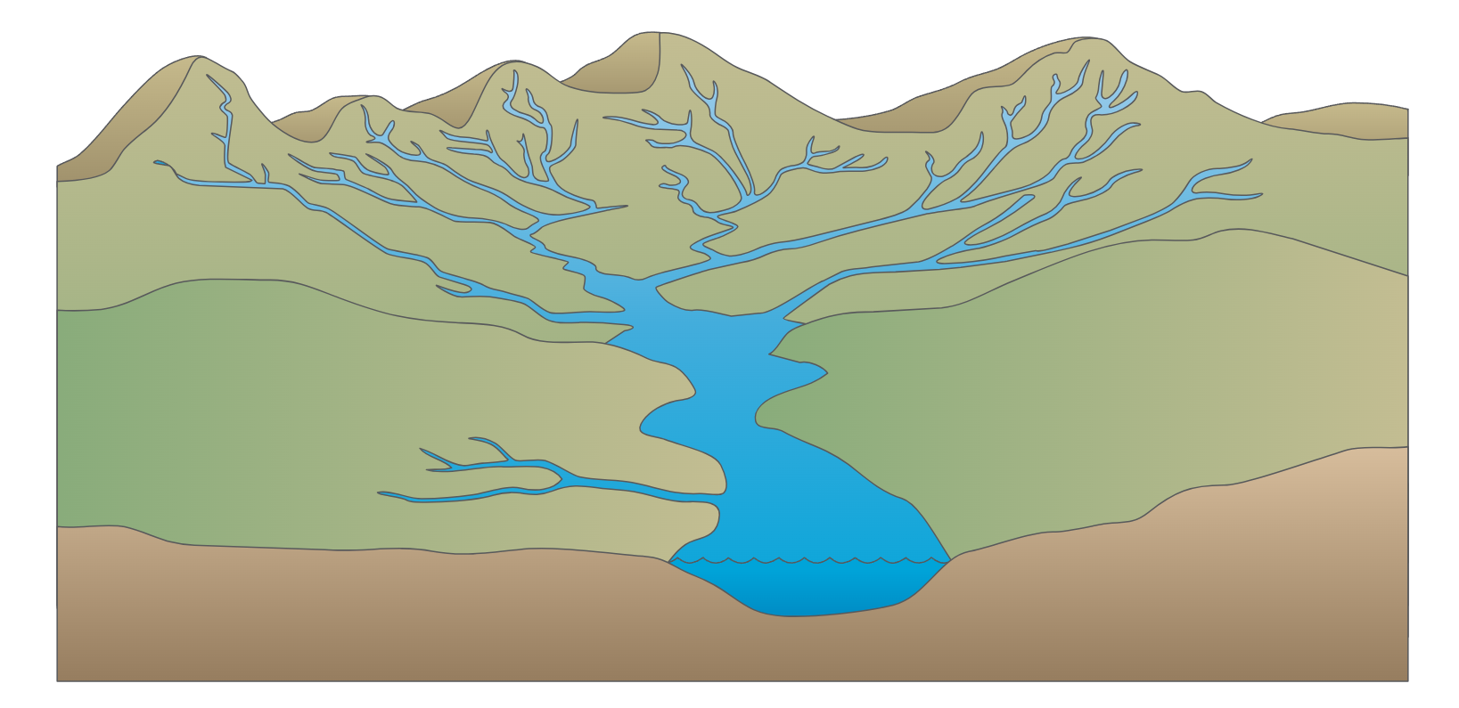


Why do we need memory-based models?
Introduction | Into an LSTM | Applications
Climate Model Downscaling
Exhibits strong temporal dependencies where current climate state is influenced by past states.
Rainfall-Runoff Modeling
Hydrologic processes at varying time scales influence runoff (snow accumulation, precipitation, groundwater processes)
Load Forecasting
Predicting future energy demand and renewable energy generation/integration
Household Behavior
Learning customer behavior in response to electricity prices

Slide 12
Recurrent Networks
Introduction | Into an LSTM | Applications

Slide 13
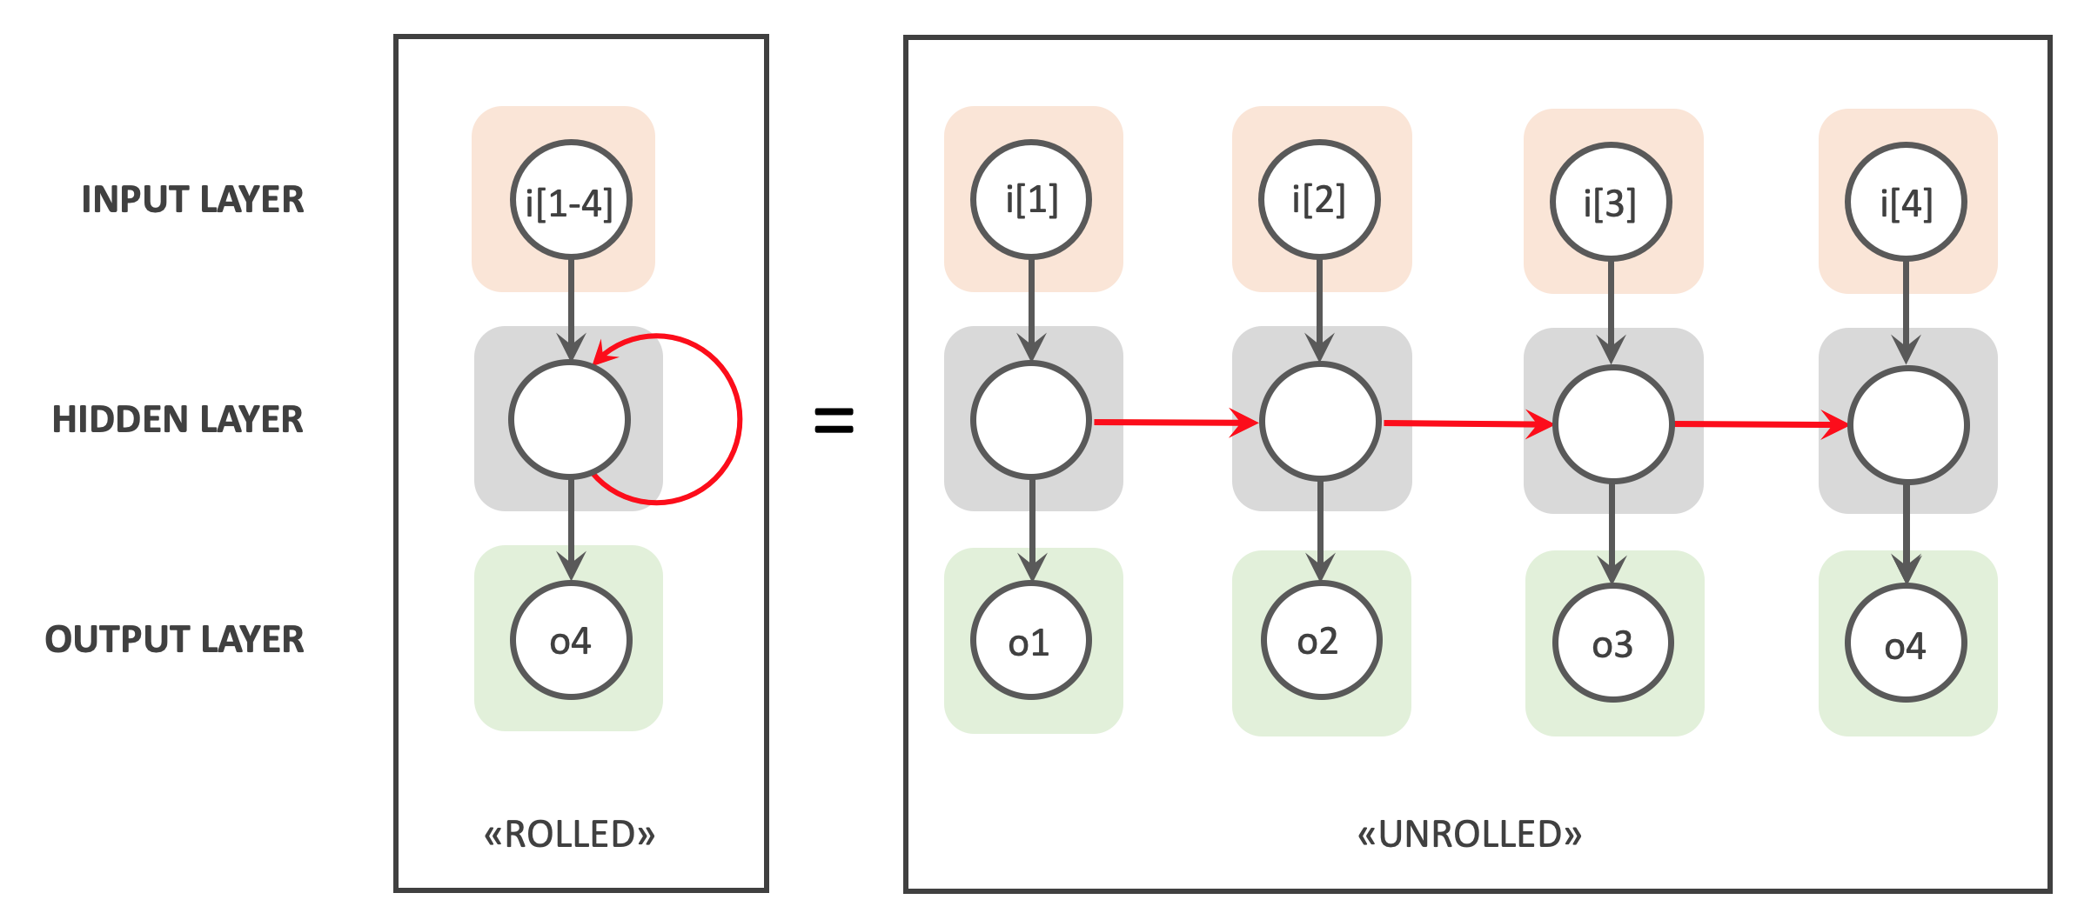
Recurrent Networks
Introduction | Into an LSTM | Applications
RNNs struggle to retain longer dependencies
West, 2019

Slide 14
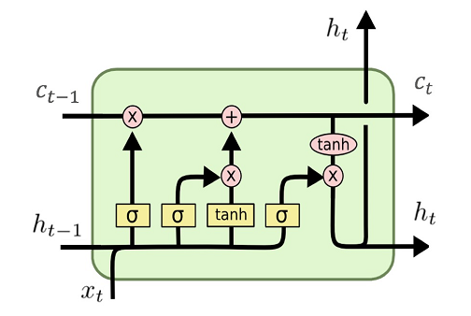
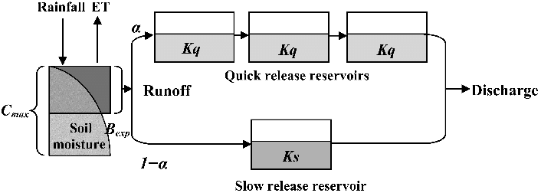
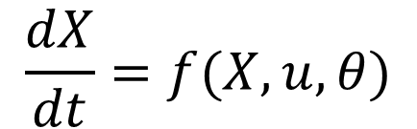
Long Short-Term Memory (LSTM) Models
Introduction | Into an LSTM | Applications
Cell State
$$\frac{dX}{dt}=f(X,u,θ)$$
Both models have states that are updated through time
Notes:
https://colah.github.io/posts/2015-08-Understanding-LSTMs/

Slide 15
Into the Guts of an LSTM
Introduction | Into an LSTM | Applications

Slide 16
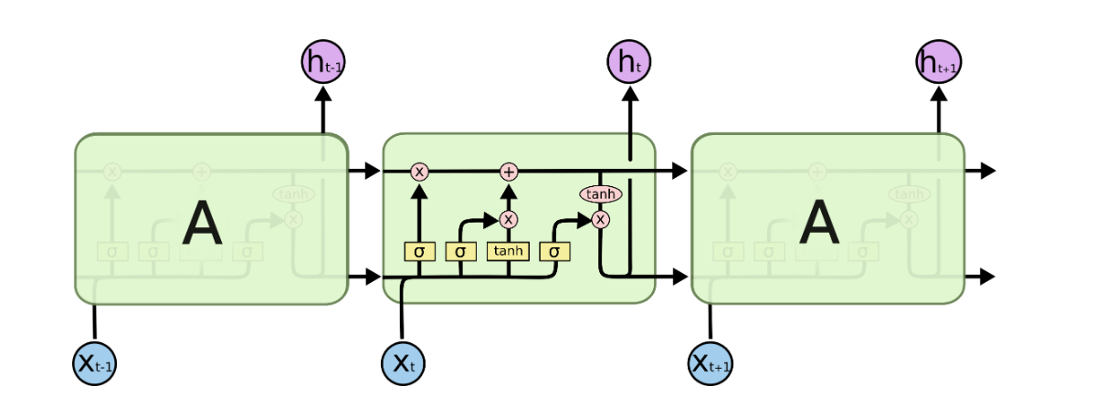
LSTM Chain
Introduction | Into an LSTM | Applications
Christopher Olah, 2015

Slide 17
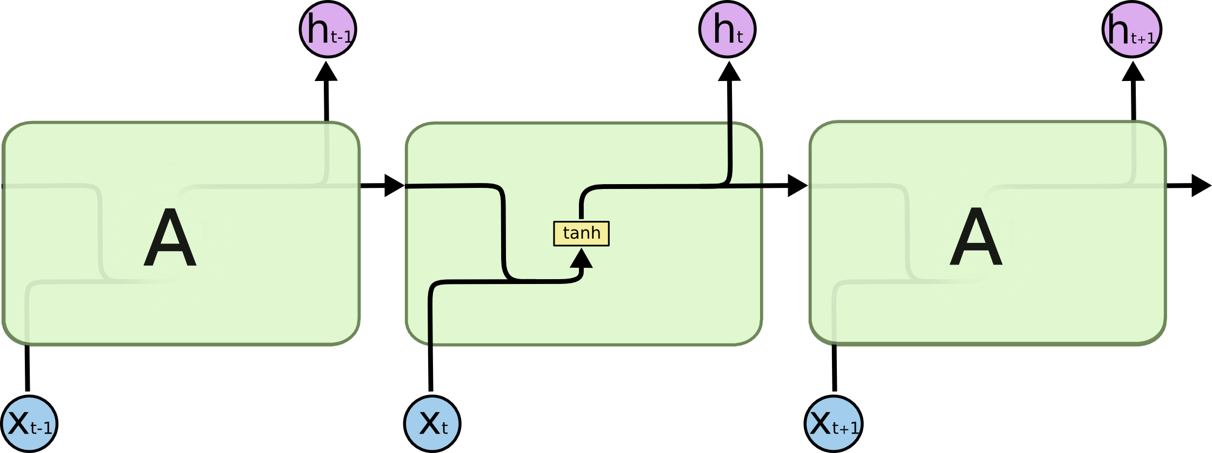
LSTM Chain
Introduction | Into an LSTM | Applications
Unlike an RNN, an LSTM has four interacting layers within a cell.
Notes:
100 inputs
10 neurons_> 10 outputs
2 neurons
Gives output

Slide 18
Deeper Look into a Cell
Introduction | Into an LSTM | Applications
Cell State
Forget
Gate
Input
Gate
Outputs
Hidden
State
Output
Gate
Inputs

Slide 19
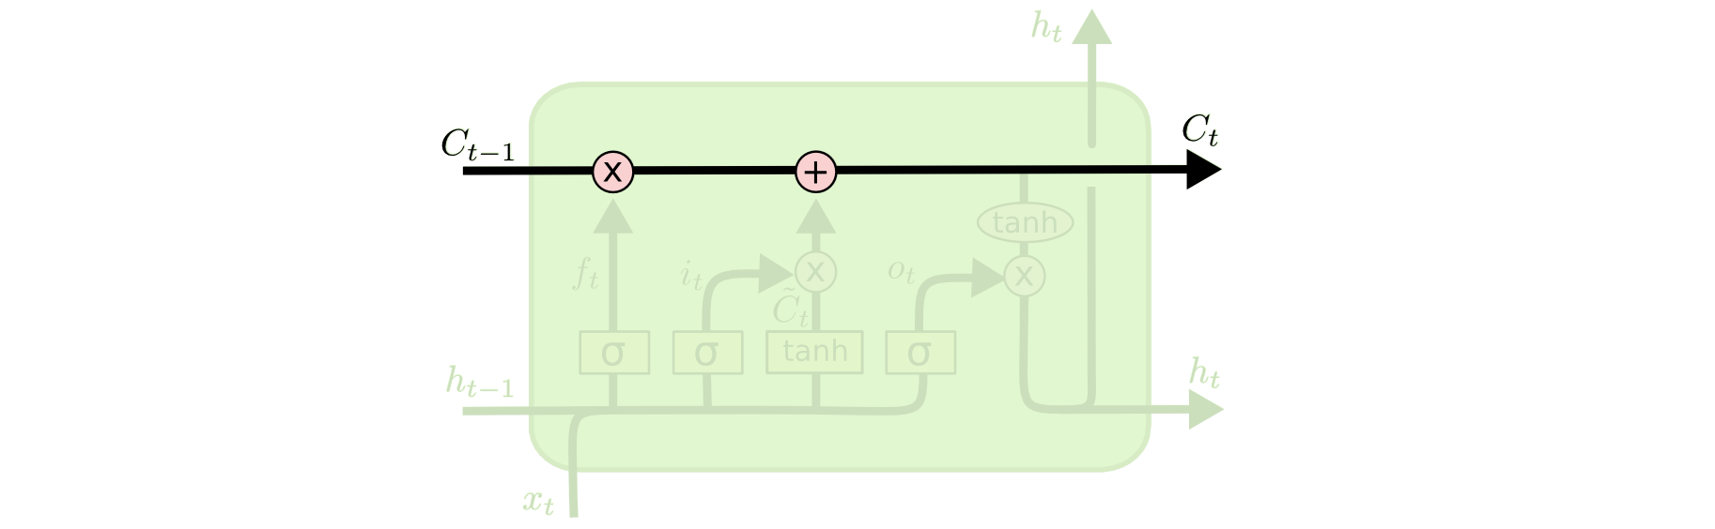
Cell State
Introduction | Into an LSTM | Applications
Runs through entire chain and represents information flow and retainment

Slide 20
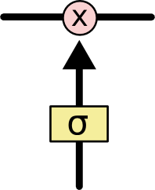
Cell State
Introduction | Into an LSTM | Applications
Information flow and retainment is dictated by gates
Runs through entire chain and represents information flow and retainment

Slide 21
Gates
Introduction | Into an LSTM | Applications
Cell State
Forget
Gate
Input
Gate
Outputs
Hidden
State
Output
Gate
Inputs

Slide 22
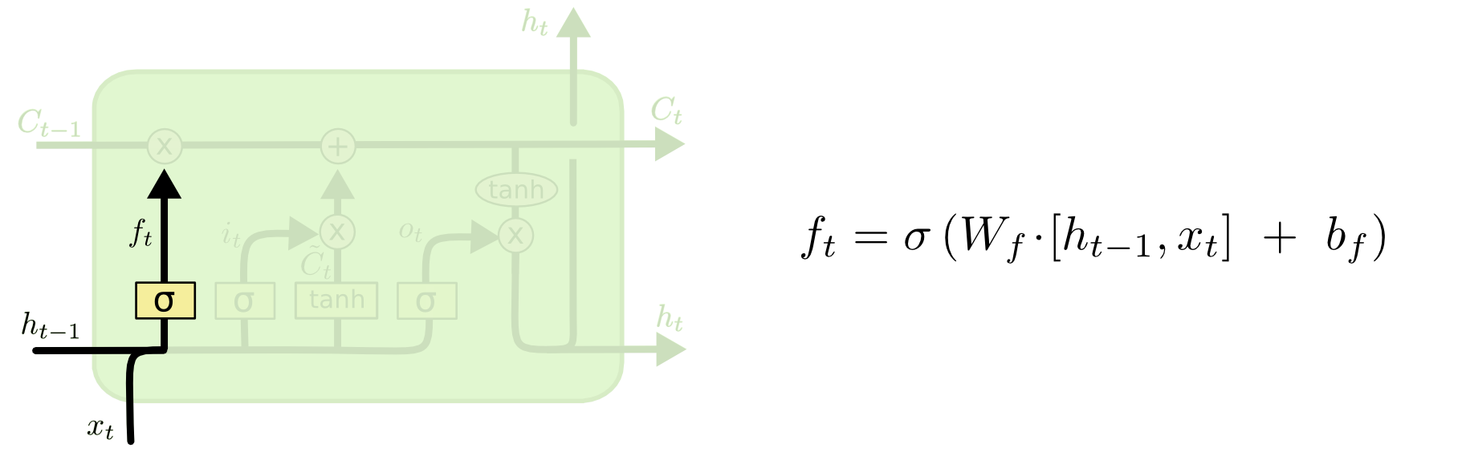
Forget Gate
Introduction | Into an LSTM | Applications
Decides what information to remove from the cell state

Slide 23
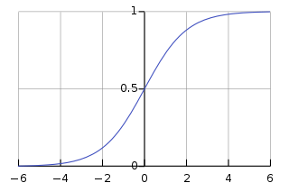

Forget Gate
Introduction | Into an LSTM | Applications
$$σ\left(z\right)= \frac{1}{1+e^{−z}}$$
Decides what information to remove from the cell state

Slide 24
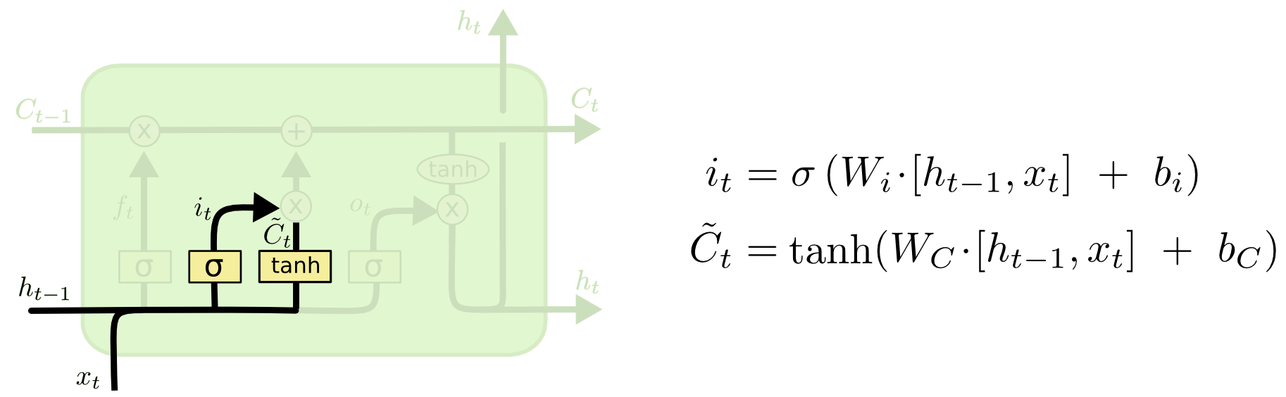
Input Gate
Introduction | Into an LSTM | Applications
Decides what information to store in the cell state
1. Tanh layer creates a vector of new candidate values

Slide 25
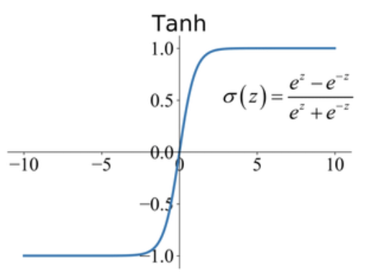
Input Gate
Introduction | Into an LSTM | Applications
Decides what information to store in the cell state

Slide 26
Input Gate
Introduction | Into an LSTM | Applications
Decides what information to store in the cell state
1. Tanh layer creates a vector of new candidate values
2. Sigmoid layer decides which values to keep and update

Slide 27
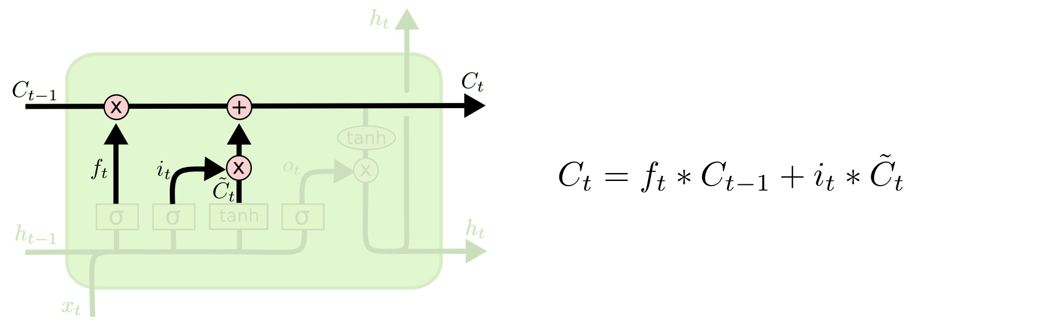
Update the Cell State
Introduction | Into an LSTM | Applications
Multiply the old state by the output from the forget gate
Add new candidate values from the input gate

Slide 28
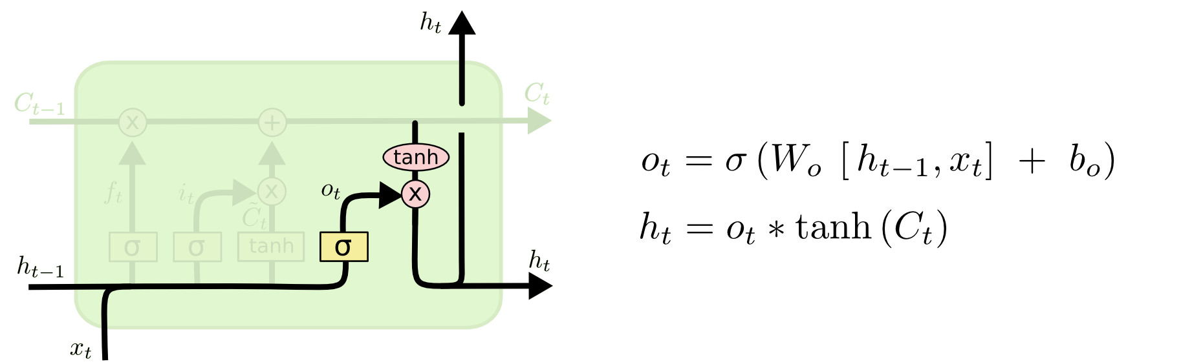
Output Gate
Introduction | Into an LSTM | Applications
1. Apply the tanh function to the current cell state pointwise to obtain the squished cell state, which now lies in [-1,1].
2. Pass the previous hidden state and current input data through the sigmoid activated neural network.

Slide 29
Applications
Introduction | Into an LSTM | Applications

Slide 30
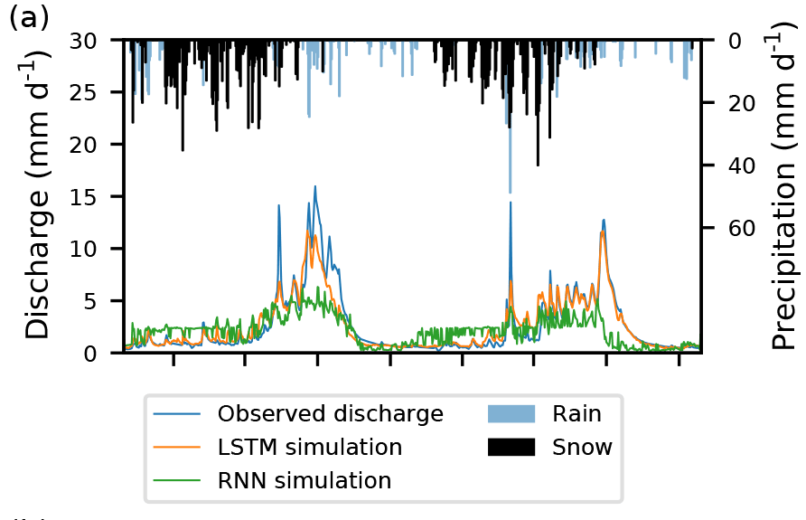
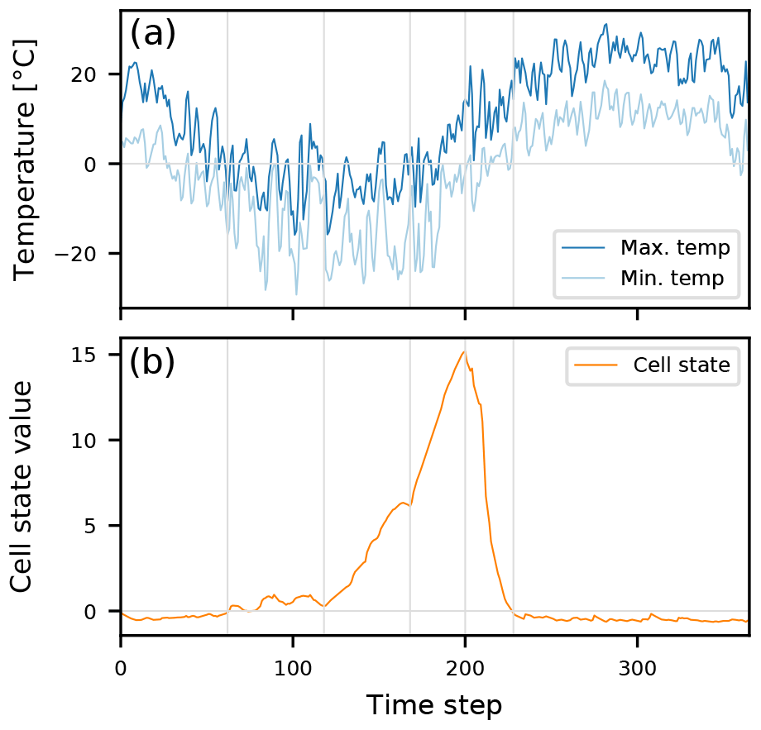
Learning Real Hydrologic Processes
Introduction | Into an LSTM | Applications
Cell state captures snow dynamics though the model is only trained on rainfall and temperature
Kratzert, F., Klotz, D., Brenner, C., Schulz, K., & Herrnegger, M. (2018). Rainfall–runoff modelling using long short-term memory (LSTM) networks. Hydrology and Earth System Sciences, 22(11), 6005-6022.

Slide 31
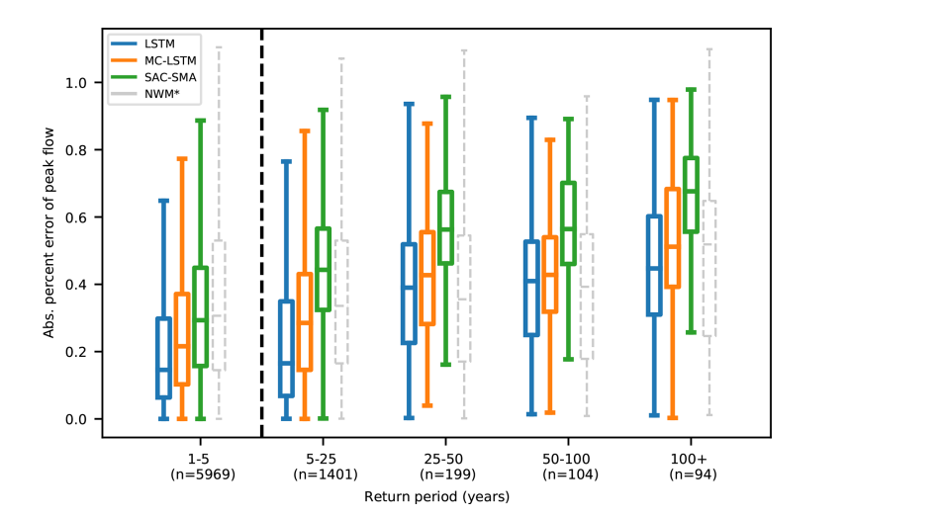
Introduction | Into an LSTM | Applications
Better predictions of extremes
LSTMs demonstrate better accuracy when predicting extreme events (even compared to physics-constrained models).
Frame, J., Kratzert, F., Klotz, D., Gauch, M., Shelev, G., Gilon, O., ... & Nearing, G. S. (2021). Deep learning rainfall-runoff predictions of extreme events. Hydrology and Earth System Sciences Discussions, 1-20.

Slide 32
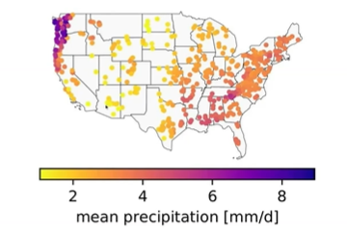
Better prediction in gauged and ungauged basins at the CONUS scale
Introduction | Into an LSTM | Applications
Better predictions of extremes
LSTMs demonstrate better accuracy when predicting extreme events (even compared to physics-constrained models).
Regional LSTMs demonstrate better accuracy when predicting in gauged and ungauged basins compared to physics-based models directly conditioned on individual basins.
Frame, J., Kratzert, F., Klotz, D., Gauch, M., Shelev, G., Gilon, O., ... & Nearing, G. S. (2021). Deep learning rainfall-runoff predictions of extreme events. Hydrology and Earth System Sciences Discussions, 1-20.
Kratzert, F., Klotz, D., Herrnegger, M., Sampson, A. K., Hochreiter, S., & Nearing, G. S. (2019). Toward improved predictions in ungauged basins: Exploiting the power of machine learning. Water Resources Research, 55(12), 11344-11354.

Slide 33
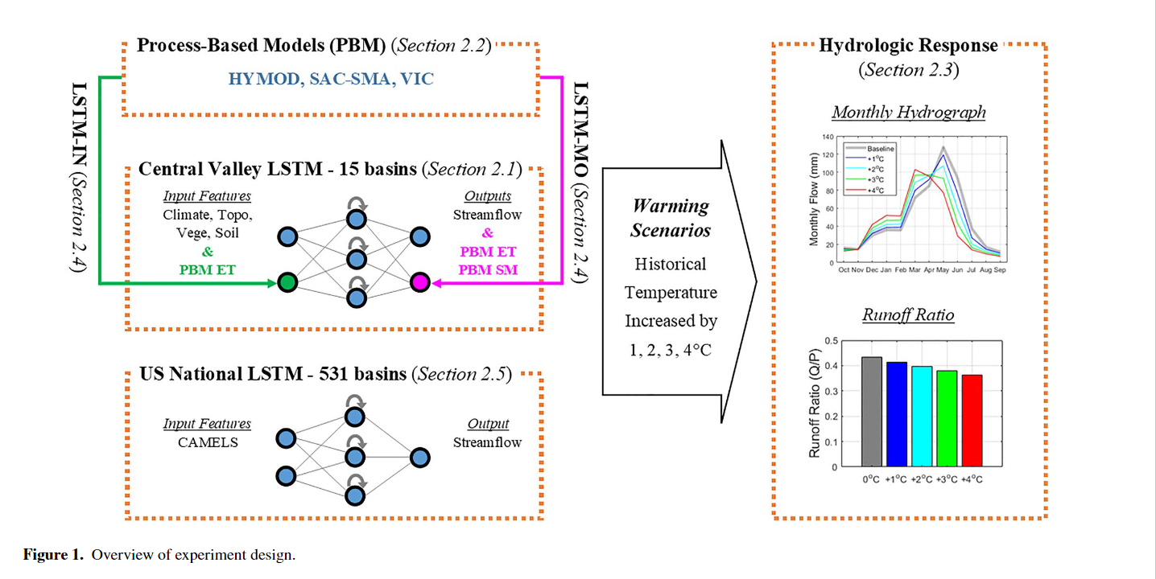
Better prediction in gauged and ungauged basins at the CONUS scale
Introduction | Into an LSTM | Applications
Better predictions of extremes
Unclear skill under non-stationary conditions
LSTMs demonstrate better accuracy when predicting extreme events (even compared to physics-constrained models).
Regional LSTMs demonstrate better accuracy when predicting in gauged and ungauged basins compared to physics-based models directly conditioned on individual basins.
LSTM can produce increasing (unrealistic) runoff ratios during warming scenarios
Frame, J., Kratzert, F., Klotz, D., Gauch, M., Shelev, G., Gilon, O., ... & Nearing, G. S. (2021). Deep learning rainfall-runoff predictions of extreme events. Hydrology and Earth System Sciences Discussions, 1-20.
Kratzert, F., Klotz, D., Herrnegger, M., Sampson, A. K., Hochreiter, S., & Nearing, G. S. (2019). Toward improved predictions in ungauged basins: Exploiting the power of machine learning. Water Resources Research, 55(12), 11344-11354.
Wi, S., & Steinschneider, S. (2022). Assessing the physical realism of deep learning hydrologic model projections under climate change. Water Resources Research, 58(9), e2022WR032123.

Slide 34
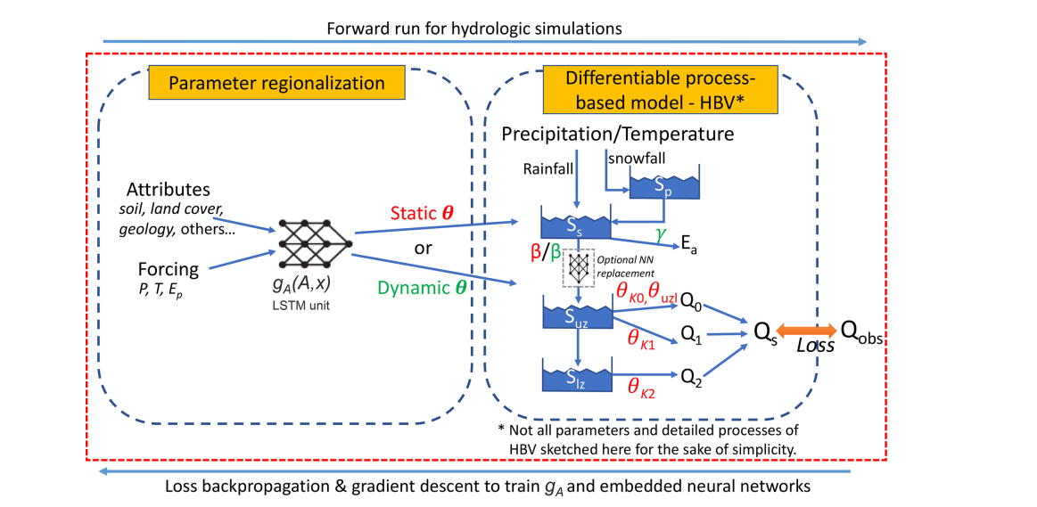
Introduction | Into an LSTM | Applications
Hybrid Structures for Non-Stationary Applications
Addition of process-based model can constrain LSTM predictions in non-stationary conditions
Feng, D., Beck, H. E., Lawson, K., & Shen, C. (2023). The suitability of differentiable, physics-informed machine learninghydrologic models for ungauged regions and climate change impact assessment.

Slide 35
Introduction | Into an LSTM | Applications
Discussion Questions
Do you see value in LSTMs and/or interpretable ML/AI in your field?
What additional advances are needed for ML models to be suitable for modeling in complex adaptive Human-Earth systems? Uncertainty analysis? Non-stationary conditions?
Computational advances, algorithmic improvements, increased interpretability?

