Slide 1
FOREST FIRE PREVENTION
Gabriel Rajendran (1019121)

Slide 2
INTRODUCTION
Every year, million acres of forests are burnt down. These forest fires have an important impact on the destruction of vegetation, on atmospheric pollution, and directly on human lives. In many cases, the authorities do not have any fire pre warning system nor an alert system to send and receive the warning messages. Therefore, the alerts to the population and to the rescue forces often come too late.

Slide 3
TABLE OF CONTENTS
01
02
PAPER 1
PAPER 2
03
04
COMPARISON
CONCLUSION
Fire Detection using Image processing methods
Fire Detection using Temperature, humidity and smoke sensors
Comparison between the two papers
conclusion

Slide 4
01
FIRE DETECTION USING IMAGE PROCESSING

Slide 5
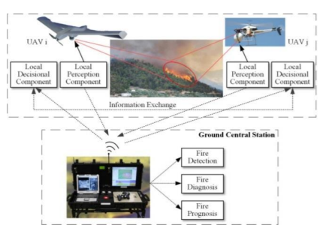
DESIGN

Slide 6
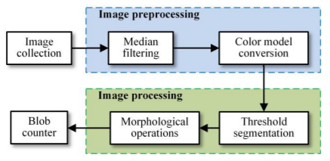
WORKING
Algorithm for Fire detection at Ground stations

Slide 7
WORKING
Median Filtering
Since impulse noises generated by sensor or communication errors usually corrupt images, noise reduction is essential for improving the results of subsequent processing such as image segmentation, morphological operations, and edge detection
median filter (a widely used nonlinear digital filtering technique) is adopted to eliminate noise in images due to its simplicity and capability of preserving image edges while removing noise

Slide 8
WORKING
Color Model Conversion
Color is one of the dominant features of fire and the color information is widely used as a pre-processing step in the detection of potential fire. The discriminative properties in color space are generally utilized to obtain the fire regions.
The color channels used in this paper are:
L -> Luminance
Chrominance ‘a’ -> Represents colors from red to green
Chrominance ‘b’ -> Represents colors from yellow to blue

Slide 9
WORKING
Threshold segmentation
Segmentation is an important step for fire detection. Its main objective is to differentiate fire pixels from background pixels. Thresholding is a frequently adopted technique to segment the fire regions in images, while Otsu method is one of the widely adopted thresholding approach for image segmentation.
Otsu method is a classic non-parametric and unsupervised adaptive threshold method. Whilst its principle is to automatically search out the appropriate image threshold. Otsu image segmentation method is employed in this paper to segment the fire from the captured images.

Slide 10
WORKING
Morphological Operations
Although noise reduction, color model conversion, and fire segmentation have been applied, there still exist some small irrelative objects, which may affect the ultimate fire confirmation. In this paper, the solution to this is to employ the mathematic morphological operations to remove the small objects which are not target objects in the thresholding images.
Mathematic morphological operations contain a series of operators such as dilation, erosion, opening, and closing, which is capable of effectively removing small irrelative objects in the thresholding images. This paper applies dilation after erosion, since erosion can get rid of pixels on the object boundaries while dilation can add pixels.

Slide 11
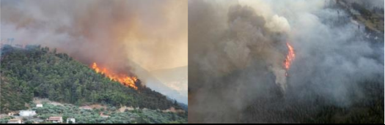
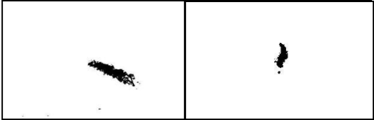

WORKING
ORIGINAL IMAGE
AFTER OTSU SEGMENTATION
AFTER MORPHOLOGICAL OPERATIONS

Slide 12
02
FIRE DETECTION USING TEMPERATURE, HUMIDITY & SMOKE SENSORS

Slide 13
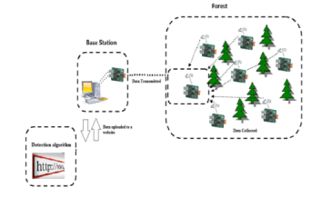
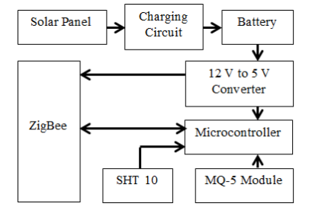
DESIGN
Transmission Unit
Block diagram

Slide 14
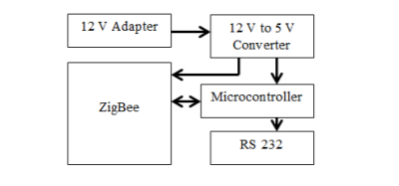
WORKING
Receiver Unit

Slide 15
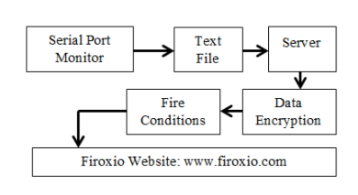
WORKING
Block diagram for software part
After the data has been collected and saved to a text file. Every one minute, it opens a tunnel between the computer that has the program running and the server to upload the file that includes the data collected “firoxio_data.txt”. Another program on the server opens the “firoxio_data.txt” that is located on the server, counts the last 14 Bytes and divides them to specific format to obtain
the temperature, relative humidity, the ID of the unit that has sent the data, and to discern if there is smoke or not. The format used is ttt.tthhh.hhxi, the first six Bytes “ttt.tt” represent the temperature that could vary from -40 degree Celsius to 123.8 degree Celsius. As for the second six Bytes “hhh.hh”, it represents the relative humidity that is calculated using a specific formula founded in the SHT10 digital temperature and humidity sensor datasheet.

Slide 16
COMPARISON
ATTRIBUTES | PAPER 1 | PAPER 2
COST | Low cost | High cost
SENSORS | Camera | Temperature, humidity & smoke sensor
SOFTWARE | Image processing in central station | Processing in website
LATENCY | Low latency | High latency

Slide 17
CONCLUSION
First paper proposes an approach for forest fire detection and tracking. Median filtering, color space conversion, Otsu
threshold segmentation, morphological operations, and blob
counter are applied to detect and track the potential fire in
sequence
The device could be upgraded to serve as a
weather sensor point by adding additional sensors that measure
CO2 concentration and wind direction; the data collected can
be also used to be analyzed to predict forest fires as well, rather
than only detect them.

Slide 18
THANK YOU!

