Slide 1
Review of Previous Day
Tweet me @Benstronaut

Slide 2
What is time series data?
Tweet me @Benstronaut

Slide 3
Time series data is…
A time series is a sequence of data points, typically consisting of successive measurements made from the same source over a time interval.
What this essentially means is that if you were to plot the points on a graph, one of your axes would always be time.

Slide 4
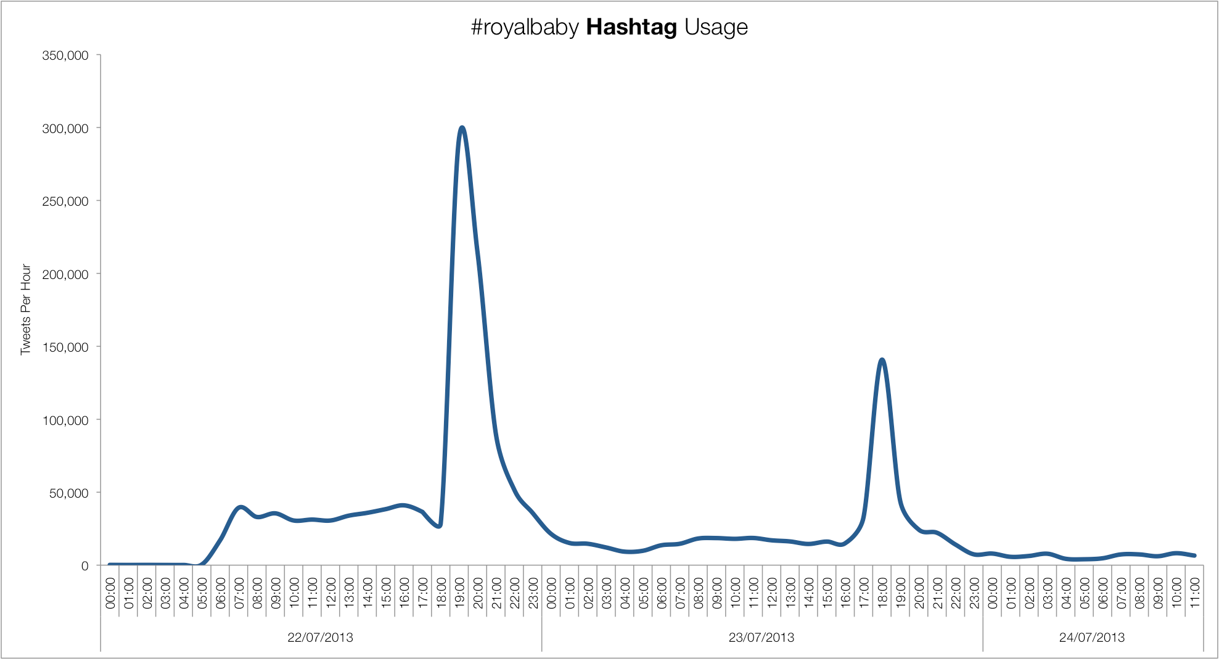
Time series data

Slide 5
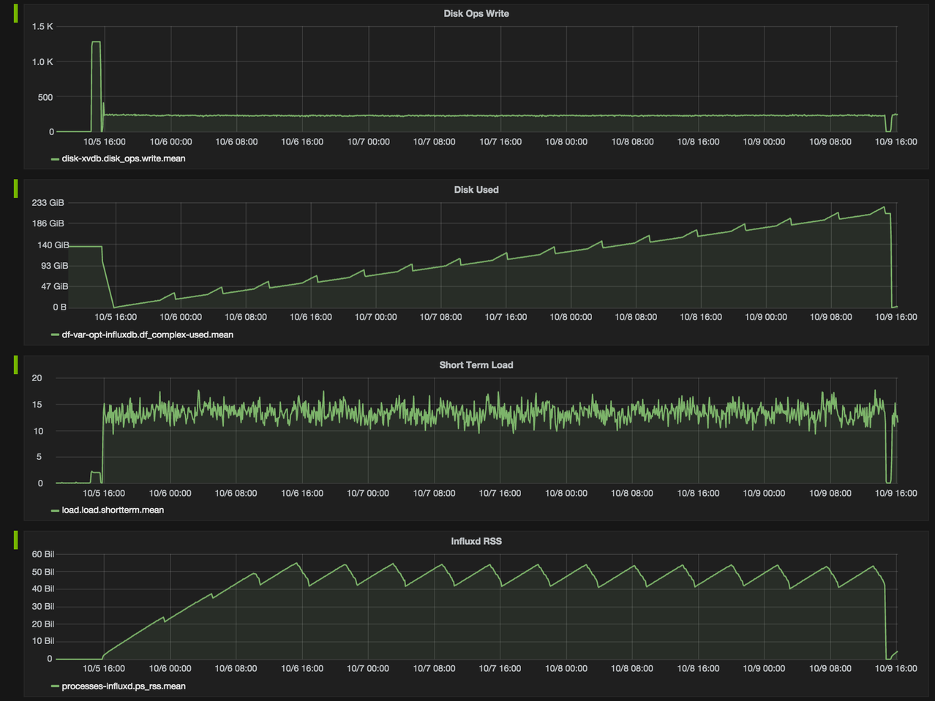
Time series data

Slide 6
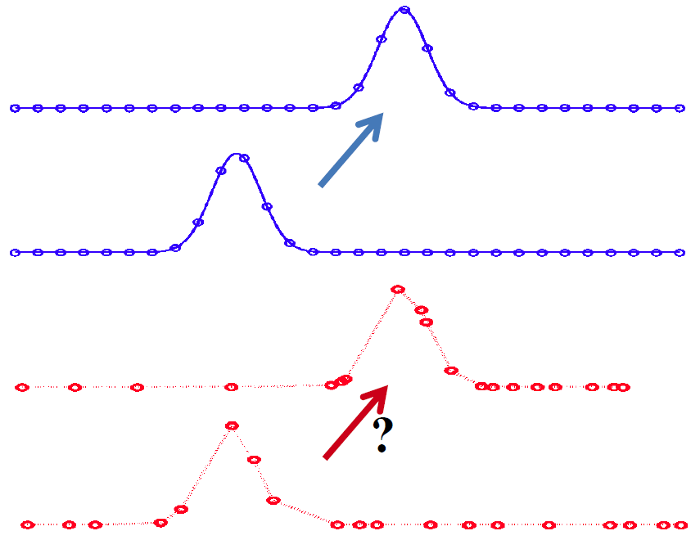
Regular vs Irregular Timeseries

Slide 7
The InfluxDB Data Model

Slide 8
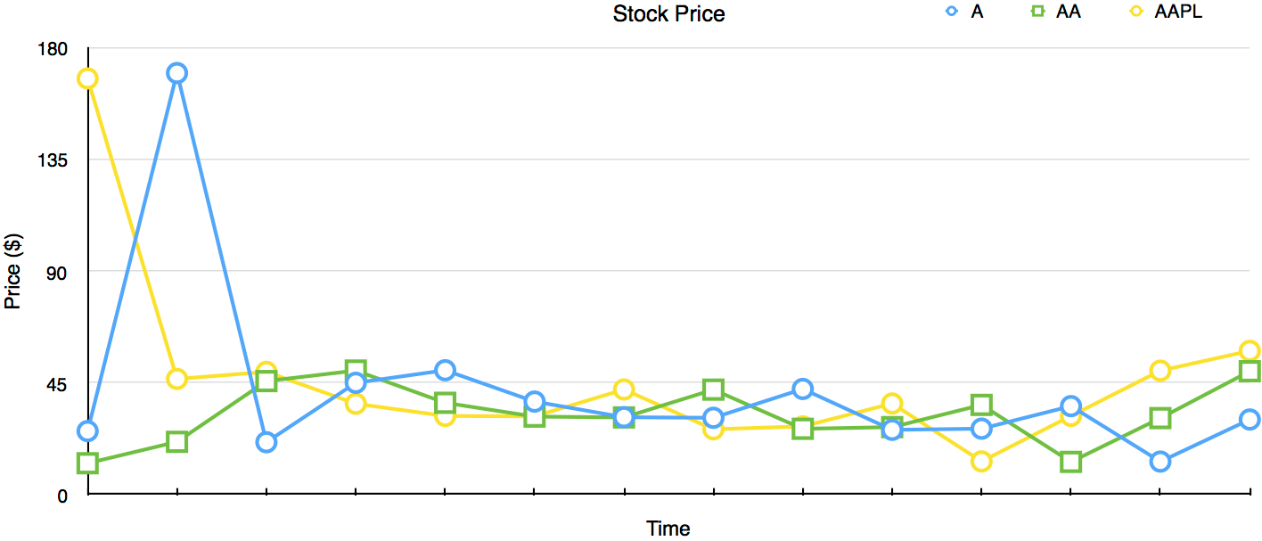
A typical time series graph
What components do we have?

Slide 9
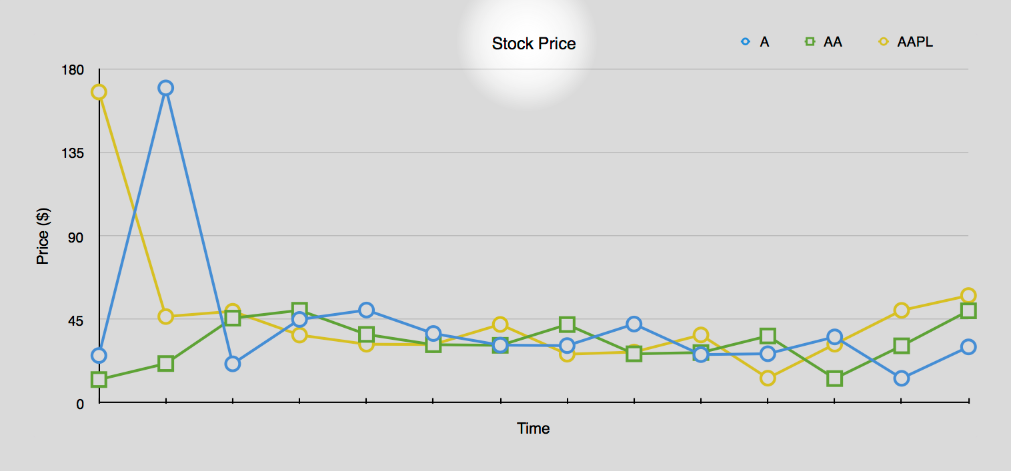
The Label
stock_price
We call this the measurement

Slide 10
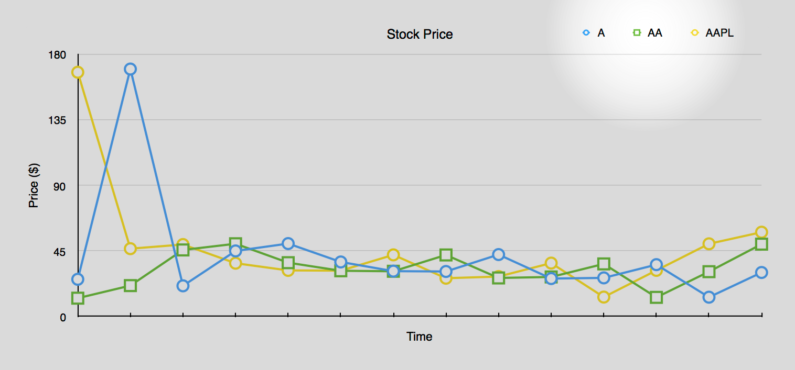
The Legend (metadata)
ticker=A
ticker=AA
ticker=AAPL
market=NASDAQ
market=NYSE
We call these tags.
Tags are indexed.

Slide 11
Collection of all tags
ticker=A,market=NASDAQ
ticker=AA,market=NYSE
ticker=AAPL,market=NASDAQ
We call this the tag set.

Slide 12
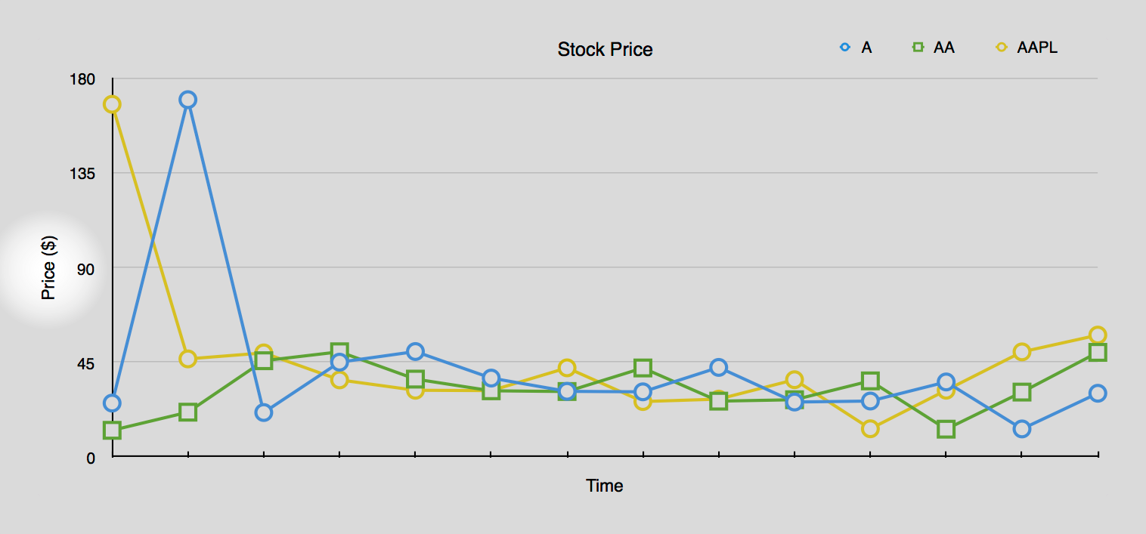
Y-Axis Values
price=177.03
price=32.10
price=35.52
We call these fields.
Note that the values that the field stores can be floats, ints, strings, or bools.

Slide 13
The Collection of Fields
price=177.03,volume=1200
price=32.10,volume=10000
price=35.52,volume=350
We call the field set.
Note that in this case, there's only one field.
(There could be many.)

Slide 14
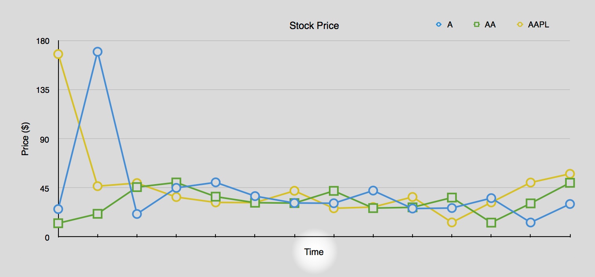
X-Axis Value
1445299200000000000
We call this the timestamp.

Slide 15
How do we represent points textually?
Tweet me @Benstronaut

Slide 16
The Line protocol
measurement,tag_set field_set timestamp
stock_price,ticker=A,market=NASDAQ price=177.03 144529920000

Slide 17
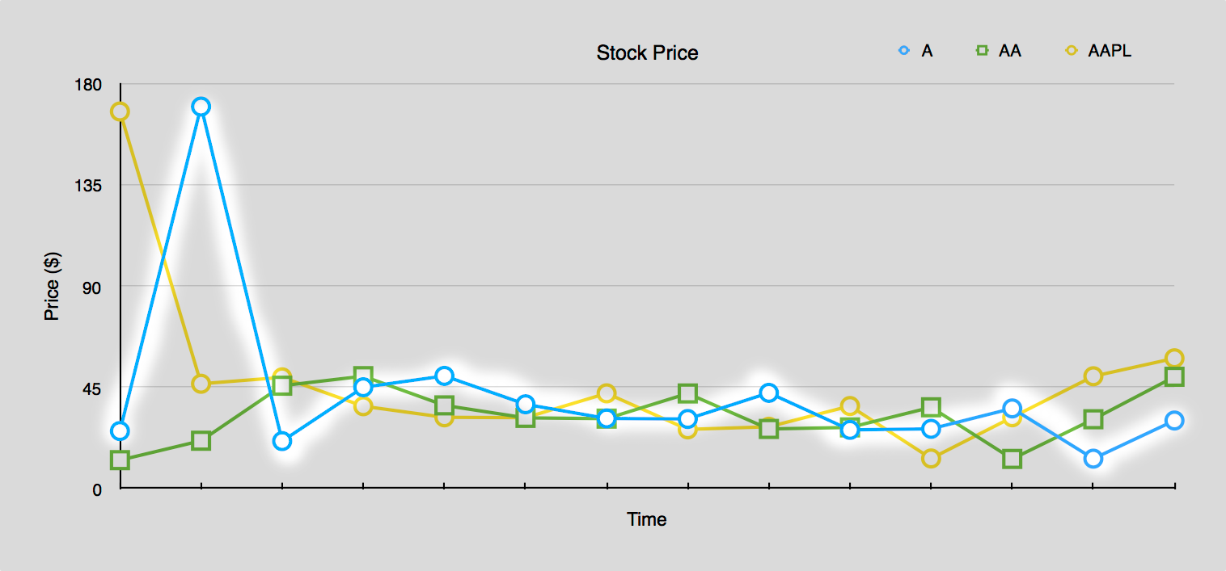
A Series in InfluxDB
measurement + tag_set + timestamp = single point
measurement + tag_set = the series as a whole

Slide 18
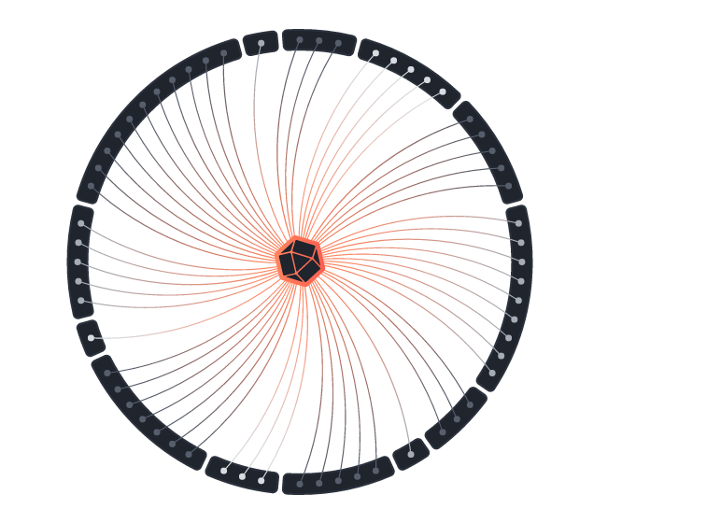
InfluxQL

Slide 19
Meta Queries
…tell you about the underlying structure of the data.
SHOW DATABASES
SHOW SERIES
SHOW MEASUREMENTS
SHOW TAG KEYS
SHOW FIELD KEYS

Slide 20
Queries
…operate on the data
SELECT * FROM …
SELECT MEAN(value) FROM …
SELECT … GROUP BY time(10m)
DELETE FROM …

Slide 21
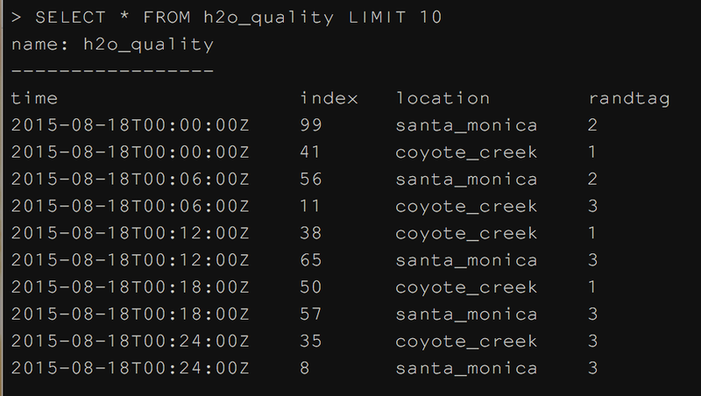
Basic Select Statement
SELECT <field> FROM <measurement>
SELECT * FROM cpu
SELECT free FROM mem
SELECT x + y FROM vars
SELECT x,y FROM nums
Try Running:
SELECT * FROM h2o_quality LIMIT 10

Slide 22
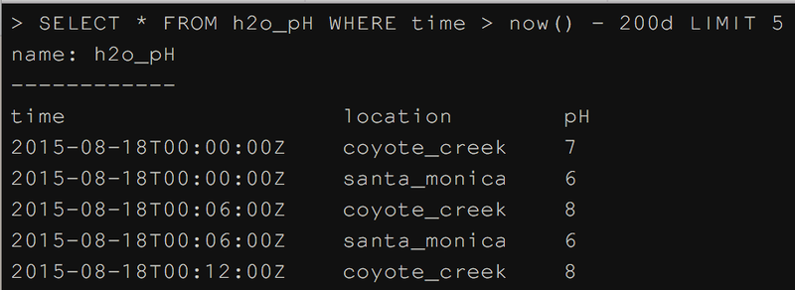
Select Statement with Relative Time
SELECT <field> FROM <measurement> WHERE <time condition>
SELECT * FROM cpu WHERE time > now() - 1h
SELECT * FROM cpu WHERE time > now() - 10s
SELECT free FROM mem WHERE time > now() - 4d
SELECT x + y FROM vars WHERE time > now() - 10w
SELECT x,y FROM nums WHERE time > now() + 15m
Using now() implies relative time
Try Running:
SELECT * FROM h2o_pH WHERE time > now() - 400d LIMIT 5

Slide 23
Select Statement with Absolute Time
SELECT <field> FROM <measurement> WHERE <time condition>
SELECT * FROM cpu WHERE time > '2015-08-18 23:00:01.232000000'
SELECT free FROM mem WHERE time < '2015-09-19'
SELECT x + y FROM vars WHERE time > '2015-08-18T23:00:01.232000000Z'
SELECT x,y FROM nums WHERE time > 1388534400s
Absolute time can be specified in two ways
Date Time: YYYY-MM-DD HH:MM:SS.nnnnnnnnn (RFC 3339)
Epoch: number of nanoseconds since January 1, 1970
Try Running:
SELECT * FROM h2o_pH WHERE time > '2015-08-18 23:00:01.232000000' LIMIT 10

Slide 24
Functions
…in InfluxDB fall into 3 major types…
Aggregators
Selectors
Transformers

Slide 25
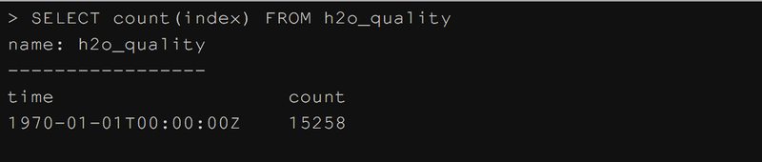
Using an Aggregator
SELECT <aggregator>(<field>) FROM <measurement> [extra stuff]
SELECT count(value) FROM cpu
SELECT mean(free) FROM mem WHERE time > now() - 1h
SELECT sum(x) FROM vars WHERE x > 100
SELECT median(y) FROM nums WHERE domain = 'Z'
Try Running:
SELECT count(index) FROM h2o_quality
SELECT count(index) FROM h2o_quality WHERE location = 'coyote_creek'

Slide 26
Select Statement with GROUP BY time
[SELECT STATEMENT] WHERE <time condition> GROUP BY time(<period>)
SELECT max(busy) FROM cpu WHERE time > now() - 1h GROUP BY time(10m)
SELECT mean(free) FROM free WHERE time > now() - 1d GROUP BY time(1h), host
Note that the following queries are not valid:
SELECT busy FROM cpu WHERE time > now() - 1h GROUP BY time(10m)
SELECT mean(busy) FROM cpu GROUP BY time(10m)
SELECT mean(busy) FROM cpu GROUP BY time(10m) WHERE time > now() - 1h
Try Running:
SELECT mean(degrees) FROM average_temperature WHERE time < '2015-09-19' AND time > '2015-09-18' GROUP BY time(1h)
SELECT mean(degrees) FROM average_temperature WHERE time < '2015-09-19' AND time > '2015-09-18' GROUP BY time(1h), *

Slide 27
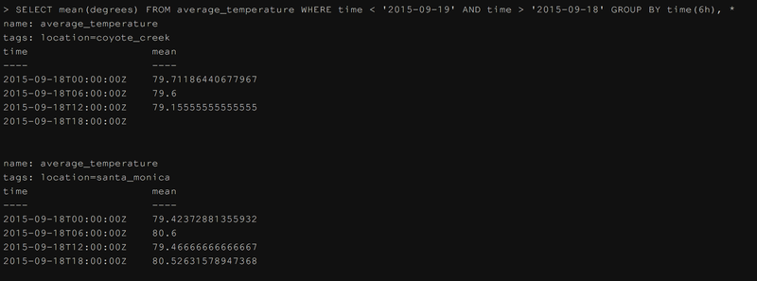
Select Statement with GROUP BY time
[SELECT STATEMENT] WHERE <time condition> GROUP BY time(<period>)
Try Running:
SELECT mean(degrees) FROM average_temperature WHERE time < '2015-09-19' AND time > '2015-09-18' GROUP BY time(6h), *

Slide 28
Selectors
bottom()
first()
last()
max()
min()
percentile()
top()

Slide 29
Using a Selector
SELECT <selector>(<field>)[,<tags>] FROM <measurement> [extra stuff]
SELECT percentile(busy,90) FROM cpu WHERE time > now() - 1h
SELECT bottom(water_level,10) FROM factory WHERE location = 'SF'
SELECT max(x) FROM vars
SELECT last(y) FROM nums WHERE domain = 'Z'
Try Running:
SELECT max(degrees) FROM average_temperature GROUP BY *
SELECT top(degrees, 10) FROM average_temperature GROUP BY *

Slide 30
Transformers
derivative()
difference()
elapsed()
moving_average()
non_negative_derivative()

Slide 31
Using a Transformer
SELECT <transformer>(<field>) FROM <measurement> [extra stuff]
SELECT derivative(mean(write_ops)) FROM disk WHERE time > now() - 10m GROUP BY time(10s)
SELECT non_negative_derivative(x) FROM vars

Slide 32
Schema Design

Slide 33
HERE'S SOME GENERAL THINGS TO KEEP IN MIND
ASK
What kind of queries do I want to run?
Do I want to look things up by a particular value?
Do I lose information by storing a value as a string?
GUIDELINES
Anything in a GROUP BY clause must be a tag.
Anything that you want to pass into a function must be a field.
Few measurements with many tags is better than many measurements with few tags.
If you lose information by storing as a string, use a field.

Slide 34
Continuous queries
Continuous queries are queries that will periodically run on data in InfluxDB.
They're somewhat similar to running queries with cron.
They're used to "downsample" data or pre-calculate common queries.

Slide 35
FORMAT OF A CONTINUOUS QUERY
CREATE CONTINUOUS QUERY [name_of_continuous_query]
ON [name_of_db]
[RESAMPLE [EVERY interval] [FOR interval]]
BEGIN
SELECT [inner_part_of_select]
INTO [new_measurement]
FROM [measurement]
GROUP BY time([frequency]), [tags]
END
The EVERY clause specifies how frequently the CQ will run.
The FOR clause specifies how far back the CQ resamples.

Slide 36
RETENTION POLICIES
A retention policy describes how long the data should be stored in the database. (DURATION)
A retention policy belongs to a database.

Slide 37
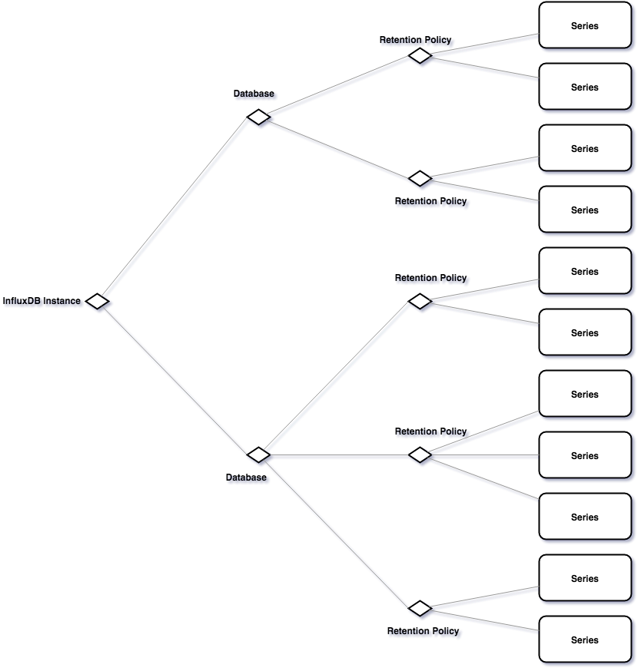
A Complete Picture
CQ
CQ
CQ

Slide 38
Creating a Retention Policy
CREATE RETENTION POLICY [name_of_policy]
ON [name_of_database]
DURATION [time_duration]
REPLICATION [number] [DEFAULT]

