Slide 1
Introduction to Telegraf
Tweet me @Benstronaut

Slide 2
By the end of this section, participants will be able to…
Explain what Telegraf is and when to use it
Install and Configure Telegraf
Create Dashboards using Telegraf and Grafana data

Slide 3
Telegraf

Slide 4
Telegraf…
Agent written in go for collecting metrics
Metrics can be local to the instance where Telegraf is running or external.
Minimal memory footprint
Works trivially as a data normalization layer for InfluxDB
Supports ~20 different output types

Slide 5
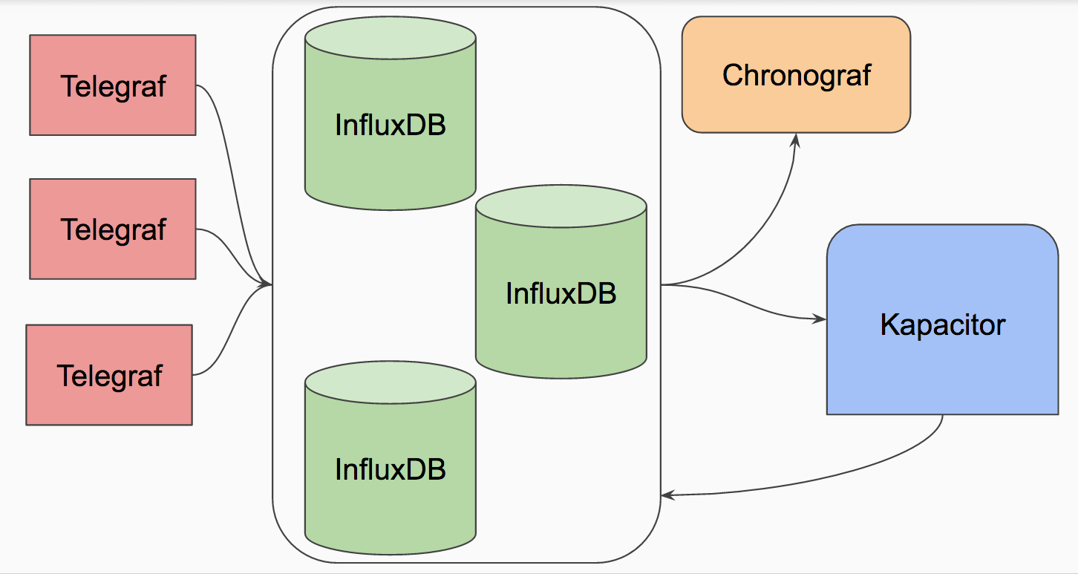
How Telegraf Fits Into Things

Slide 6
Why build yet-another-metrics-collector?
Ease of use
Creating new Plugins
Configuration and Setup
Works seamlessly with InfluxData products
Sets example of ideal schema design for InfluxDB
Provides a data normalization layer for InfluxDB
Support for regular and irregular time series

Slide 7
Telegraf Plugins
Output Plugins
Services that Telegraf can write data to
Input Plugins
Services that Telegraf can collect data from
Service Plugins
Service that can push data to Telegraf
For a full list see:
https://docs.influxdata.com/telegraf/v0.13/

Slide 8
Output Plugins
InfluxDB
AWS Kinesis
AWS Cloudwatch
Datadog
Graphite
Kafka
MQTT
OpenTSDB
Prometheus
Riemann
… and more

Slide 9
Input Plugins
AWS Cloudwatch
Apache
DNS Query Time
Docker
Elasticsearch
Exec
Influxdb
Mongodb
MySQL
Nginx
Ping
PostgreSQL
RabbitMQ
Redis
SNMP
ZFS
Zookeeper
win_perf_counters
System
… many more

Slide 10
Service Plugins
Statsd
Tail
UDP Listener
TCP Listener
MQTT Consumer
Kafka Consumer
NATS consumer
Webhooks
Github
Rollbar
NSQ Consumer

Slide 11
Installing Telegraf
OSX
$ brew update
$ brew install telegraf
Debian/Ubuntu
$ wget https://dl.influxdata.com/telegraf/releases/telegraf_0.13.1_amd64.deb
$ sudo dpkg -i telegraf_0.13.1_amd64.deb
RedHat/CentOS
$ wget https://dl.influxdata.com/telegraf/releases/telegraf-0.13.1.x86_64.rpm
$ sudo yum localinstall telegraf-0.13.1.x86_64.rpm

Slide 12
The Telegraf Command
$ telegraf -help
Telegraf, The plugin-driven server agent for collecting and reporting metrics.
Usage:
telegraf <flags>
The flags are:
-config <file> configuration file to load
-test gather metrics once, print them to stdout, and exit
-sample-config print out full sample configuration to stdout
-config-directory directory containing additional *.conf files
-input-filter filter the input plugins to enable, separator is :
-output-filter filter the output plugins to enable, separator is :
-usage print usage for a plugin, ie, 'telegraf -usage mysql'
-debug print metrics as they're generated to stdout
-quiet run in quiet mode
-version print the version to stdout

Slide 13
Generating a Telegraf Config
Generating the full config
$ telegraf -sample-config > telegraf.conf
Generating config for specific plugins
$ telegraf -sample-config \
-input-filter cpu:mem:net:swap \
-output-filter influxdb:kafka > telegraf.conf

Slide 14
Telegraf Config: Agent
[agent]
## Default data collection interval for all inputs
interval = "10s"
...
## Telegraf will send metrics to outputs in batches of at
## most metric_batch_size metrics.
metric_batch_size = 1000
...
## By default, precision will be set to the same timestamp order as the
## collection interval, with the maximum being 1s.
precision = ""
...
## Override default hostname, if empty use os.Hostname()
hostname = ""
## If set to true, do no set the "host" tag in the telegraf agent.
omit_hostname = false

Slide 15
Telegraf Config: InfluxDB Output
[[outputs.influxdb]]
# urls = ["udp://localhost:8089"] # UDP endpoint example
urls = ["http://localhost:8086"] # required
## The target database for metrics (telegraf will create it if not exists).
database = "telegraf" # required
## Retention policy to write to. Empty string writes to the default rp.
retention_policy = ""
...
## Write timeout (for the InfluxDB client), formatted as a string.
timeout = "5s"
...

Slide 16
Running Telegraf
Note: The default configuration assumes there is an InfluxDB instance running on localhost
$ influxd $ sudo service influxdb start
In foreground
$ telegraf -config telegraf.conf
As a Service
$ sudo service telegraf start

Slide 17
Looking at Telegraf Data

Slide 18
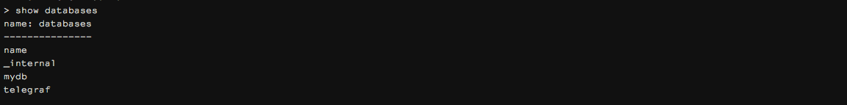
Verifying the Telegraf DB was created
$ influx
SHOW DATABASES

Slide 19

Using the Telegraf DB
USE telegraf

Slide 20
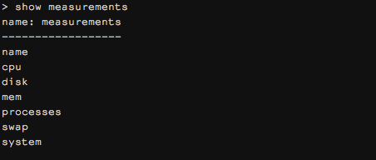
See what Data was written
SHOW MEASUREMENTS

Slide 21
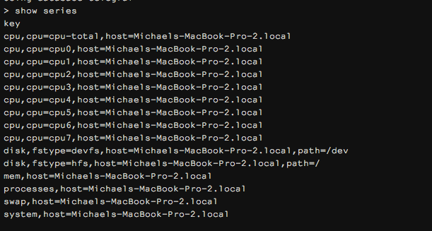
See what Data was written
SHOW SERIES
SHOW MEASUREMENTS

Slide 22
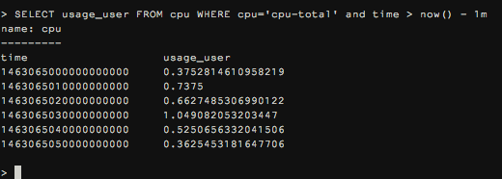
Select the Data
SELECT * FROM cpu WHERE cpu='cpu-total' and time > now() - 1m

Slide 23
Grafana

Slide 24
Grafana…
Canonical Graphing Solution
Maintained by RainTank
Support for many different databases
Makes great dashboards

Slide 25
Installing Grafana
OSX
$ brew update
$ brew install grafana/grafana/grafana
Debian/Ubuntu
$ wget https://grafanarel.s3.amazonaws.com/builds/grafana_3.1.0-1468321182_amd64.deb
$ sudo apt-get install -y adduser libfontconfig
$ sudo dpkg -i grafana_3.1.0-1468321182_amd64.deb
RedHat/CentOS
$ sudo yum install https://grafanarel.s3.amazonaws.com/builds/grafana-3.1.0-1468321182.x86_64.rpm

Slide 26
Starting Grafana
OSX
$ grafana start
Linux
$ sudo service grafana-server start

Slide 27
Work inside browser…

