Slide 1
Introduction to Kapacitor
Tweet me @Benstronaut

Slide 2
By the end of this section, participants will be able to…
Describe what Kapacitor is and when to use it.
Install and Configure Kapacitor
Explain the Kapacitor computational model
Understand the TICKscript syntax
Process data with Kapacitor
Alert on data with Kapacitor

Slide 3
Kapacitor
Using Kapacitor

Slide 4
Kapacitor Features
Kapacitor Features
Time series Data processing utility
Process data in streams or batches
Trigger alerts based on dynamic criteria
Transform data via InfluxQL functions
Subscribe to data in InfluxDB
Store data back in InfluxDB

Slide 5
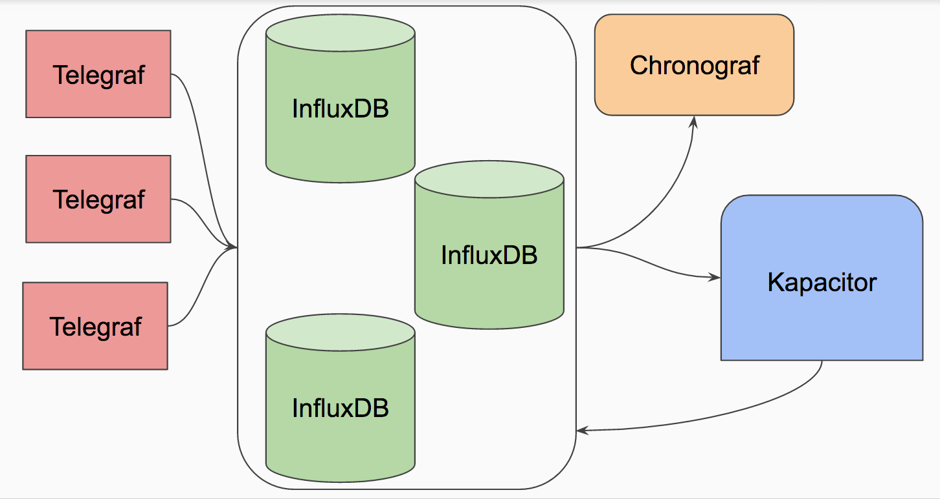
Kapacitor Features
How Kapacitor Fits Into Things

Slide 6
Installing Telegraf
Installing Kapacitor
OSX
$ brew update
$ brew install kapacitor
Debian/Ubuntu
$ wget https://dl.influxdata.com/kapacitor/releases/kapacitor_0.13.1_amd64.deb
$ sudo dpkg -i kapacitor_0.13.1_amd64.deb
RedHat/CentOS
$ wget https://dl.influxdata.com/kapacitor/releases/kapacitor-0.13.1.x86_64.rpm
$ sudo yum localinstall kapacitor-0.13.1.x86_64.rpm

Slide 7
Kapacitor Binaries
Server Daemon (kapacitord)
Config for inputs/outputs/services/etc
CLI (kapacitor)
Calls the HTTP API of server
Not interactive

Slide 8
k
Running Kapacitor
$ kapacitord config > kapacitor.conf
$ kapacitord -config kapacitor.conf

Slide 9
Kapacitor Abstractions
Tasks - units of work
Defined by a TICKscript
Stream or Batch
DAG - pipeline
Recordings - saved data
Useful for isolated testing

Slide 10
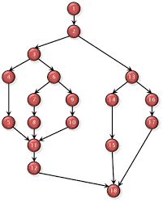
Computational Model
Computation Model - DAG
Directed Acyclic Graph
Streams
Batches

Slide 11
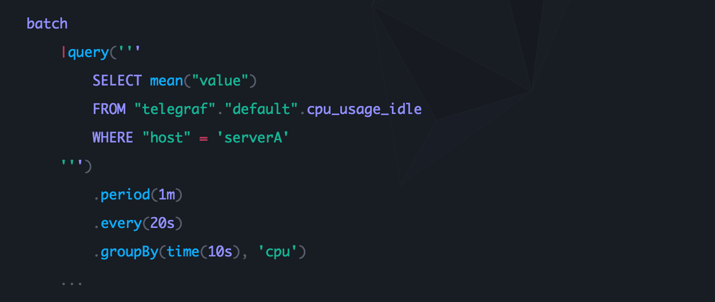
Batching

Slide 12
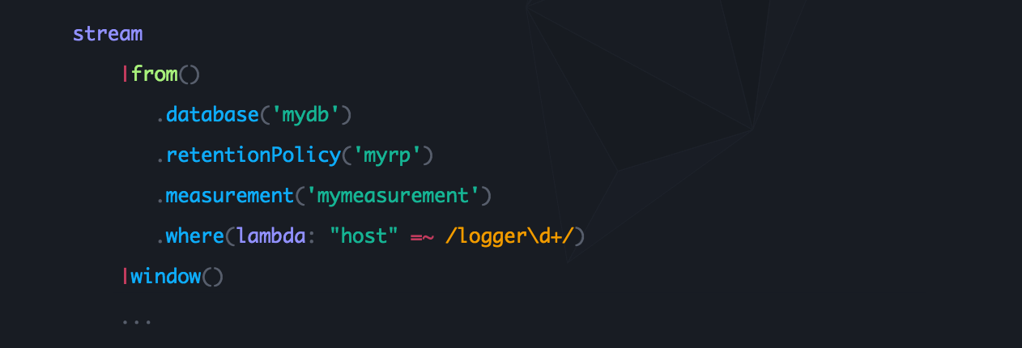
Streaming

Slide 13
TICKSCRIPT
TICKscript - Kapacitor DSL
The TICKscript language is an invocation chaining language. Each script has a flat scope and each variable in the scope defines methods that can be called on it. These methods come in two flavors:
Property methods – Modifies the node they are called on and returns a reference to the same node.
Chaining methods – Creates a new node as a child of the node they are called on and returns a reference to the new node.
Essentially TICKscript is a DSL that is used to define Directed Acyclic Graphs (DAGs) that are used for Processing Data. These DAGs are used to define what are called Pipelines.

Slide 14
TICKSCRIPT
TICKscript - Chaining methods
Chaining methods - Creates a new node as a child of the node they are called on and returns a reference to the new node.
In the example above, query is the only chaining method.

Slide 15
TICKSCRIPT
TICKscript - Property Methods
Property methods – Modifies å node they are called on and returns a reference to the same node.
In the example above, period, every and groupBy are all property methods that modify the query chaining method

Slide 16
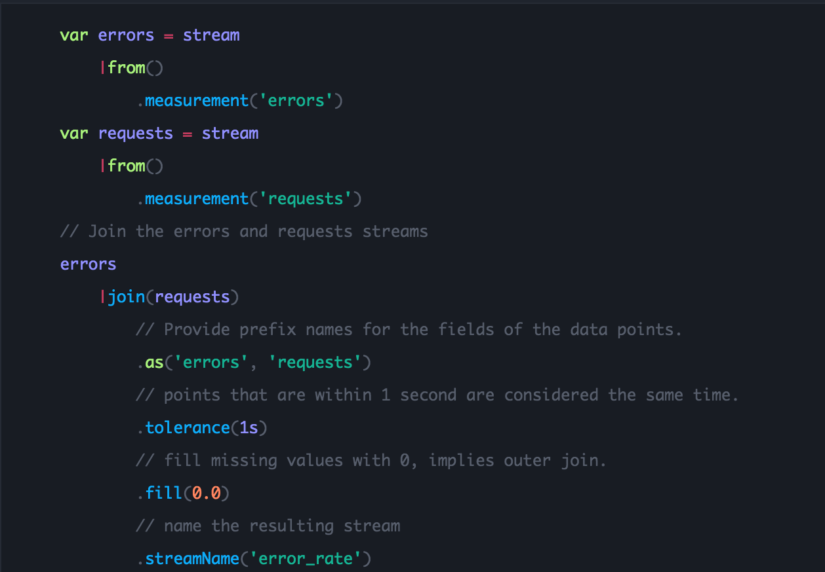
TICKscript Syntax
Literals
Booleans: TRUE, FALSE
Numbers: 5 int64, 5.0 float64
Strings
Durations: 10ms, 30s, 5m, 6h
Statements
Variable
Comments

Slide 17
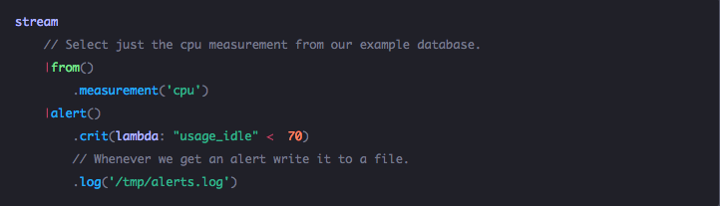
TICKscript - Quoting Rules
Single quotes are used to refer to the name of thing
Double quotes refer to the actual value of the thing

Slide 18
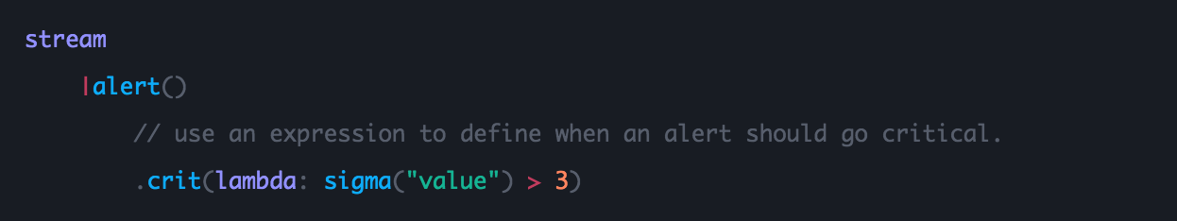
Lambda Expressions
TICKscript uses lambda expressions to define transformations on data points as well as define boolean conditions that act as filters.
WHERE Expressions
Builtin Functions

Slide 19
Node Types in TICKscript
Initial Nodes
Batch Node
Stream Node
Interior Nodes
Derivative Node - computes the derivative
Eval Node - evaluates lambda expressions
Group by Node - groups incoming data appropriately
Where Node
Window Node - windows incoming data
InfluxQL Node - performs various InfluxQL functions on incoming data
Join Node - performs a join on incoming data from two different data sources
Union Node
Sample Node - samples data at a particular rate
UDF Node - allows for custom data processing
Output Nodes
Alert Node - used for alerting
HTTP Output Node - caches data that can be retrieved
InfluxDB Output Node - writes the data to the InfluxDB instance as specified

Slide 20
Batch Node
Batch Node
A Batch Node is an initial node in a Kapacitor DAG.
Takes in an InfluxQL query and performs various operations on the whole batch of data returned by the query. It also provides utilities for describing the frequency and periodicity for the batch-query execution.

Slide 21
Exercise
Exercise
Write a simple TICKscript that works on batches of data generated by the query
SELECT mean(busy) FROM "telegraf"."autogen"."cpu"
With a period of 1 hour, an every of 1 hour, and a groupBy *

Slide 22
Solution
Solution
Write a simple TICKscript that works on batches of data generated by the query
SELECT mean(busy) FROM "telegraf"."autogen"."cpu"
With a period of 1 hour, an every of 1 hour, and a groupBy *
batch
|query('SELECT mean(busy) from "telegraf"."autogen"."cpu"')
.period(1h)
.every(1h)
.groupBy(*)

Slide 23
Stream Node
A stream node is an initial node in a Kapacitor DAG.
Takes in a stream of data from a particular measurement and performs various operations on it.

Slide 24
Exercise
Exercise
Write a simple TICKscript that streams data from the measurement 'cpu'.

Slide 25
Solution
Solution
Write a simple TICKscript that streams data from the measurement 'cpu'
stream
|from().measurement('cpu')

Slide 26
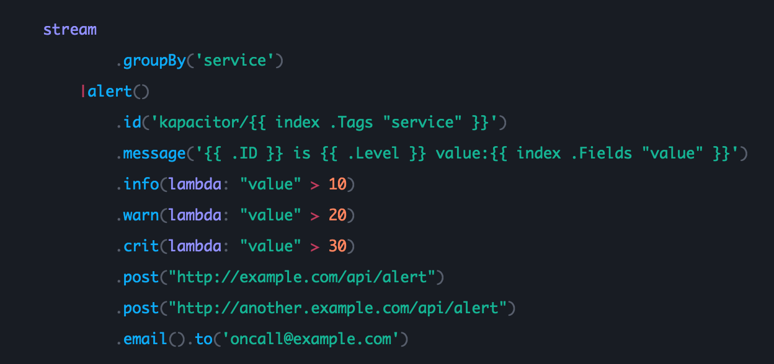
Alert Node
Alert Node
Alerts can be sent to many different services:
OpsGenie
PagerDuty
HTTP POST
Sensu
Slack
VictorOps
Alerta
Email
Exec
Hipchat

Slide 27
Exercise
Exercise
Write a simple TICKscript that streams data from the measurement 'mem' and issues a critical alert if the free is less than 500MB.

Slide 28
Solution
Solution
Write a simple TICKscript that streams data from the measurement 'mem' and issues a critical alert if the free is less than 500MB.
stream
|from().measurement('mem')
|alert()
.crit(lambda: "free" < 50000000)
.log('/tmp/alerts.log')

Slide 29
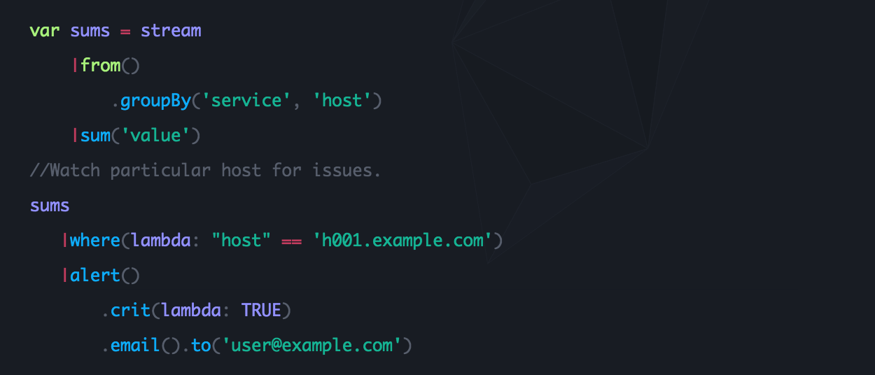
Where Node
Where Node
A Where node filters incoming data according to some lambda expression.

Slide 30
Exercise
Exercise
Write a simple TICKscript that streams data from the measurement 'mem' where host is localhost and issues a critical alert if the free is less than 500MB.

Slide 31
Solution
Solution
Write a simple TICKscript that streams data from the measurement 'mem' where host is localhost and issues a critical alert if the free is less than 500MB.
stream
|from().measurement('mem')
|where(lambda: "host" == 'localhost')
|alert()
.crit(lambda: "free" < 50000000)
.log('/tmp/alerts.log')

Slide 32
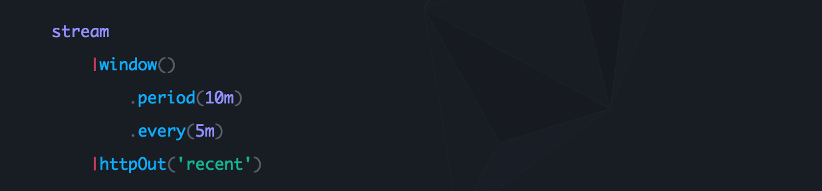
Window Node
A Window node bundles data together. A window's period specifies the amount of data that will be yielded to the pipeline. The window's every specifies the frequency at which the data will be yielded to the pipeline.

Slide 33
Exercise
Exercise
Write a simple TICKscript that creates a 10 minute window out of the stream data from the measurement 'cpu'. The window should emit to the pipeline every 5 minutes.

Slide 34
Solution
Solution
Write a simple TICKscript that creates a 10 minute window out of the stream data from the measurement 'cpu'. The window should emit to the pipeline every 5 minutes.
stream
|from().measurement('mem')
|window()
.period(10m)
.every(5m)

Slide 35
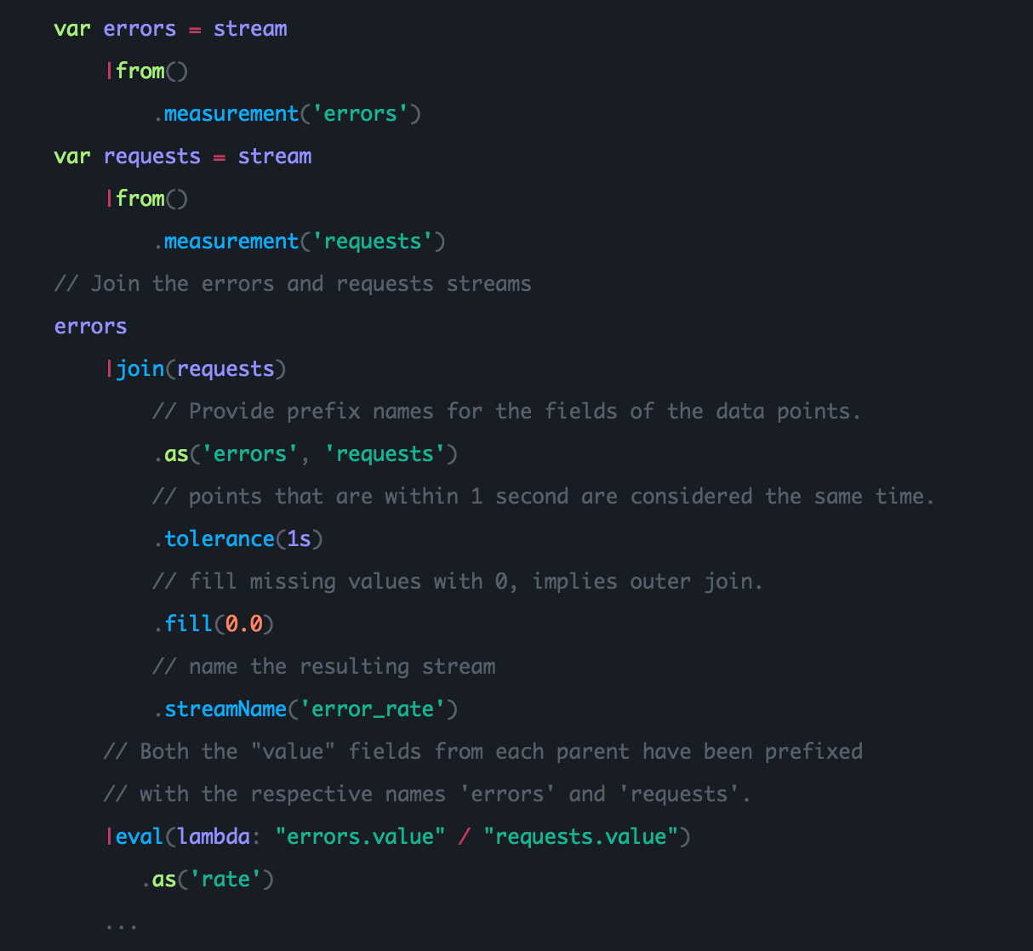
Join Node
Join Node

Slide 36
Using Kapacitor
Using Kapacitor

Slide 37
Defining a Task
Defining a Task
Create a TICKscript cpu_alert.tick
Define a task
cpu_alert.tick
stream
|from().measurement('cpu')
.where(lambda: "cpu" == 'cpu-total')
|alert()
.crit(lambda: "usage_idle" < 70)
.log('/tmp/alerts.log')
$ kapacitor define
-name cpu_alert
-type stream
-tick cpu_alert.tick
-dbrp telegraf.default

Slide 38
Defining a Task
Defining a Task
cpu_alert.tick
stream
|from().measurement('cpu')
.where(lambda: "cpu" == 'cpu-total')
|alert()
.crit(lambda: "usage_idle" < 70)
.log('/tmp/alerts.log')
$ kapacitor define
-name cpu_alert
-type stream
-tick cpu_alert.tick
-dbrp telegraf.default
$ kapacitor list tasks
Name Type Enabled Executing Databases and Retention Policies
cpu_alert stream false false ["telegraf"."default"]
Create a TICKscript cpu_alert.tick
Define a task
Chown the /tmp/alerts.log as kapacitor:kapcitor

Slide 39
Recording/Replaying a Stream
$ kapacitor record stream -name cpu_alert 20s
eee95c1e-3c36-4ded-9495-6456f08761a0
$ rid=eee95c1e-3c36-4ded-9495-6456f08761a0
$ kapacitor list recordings
$ kapacitor replay -id $rid -name cpu_alert -fast

Slide 40
Showing a Task
Showing a Task
$ kapacitor show cpu_alert
Name: cpu_alert
Error:
Type: stream
Enabled: false
Executing: false
Databases Retention Policies: ["telegraf"."default"]
TICKscript:
stream
|from().measurement('cpu')
.where(lambda: "cpu" == 'cpu-total')
|alert()
.crit(lambda: "usage_idle" < 70)
.log('/tmp/alerts.log')
DOT:
digraph cpu_alert {
srcstream0 -> stream1;
stream1 -> alert2;
}

Slide 41
Enabling a Task
Enabling a Task
$ kapacitor enable cpu_alert
$ kapacitor show cpu_alert
Name: cpu_alert
Error:
Type: stream
Enabled: true
Executing: true
Databases Retention Policies: ["telegraf"."default"]
TICKscript:
stream
|from().measurement('cpu')
.where(lambda: "cpu" == 'cpu-total')
|alert()
.crit(lambda: "usage_idle" < 70)
.log('/tmp/alerts.log')
DOT:
digraph cpu_alert {
srcstream0 -> stream1;
stream1 -> alert2;
}

Slide 42
Exercise
Exercise
Define a task off of the following TICKscript
stream
|from().measurement('mem')
|alert()
.crit(lambda: "free" < 50000000)
.log('/tmp/alerts.log')
Write a simple TICKscript that streams data from the measurement 'mem' and issues a critical alert if the free is less than 500MB.

Slide 43
Solution
Exercise
Define a task off of the following TICKscript
stream
|from().measurement('mem')
|alert()
.crit(lambda: "free" < 50000000)
.log('/tmp/alerts.log')
$ kapacitor define
-name mem_alert
-type stream
-tick mem_alert.tick
-dbrp telegraf.default
Write a simple TICKscript that streams data from the measurement 'mem' and issues a critical alert if the free is less than 500MB.

Slide 44
CQs -> TICKscripts

Slide 45
The CQ
Defining a Task
CREATE CONTINUOUS QUERY cpu_idle_median ON telegraf BEGIN
SELECT median("usage_idle") as usage_idle
INTO "telegraf"."sampled_5m"."median_cpu_idle"
FROM "telegraf"."default"."cpu"
GROUP BY time(5m),*
END

Slide 46
CQ -> TICKscript (batch)
Defining a Task
CREATE CONTINUOUS QUERY cpu_idle_median ON telegraf BEGIN
SELECT median("usage_idle") as usage_idle
INTO "telegraf"."sampled_5m"."median_cpu_idle"
FROM "telegraf"."default"."cpu"
GROUP BY time(5m),*
END
batch
|query('SELECT median(usage_idle) as usage_idle FROM "telegraf"."default"."cpu"')
.period(5m)
.every(5m)
.groupBy(*)
|influxDBOut()
.database('telegraf')
.retentionPolicy('sampled_5m')
.measurement('median_cpu_idle')
.precision('s')

Slide 47
CQ -> TICKscript (stream)
Defining a Task
stream
|from()
.database('telegraf')
.retentionPolicy('default')
.measurement('cpu')
.groupBy(*)
|window()
.period(5m)
.every(5m)
.align()
|median('usage_idle')
.as('usage_idle')
|influxDBOut()
.database('telegraf')
.retentionPolicy('sampled_5m')
.measurement('median_cpu_idle')
.precision('s')

Slide 48
TICKSCRIPT
Stream vs. Batch
Basically the answer boils down to two things, the available RAM and time period being used. A stream task will have to keep all data in RAM for the specified period. If this period is too long for the available RAM then you will first need to store the data in InfluxDB and then query using a batch task.
A stream task does have one slight advantage in that since its watching the stream of data it understands time by the timestamps on the data. As such there are no race conditions for whether a given point will make it into a window or not. If you are using a batch task it is still possible for a point to arrive late and be missed in a window.

