Slide 1
Kapacitor Motley
Tweet me @Benstronaut

Slide 2
By the end of this section, participants will be able to…
Explain what Morgoth is and it is used for
Describe the two types of work flows available for predictive analytics
Use the InfluxData implementation of Holt-Winters to do predictive analytics
Overview implementing predictive analytics UDFs with Kapacitor

Slide 3
Anomaly detection
Using Kapacitor

Slide 4
Morgoth
Morgoth is an anomaly detection framework to be used with Kapacitor.
Compares windows of data to a maintained dictionary, if the data isn't within the dictionary then it is considered anomalous.
Use of Morgoth requires that golang be installed.

Slide 5
Morgoth TICKscript
stream
|from()
.measurement('cpu')
.where(lambda: "cpu" == 'cpu-total')
.groupBy(*)
|window()
.period(1m)
.every(1m)
@morgoth()
// track the 'usage_idle' field
.field('usage_idle')
.errorTolernace(0.01)
// The window is anomalous if it occurs less the 5% of the time.
.minSupport(0.05)
// Use the sigma fingerprinter
.sigma(3.0)
// Multiple fingerprinters can be defined...

Slide 6
Morgoth Configuration
[udf]
[udf.functions]
[udf.functions.morgoth]
prog = "/path/to/bin/morgoth"
timeout = "10s"

Slide 7
Exercise
Exercise
Configure Kapacitor to work with Morgoth and create a Task out of the following TICKscript. I've included the Morgoth binary in this repository.
stream
|from()
.measurement('cpu')
.where(lambda: "cpu" == 'cpu-total')
.groupBy(*)
|window()
.period(1m)
.every(1m)
@morgoth()
// track the 'usage_idle' field
.field('usage_idle')
.errorTolernace(0.01)
// The window is anomalous if it occurs less the 5% of the time.
.minSupport(0.05)
// Use the sigma fingerprinter
.sigma(3.0)
// Multiple fingerprinters can be defined...

Slide 8
Predictive Analytics
Using Kapacitor

Slide 9
Holt-Winters
Holt-Winters Exponential smoothing is a rule of thumb technique for time series data. It is a common technique used for forecasting time series data.
Holt-Winters is implemented in both InfluxQL and Kapacitor.
If simply graphing the output, Holt-Winters can be ran from within InfluxQL.
If you'd like to alert on the data, one should use it from within Kapacitor.

Slide 10
Holt-Winters Example
// The interval on which to aggregate the disk usage
var growth_interval = 1d
// The number of `growth_interval`s to forecast into the future
var forecast_count = 7
// The amount of historical data to use for the fit
var history = 30d
// The critical threshold on used_percent
var threshold = 90.0
batch
|query('''
SELECT max(used_percent) as used_percent
FROM "telegraf"."default"."disk"
''')
.period(history)
.every(growth_interval)
.align()
.groupBy(time(growth_interval), *)
|holtWinters('used_percent', forecast_count, 0, growth_interval)
.as('used_percent')
|max('used_percent')
.as('used_percent')
|alert()
// Trigger alert if the forecasted disk usage is greater than threshold
.crit(lambda: "used_percent" > threshold)

Slide 11
Exercise
Create a task out of the following TICKscript. Graph the result in Grafana
var growth_interval = 1d
var forecast_count = 7
var history = 30d
var threshold = 90.0
var holt = batch
|query('''
SELECT max(used_percent) as used_percent
FROM "telegraf"."autogen"."disk"
''')
.period(history)
.every(growth_interval)
.align()
.groupBy(time(growth_interval), *)
|holtWinters('used_percent', forecast_count, 0, growth_interval)
.as('used_percent')
holt
|influxDBOut()
.database('telegraf')
.retentionPolicy('autogen')
.measurement('disk_holt_winters')
holt
|max('used_percent')
.as('used_percent')
|alert()
// Trigger alert if the forecasted disk usage is greater than threshold
.crit(lambda: "used_percent" > threshold)

Slide 12
Statistical Techniques for Timeseries.

Slide 13
Stationary vs. Non-Stationary
A series is considered to be stationary if it meets the following criteria:
The expected value of the series should be constant.
The variance of the series should not be a function of time.
The covariance of the ith and (i+m)th term should not be a function of time.

Slide 14
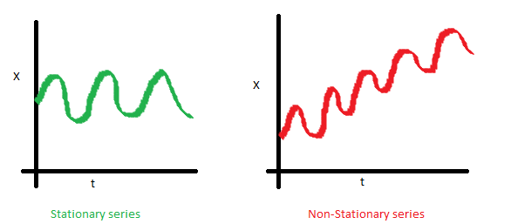
Stationary vs. Non-Stationary
The expected value of the series should be constant.

Slide 15
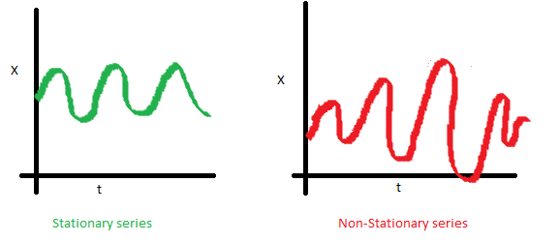
Stationary vs. Non-Stationary
The variance of the series should not be a function of time.

Slide 16
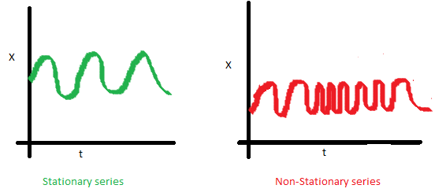
Stationary vs. Non-Stationary
The covariance of the ith and (i+m)th term should not be a function of time.

Slide 17
Stationarity
The stationarity of a series determines whether or not you'll be able to apply a particular technique.
Many popular time series forecasting methods require that the series be stationary.
If a series is non-stationary, the standard method is to turn the series into a stationary series and then apply standard methods.
For more information on time-series modeling see the following link:
http://www.analyticsvidhya.com/blog/2015/12/complete-tutorial-time-series-modeling/

Slide 18
ARIMA
The directory where these slides are contain a basic implementation of an ARIMA.
Due to time constraints, I could not get it working, but it still serves as an example of what needs to be done to create a fairly complex UDF.
I'll go over the implementation in a terminal, as well as how I developed it.

Slide 19
Ways to Create UDFs

Slide 20
Two types of predictive UDFS
UDFs that are trained outside of Kapacitor and then run against the incoming data stream.
UDFs that collect all of the data necessary and do all the modeling with the data they're given.

