Slide 1


Open.
Agile.
Cloud-Ready.

Slide 2
10 things every Operator should know about operating a platform
Pivotal Cloud Foundry

Slide 3
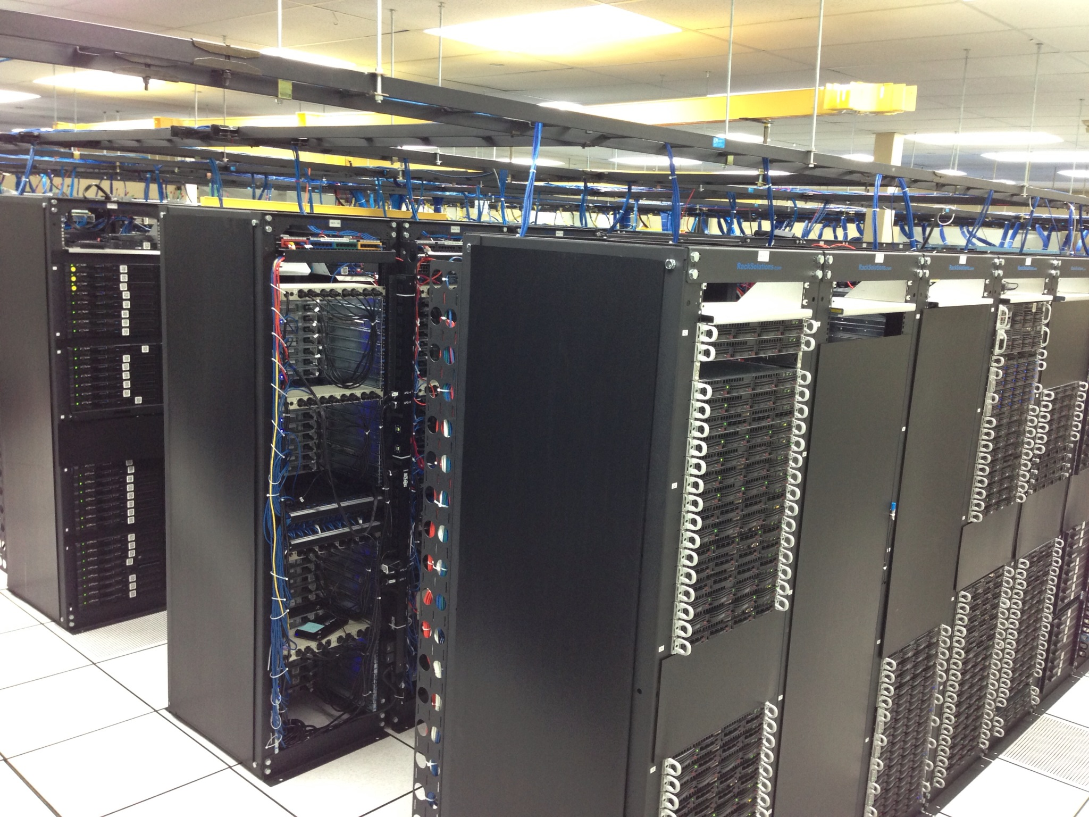

2nd Generation
3rd Generation
What’s the difference?

Slide 4
2nd Generation
3rd Generation
Managed under-utilized physical servers
Wasted floor space
Heavy process in ITIL
Run books for Disaster
Fully automated lifecycle
Dramatically increased utilization
Decreased wait times
Reduced dependency on process

Slide 5
1
Platforms change our mindset

Slide 6

Cloud Scale
Automation over Process
Services vs Types (Dev, Prod)
Mindset

Slide 7
2
Platform installs are different

Slide 8

Storage API
Compute API
Network API
clouds are code

Slide 9

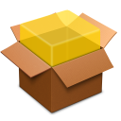
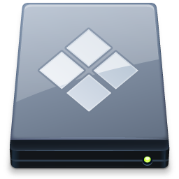
Bosh
clouds are automated

Slide 10
clouds build big things

Slide 11
but … not Cloud Foundry

Slide 12
BOSH
For any Cloud or IaaS provider API
To manage complete lifecycle of all resources
For any small or large scale deployment or release engineering

Slide 13
3
Platforms support many deployments

Slide 14
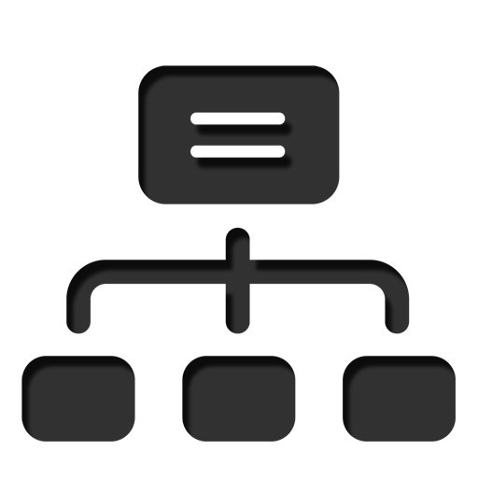
Clusters of compute of HA
Single or Multiple Networks
Shared storage
Basic

Slide 15
and then …

Slide 16
Multiple Networks for Apps
Availability zones for HA
Specialized deployments (DMZ)
Enterprise Driven Deployment

Slide 17
and then …

Slide 18
Multiple Clouds for Apps
Cloud bursting to meet demand
Single management
Business Driven Deployment

Slide 19
4
Logging, Metrics and Health Management are different in a platform

Slide 20
Distributed systems working together
Verbose and cloud scale logging
Easy integration or PCF Dashboards
Drained for collection & analysis
Logging

Slide 21

Measurement of performance and health (490+ metrics)
Platform Capacity
Everything is measured (Etsy)
Drained for collection & analysis
Metrics

Slide 22
How?

Slide 23

Logs and metrics delivered via firehose
Scaled to meet log and metric volume
Nozzle’s provide integration, CF nozzle
Support for multi-cloud
Firehose

Slide 24

Application Instances
Platform processes
Virtual Machines
Rack Aware Deployments (AZs)
Health Management

Slide 25

5
No Services, No from Devs

Slide 26

Fully automated lifecycle (API Driven)
User chooses lifetime and availability
Operator decides on plan and cost
Cloud Managed Services

Slide 27

Existing Enterprise infrastructure
External managed by existing tools
Exposed as an endpoint with URL and credentials by operations
Applications can bind to during deployment
User Managed Services

Slide 28
6
Size and Availability Matters

Slide 29

Capacity is determined by # of App Instances
Consolidation is determined by memory consumption
Memory can be set by users
Operators can use quotas to limit
Scaling for Capacity

Slide 30
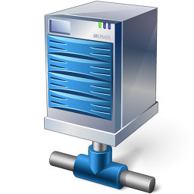
Multiple PCF components
Availability Zones
Multiple Clouds
Scaling for Availability

Slide 31
7
Platforms don’t have service windows

Slide 32

Pivotal network for packing, stemcells and CVEs
Fully automated with zero downtime
Buildpacks for application upgrades and patching
Upgrades

Slide 33
8
Its an App centric world in the platform

Slide 34
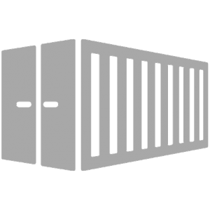
Applications maintain their independence
Platform matches application to a buildpack to operationalize it
JIT build of a container
Support for OCI containers
Buildpacks and Containers

Slide 35
9
CI/CD Pipelines are the secret sauce

Slide 36

Automates deliver of applications to platform
Removes snowflakes configurations
Increases software quality
Align developers, rel eng and operations
Pipelines

Slide 37
10
Platform is all about agility

Slide 38
Platform routing increase agility and reduces deployment risk
Side-by-side deployments
Blue/green and A/B testing
Policy and rate limiting
Dynamic Routes

Slide 39
Platform Demo

Slide 40
What am I going to see?
Pivotal Ops Manager
BOSH Tasks
Pivotal Ops Metrics and Datadog
cf login
cf push
Pivotal Cloud Foundry Upgrade

Slide 41
Open.
Agile.
Cloud-Ready.

Slide 42
Appendix
Additional Slides

Slide 43
Agenda
Prerequisites
Installation & Configuration
Ops Manager Introduction
Backup and Recovery
Patching & Upgrading
Logging & Monitoring
Basic Troubleshooting
Network Topology
Products & Services
Blue / Green Deployments
Application Scaling
Platform Scaling
Notes:
The goal of these slides is to introduce the day-to-day operations for Pivotal Cloud Foundry. It covers installation and configuration, backup / recovery, scaling, and upgrading the platform. It also covers PCF products and services, as well as how to achieve zero downtime deployments.

Slide 44
Installation Prerequisites
Determine cloud provider
On-premise
vSphere, vCloud Director, or OpenStack
Off-premise
Amazon AWS, Managed OpenStack, or vCloud Air
Determine Network Topology
Notes:
The first step in preparing for a PCF installation is to determine which location (on-premise or off-premise) and which cloud provider will be used. This will determine the Ops Manager flavor that you will download and deploy. Ops Manager includes the specific cloud provider interface and stemcells, and will provision Ops Manager Director, which contains the specific cloud provider configuration.
Ops Manager is provided in an VM template format for your cloud provider. For example, in vSphere, Ops Manager is provided as an OVA template; in AWS, Ops Manager is an AMI already created in AWS.

Slide 45
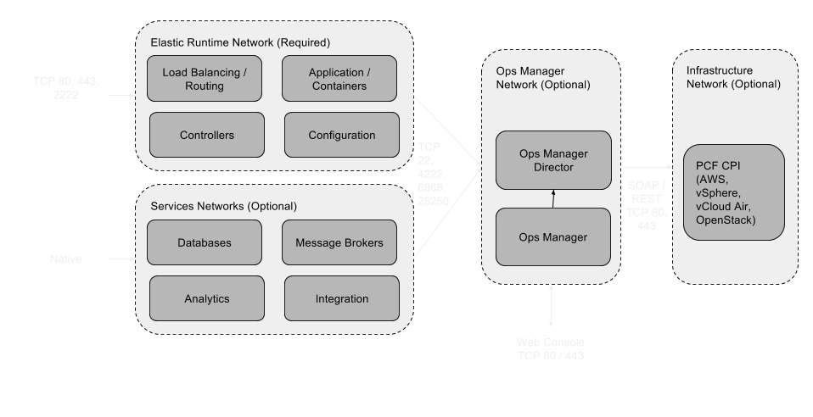
Network Topology
Detailed topologies for AWS & vSphere can be found here: https://drive.google.com/open?id=0B4KCenwl13JOcUJjUXdsVzNxZlkF
Notes:
This graphic depicts the basic network topology for a PCF installation. As can be seen, different components can be isolated to within different networks to provide security boundaries. Only specific ports need to be open for traffic between the components. This allows you to have isolated workloads and well known traffic ingress and egress.
Existing and new features of PCF will strengthen this model. Application security groups allow operators to define egress rules for applications in Elastic Runtime. Elastic clusters, a new feature being planned for PCF, will allow operators to isolate application workloads on different networks or even cloud providers.
Detailed topologies for AWS & vSphere can be found here:
https://drive.google.com/folderview?id=0B4KCenwl13JOcUJjUXdsVzNxZlk&usp=drive_web
Topics of Discussion - NSX capabilities. Dynamic Segmentation
CF is a deliberate process with known network resource consumption.
Network segmentation - Elastic Clusters - James Bayer “Isolation groups, Elastic clusters”

Slide 46
Installation Requirements
General Requirements
Cloud Provider | Requirements
vSphere | vSphere Requirements
vCloud Air | vCloud Air Requirements
OpenStack | OpenStack Requirements
AWS | AWS Requirements
Notes:
There are several general requirements that must be met for installing PCF. In addition to the general requirements, each cloud provider has a specific set of requirements that must be met prior to installation. These requirements include available capacity, firewall rules, load balancers, and network provisioning, as well as credentials with appropriate privileges assigned. Follow the links provided for General Requirements as well as the cloud provider specific requirements prior to installation.

Slide 47
Installation & Configuration
Create Ops Manager Instance (AMI, OVA)
Configure Ops Manager Director
Install Ops Manager Director
Upload Elastic Runtime Product
Configure Elastic Runtime
Install Elastic Runtime
Upload, Configure, & Install Other Products
Notes:
Note: The installation & configuration steps are meant to demonstrate the basic process, not to be a step-by-step list of installation steps. For actual installation procedures, refer to the steps here.
The basic process for installing and configuring PCF is as follows:
Create the Ops Manager VM from the appropriate VM template. This may be an OVA file downloaded from Pivotal Network, or an AMI on AWS.
Configure Ops Manager Director with specific cloud provider settings from the prerequisites.
Use Ops Manager to install Ops Manager Director.
Upload Elastic Runtime (.pivotal file) into Ops Manager.
Configure Elastic Runtime.
Use Ops Manager to install Elastic Runtime.
Repeat steps 4-6 for each PCF product you want installed (i.e. MySQL, RabbitMQ, or Push Notifications).

Slide 48
PCF Installation
Elastic Runtime
Ops Manager (OVA, AMI)
Ops Manager Director
MySQL
RabbitMQ
BOSH (Cloud Provider Interface)
Cloud Provider (vSphere, AWS, vCA)
Notes:
This graphic depicts the basic installation steps for Pivotal Cloud Foundry.
(Each transition in the slide relates to the following steps)
Assuming your cloud provider has been installed and configured correctly, the first step is to create an Ops Manager instance for your cloud provider. Ops Manager is delivered in a specific cloud provider format, such as an OVA file for vSphere or an AMI for AWS EC2. The Ops Manager installation contains the cloud provider interface (CPI), and is responsible for provisioning Ops Manager Director, as well as generating deployment manifests and managing product dependencies.
Once Ops Manager has been deployed, the Ops Manager Director instance is configured and deployed. Ops Manager Director contains configuration for your specific cloud provider, and is the orchestrator for deploying and managing the rest of the PCF products.
PCF products, such as Elastic Runtime, MySQL, and RabbitMQ, are then configured in Ops Manager, and deployed by Ops Manager Director through Cannery style deployment.

Slide 49
Ops Manager Installation
Cloud Provider | Installation Instructions
vSphere & vCloud Air | vSphere & vCloud Air Installation
OpenStack | OpenStack Installation
AWS | AWS Installation
Notes:
As we talked about before, the first step is to create an Ops Manager VM from the VM template for your particular cloud provider. Use these links to view the step-by-step documentation for installing Ops Manager on your cloud provider.

Slide 50
Ops Manager Configuration
Cloud Provider | Ops Manager Configuration
vSphere | vSphere Configuration
vCloud Air | vCloud Air Configuration
OpenStack | OpenStack Configuration
AWS | AWS Configuration
Notes:
Once Ops Manager has been installed via the appropriate VM template, a tile will appear in the Ops Manager UI for Ops Manager Director. Use these links to configure Ops Manager Director for your particular cloud provider.

Slide 51
Backup & Recovery
A comprehensive backup and recovery strategy will go a long way in the event of a catastrophic system failure. Having automated backup and recovery plans will greatly contribute to the stability of the Pivotal Cloud Foundry.
There are four major steps that need to be completed to ensure a sufficiently backed up installation.
Record DB Encryption Credentials
Export Installation Settings
Download BOSH Manifest
Backup Critical Datastores

Slide 52
Backup & Recovery
The encryption credentials that control access to the Cloud Controller database should be recorded, this will provide an entry point for Pivotal Support, should you need to contact them.
Exporting the installation settings will greatly speed up the recovery process and insure an exact replica of the PCF you backed up from. NOTE: This will not back up your VM’s or external systems.

Slide 53
Backup & Recovery
The BOSH deployment manifest needs to be downloaded and stored. Make sure you download the manifest for each BOSH deployment. These contain information about your BOSH databases, which will allow us to back up the critical datastores in the next step
Up to now, the backup steps have focused on the configuration aspect of the installation, it is equally important to backup the installation critical datastores. Various components of Pivotal Cloud Foundry rely on these datastores: Cloud Controller, UAA, and the Apps Manager to name a few. Use the manifest to access these datastores.
Full instructions for Backup can be found here: http://docs.pivotal.io/pivotalcf/customizing/backup-restore/backup-pcf.html

Slide 54
Backup & Recovery
Recovery
The recovery process is even more simple than the backup. You only need to do two things:
Import those settings from the second step in the backup process
Restore the critical data stores, using the BOSH deployment manifest, that were saved in the fourth step.
An optional third step would be to download new copies of the BOSH deployment manifest after you have completed step one here. These can be used to validate the import.
Full instructions for Recovery can be found here: http://docs.pivotal.io/pivotalcf/customizing/backup-restore/restore-pcf.html
Notes:
The main point is to think of the entire platform can be automated and scriptable. Meaning it is completely ephemeral from an operations perspective.

Slide 55
Patching & Upgrading Ops Manager
Verify Upgrade Path
Export Installation Settings
Shut Down Existing Ops Manager VM
Deploy Patched / Upgraded Ops Manager VM
Import Installation Settings
Full instructions can be found here: http://docs.pivotal.io/pivotalcf/customizing/upgrading-pcf.html
F
Notes:
Patching and upgrading Ops Manager is critical to maintain system updates and new features. Upgrading Ops Manager, unlike PCF products that use canary deployments, requires downtime for the existing Ops Manager instance. Elastic runtime and other PCF products will continue to operate normally, but Ops Manager functions like installing products or monitoring PCF VMs will be unavailable during upgrades.
To apply a patch or upgrade to Ops Manager, follow these steps:
Verify that you are able upgrade from your current version according to the release notes. Typically, only 1 version is supported for upgrades (i.e. 1.5 -> 1.6, not 1.4 -> 1.6), so you may have to perform incremental upgrades.
Export your installation settings in the Ops Manager UI.
Power off the existing Ops Manager VM in your cloud provider, and record it’s IP address.
Deploy the new Ops Manager VM template in your cloud provider, using the older version’s IP address.
Import your installation settings through the Ops Manager UI.
Full patching / upgrading instructions for Ops Manager can be found here:
http://docs.pivotal.io/pivotalcf/customizing/upgrading-pcf.html

Slide 56
Patching & Upgrading PCF Products
Verify Upgrade Path
Import Patched / Upgraded Product
Click “Upgrade”
Enable disabled errands if necessary
Click “Apply Changes”
Full instructions can be found here: http://docs.pivotal.io/pivotalcf/customizing/upgrading-products.html
F
Notes:
Patching and upgrading installed PCF products is very similar to installing new products. Upgrading PCF products use canary style deployments, which ensures that there is no downtime for the product while it is being upgraded.
Verify that the current version is supported to be upgraded according to the release notes, as well as any required dependencies.
Import the new version of the product in the Ops Manager UI.
Click the Upgrade button for your product.
Optionally, change any configuration settings needed for your product (i.e. enable errands that were disabled previously).
Click the Apply Changes button.

Slide 57
Logging & Monitoring
Monitoring VMs
Ops Manager UI (Product -> Status)
BOSH CLI (‘bosh vms’)
vCenter Client (vSphere)
vCenter Operations Manager (vCloud Air)
vCenter Hyperic (vCloud Air)
Notes:
There are a number of ways to monitor VM status and health for your PCF installation. For each PCF product installed, there is a tab labeled Status that will give information on all of the managed VMs, such as health, IP address, and capacity assigned. You can also get the same information from the BOSH command line interface, using the bosh vms command.
Most cloud providers also provide various tools to monitor and manage VMs provision by PCF. In a vSphere environment, you can use the vCenter client. In vCloud Air environments, you can use vCenter Operations Manager or vCenter Hyperic. In AWS environments, you can use AWS CloudWatch.

Slide 58
Logging & Monitoring
Viewing Platform Logs
Ops Manager UI (Product -> Status -> Logs and then Product -> Logs)
CloudFoundry CLI (‘cf logs <APPNAME> --recent’)
BOSH CLI (‘bosh logs’)
Notes:
There are 2 ways to get access to platform-generated logs, which can be useful to troubleshooting problems or working with the Pivotal support team.
Through the Ops Manager UI. Logs for each component in a product can be obtained using the following steps:
Go into the Product tile, Status tab, and click the Logs button for that component.
Go into the Product tile, Logs tab, and click the download link(s) the logs.
Through the BOSH CLI, using the bosh logs command. This typically requires that you have SSH access to the Ops Manager VM.
The platform logs are separate from application logs. Elastic Runtime components and application logs are collected by the Loggregator component and sent to an external syslog server.

Slide 59
Basic Troubleshooting
Ops Manager Debug Endpoint - http://<ops-manager>/debug
Files
Components
Rails Log
BOSH CLI
PCF Troubleshooting Guide: https://docs.pivotal.io/pivotalcf/customizing/troubleshooting.htmll
BOSH CLI Troubleshooting Guide: https://docs.pivotal.io/pivotalcf/customizing/trouble-advanced.html
Notes:
There are a couple of methods for troubleshooting PCF issues. Ops Manager exposes a debug endpoint, which can give you detailed information about product installations, platform configuration, and the Ops Manager web application itself. For more advanced troubleshooting, the BOSH CLI can be used to get information and perform checks on the platform.
Using the BOSH CLI usually requires SSH access to the Ops Manager VM.

Slide 60
Products & Services
Products
PCF products add capabilities to the platform
PCF products are provided as .pivotal files
Download products from Pivotal Network
Import into Ops Manager
Configure product
Install product
Customers can create their own products
Notes:
There is a strong distinction between PCF products and services. Products add capabilities to a PCF installation. Examples of PCF products include Elastic Runtime, data products, and mobile back-end products. Products may also be provided by 3rd parties, such as Jenkins, and customers can also create their own custom products.
As an example of why customers may want to create their own custom products, consider a content management system (CMS) that a custom uses as a content database for custom applications. The customer may want allow developers to create a ‘sandbox’ environment for new development that includes it’s own instance of the CMS. By creating a custom product for the CMS, a cloud operator can make the CMS available in the platform, and allow developers to create their own instances of the CMS for development.
Note that most PCF products ultimately expose themselves as services in Elastic Runtime, but this is not always the case.

Slide 61
Products & Services
Services
Services are systems external to applications that applications can use
Services may be managed by the platform or they may be external services
Applications use services through a Service Broker API
Notes:
Services are systems that custom applications need to function properly, or to be deployed properly. Services may be managed by PCF (in other words, a PCF product), or they may be an existing enterprise service integrated into the platform, like a mainframe or Oracle database. Services integrate with the platform by providing a Service Broker API that cloud operators install in the platform, regardless of where the actual service lives. The one exception are user-provided services, which we will discuss shortly.

Slide 62
Products & Services
3 Types of PCF Services:
User-provided - Existing service, and applications just need connection information
Service broker - Existing service, but applications need full lifecycle experience (catalog, create, bind, etc.)
PCF product - Service runtime is managed by PCF. Typically installs a service broker too
Notes:
There are 3 types of services in PCF, with increasing levels of platform benefits:
User-provided - A user-provided service is simply a list of connection parameters that are stored in the platform and provided to an application when it binds to the service. User-provided services are useful for quickly getting parameters to an application, without having to create a service broker and registering with it the platform. They are also helpful for services that will probably only be used once or twice. User-provided services are created using the CF CLI’s create-user-provided-service command, which takes an arbitrary set of key/value pairs as an argument.
Service broker - A service broker is a set of 5 REST endpoints that implement the lifecycle of developers interacting with a service. A service broker can run on PCF, or anywhere else, and it’s URL is registered with PCF. Most customers create service brokers for existing enterprise services that are managed externally but are used by many applications, like an Oracle database or a message broker. Most PCF products also create a service broker as part of the installation. Note that service brokers do not act as a proxy between an application and the service. All application and service communication is direct via the native protocol (JDBC, JMS, etc.). The 5 REST endpoints that are exposed are:
Catalog - The catalog method is intended to get information about the service, such as a description of the service and different plans available. The catalog method is what gets displayed in the Elastic Runtime marketplace.
Create - The create method should create resources in the service. Those resources may be a new database or schema in a database, a new queue in a message broker, or a folder structure in a filesystem service. The create method will typically create new credentials for the service instance as well.
Bind - The bind method is invoked when an application binds to a service, and is responsible for returning connection information such as a URL or credentials to PCF. PCF then injects that information into the application via an environment variable called VCAP_SERVICES. This is similar to binding to a user-provided service.
Unbind - Unbinding tells the service broker to clean up any resources created during binding. Typically it will disallow access to the service.
Delete - The delete method should clean up any resources created by the create method, such as deleting a database or schema that was created.
PCF product - A PCF product will typically install a service broker, so it provides the service broker functionality. A PCF product’s runtime is also provisioned and managed by PCF, so PCF can scale, monitor, and upgrade the product.

Slide 63
Products & Services
 | Late binding | User self-service | Platform managed
User-provided | ✔
Service broker | ✔ | ✔
PCF product | ✔ | ✔ | ✔
Notes:
This table depicts the operator and developer experience for each of the 3 types of services. All services, including user-provided, provide the ability for applications to do late binding to the service. In other words, from a developer’s perspective, when services are bound to an application, connection information is injected into the application in the form of a VCAP_SERVICES environment variable. Connection information is not contained within the application, but is managed and injected by the platform at deployment time, which ensures portability and automation of the application.
When a service broker is created and installed, it extends the developer’s experience by allowing the developer to discover service capabilities, create resources in the service, and clean up the resources when finished. This experience is provided in a self-service model, without the need to involve administrators or operators.
PCF products, in addition to the service broker interaction, also provide platform management benefits to the operator. With PCF products, operators get the additional benefits of PCF’s ease of deployment, upgrading, scaling, and health management for the service.

Slide 64
Blue / Green Deployments
Blue / green deployments are a way of deploying new app versions with no downtime.
Multiple versions are deployed, but the “live” route only points to a single version
PCF enables blue / green deployments by allowing multiple routes to be mapped to an application
Gorouter will enable more complex traffic shaping in future releases
Notes:
A blue/green deployment is a technique used to deploy new versions of applications without incurring any downtime. It relies on having multiple routes (or URLs) defined for an application version. A live or public route is mapped to a particular version, and then switched to a new version when ready. Using this technique also allows you to rapidly roll back a version if necessary.
Zero-downtime deployments are very important in a continuous delivery environment. Incurring downtime for releases every 6 months isn’t a big deal, but downtime when updates are being delivered weekly or daily would drastically impact business. PCF easily enables blue/green deployments through it’s ability to have multiple routes and domains assigned to an application.
With the release of gorouter, even more complex scenarios will be possible in future releases of PCF, such as using weighted routing to send a percentage of traffic to different versions of an application for controlled rollouts and beta testing.

Slide 65
Blue / Green Deployments
www.example.com
Blue Deployment
www-blue.example.com
GoRouter
www.example.com
Green Deployment
www-green.example.com
Notes:
This graphic demonstrates how blue / green deployments work in PCF.
(Each transition in the slide relates to the following steps)
The ‘blue’ deployment of an application is the current live version. Both www-blue.example.com and www.example.com are routed to blue. www.example.com is the live, public URL, and www-blue.example.com is an internal URL unique to that version.
The next version of the application, the ‘green’ deployment, is deployed to PCF, and is given the unique internal URL www-green.example.com. Whatever acceptance testing that needs to happen will be done through the www-green.example.com URL.
Once the green deployment is ready to go live, www.example.com is mapped to green, and then immediately unmapped from blue. All requests for www.example.com will now be routed to green.
Blue can then be retired if desired, or kept running with only www-blue.example.com mapped to it. If the green version needs to be rolled back, www.example.com can just be mapped to blue and unmapped from green.
In practice, most customers use something other than blue and green for the instance names. Using a version or build identifier as part of the app and route naming conventions will allow to you keep multiple versions deployed and avoid some of the confusion about which version is live.

Slide 66
Application Scaling
Applications can be scaled 2 ways
Vertically - add more memory / disk per instance
Horizontally - add more instances
Horizontally scaling can be manual or automatic
Autoscaling is bound as a service to an application
Autoscaling only supports CPU thresholds or scheduling
Notes:
In PCF, there are 2 types of scaling of applications:
Vertical scaling of an application, where as the amount of memory or disk assigned is changed. This is the traditional scaling model for application servers, as it was costly and time consuming to create new application servers in a cluster, so modifying the resources for an existing instance was the only feasible choice. Applications are rarely vertically scaled in a cloud environment.
Horizontal scaling, where the number of running instances of an application are modified. There are many benefits to horizontal scaling, but there are certain application design patterns that need to be followed, such as statelessness and external shared file storage.
PCF also provides an autoscaling service for horizontal scaling. The autoscaling service will scale applications that are bound to it in or out based on CPU thresholds, and can be scheduled as well.

Slide 67
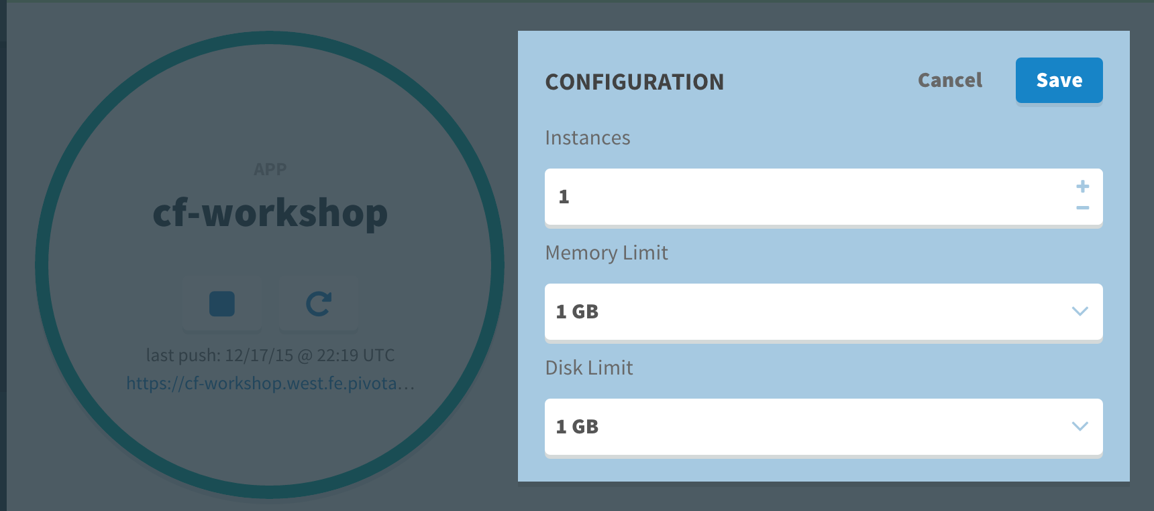
Application Scaling
Notes:
Scaling in PCF is very simple to do. The number of instances, memory, and disk quota, can all be modified through the CF CLI, Apps Manager, and other PCF clients. Note that vertical scaling requires a restart of the application to have the changes take affect.

Slide 68
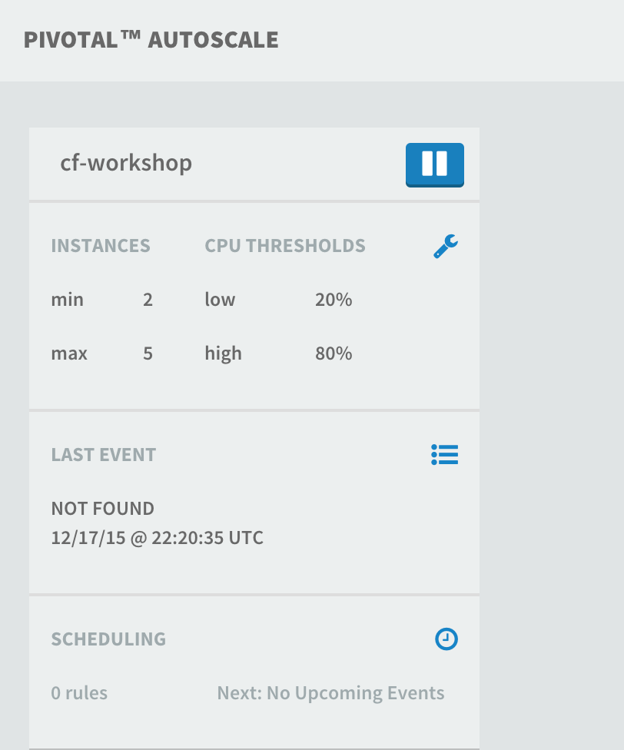
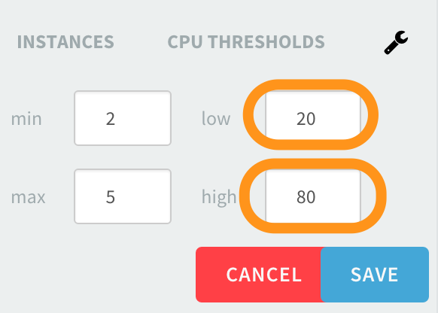
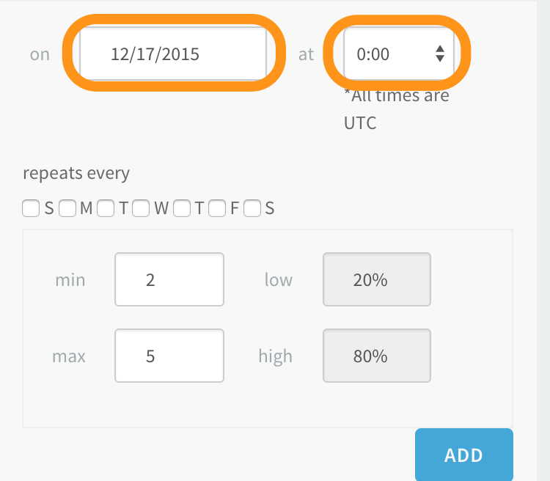
Application Auto-Scaling
Notes:
The autoscaling service can be bound to applications, and managed through the Apps Manager UI. Multiple applications can take advantage of autoscaling if desired, with different thresholds and parameters. Autoscaling events are also tracked and are available through the Apps Manager UI.

Slide 69
Platform Scaling
Platform scaling is performed by the cloud operator
Scaling is done in the resource config tab in Ops Manager
For elastic runtime, only a few components typically need to be scaled for capacity
GoRouter
DEA / Cell
Loggregator / Doppler
More information on platform scaling can be found here: https://docs.pivotal.io/pivotalcf/concepts/high-availability.html#capacity
F
Notes:
Platform capacity and scaling is the responsibility of the cloud operator. Each PCF product installed, including Elastic Runtime has it’s own capacity configuration definition, and is scaled independently of the other installed products. Each product provides a Resource Config tab in the tile, which is a table of each component, the number of VM instances for that component, and the resources definitions for each instance. The Resource Config for a product is cloud provider specific, since each cloud provider has different notions of VM capacity (OpenStack has flavors, AWS has instance type, vSphere has traditional hardware configuration).
For Elastic Runtime, there are only a few components that are typically scaled to add or remove capacity. These are the components whose performance is impacted by the number of application instance running:
GoRouter, which is responsible for routing requests / responses, and is impacted by the number of application instances as well as the amount of traffic.
DEA / Cell, which is the execution environment for applications.
Loggregator / Doppler, which is responsible for assembling logs collected from applications.
There is no ability to autoscale the platform at this time. Although technically feasible, most cloud operators aren’t comfortable with additional infrastructure being consumed without their manual intervention.
There are also a number of components which should have multiple instances to eliminate a single point of failure, but aren’t necessarily impacted by application load.
More information on platform scaling and HA configuration can be found here:
https://docs.pivotal.io/pivotalcf/concepts/high-availability.html#capacity

Slide 70
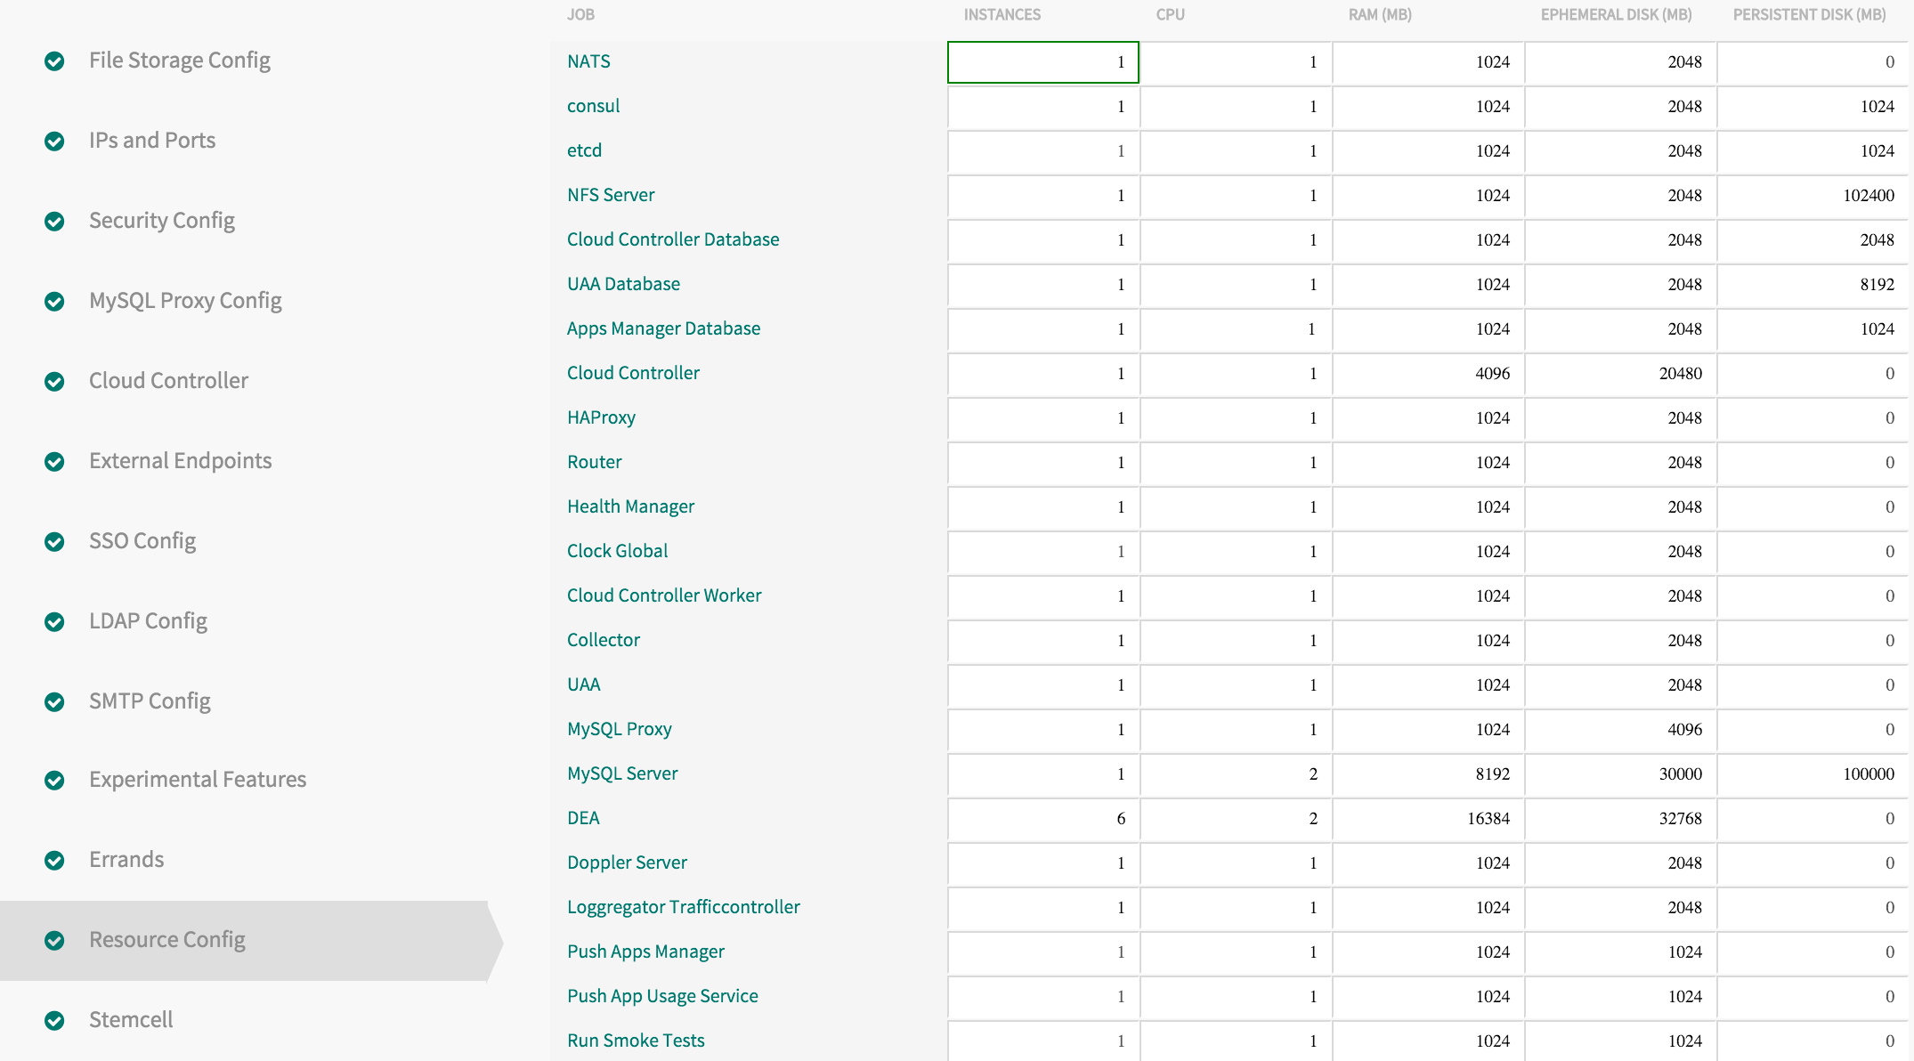
Platform Scaling
Notes:
This graphic shows the resource config page for Elastic Runtime. Each component can be individually configured and scaled as needed.

Slide 71
Sizing & Capacity Planning
Shekel Tool for Sizing Environments:
https://pcfsizer.cfapps.pez.pivotal.io
Notes:
Sizing and capacity planning is a complex process for PCF, as you have to take into account what the total workloads will be in the future. For initial sizing calculations, Pivotal’s Custom Solutions team has built a web-based tool called ‘Shekel’. This tool is available at:
https://pcfsizer.cfapps.pez.pivotal.io

