Slide 2


PCF – Backup / Restore
Ravi Gadhia, Field Engineering, Pivotal
@ravigadhia

Slide 3

Why care?
Time Travel

Slide 4










B/R as we know it…
Use Cases
Disaster Recovery
Version Rollback
Relocation / Cloning
Possible Targets
Data – system vs app
Configuration Settings
Data Types
Logical vs Binary
Methods
Full / Partial / Incremental

Slide 5
PCF Backup / Restore Today
Use Cases
Disaster Recovery
Version Rollback
Relocation / Cloning
Possible Targets
Data – system vs app
Configuration Settings
Data Types
Logical vs Binary
Methods
Full / Partial / Incremental

Slide 6

Back Up Steps
Record the Cloud Controller DB Encryption Credentials
Export Installation Settings
Download the BOSH Deployment Manifest
Back Up Critical Backend Components
Stop Cloud Controller
Back Up the Cloud Controller Database
Back Up the UAA Database
Back Up the Apps Manager Database
Back Up NFS Server
Back Up Pivotal MySQL Server
Start Cloud Controller
http://docs.pivotal.io/pivotalcf/customizing/backup-restore/backup-pcf.html

Slide 7

Restore Steps
Import Installation Settings (export first)
Download the BOSH Deployment Manifest
Restoring Critical Backend Components
Stop Cloud Controller
Restore the Cloud Controller Database
Restore the Apps Manager Database
Restore UAA Database
Restore NFS
Restore MySQL Database
Start Cloud Controller

Slide 8
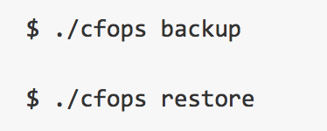
cfops

Slide 9
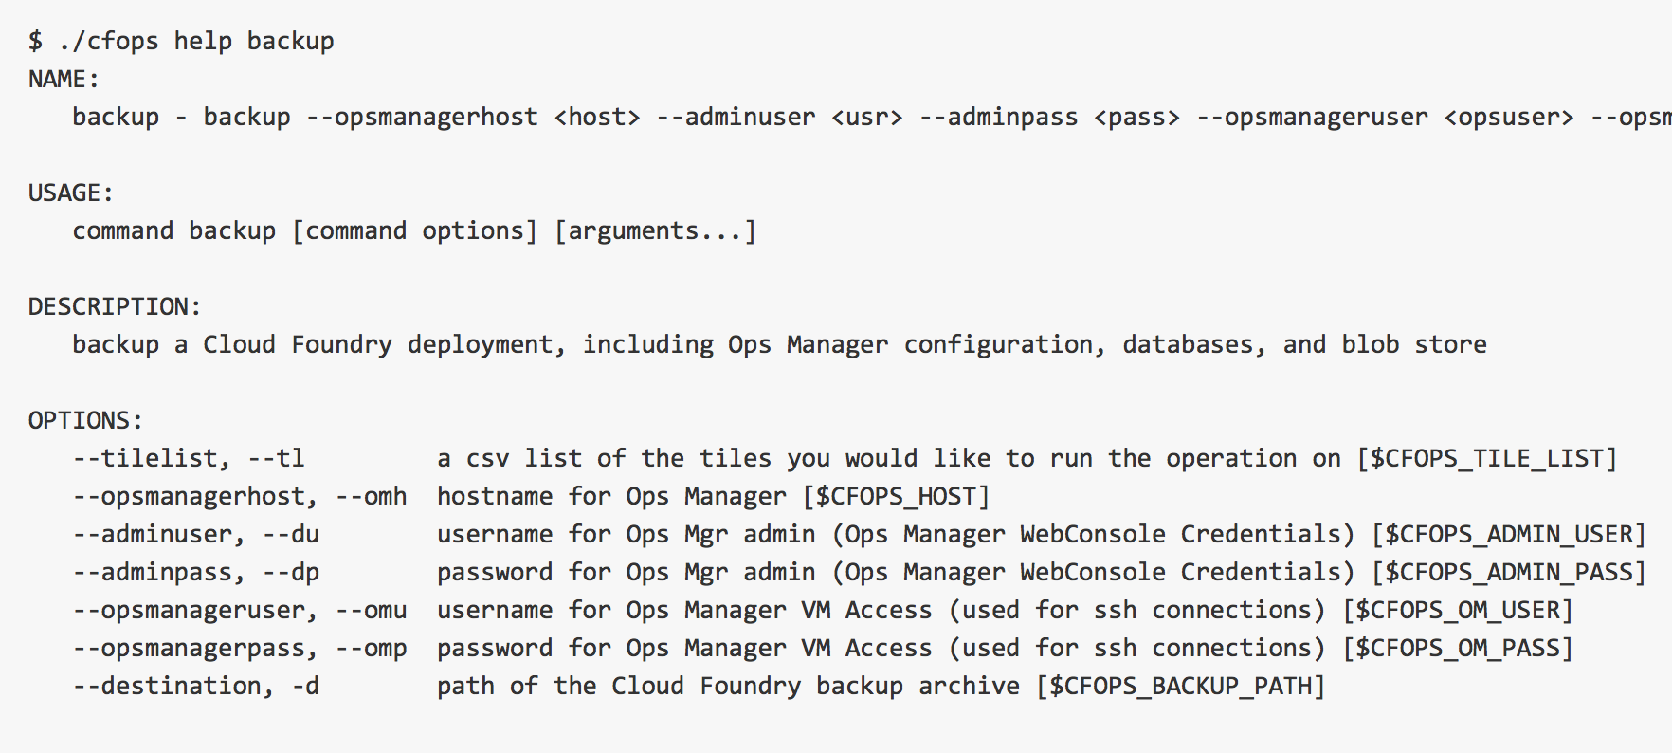
cfops backup

Slide 10
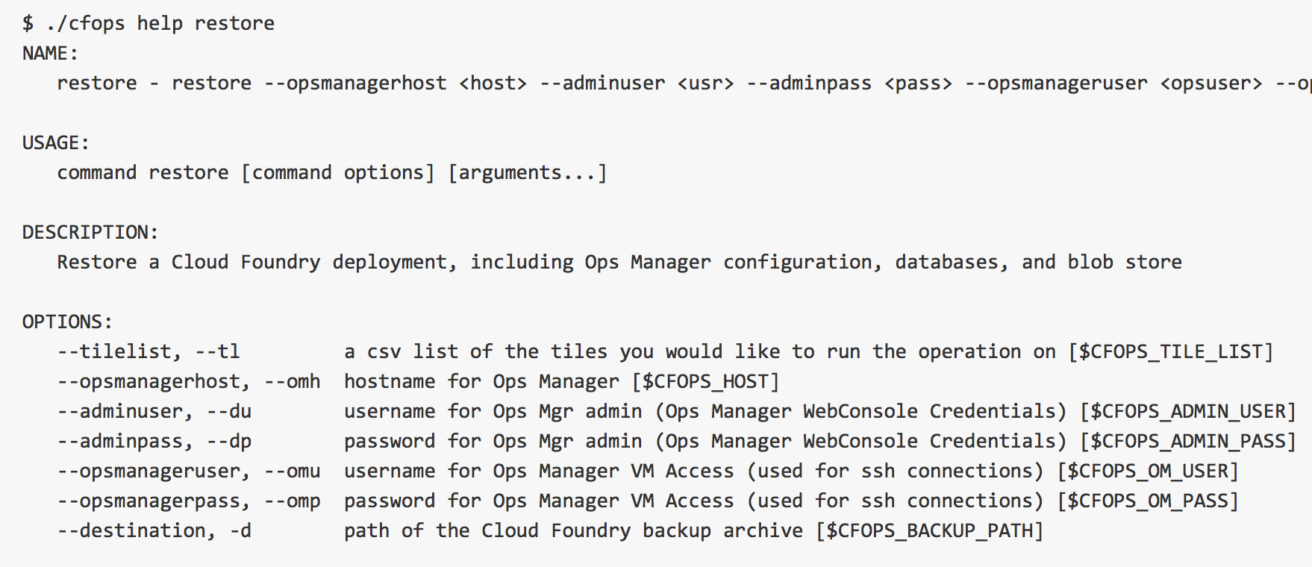
cfops restore

Slide 11

Is this the Backup / Restore you were looking for?

Slide 12
Thank You!

