Slide 1
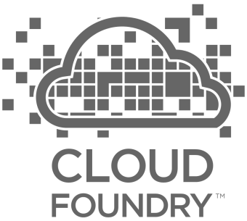
Pivotal Cloud Foundry
Technical Overview
Vivian Fialho – Platform Architect
vfialho@pivotal.io
Notes:
You should never give this presentation to folks who have not seen a basic CF demo. You want to use the push of an app, with a service binding (i.e. spring-music) as the backstory for this deck.
The story line for this deck is:
you’ve seen us deploy and scale and app; we want to show you how it’s done.
This deck is intended to instill confidence in our customers, that they can trust their application to our platform. Cloud foundry is implemented with well understood patterns for distributed, web-based computing that result in extreme scalability and resilience. We know cloud and distributed systems.
We have two main layers:
The part that runs your apps (the elastic runtime)
And a whole ‘nother, kickass system, BOSH, that manages the elastic runtime and services
Let’s see how the elastic runtime deploys your app, supports service bindings and scales your app.
Let’s then see how BOSH deploys clusters, such as the elastic runtime, and services.
BUT that’s not all! Now show that the platform does SO much more than just deploy apps or clusters. → The four levels of HA.
Point out similarity of patterns between the ERS and BOSH. These are some of the patterns for distributed systems. This instills confidence.

Slide 2
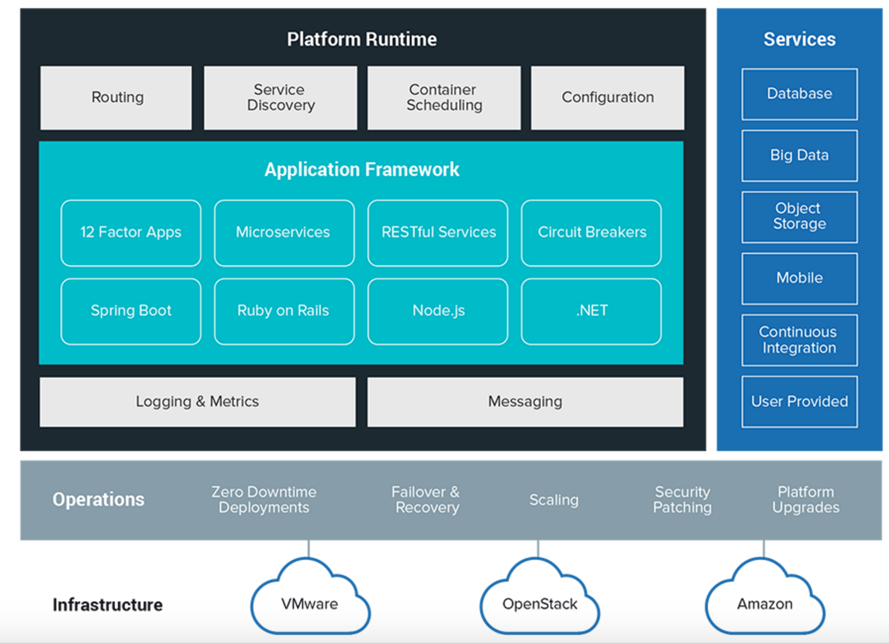
Pivotal Cloud Foundry Architecture

Slide 3
Elastic Runtime
Technical Drill Down
Notes:
Now dive into the ERS

Slide 4

Overview: Deploying App to Cloud Foundry Runtime
Blobstore
Service
credentials
Upload app bits and metadata
DB
push app
+ app MD
Cloud Controller
Service Broker Node(s)
Create and bind services
Stage application
Deploy application
Manage application health
Router
Cloud Controller Bridge
BBS
CELL
DEA
DEA
DEA
+
=
Auctioneer
Notes:
Cloud Foundry PaaS – Pushing an Application with Diego
App deployment: what has changed?
1- Domain specific (notion of apps) -> Abstractions (notions of LRPs and Tasks). App staging is a Task. App start is launching a LRP.
2- Platform specific (linux) -> Supporting multi platform (Windows & Linux) enabling running also .NET apps, thanks to our new Container implementation: Garden
What’s more, there is a 3rd workflow supported: Docker on Linux
3- New Auction-based workload scheduler: Cloud Controller no longer in charge of deciding where AIs are spun up. Auctioneer manages the process running an auction, making it more optimized.
With Diego in place, more loosely-coupled components take part in the process, stripping down the Cloud Controller from too many previous responsibilities, making it easier to maintain and evolve the entire architecture.
The Cloud Controller handles the routing of client requests internally through the Cloud Controller Bridge. It also manages the Blobstore to store packages and droplets and the DB to store App Metadata and Service credentials. Blobstore could be internal or external, depending on the setup.
A service gateway provides an interface for services (native or external).
More in the next slide about the Cloud Controller Bridge (CC-Bridge), the Bulletin Board System (BBS) and the Auctioneer in the next slide
Apps run in a CELL, part of the new Cloud Foundry Runtime, called Diego
Routers manage application traffic.
Diego handles all health management for apps (now LRPs), through a series of single-purpose components: Nsync (part of the CC-Bridge), BBS (part of Diego DB) and the Converger (part of the Diego Brain)
Apps are accessed directly through the router while web and CLI clients (e.g., vmc, STS) access Cloud Controller via RESTful services.

Slide 5
Creating and Binding a Service
Service
credentials
DB
CLI
create service (HTTP)
Cloud Controller
create service (HTTP)
Service
Broker
reserve resources
Data
Service
Router
bind service (HTTP)
bind service (HTTP)
obtain connection data
Cloud Foundry
Elastic Runtime

Slide 6
Stage an Application
Blobstore
DB
Service
credentials
creds
Cloud Controller
Cloud Controller Bridge
Task
Router
CELL
System
Buildpacks
Detect
Compile
Upload
Yes
No
+
=
Cloud Foundry
Elastic Runtime

Slide 7
Deploying an Application
Cloud Controller
Cloud Controller Bridge
Auctioneer
BBS
Router
ACCESS APP
CELL
CELL
CELL
Rep
Rep
Rep
Executor
Executor
Executor
Notes:
The Cloud Controller passes requests to stage and run applications to the Cloud Controller Bridge (CC-Bridge), and it is no longer in charge of allocating the work.
The CC-Bridge translates app staging and app running requests into Tasks and Long Running Processes(LRPs) respectively, then submits these to the Bulletin Board System (BBS) through an RPC-style API over HTTP.
It is a key component to support Diego’s abstractions and maintain the Cloud Controller API unchanged and handling the same calls from the CLI
Domain specific (notion of apps) -> Abstractions (notions of LPRs and Tasks). App staging is a Task. App start is launching a LRP.
Sub-component responsibility:
The stager takes care of staging requests passing them to the BBS
The nsync takes care of updating the DesiredLPR in the BBS so that new apps can start running.
The CC-Uploader helps at the end of the staging process: Mediates uploads from the Diego Executor to the Cloud Controller Blobstore
The Bulletin Board System (BBS) submits the Tasks and LRPs to the Auctioneer, part of the Diego Brain
Maintains a real-time representation of the state of the Diego cluster, including all desired LRPs, running LRP instances, and in-flight Tasks
The Auctioneer distributes these Tasks and LRPs to Cells through an Auction.
There are two components in Diego that participate in auctions:
The Auctioneer is responsible for holding auctions whenever a LRP needs to be started.
The Rep represents a Diego Cell in the auction by making bids and, if picked as the winner, running the LRPs.
All auctions are held by one Auctioneer with the others standing by as backups in case of failure.
The Auctioneer communicates with Reps on all other Cells when holding an auction.
Only one Auctioneer working at a time. Only one auction can take place at a time.
An Auctioneer initiates an auction when it receives a request to allocate a batch of work (tasks and LRPs) either from:
In response to a request from the Cloud Controller via the CC-Bridge.
The Converger, in response to a mismatch between the desired LRPs and actual LRPs as represented in the BBS.
The Auctioneer queries the state of each Cell via a request to the Cell Rep. The information provided by the Rep includes:
the Cell’s available capacity
the Cell’s stack (windows or linux), important since the Auctioneer checks all cell reps, and it might be trying to run an app compatible only with some cells not all of them.
the set of Actual LRPs currently running on the Cell
Once the Auctioneer assigns a Task or LRP to a Cell, an in-process Executor creates a Garden container in the Cell. The Task or LRP runs in the container.
Thanks to Diego platform agnostic, now these (Garden) Containers can be Linux or Windows. Both implement a generic Garden Interface so that the platform-agnostic Garden can manage either.
Once an App is running in its Container it can be directly accessed through the Router directly into the Cell.

Slide 8












Elastic Runtime High Level Architecture
Pivotal CF Elastic Runtime
Turnkey, fully automated Platform-as-a-Service
Scalable runtime environment, extensible to most modern frameworks and languages running on Linux
Instant expansion or upgrade with no downtime
Deploy, scale and manage applications with bindable services using simplified semantics and APIs
Dynamic Router
ROUTING
OAuth 2.0 Server (UAA)
Login Server
AUTHENTICATION
CC & CC Bridge
BBS
Converger
APP LIFECYCLE
BBS/etcd
MESSAGING
Service Brokers
CELL
Blob Store
APP STORAGE
& EXECUTION
Warden
Build Packs
Sys Log
Collector
App Log
METRICS & LOGGING
Pivotal CF OpsManager/BOSH
Notes:
Some people suggest explaining each block in couple of sentences and emphasize our IP. I [Cornelia Davis] don’t feel there is value in that here. I use this as a transition to say “the elastic runtime deployed a cluster of VMs – each of the green boxes is one, usually deployed in duplicates – and BOSH/Pivotal CF OpsManager is what we will talk about now…

Slide 9
BOSH
Overview
Notes:
Now just a brief BOSH overview. It does far more than this!

Slide 10

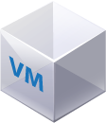
Deploying the CF Runtime with Cloud Foundry BOSH
DB
Worker VMs
Deploy my CF
BOSH Director
Blobs
etcd
Message Bus
Deployment
Packages
Blobs
Source
Jobs
Manifest
CELL
Health Monitor
Target VM
Cloud Controller
Target VM
Cloud Foundry Operations Manager/BOSH
Target VM
IaaS

Slide 11
Four levels of HA
Built in!

Slide 12
How Pivotal CF enables four layers of HA
1.
2.
3.
4.
PCF
PCF
PCF
Zone 1
Zone 2
A
B
C
A
B
C
A
B
C
A
B
C
A
B
C
A
B
C
A
B
C
Process
VM1
VM2
VM3
B
B
B
B
3. Resurrector restarts failed VMs
VM1
VM2
B
A
B
C
A
B
C
A
B
C
A
B
C
OS,
Mware
OS,
Mware
OS,
Mware
B
B
B
B
If an app fails, PCF reboots app in a new container.
If a process fails, PCF restarts the process
If an OS or network failure occurs PCF kills the VM and reboots the host in a new Virtual machine.
If a datacenter rack fails, PCF ensures applications stay running in multiple availability zones
App Fail
Process Fail
VM Fail
Rack Fail

Slide 13
Application Instances and Availability Zones
App Ops
Zone 1
Zone 2
Application instances are evenly distributed over two availability zones.
CELL
CELL
Loosing an AZ keeps instances running and available.
CELL
CELL
Router
CELL
CELL
Cloud Foundry Elastic Runtime
Notes:
Zone could = rack, for example

Slide 14
Failed Application Instances Replaced
App Ops
Pivotal Cloud Foundry
Elastic Runtime
Desired State
Blobstore
Cloud Controller
DB
Service
credentials
creds
Cloud Controller Bridge
Router
BBS
Converger & Auctioneer
Access App
Cell
Cell
Cell
creds
creds
Actual State
Notes:
Nsync splits its responsibilities between two independent processes:
The nsync-listener listens for desired app requests and updates/creates the desired LRPs via the BBS.
The nsync-bulker periodically polls CC for all desired apps to ensure the desired state known to Diego is up-to-date.
The BBS also provides a real-time representation of the state of the Diego cluster (including all desired LRPs, running LRP instances, and in-flight Tasks). The Converger periodically analyzes snapshots of this representation and corrects discrepancies, ensuring that Diego is eventually consistent.
Converger
maintains a lock in the BBS to ensure that only one converger performs convergence. This is primarily for performance considerations. Convergence should be idempotent.
uses the converge methods in the runtime-schema/bbs to ensure eventual consistency and fault tolerance for Tasks and LRPs
when converging LRPs, the converger identifies which actions need to take place to bring DesiredLRP state and ActualLRP state into accord. Two actions are possible:
if an instance is missing, a start auction is sent.
if an extra instance is identified, a stop message is sent to the Rep on the Cell hosting the instance.
periodically sends aggregate metrics about DesiredLRPs, ActualLRPs, and Tasks to Doppler.
Rep
represents a Cell and mediates all communication with the BBS by:
ensuring the set of Tasks and ActualLRPs in the BBS is in sync with the containers actually present on the Cell
maintaining the presence of the Cell in the BBS. Should the Cell fail catastrophically, the Converger will automatically move the missing instances to other Cells.
Route-Emitter
monitors DesiredLRP state and ActualLRP state via the BBS. When a change is detected, the Route-Emitter emits route registration/unregistration messages to the router
periodically emits the entire routing table to the router.

Slide 15
ERS Processes are Monitored
PaaS Ops
BBS
AGENT
Health Monitor
Responses:
CELL
pager
AGENT
Message Bus
email
monitoring
…
Cloud Controller
AGENT
Pivotal CF Operations Manager
IaaS
Notes:
The processes running on the virtual machines (i.e. the health manager) are started with monit, a nice little utility that keeps an eye on processes and will respond when one dies. If a process dies then, monit will do two things: first, it will try to restart the process and second, whether the restart is successful or not, it will tell the BOSH agent about the failure. Recall that the Bosh agent is there to communicate with Operations Manager and in this case it will relay this failure information to the Operations Manager Health Monitor (not to be confused with the Health Manager of the elastic runtime that was discussed above) – we’ll abbreviate it OMHM. The OMHM will take this alert and pass it through a list of responders that can be configured to do things like send emails, page administrators and display alerts in operations dashboards. There’s a good chance that monit will already have recovered the process, but we also want there to be an opportunity for a human to respond.

Slide 16
ERS Processes are Monitored
PaaS Ops
BBS
AGENT
Health Monitor
Responses:
CELL
pager
AGENT
Message Bus
email
monitoring
…
Cloud Controller
AGENT
Pivotal CF Operations Manager
IaaS
Notes:
The processes running on the virtual machines (i.e. the health manager) are started with monit, a nice little utility that keeps an eye on processes and will respond when one dies. If a process dies then, monit will do two things: first, it will try to restart the process and second, whether the restart is successful or not, it will tell the BOSH agent about the failure. Recall that the Bosh agent is there to communicate with Operations Manager and in this case it will relay this failure information to the Operations Manager Health Monitor (not to be confused with the Health Manager of the elastic runtime that was discussed above) – we’ll abbreviate it OMHM. The OMHM will take this alert and pass it through a list of responders that can be configured to do things like send emails, page administrators and display alerts in operations dashboards. There’s a good chance that monit will already have recovered the process, but we also want there to be an opportunity for a human to respond.

Slide 17
ERS Processes are Monitored
PaaS Ops
BBS
AGENT
Health Monitor
Restart!
Responses:
CELL
pager
AGENT
Message Bus
email
monitoring
…
Cloud Controller
AGENT
Pivotal CF Operations Manager
IaaS
Notes:
The processes running on the virtual machines (i.e. the health manager) are started with monit, a nice little utility that keeps an eye on processes and will respond when one dies. If a process dies then, monit will do two things: first, it will try to restart the process and second, whether the restart is successful or not, it will tell the BOSH agent about the failure. Recall that the Bosh agent is there to communicate with Operations Manager and in this case it will relay this failure information to the Operations Manager Health Monitor (not to be confused with the Health Manager of the elastic runtime that was discussed above) – we’ll abbreviate it OMHM. The OMHM will take this alert and pass it through a list of responders that can be configured to do things like send emails, page administrators and display alerts in operations dashboards. There’s a good chance that monit will already have recovered the process, but we also want there to be an opportunity for a human to respond.

Slide 18
VMs are Monitored
PaaS Ops
BBS
Desired State
Actual State
AGENT
Health Monitor
BOSH Director
Responses:
CELL
pager
AGENT
Message Bus
email
monitoring
ressurector
Cloud Controller
…
AGENT
Pivotal CF Operations Manager
IaaS
Notes:
Of course, the BOSH agent on a VM can only communicate back to the Operations Manager if the VM is there, so let’s talk about what happens when a VM disappears. First thing to understand is that by “disappear” I mean that the BOSH agent is not functional; the VM could be there, but Ops Manager no longer knows what it is up to so for all intents and purposes it’s “gone”. How does Ops Manager know? One of the things that a BOSH agent is responsible for is sending out heartbeat messages and by default it does so every 60 seconds. The OMHM is constantly listening for those heartbeats and when it finds that one is missing it will itself produce and alert and pass that through the list of responders. Just as described above, this could result in emails, pages and operations dashboard alerts, but in this case there is one more responder that kicks in – the “resurector”. The resurector will communicate with the IaaS over which PCF is running and will ask that the failed VM be replaced. Of course it will be replaced with a VM running the appropriate part of the elastic runtime – i.e. a health manager or DEA, etc. That’s right, Operations Manager will restart failed cluster components.

Slide 19
VMs are Monitored
PaaS Ops
BBS
Desired State
Actual State
AGENT
Health Monitor
BOSH Director
Responses:
CELL
pager
AGENT
Message Bus
email
monitoring
ressurector
Cloud Controller
…
AGENT
Pivotal CF Operations Manager
IaaS
Notes:
Of course, the BOSH agent on a VM can only communicate back to the Operations Manager if the VM is there, so let’s talk about what happens when a VM disappears. First thing to understand is that by “disappear” I mean that the BOSH agent is not functional; the VM could be there, but Ops Manager no longer knows what it is up to so for all intents and purposes it’s “gone”. How does Ops Manager know? One of the things that a BOSH agent is responsible for is sending out heartbeat messages and by default it does so every 60 seconds. The OMHM is constantly listening for those heartbeats and when it finds that one is missing it will itself produce and alert and pass that through the list of responders. Just as described above, this could result in emails, pages and operations dashboard alerts, but in this case there is one more responder that kicks in – the “resurector”. The resurector will communicate with the IaaS over which PCF is running and will ask that the failed VM be replaced. Of course it will be replaced with a VM running the appropriate part of the elastic runtime – i.e. a health manager or DEA, etc. That’s right, Operations Manager will restart failed cluster components.

Slide 20
VMs are Monitored
PaaS Ops
CPI
BBS
Desired State
Actual State
AGENT
Health Monitor
BOSH Director
Responses:
CELL
pager
AGENT
Message Bus
email
monitoring
ressurector
Cloud Controller
…
AGENT
Pivotal CF Operations Manager
IaaS
Notes:
Of course, the BOSH agent on a VM can only communicate back to the Operations Manager if the VM is there, so let’s talk about what happens when a VM disappears. First thing to understand is that by “disappear” I mean that the BOSH agent is not functional; the VM could be there, but Ops Manager no longer knows what it is up to so for all intents and purposes it’s “gone”. How does Ops Manager know? One of the things that a BOSH agent is responsible for is sending out heartbeat messages and by default it does so every 60 seconds. The OMHM is constantly listening for those heartbeats and when it finds that one is missing it will itself produce and alert and pass that through the list of responders. Just as described above, this could result in emails, pages and operations dashboard alerts, but in this case there is one more responder that kicks in – the “resurector”. The resurector will communicate with the IaaS over which PCF is running and will ask that the failed VM be replaced. Of course it will be replaced with a VM running the appropriate part of the elastic runtime – i.e. a health manager or DEA, etc. That’s right, Operations Manager will restart failed cluster components.

Slide 21



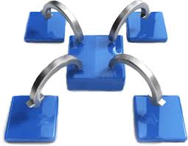
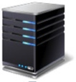











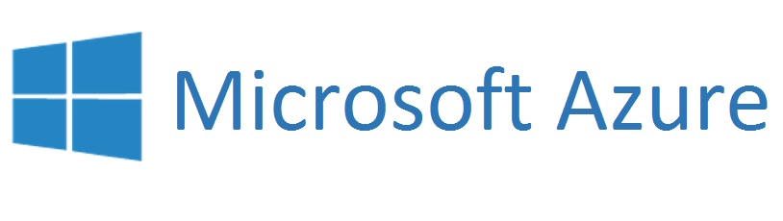
Pivotal CF: Technical Capabilities
Automatic App Server & OS Configuration with Buildpacks (“just push your app”)
Application
Containerization & Cluster Scheduling
Application Network Security Groups
App Health Management, Load Balancing,
Rapid Scaling, Availability Zones
Application to Services Binding and Access
Policy, Identity and Roles Management
Logging as a service,
Application metrics & performance,
Metric based scaling
Native & Extended Data, Mobile and Platform Services
IaaS Provisioning, Scaling & Configuration
Deploy, Operate, Update & Scale with minimal downtime on choice of IaaS

