Slide 1


Monitoring
(Logging and Metrics)
Vivian Fialho – Platform Architect
vfialho@pivotal.io

Slide 2

Monitoring
What?
For Applications
For Operations
How?
Log Event Streams
Application Log Analytics
Application Performance Monitoring
Platform Performance Monitoring
Logging Events
4 layers of HA and Resiliency provided by platform
Still need to be aware of the applications and platforms operational health

Slide 3
The Loggregator
Allows application users and operators to:
Tail their application logs
Dump a recent set of application logs
Continually drain their application logs to 3rd party log archive and analysis service
Attach Firehose nozzles to filter and forward data stream to external analytics systems.
No longer single point of failure

Slide 4
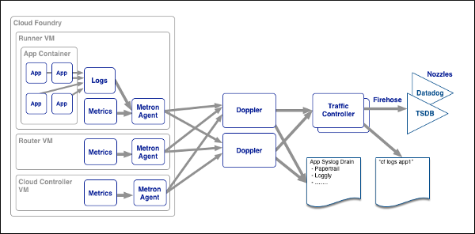
Loggregator Technical Overview
Applications write logs to STDOUT and STDERR
Relevant Cloud Foundry component events added to application stream
Log events collected, collated, and expose via API and the firehose
Notes:
Need a version of this for operations teams

Slide 5
The Firehose
Streaming endpoint of logs, HTTP events and application container metrics, and metrics from Elastic Runtime components.
Secured to system operators/admins
Nozzles used to consume data from the firehose
Datadog Nozzle
Syslog Nozzle

Slide 6
Log Management Services
External logging systems configured for application and system level components
Supported 3rd Party services
Splunk
Papertrail
Sumo Logic
Notes:
For this one setup that this is an endpoint for application and platform logs
List out implementations form docs

Slide 7
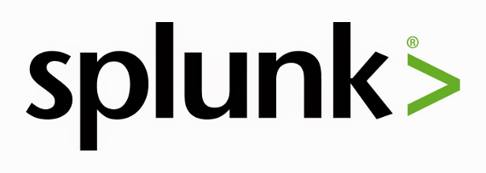
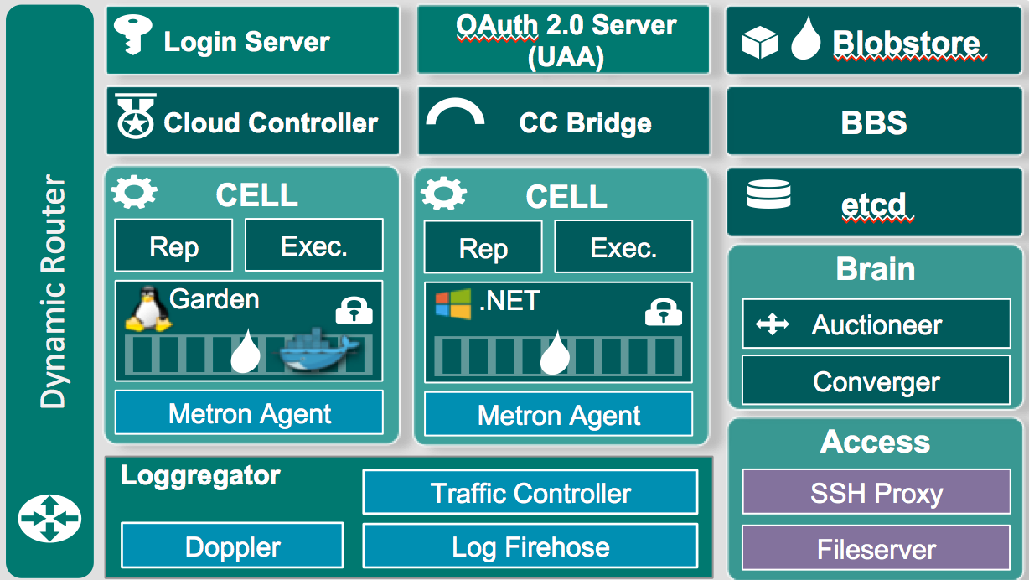
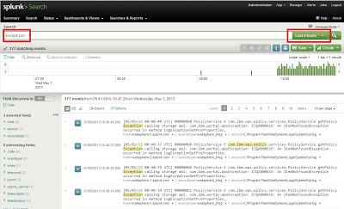
Log Management Services

Slide 8
Metrics

Slide 9
Metrics: Why Are They Important?
Developers have the need for a real time, detailed view into system measures
Compare typical activity to peak load and historical data for performance tuning
Very important to understand when to scale your app or platform
Notes:
For this one setup that this is an endpoint for application and platform logs
List out implementations form docs

Slide 10
Metrics Pipeline Destinations
Ops Metrics
Built in Apps & Platform Metrics (Roadmap)
3rd Party
APM: New Relic, App Dynamics, Dynatrace
Ops: Datadog, Amazon Cloud Watch

Slide 11
Pivotal Ops Metrics
Provides JMX Interface into key Pivotal CF Components: Cells, CC, Router, UAA etc…
Can be plugged into any JMX endpoint like JConsole, Datadog or Hyperic
Leverages Loggregator/Firehose to capture exposed metrics

Slide 12
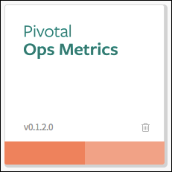
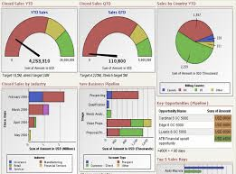
JMX Metrics Services
JMX Monitoring Tool
JMX Provider
Collector

Slide 13
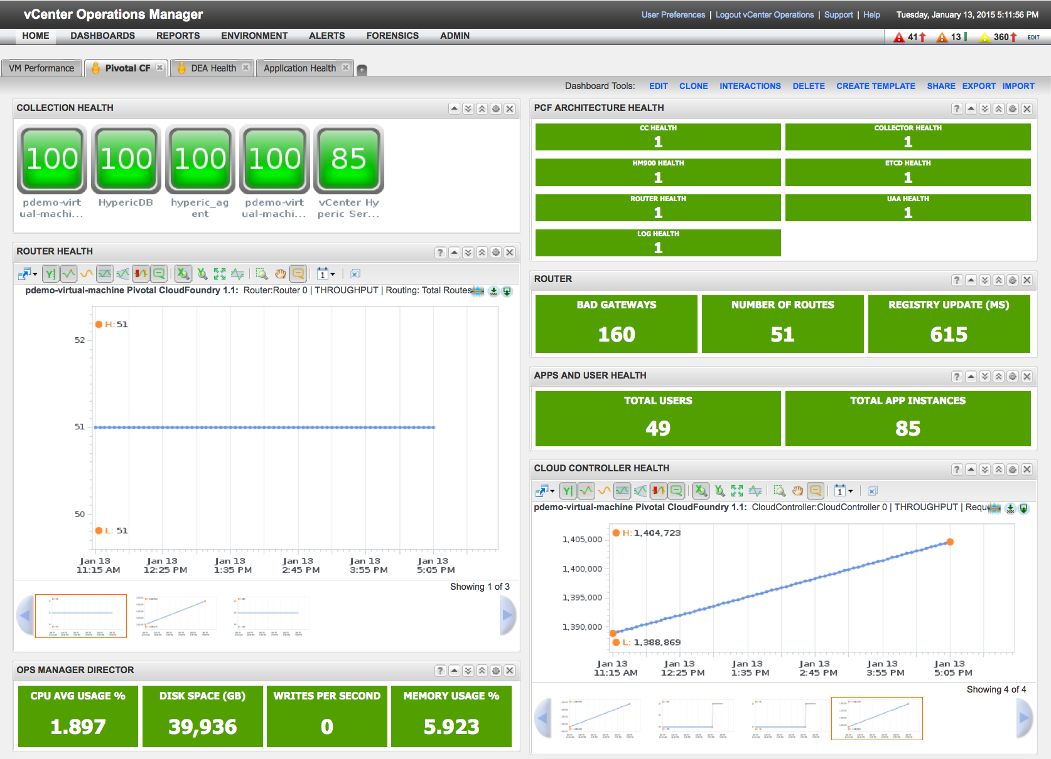
Pivotal Ops Metrics Hyperic Dashboard

Slide 14
Built in Platform Metrics (Roadmap)
Built in conjunction with consolidated platform metrics for both Applications and Platform Components
Leverages Loggregator/Firehose data stream
Capabilities:
Email and SNMP notifications on platform component failures
Platform Capacity thresholds notifications

Slide 15
Built in Application Metrics
Built on Loggregator/Firehose Architecture
HTTP metrics: HTTP requests, HTTP request errors, and average latency (updated every second)
Container metrics: CPU, disk, and memory (updated every 30 seconds)
App events: create, update, start, stop, crash (updated on occurrence)
24 Hours of Metrics Available

Slide 16
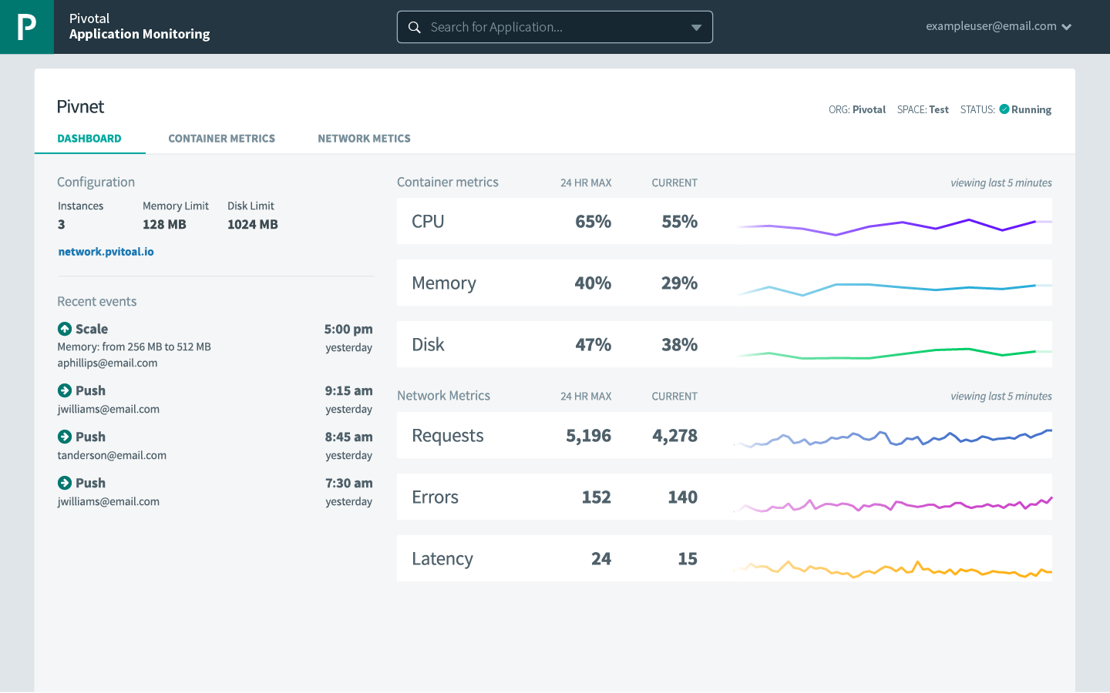
Application Dashboard
Display current app status, scale, and route
Streaming Data
last five minutes of container and network metrics
most recent app events

Slide 17
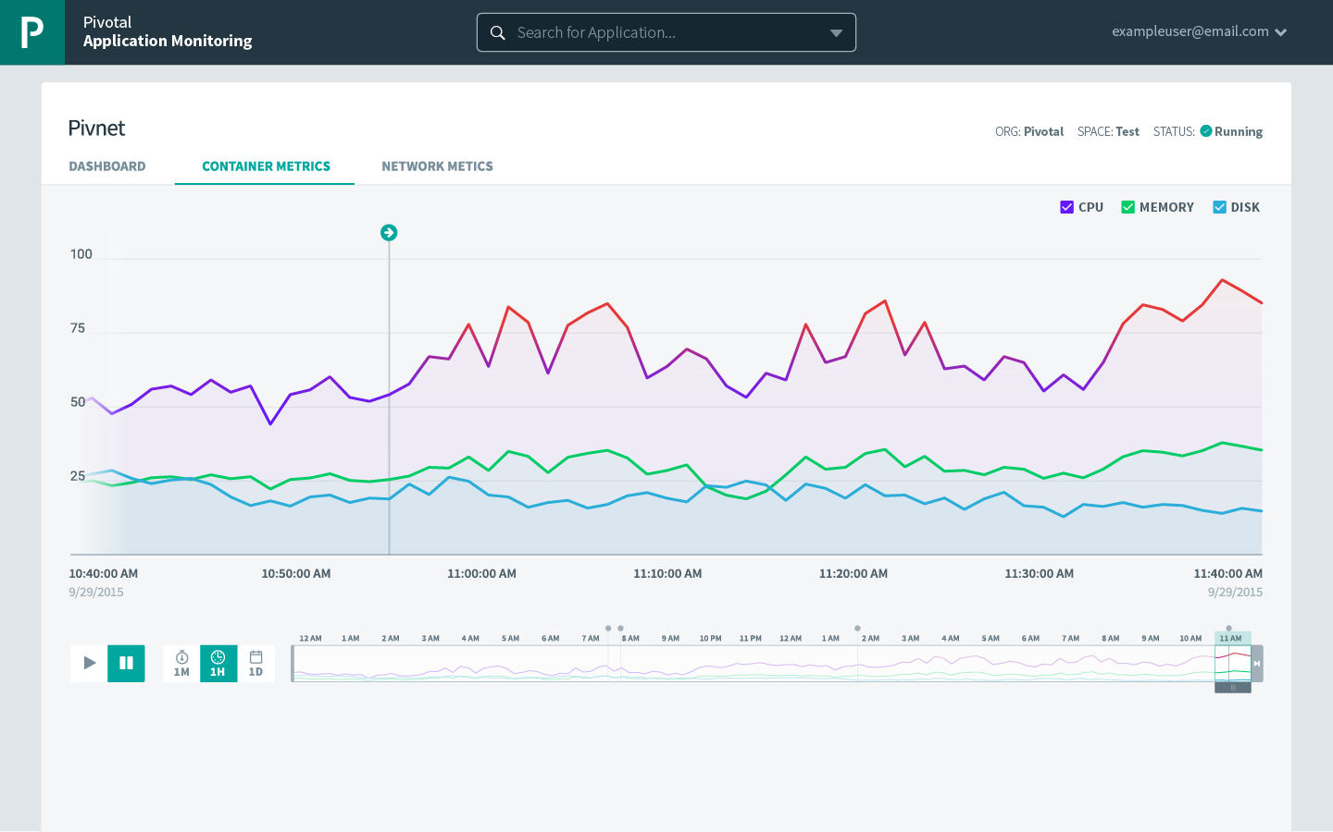
Container Metrics Detail
View app events in context with streaming:
CPU
Disk
Memory
Viewable by day, hour and minute

Slide 18
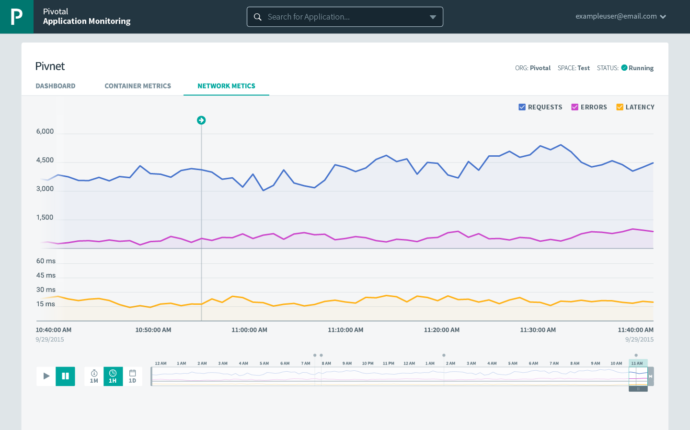
Network Metrics Detail
View app events in context with streaming:
HTTP requests
HTTP errors
Latency
Viewable by day, hour and minute

Slide 19
Built in Application Metrics (Roadmap)
Events, logs, and metrics in one UI
Notifications on events and thresholds
Distributed tracing with SCS
Per instance metrics (identify unhealthy app instances)
Rich, rules-based auto-scaling
Custom app metrics
Increased capacity of prior metrics

Slide 20
Roadmap Goals – Metrics Based Automation
Right-sizing app config (better understand usage over time to precisely scale apps)
Canary deployments (incrementally distribute traffic to new app versions: replace old version if performant, immediately rollback if not)
Capacity planning (use app metrics to drive a holistic view of demand on the platform, now and into the future)

Slide 21
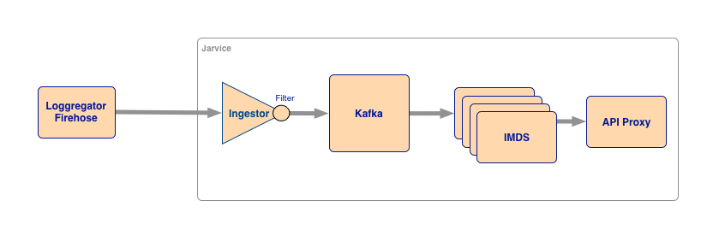
Platform Metrics Architecture
Loggregator Firehose Nozzle used to capture data
Exposed API for custom extension

