Slide 1
Security
Access Control, Application Security Groups and Identity Management

Slide 2


Data Protection
Data-in-Motion, Data-at-Rest
Notes:
At Pivotal, we believe Transforming how the world builds software will shape the future.
This is our core guiding principle that shapes our product and corporate strategy

Slide 3












Elastic Runtime High Level Architecture
Pivotal CF Elastic Runtime
Dynamic Router
ROUTING
OAuth 2.0 Server (UAA)
Login Server
AUTHENTICATION
CC & CC Bridge
BBS
Converger
APP LIFECYCLE
BBS/etcd
MESSAGING
Service Brokers
CELL
Blob Store
APP STORAGE
& EXECUTION
Garden
Build Packs
Sys Log
Collector
App Log
METRICS & LOGGING
Pivotal CF OpsManager/BOSH
Notes:
First, it’s important to understand that the Cloud Foundry Elastic Runtime is, itself, a collection of microservices running on virtual machines. These services govern the health of your containerized applications, provide centralized logging aggregation, automatic scaling and load balancing, etc. Let’s take a look at an example of an inbound HTTP request to our sample application:

Slide 4
ER Ingress Networking Traffic Example
DMZ
Elastic Runtime Network
Services Network
Router
Cell
Cell
Cell
Container
Router
Container
Container
Load Balancer
Container
Outbound NAT
RabbitMQ
HTTP Client
Container
Container
Router
Container
Container
Container
Container
Router
Container
Container
Notes:
Talking points:
Walk through the multiple isolated networks referenced here https://docs.pivotal.io/pivotalcf/customizing/network-segmentation.html#multiple
Talk about your customer’s LB, and how it will need to reference the routers from the ER. The gporouters support ssl connections.
Talk about the routing tables, and the fact that the containers are on a different network than the Cell service / VM
It’s also a good time (if prompted) to talk about encryption between the router and the container. This is an IPSec story at the IaaS level
Security groups!

Slide 5
Container Isolation
Cell
Containers provide isolation of resources – CPU, memory, file system, process space, network
Containers have their own private network, not accessible from outside the Cell
App
App
App
App
Cell
App
App
App
App

Slide 6
Data-at-Rest
In the ER – two main points of non-ephemeral storage:
CCDB – Centralized storage for application metadata, includes access information for services leveraged by the application containers.
BLOB Store – Stores container images, application artifacts
Both can be externally managed and configured.
Notes:
Main point here is that you can accept the defaults (perhaps with disk encryption via IaaS), or use external MySQL DB / S3 storage that may more easily align with organization policy.

Slide 7
Network Surface Area
Getting Access via Network Endpoints, Controlling Access via AuthZ and AuthN
Notes:
At Pivotal, we believe Transforming how the world builds software will shape the future.
This is our core guiding principle that shapes our product and corporate strategy

Slide 8


System Boundaries
HTTP/HTTPS
TCP (Q1 2016)
service
dependent
HTTP/HTTPS
Minimal Pivotal CF network access
allows PCF to be easily deployed on a VLAN or behind a firewall
reduces surface area for vulnerabilities
Ops Manager UI
Load balancer (HAproxy or other)
Service Broker
Ops Manager Director
Dynamic Router
Service Nodes
Operations Manager
Service
Cloud Controller
Cluster Brain
UAA
Login Server
Service Broker
Cell Pool
Service Nodes
Apps
Apps
Service
Messaging (NATS)
Metrics Collection
App Log Aggregator
Elastic Runtime

Slide 9
Container Isolation
Routers forward requests from outside using the app’s route to the assigned port on the Cell, which does network translation to the container’s internal IP and port
Apps are prevented from communicating directly with each other by container firewall rules; they must communicate through published routes
HA Proxy LB
Dynamic Router
Cell
Cell
App
App
App
App
App
App
App
App

Slide 10
End-User Identity
CLI
custom clients
Multitenant UAA/Login Server handles authentication
LDAP/AD integration
Identity Zones provides unique, isolated sub-domains
UAA is an OAuth2 token server
All interactions with the API must include a valid OAuth2 access token
HTTP/HTTPS
HA Proxy LB
HTTP
Dynamic Router
HTTP
Cloud Controller
UAA
Login Server

Slide 11
API Access
https://api.mypivotalcf.com
API access (app management, service management, org/space management, etc.) is routed to Cloud Controller via HTTP/HTTPS
Load balancer
HTTP
Dynamic Router
HTTP
Cloud Controller

Slide 12
Application Access
https://my-app.mypivotalcf.com
Application access is routed directly to an application instance for any number of domans
SSL is terminated at the load balancing layer; optionally at the routing layer; all internal PCF traffic is trusted HTTP (or TCP in PCF 1.7+)
Load balancer
HTTP(S) – TCP (Q1 2016)
Dynamic Router
HTTP, TCP
Cell
Cell
Cell
Apps
Apps
Apps

Slide 13
External Load Balancer
HTTP/HTTPS/ TCP
HA Proxy can be replaced with an external Load Balancer
SSL is terminated at the Load Balancer and/or Router
External Load Balancer
HTTP(S) / TCP
Dynamic Router
HTTP / TCP
Cell
Cell
Cell
Apps
Apps
Apps

Slide 14
Service Access
Applications connect directly to managed services via assigned addresses and ports
Applications can access “user provided” services outside of the PCF VLAN
Cell
Apps
Service Broker
Service Nodes
Cell
Apps
Service Broker
Service Nodes
Cell
Apps
External Service

Slide 15
Service Access
service
dependent
Users can access managed services from outside the PCF VLAN as allowed by firewall rules
ports are dependent on the service
Some services (e.g. RabbitMQ expose dashboard UIs on additional ports
Cell
Apps
Service Broker
Service Nodes
Cell
Apps
Service Broker
Service Nodes
Cell
Apps
External Service

Slide 16
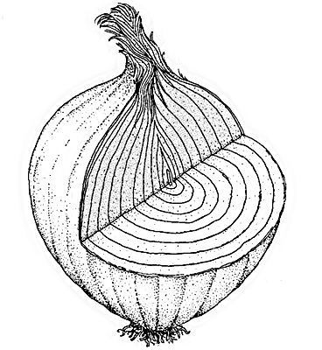
Security Groups – A Layered Approach
Network Edge
Hardware Firewalls
IaaS Security Groups
CF BOSH Default Network Security Rules
Elastic Runtime Default Network Security Rules
CF Application Security Groups
My Application

Slide 17
Security Groups – Highlights
Outbound firewall rules to restrict network traffic to applications
A set of whitelist rules in three targets
All running application (“Global Running”)
All application in staging mode (“Global Staging”)
Specific groups of applications (“Space”)
Rules are automatically applied at the app-container creation
Result in IPTABLES rules applied to the virtual network interface used by application containers
The rule at the bottom of the chain is REJECT
Notes:
Fine grained, policy-based network access whitelists to restrict network traffic
System defaults with additional policy mapped to groups of applications
Network traffic auditing

Slide 18
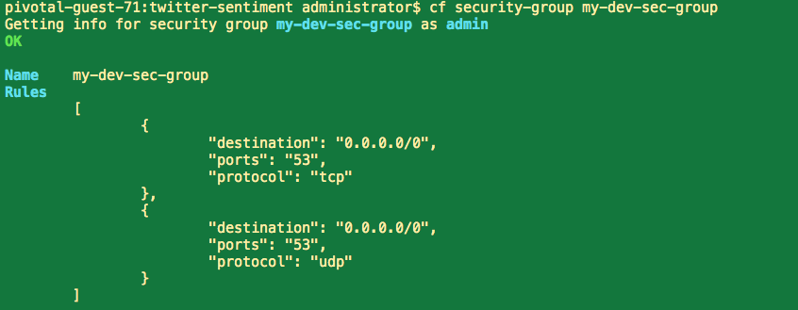
Security Group - Example

Slide 19
End-User Identity
CLI
custom clients
UAA is an OAuth2 token server
Handles web authentication
manages access and refresh tokens
by default, stores usernames and passwords in CCDB
LDAP/AD integration
SAML SSO Integration
All interactions with the API must include a valid OAuth2 access token
All applications can integrate with Pivotal Single Sign On services for their own Oauth2 identity zones
HTTP/HTTPS
Load Balancer
HTTP
Dynamic Router
HTTP
Cloud Controller
Cell
UAA
Apps
Pivotal SSO

Slide 20
Operator Identity
Operations Manager <= 1.6 supports a single username and password for access to operations functions
Operations Manager 1.7+ introduces UAA integration for full LDAP/AD/SAML integration
Ops Manager UI
Ops Manager Director
UAA

Slide 21
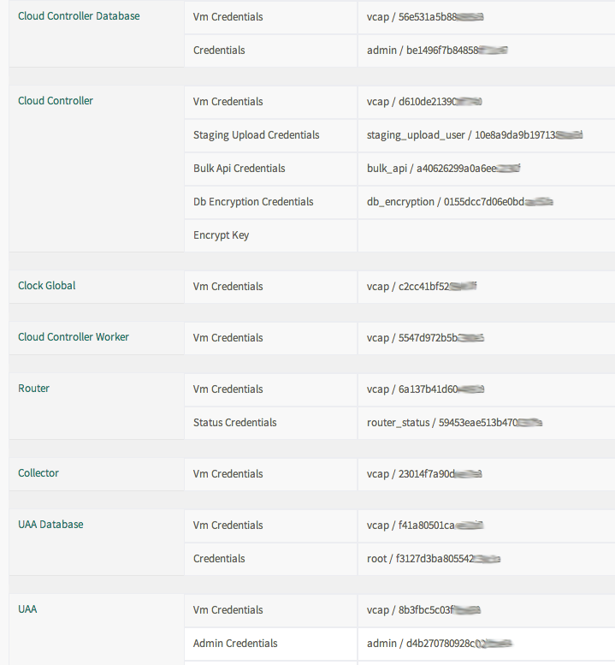
Operator Identity
Operations Manager creates randomized passwords for access to all managed VMs
VM credentials are visible in the Operations Manager UI

Slide 22
Multi-tenancy
Overview

Slide 23
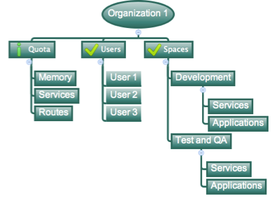
Organizations
Logical division within a Pivotal CF Installation / Foundation.
Each organization has its own users and assigned quota
Sub-divided into Spaces
User permissions / roles are specified per space within an organization

Slide 24
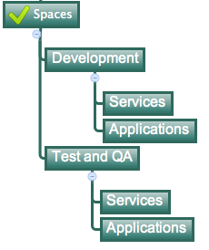
Spaces
Logical sub-division within an organization
Users authorized at an organization level can have different roles per space
Services and Applications are created / specified per Space
Same Service can have different meanings per space
Spaces can be assigned quotas

Slide 25

Quotas & Plans
Different quota limits (e.g. “small”, “enterprise”, “default”, “runaway”) can be assigned per Org/Space
Quota defines
Total Memory
Total # of Services
Total # of Routes

