Slide 1


LAB 1:
Configure bosh-lite
And PcfDev

Slide 2
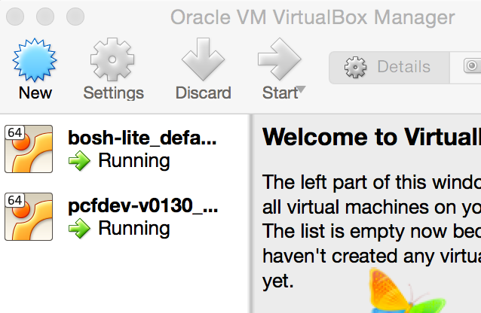

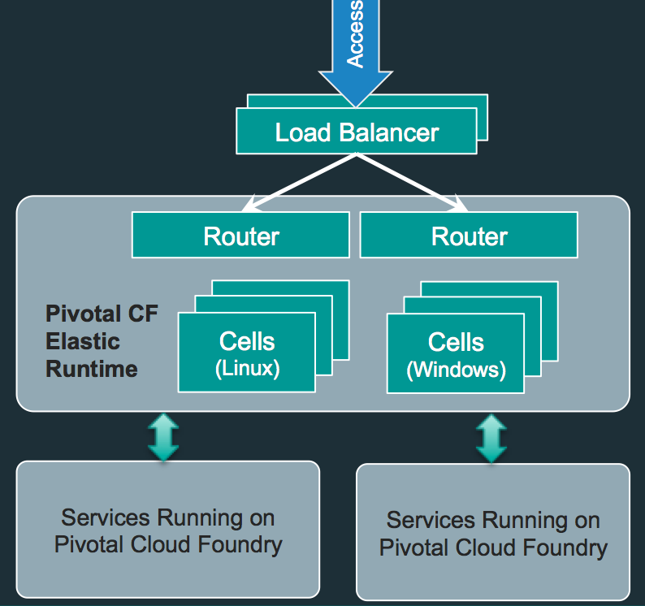
Laptop Environment for Lab
Vagrant
VBox
Bosh-Lite 192.168.50.4
PcfDev: 192.168.11.11
Postgres
10.68.45.151
Warden container
Bosh Director
VM
VM
Laptop:

Slide 3
BOSH-Lite
BOSH Lite is a pre-built Vagrant box which includes the Director. It uses containers to emulate VMs which makes it an excellent choice for:
General BOSH exploration without investing time and resources to configure an IaaS
Development of releases (including BOSH itself)
Testing releases locally or in CI

Slide 4
Setting up a BOSH Director
Install Vagrant
Spin up a BOSH-Lite VM
Target our new environment
Check BOSH-Lite status

Slide 5

1. Install Vagrant
Download and install Vagrant
https://www.vagrantup.com/
Install Virtual Box
Install Vagrant Vbox Plugin

Slide 6
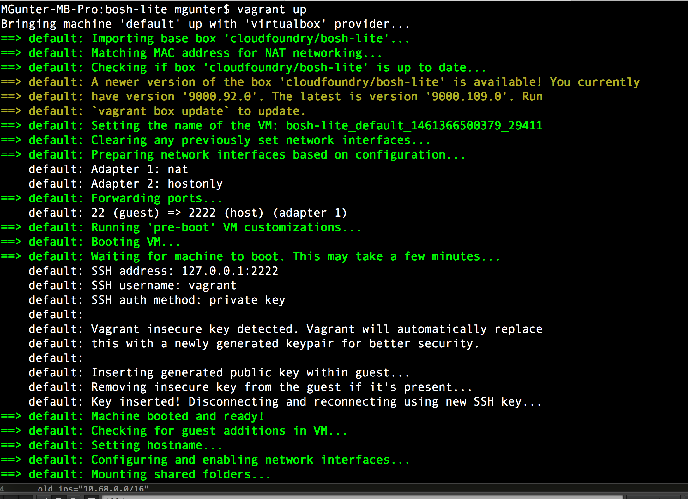
2. Spin up a BOSH Lite VM
vagrant up –provider=virtualbox

Slide 7
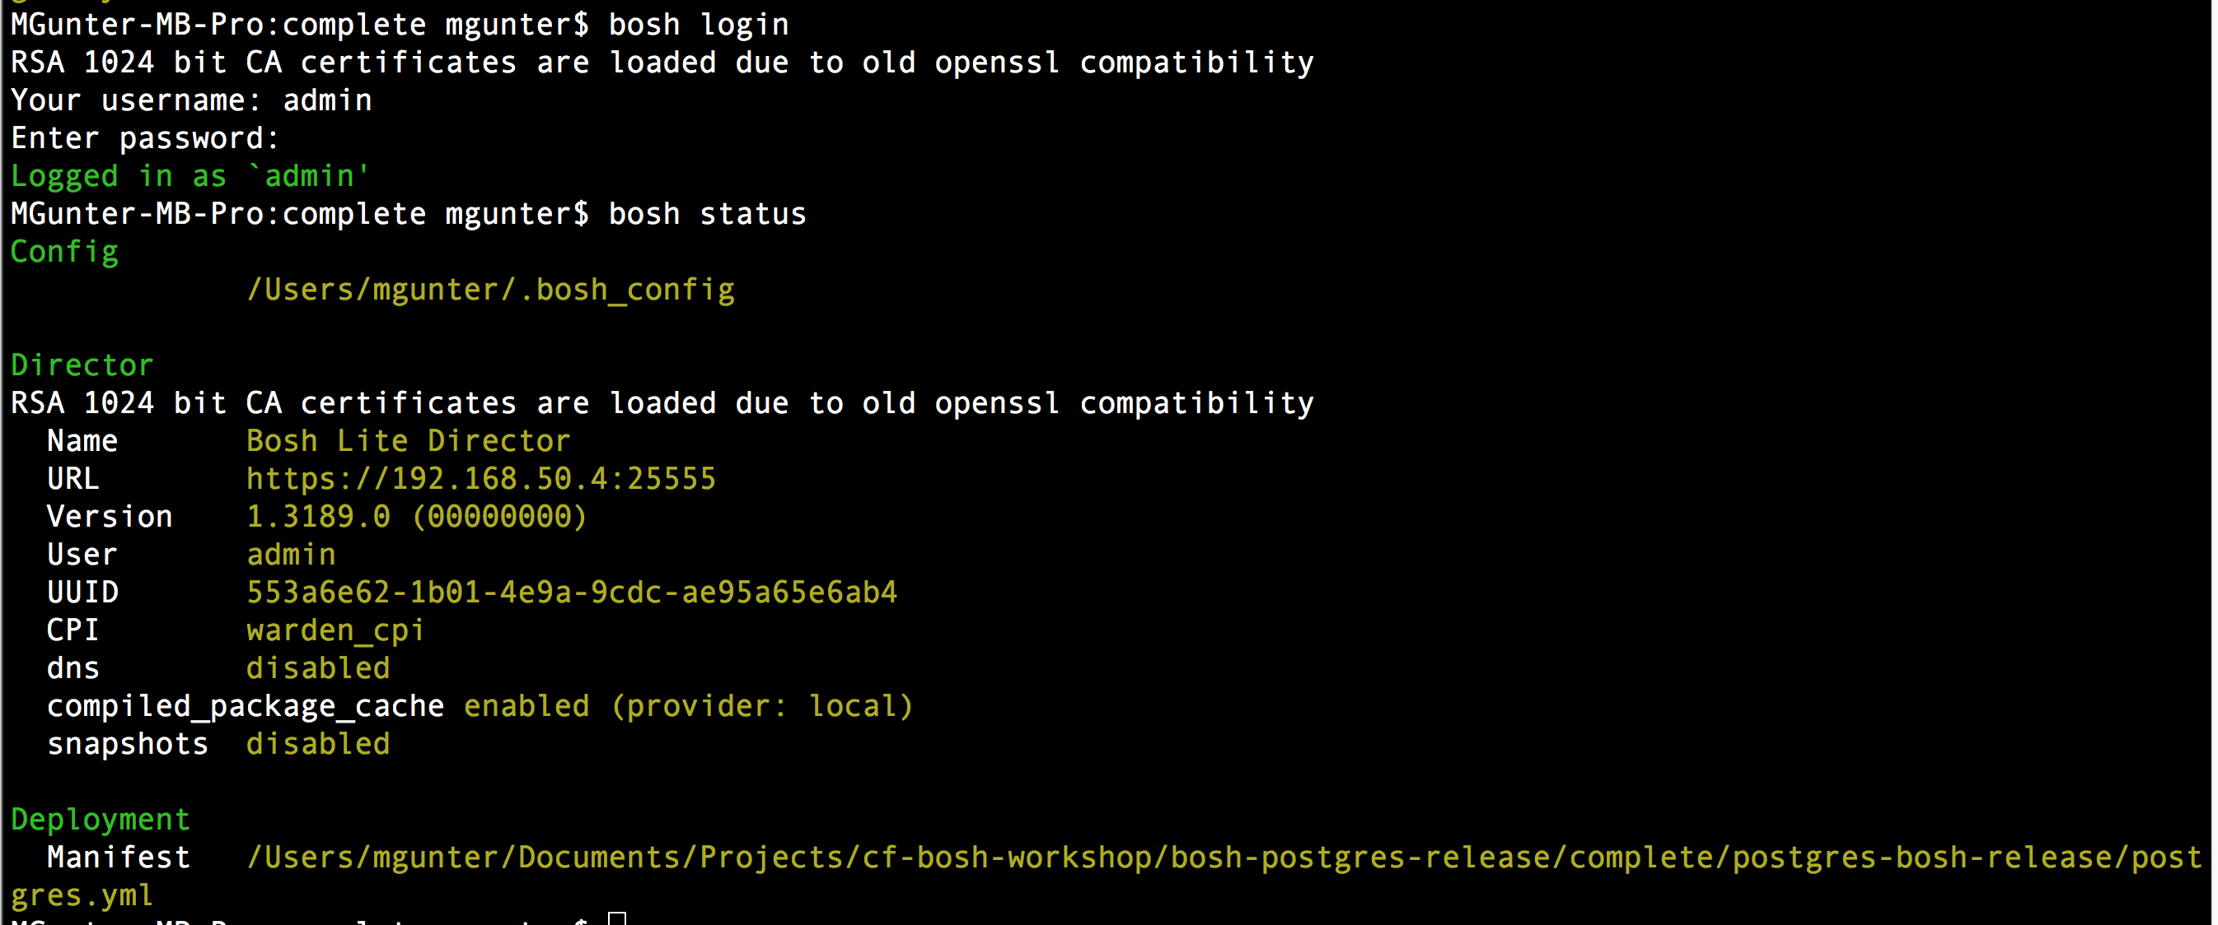
3. Target our new environment
vagrant ssh
bosh target 192.168.50.4
bosh login ( use: admin /admin)

Slide 8
4. Check BOSH-Lite status
bosh status

Slide 9
Setting up a pcfdev environment
Download pcfdev from https://network.pivotal.io/
Install Vagrant
Spin up a PcfDev VM
Login to our new environment
Check CF status

Slide 10
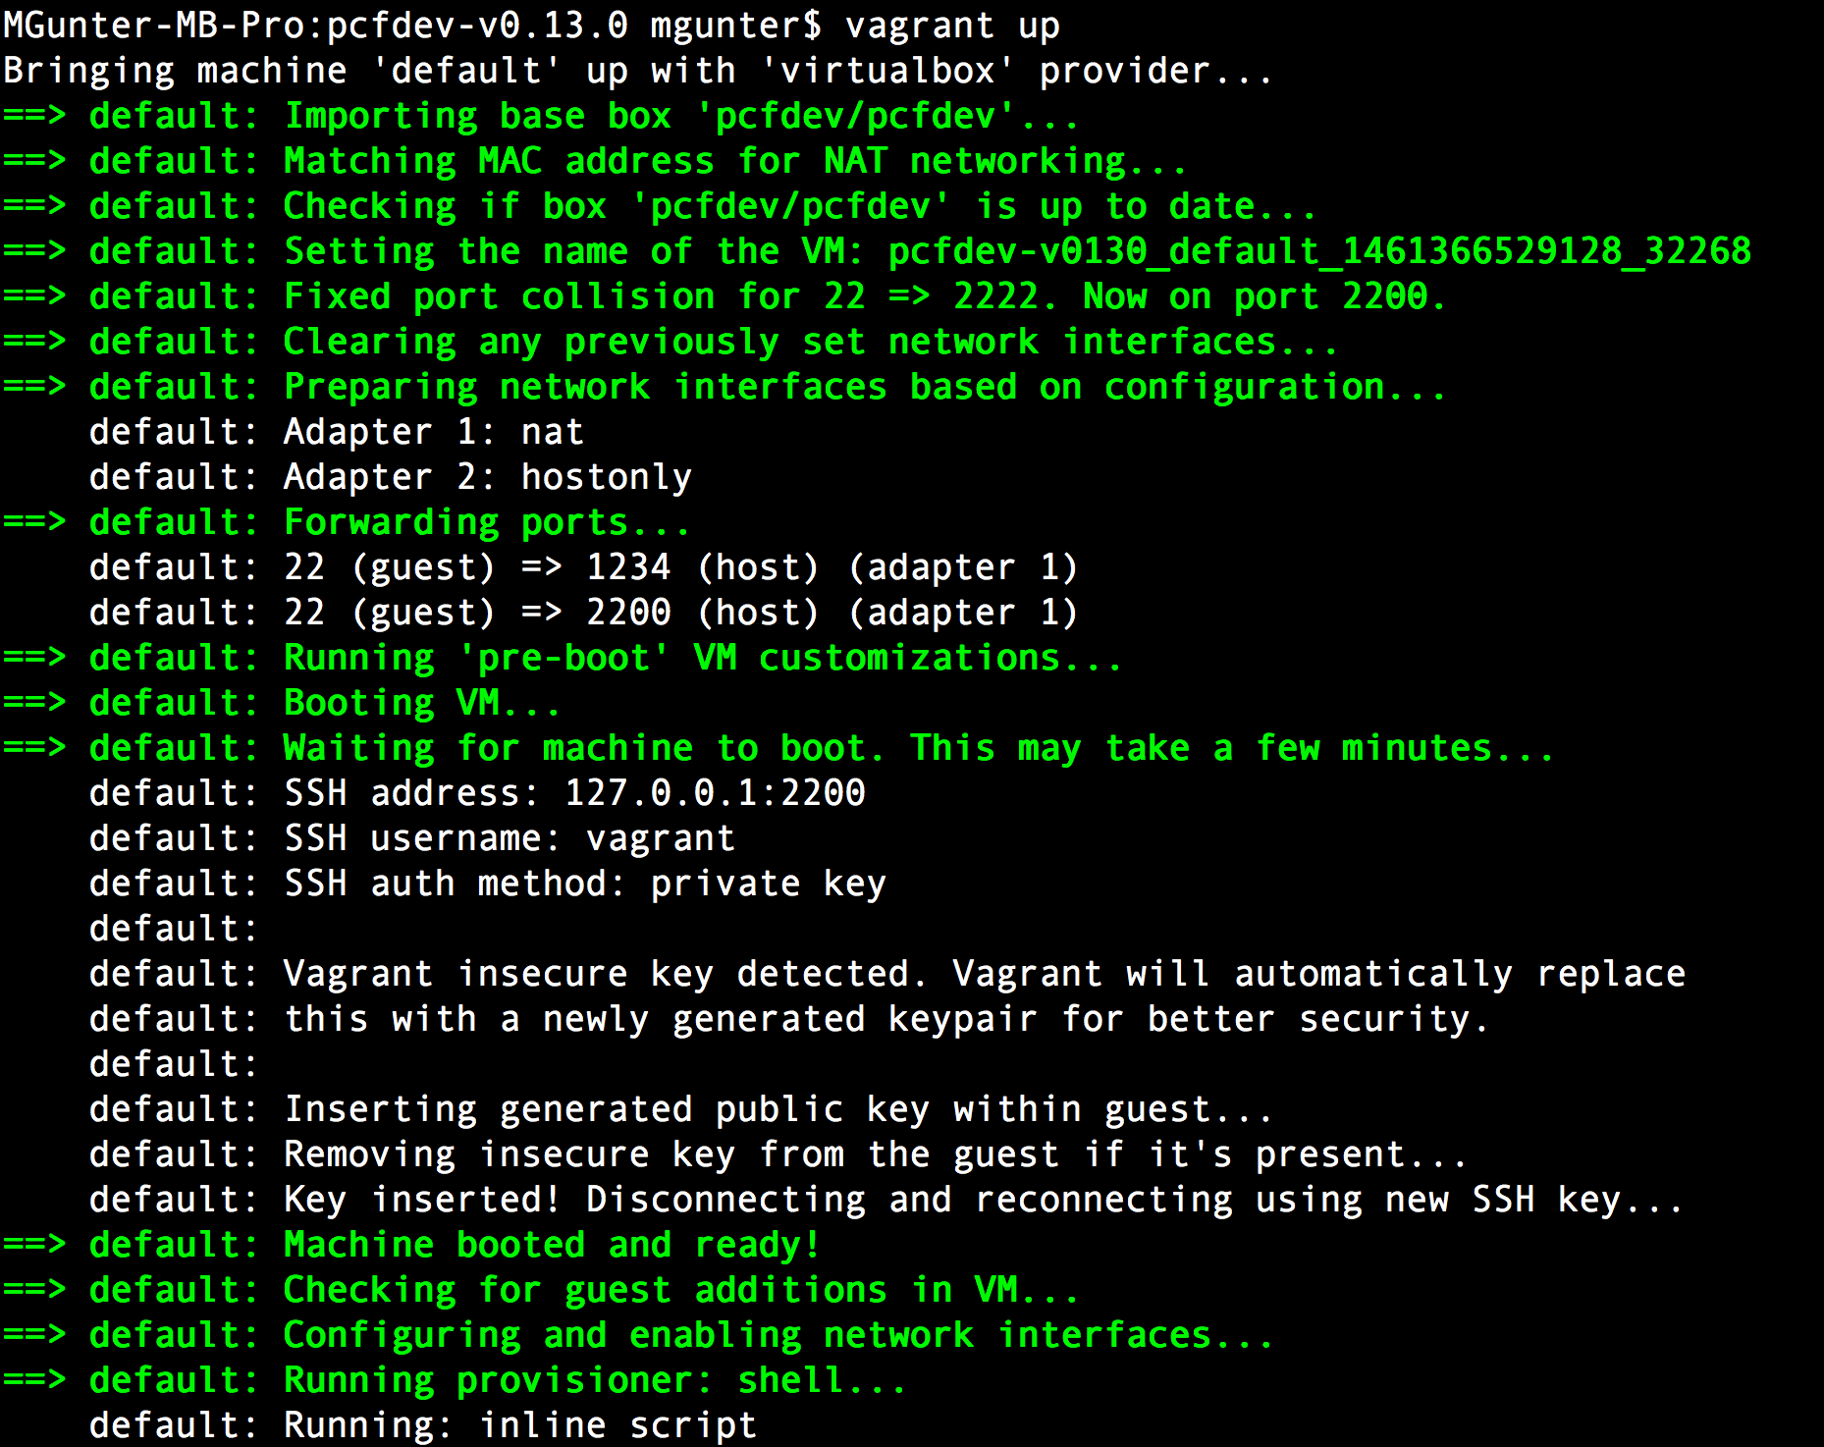
2. Spin up a pcfdev VM
vagrant up –provider=virtualbox

Slide 11
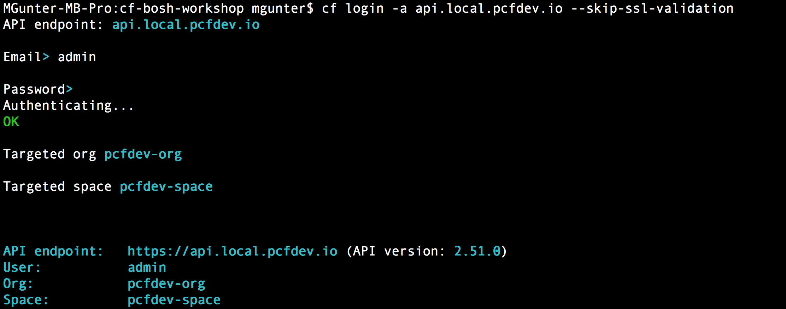
3. Login to our new environment
cf login -a api.local.pcfdev.io --skip-ssl-validation
admin
admin

Slide 12
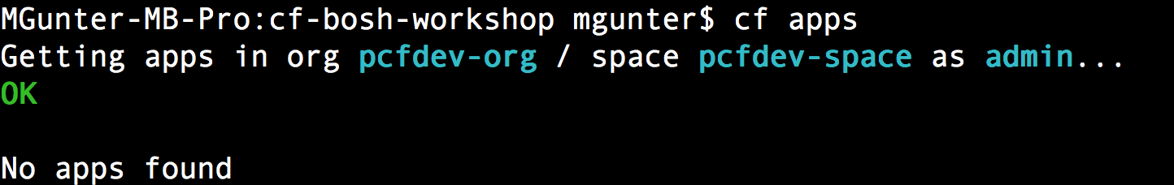
4. Check PcfDev status
cf apps

Slide 13
Laptop Environment for Lab
Vagrant
VBox
Bosh-Lite 192.168.50.4
PcfDev: 192.168.11.11
Postgres
10.68.45.151
Warden container
Bosh Director
VM
VM
Laptop:

