Slide 1


Anatomy of a BOSH deployment

Slide 2
LAB 2:
Deploying an Existing Bosh Release

Slide 3
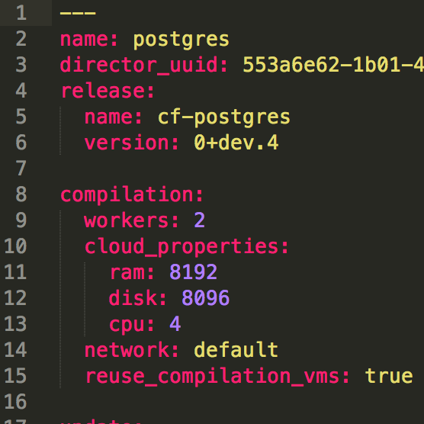
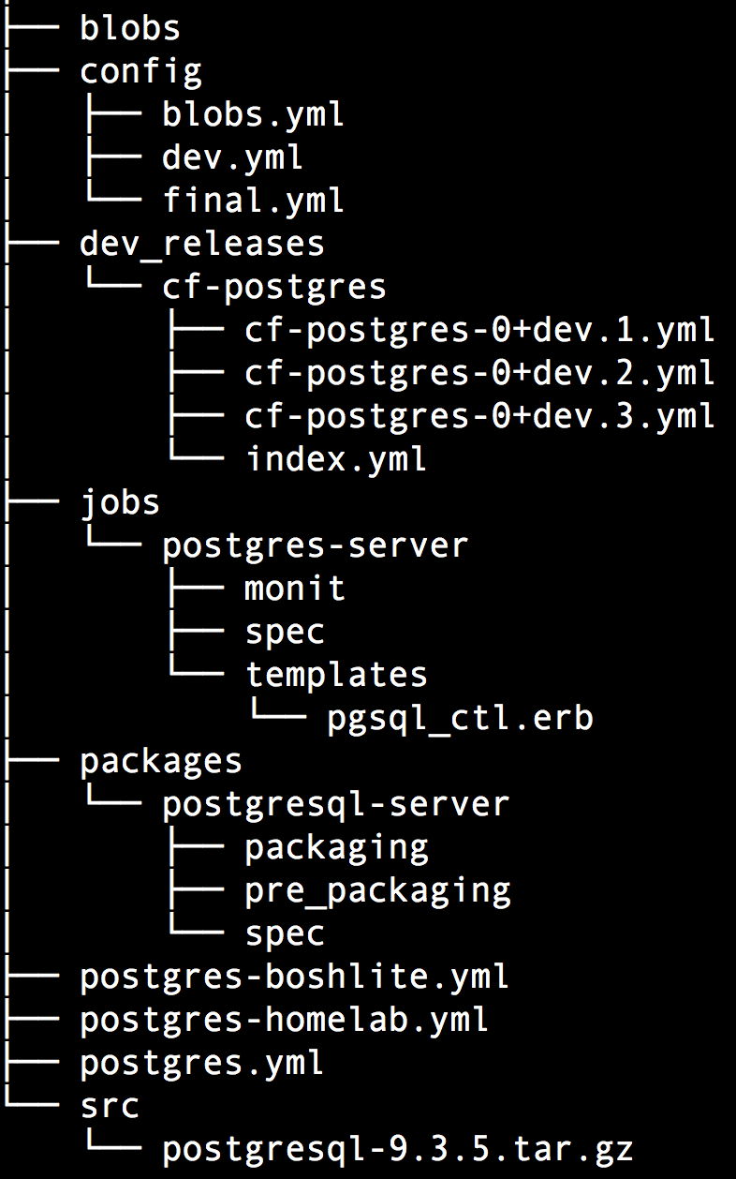
Lab 2: Big Picture
Deployment Manifest -postgres.yml-
4. Deployment postgres.yml
5. Deploy
warden container
Bosh-Lite 192.168.50.4
Postgres
10.68.45.151
Start scripts
Monitoring
Postgres Release
Source
Binaries
Bosh Director
6. Complete!
VM
2. Upload Release
1. Create Release
3. Upload Stemcell
Stemcell
Bosh Agent
Secured
IaaS-specifics

Slide 4


What is a BOSH deployment?
An encapsulation of software and configuration to be deployed to the cloud.
In BOSH terminology, an encapsulation of software releases and configuration declared via a manifest file to be deployed on VMs built from stemcells.
Manifest
Stemcell
Release
Notes:
A deployment is a collection of VMs, built from a stemcell, that has been populated with specific releases and disks that keep persistent data. These resources are created based on a manifest file in the IaaS and managed by the BOSH Director, a centralized management server.
The deployment process begins with deciding which Operating System images (stemcells) need to be used and which software (releases) need to be deployed, how to track persistent data while a cluster is updated and transformed, and how to automate steps of deploying images to an IaaS; this includes configuring machines to use said image, and placing correct software versions onto provisioned machines. BOSH builds upon previously introduced primitives (stemcells and releases) by providing a way to state an explicit combination of stemcells, releases, and operator-specified properties in a human readable file. This file is called a deployment manifest.
When a deployment manifest is uploaded to a BOSH Director, requested resources are allocated and stored. These resources form a deployment. The deployment keeps track of associated VMs and persistent disks that are attached to the VMs. Over time, as the deployment manifest changes, VMs are replaced and updated. However, persistent disks are retained and are re-attached to the newer VMs.

Slide 5
What is a stemcell?
A versioned Operating System image wrapped with IaaS specific packaging
Contains a bare minimum OS skeleton with a few common utilities, a BOSH agent, and a few configuration files to securely configure the OS
Stemcells do no contain any specific information about any software that will be installed
Notes:
A stemcell is a versioned Operating System image wrapped with IaaS specific packaging.
A typical stemcell contains a bare minimum OS skeleton with a few common utilities pre-installed, a BOSH Agent, and a few configuration files to securely configure the OS by default. For example: with vSphere, the official stemcell for Ubuntu Trusty is an approximately 500MB VMDK file. With AWS, official stemcells are published as AMIs that can be used in your AWS account.
Stemcells do not contain any specific information about any software that will be installed once that stemcell becomes a specialized machine in the cluster; nor do they contain any sensitive information which would make them unable to be shared with other BOSH users. This clear separation between base Operating System and later-installed software is what makes stemcells a powerful concept.
In addition to being generic, stemcells for one OS (e.g. all Ubuntu Trusty stemcells) are exactly the same for all infrastructures. This property of stemcells allows BOSH users to quickly and reliably switch between different infrastructures without worrying about the differences between OS images.
The Cloud Foundry BOSH team is responsible for producing and maintaining an official set of stemcells. Cloud Foundry currently supports Ubuntu Trusty and CentOS 6.5 on vSphere, AWS, OpenStack, and vCloud infrastructures.
Stemcells are distributed as tarballs.
By introducing the concept of a stemcell, the following problems have been solved:
Capturing a base Operating System image
Versioning changes to the Operating System image
Reusing base Operating System images across VMs of different types
Reusing base Operating System images across different IaaS

Slide 6
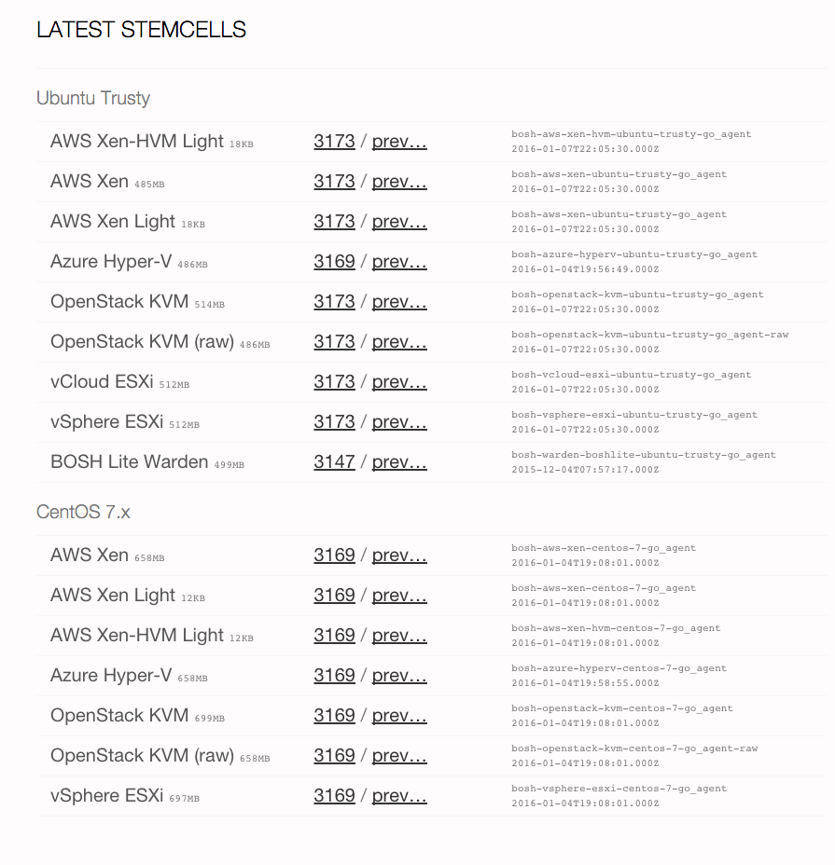
Available stemcells
http://bosh.io/stemcells

Slide 7
What is a release?
A versioned collection of source code, binary artifacts, configuration templates, and anything else required to build and deploy software in a reproducible way
Ultimatelly, a release is the layer placed on top of a stemcell
Releases should not be tied to a particular IaaS and stemcell and should not depend on internet access
Notes:
A release is a versioned collection of configuration properties, configuration templates, start up scripts, source code, binary artifacts, and anything else required to build and deploy software in a reproducible way.
A release is the layer placed on top of a stemcell. They are self-contained and provide very specific software for the purpose of that release. For example, a Redis release might include start-up and shutdown scripts for redis-server, a tarball with Redis source code obtained from the Redis official website, and a few configuration properties allowing cluster operators to alter that Redis configuration.
By allowing layering of stemcells and releases, BOSH is able to solve problems such as “how does one make sure that the compiled version of the software is reliably available throughout the deploy”, or “how to version and roll out updated software to the whole cluster, VM-by-VM, that other orchestration software is not able to solve”.
There are two common formats in which releases are distributed: artifacts checked into a git repository and as a single tarball.
By introducing the concept of a release, the following concerns are addressed:
Capturing all needed configuration options and scripts for deployment of the software
Recording and keeping track of all dependencies for the software
Versioning and keeping track of software releases
Creating releases that can be IaaS agnostic
Creating releases that are self-contained and do not require internet access for deployment

Slide 8
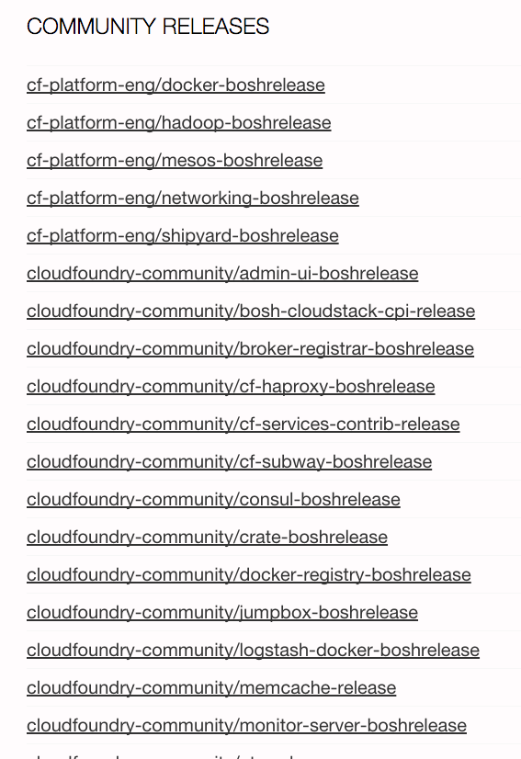
Available releases
http://bosh.io/releases
Notes:
A stemcell is a versioned Operating System image wrapped with IaaS specific packaging.
A typical stemcell contains a bare minimum OS skeleton with a few common utilities pre-installed, a BOSH Agent, and a few configuration files to securely configure the OS by default. For example: with vSphere, the official stemcell for Ubuntu Trusty is an approximately 500MB VMDK file. With AWS, official stemcells are published as AMIs that can be used in your AWS account.
Stemcells do not contain any specific information about any software that will be installed once that stemcell becomes a specialized machine in the cluster; nor do they contain any sensitive information which would make them unable to be shared with other BOSH users. This clear separation between base Operating System and later-installed software is what makes stemcells a powerful concept.
In addition to being generic, stemcells for one OS (e.g. all Ubuntu Trusty stemcells) are exactly the same for all infrastructures. This property of stemcells allows BOSH users to quickly and reliably switch between different infrastructures without worrying about the differences between OS images.
The Cloud Foundry BOSH team is responsible for producing and maintaining an official set of stemcells. Cloud Foundry currently supports Ubuntu Trusty and CentOS 6.5 on vSphere, AWS, OpenStack, and vCloud infrastructures.
Stemcells are distributed as tarballs.
By introducing the concept of a stemcell, the following problems have been solved:
Capturing a base Operating System image
Versioning changes to the Operating System image
Reusing base Operating System images across VMs of different types
Reusing base Operating System images across different IaaS

Slide 9
What is a deployment manifest?
A YAML file that identifies one or more releases, one or more stemcells and specifies how to orchestrate and configure them for a given deployment

Slide 10
Anatomy of a deployment manifest
Deployment identification
Releases
Networks
Resource Pools
Disk Pools
Jobs
Compilation
Update
Properties

Slide 11

Deployment Identification
Identifies the name of the deployment and the BOSH Director to be used
Deployment name
BOSH Director UUID

Slide 12

Releases
Identifies a collection of releases (name and version) we want to deploy
Release name
Release version

Slide 13
Networks
A BOSH network is an IaaS-agnostic representation of the networking layer. There are three types of networks that BOSH supports:
Manual: BOSH decides how to assign IPs
Dynamic: BOSH defers IP selection to the IaaS
VIP: Virtual IP address

Slide 14
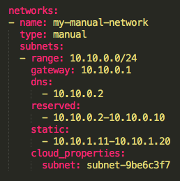
Manual networks
Manual networking allows you to specify one or more subnets and let BOSH choose available IPs from one of the subnet ranges
Network name
Network type
Network IP range
Network gateway IP address
DNS IP addresses for this network
IPs that will not be used
IPs that can only be used for static IP reservations
Specific IaaS Properties

Slide 15
Manual networks
10.10.0.0/24
10.10.0.1
Gateway: BOSH will configure each VM with this gateway
10.10.0.2
…
Reserved range: BOSH will NOT use these IP addresses
10.10.0.10
10.10.0.11
Static range: BOSH will ONLY use these IP addresses
when the job explicitely set one
…
10.10.0.20
10.10.0.21
…
Dynamic range: BOSH will use use these IP addresses
when the job does NOT explicitely set one
10.10.0.254
10.10.0.255
Broadcast: BOSH will NOT use this IP address

Slide 16
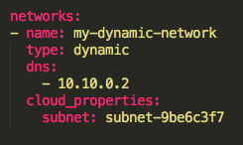
Dynamic networks
Dynamic networking defers IP selection to the IaaS
Network name
Network type
DNS IP addresses for this network
Specific IaaS Properties

Slide 17

VIP networks
VIP networking enables the association of a virtual IP address that is not backed by any particular NIC
Network name
Network type

Slide 18
IP reservation types
 | Manual | Dynamic | VIP
Static IP assignment | Supported | Not supported | Supported
Automatic IP assignment | Supported | Supported | Not Supported
Static: IP is explicitly requested by the user in the deployment manifest
Automatic: IP is selected automatically based on the network type

Slide 19
Multi-networks
IaaS | Manual | Dynamic | VIP
AWS | Single per job instance | Single per job instance | Single per job instance
OpenStack | Multiple per job instance | Single per job instance | Single per job instance
vSphere | Multiple per job instance | Not supported | Not supported
vCloud | Multiple per job instance | Not supported | Not Supported

Slide 20
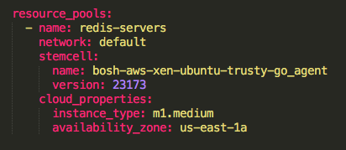
Resource Pools
Identifies a collection of VM specifications
Resource Pool name
Network to use
Stemcell (name and version)
Specific IaaS Properties

Slide 21
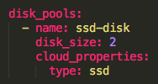
Disk Pools
Identifies a collection of disk specifications
Disk Pool name
Disk size (Mb)
Specific IaaS Properties

Slide 22
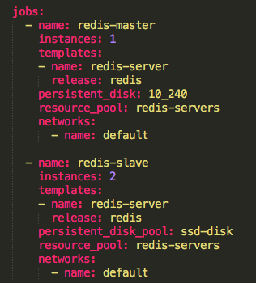
Jobs
A job is a composition of configuration and installed software on a particular VM
Name of the jobs
# of instances of this particular job
Release to be deployed and release process
Persistent disk or disk pool
Resource pool
Network

Slide 23
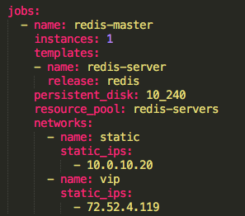
Job’s networks
Depending on the job’s network, additional properties might be configured
Manual networks allows to specify the desired private IP address(es)
VIP networks require to specify the public IP address(es)

Slide 24
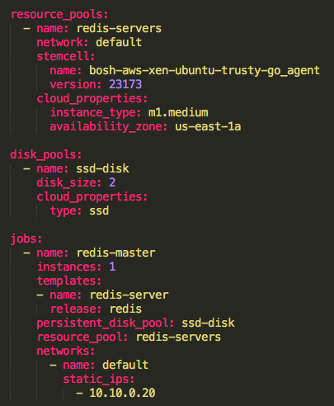
Jobs
Job
redis-servers
Instance 1
2Mb
SSD Disk
Ubuntu Trusty (23173)
m1.medium VM at us-east-1a
with IP address 10.10.0.20

Slide 25
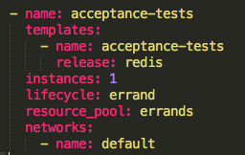
Job types
Service (default): runs indefinitely and restarts if it fails
Errand: starts with a manual trigger and does not restart if it fails
Job type

Slide 26
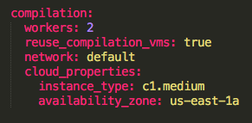
Compilation
Compilation VMs are ephemeral instances where the source code from a release package is converted to a binary compatible with the stemcell
# of compilation VMs
If VMs are re-used when compiling other packages
Network
Specific IaaS Properties

Slide 27
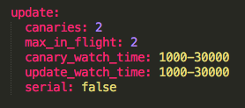
Update
Describes how BOSH updates job instances during the deployment
# of canary instances
Max # of non-canary instances to update in parallel
Wait time (ms) to check whether canary instances are healthy
Wait time (ms) to check whether instances are healthy
How jobs are updated (serial or parallel)

Slide 28

Canary Instances
Canary instances are instances updated before other instances. Any update error in a canary instance causes the deployment to stop. Since only canaries instances are affected before an update stops, problematic packages or jobs are prevented from taking over all job instances.
Canaries are Great! - https://blog.pivotal.io/pivotal-cloud-foundry/products/canaries-are-great

Slide 29
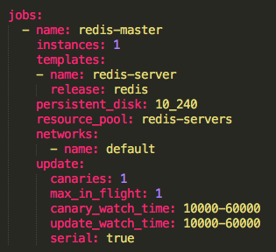
Update
Global update properties can be overriden for a particular job

Slide 30

Properties
Describes the global properties in order to configure jobs for a specific environment

Slide 31
Properties precedence
BOSH applies the properties in the release template spec file to the job.
If an identically named property exists in the Properties block of the deployment manifest, the value of this property overrides the previous value.
If an identically named property exists in the Properties sub-block of the Jobs block of the deployment manifest, the value of this property overrides all previous values.

Slide 32
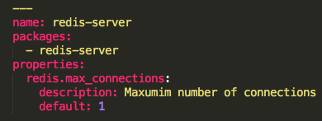
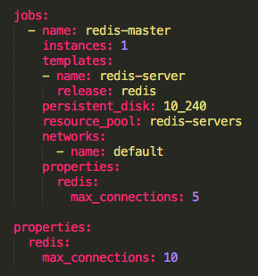
Properties order
Release template spec
Deployment manifest
3
1
Job properties
1
2
Global properties
3
Release template default
2

Slide 33
Changing the deployment manifest
An update of a release or stemcell version will trigger the compilation of (newer) packages and the update of the affected jobs
An update of a network properties might trigger a VM recreation (ie: modifying the network security group)
An update of a resource pool’s properties or a job’s resource pool will trigger a VM recreation
An update of a job’s network will trigger a VM recreation
An update of a job’s property will trigger the update of the job

Slide 34
Persistent disk considerations
Everything inside a VM is considered ephemeral except any attached persistent disk
A VM recreation will keep all data from the persistent disk intact
An update of the size and/or type of a persistent disk will trigger a migration of the data to a new persistent disk

Slide 35
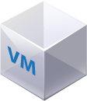

Persistent disks
A PD is attached to a VM
If the VM is deleted, the PD remains
The old PD is reattached to the new VM
PD
PD
PD

Slide 36
Persistent disk migration
A new PD is created with the new properties
The new PD is attached to the VM
The BOSH agent migrates the data from the old PD to the new PD
The old PD is detached and deleted
PD
PD
PD
PD
PD
PD
PD
PD

Slide 37
BOSH documentation
http://bosh.io/docs

Slide 38
Troubleshooting a BOSH deployment

Slide 39
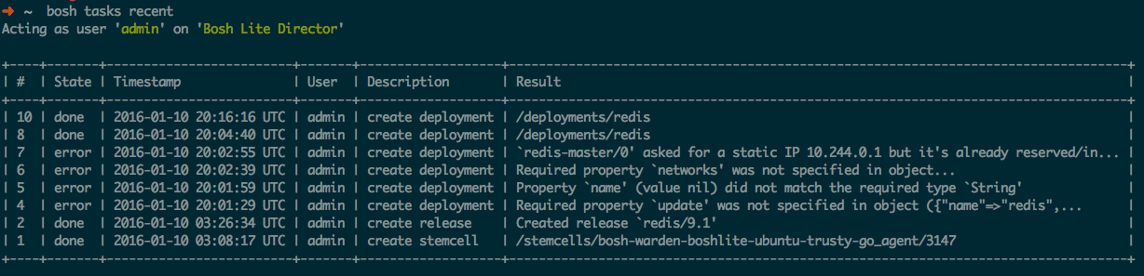
BOSH tasks
bosh tasks recent

Slide 40
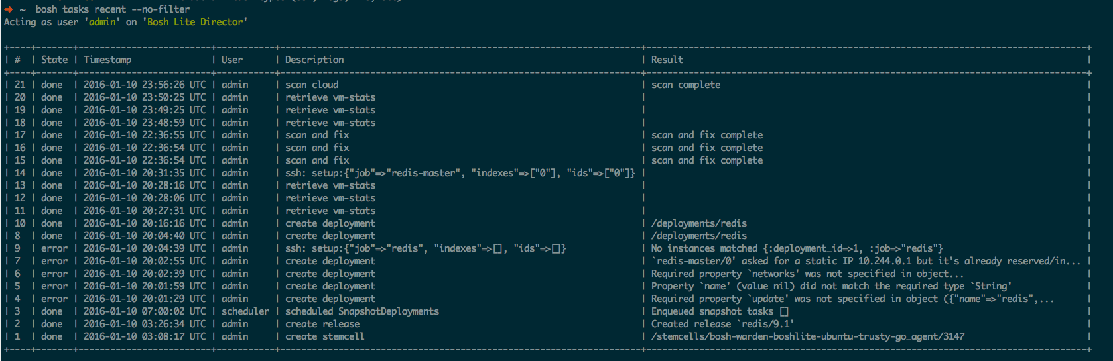
BOSH tasks
bosh tasks recent –no-filter

Slide 41
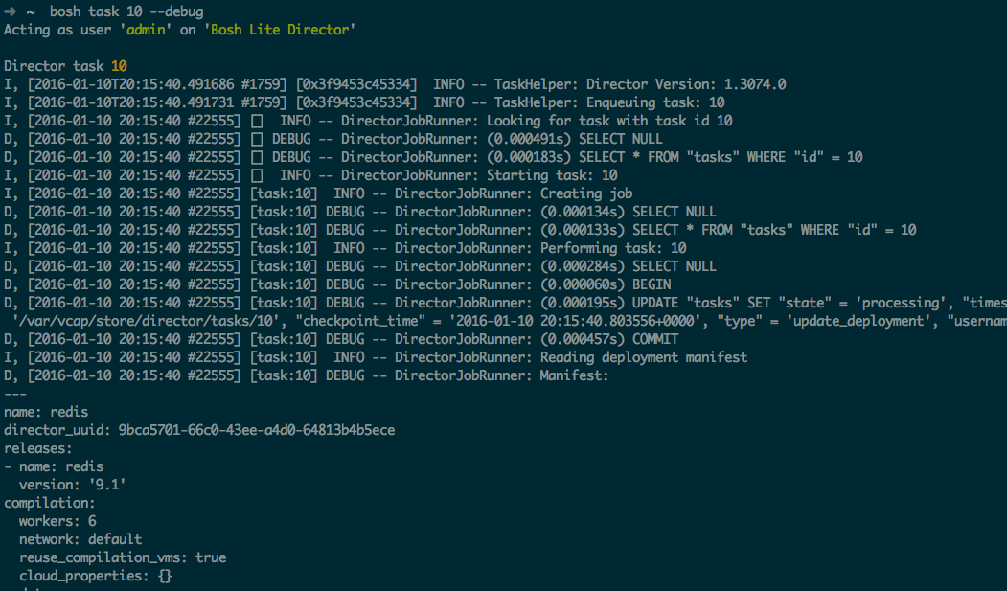
Debug a BOSH task
bosh task 10 --debug

Slide 42
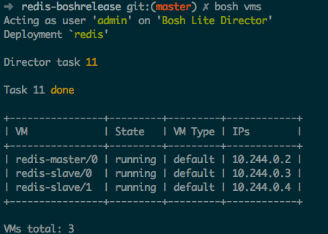
List VMs
bosh vms
running: indicates that all release job’s processes are successfully running at that moment
failing: indicates one of the release job’s processes is not successfully running (could be failing to start, or exiting after some time, etc.)
unresponsive: the Director did not receive any response from the Agent

Slide 43
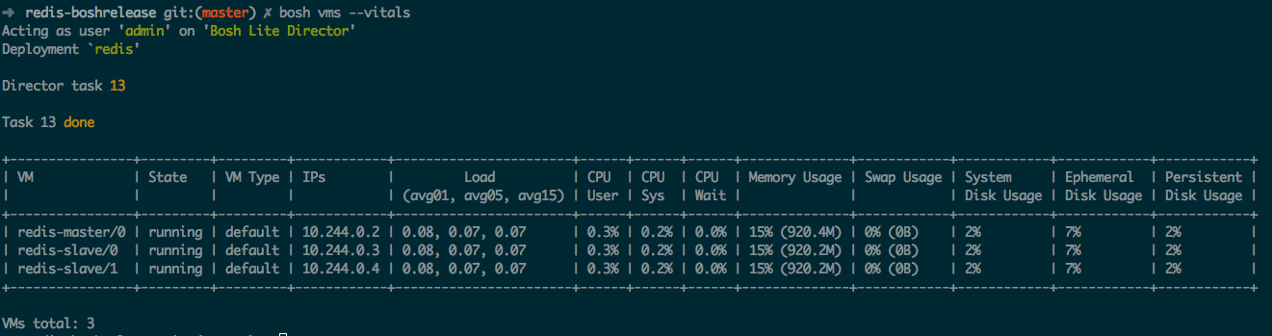
Monitor VM’s state and vitals
bosh vms --vitals

Slide 44
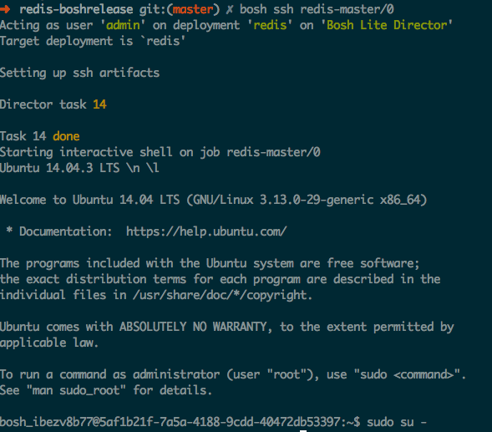
SSH into a VM
bosh ssh job/index
The Agent on each VM sends an alert when someone/something tries to log into the system via SSH. Successful and failed attempts are recorded.
Some IaaS set a “secret” root password. By default is “c1oudcw0” (SHHH!!!)

Slide 45
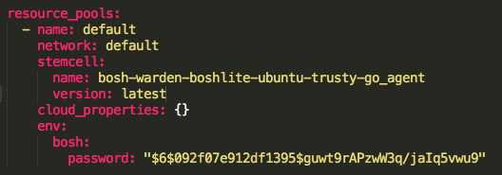
Setting a custom root password
Hashed password - Generate SHA hash using “mkpasswd -m sha-512”

Slide 46
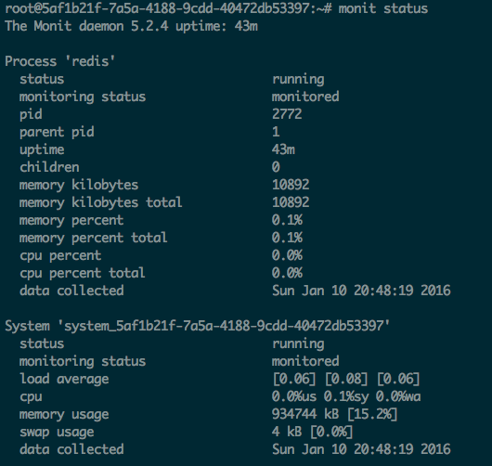
Process health-check
“monit summary”
“monit (status|start|stop)”
https://mmonit.com/monit/

Slide 47
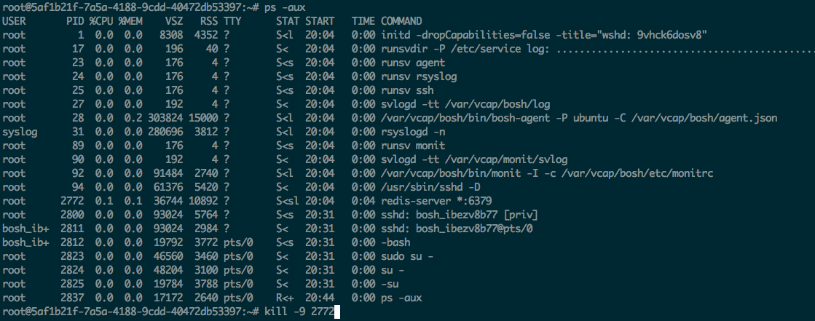
Process recovery in action
If a process dies, the BOSH agent will restart it again automatically

Slide 48
VM health-check
The Health Monitor continiously checks the presence of the deployed VMs.
The Agent on each VM produces a heartbeat every minute and sends it to the Health Monitor.
The Health Monitor is extended by a set of plugins. Each plugin is given an opportunity to act on each heartbeat, so in cases of failure it can notify external services or perform actions against the Director.

Slide 49
Health Monitor plugins
Event Logger: Logs events to a file
Resurrector: Recreates VMs that have stopped heartbeating
Emailer: Sends configurable e-mails on events reciept
OpenTSDB: Sends events to OpenTSDB
Graphite: Sends events to Graphite
PagerDuty: Sends events to PagerDuty.com using their API
DataDog: Sends events to DataDog.com using their API
AWS CloudWatch: Sends events to Amazon’s CloudWatch using their API
Configuring Health Monitor: http://bosh.io/docs/hm-config.html

Slide 50
Resurrector Health Monitor plugin
It’s responsible for automatically recreating VMs that become inaccessible.
It continiously cross-references VMs expected to be running against the VMs that are sending heartbeats. When resurrector does not receive heartbeats for a VM for a certain period of time, it will kick off a task on the Director (scan and fix task) to try to “resurrect” that VM.
Under certain conditions the Resurrector will consider the system in the “meltdown” and will stop sending requests to the Director.

Slide 51
Automatic repair with Resurrector
Redis Master
Desired State
Actual State
AGENT
Health Monitor
BOSH Director
Responses:
Redis Slave
pager
AGENT
Message Bus
email
monitoring
resurector
Redis Slave
…
AGENT
BOSH
IaaS

Slide 52
Automatic repair with Resurrector
Redis Master
Desired State
Actual State
AGENT
Health Monitor
BOSH Director
Responses:
Redis Slave
pager
AGENT
Message Bus
email
monitoring
resurector
Redis Slave
…
AGENT
BOSH
IaaS

Slide 53
Automatic repair with Resurrector
CPI
Redis Master
Desired State
Actual State
AGENT
Health Monitor
BOSH Director
Responses:
Redis Slave
pager
AGENT
Message Bus
email
monitoring
resurector
Redis Slave
…
AGENT
BOSH
IaaS

Slide 54
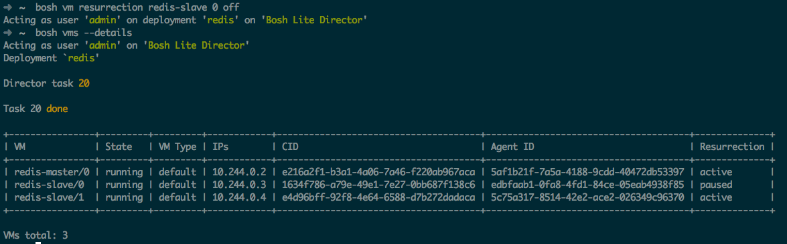
Manually Disabling the Resurrector
“bosh vm resurrection job index on|off”

Slide 55
Manual repair with Cloud Check
BOSH provides the Cloud Check CLI command (a.k.a cck) to repair IaaS resources used by a specific deployment. It is not commonly used while normal operations; however, it becomes essential when some IaaS operations failed and the Director cannot resolve problems without a human decision or when the Resurrector is not enabled.
VM is missing
VM is not responsive (unresponsive agent)
Persistent Disk is not attached
Persistent Disk is missing

Slide 56
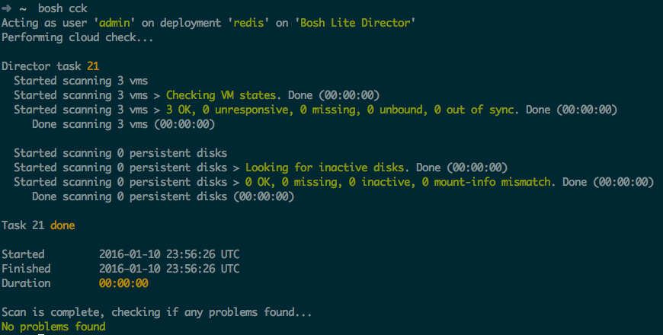
Manual repair with Cloud Check
bosh cck

Slide 57
VM Configuration Locations
/var/vcap/bosh/log/current: current BOSH agent log
/var/vcap/monit/monit.log: Monit activity log. Includes information about starts, stops, restarts, etc. of release job processes monitored by Monit

Slide 58
VM Configuration Locations
/var/vcap/jobs: contains evaluated release jobs for the assigned deployment job
/var/vcap/packages: contains enabled release packages for the assigned deployment job
/var/vcap/data: used by the release jobs to keep ephemeral data
/var/vcap/store: used by the release jobs to keep persistent data

Slide 59
VM Configuration Locations
/var/vcap/sys/run: directory that is used by the release jobs to keep miscellaneous ephemeral data about currently running processes, for example, pid and lock files
/var/vcap/sys/log: directory that is used by the release jobs to keep logs

Slide 60
Log rotation
BOSH log rotates release job logs with the Logrotate log file management utility with the following non-configurable settings:
missingok: Skip missing log files and do not generate an error message
rotate 7: Keep seven log files at a time
compress: Compress old log files with gzip
delaycompress: Postpone compression of log files until the next rotation cycle
copytruncate: Copy log files, then truncate in place instead of creating new files
size 50M: Rotate log files when they exceed 50 MB in size.

