Slide 1


Lab 3: Creating a Bosh Release "from scratch"

Slide 2




Anatomy of a BOSH release
Release
Job
Stemcell
Monit script
OS Process
OS Process
Instantiated in runtime based on
OS Process
Agent
Monit
Monit
Monit
Scripts:
Depends
src
Packaging
Depends
Packages
Pre-Packaging
Depends
Blobs
Depends

Slide 3
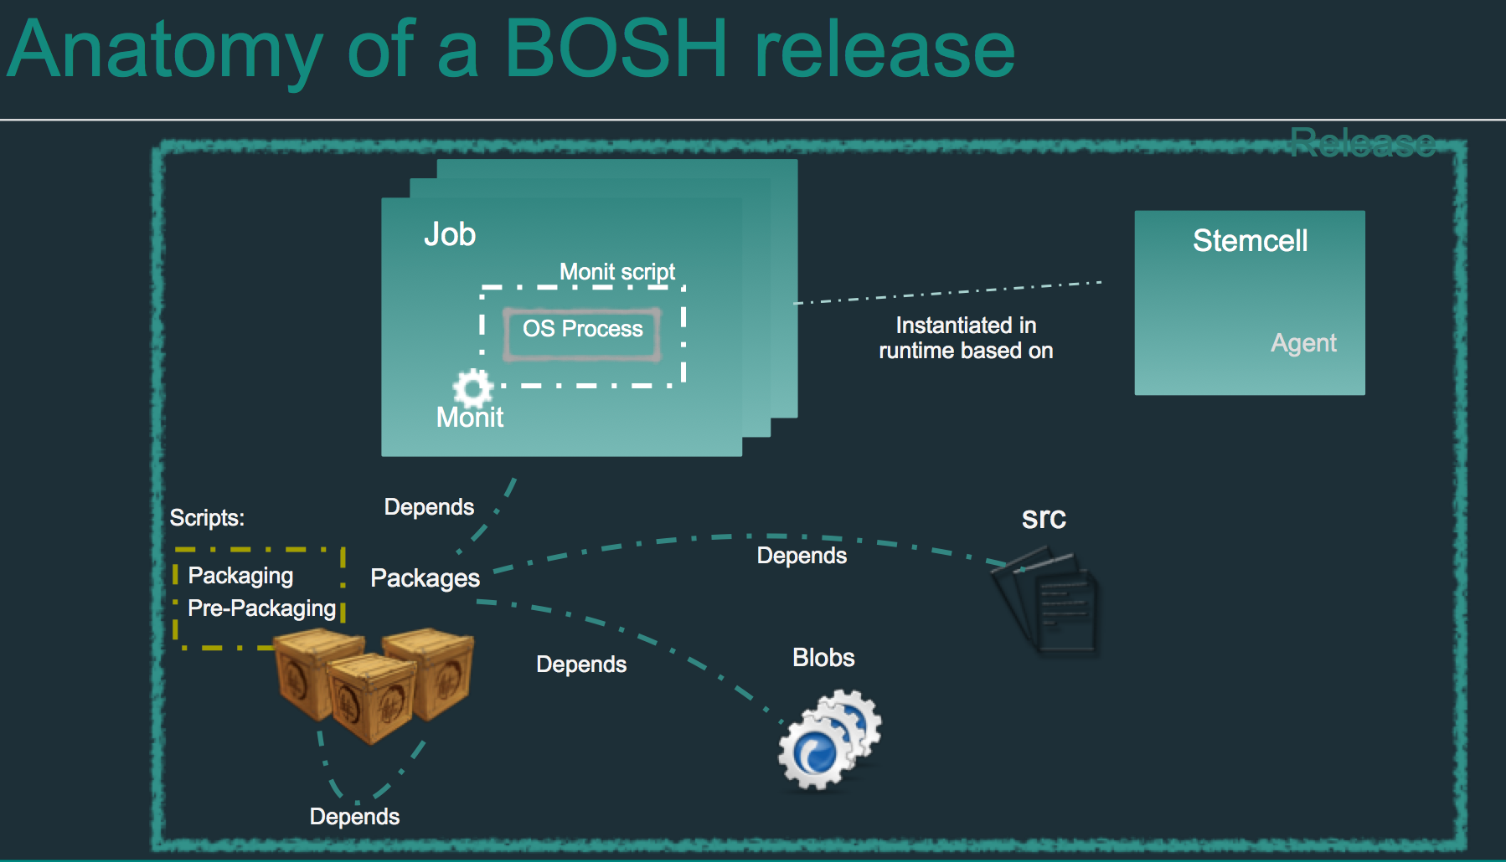
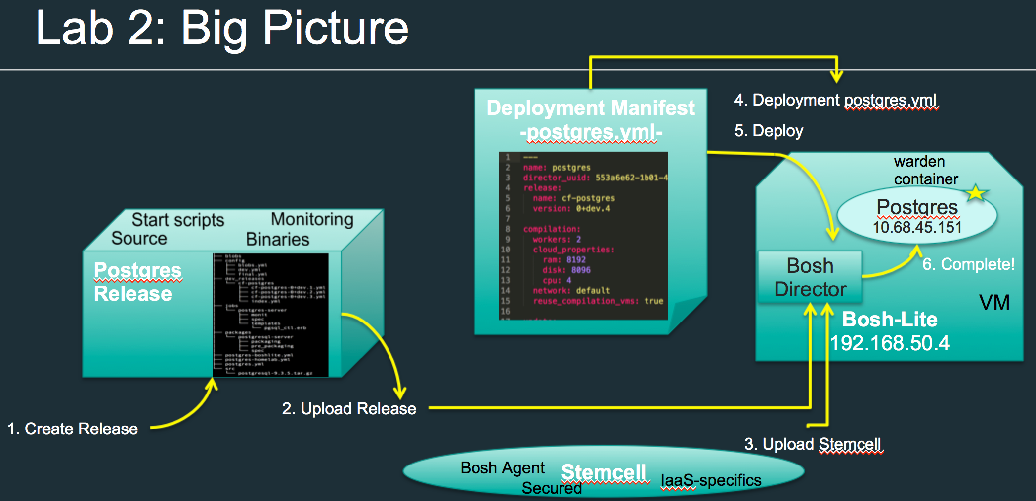
Lab 3: Big Picture
Create Jobs, Packages, Scripts and Assemble them into a new Release

Slide 4
Anatomy of a BOSH release

Slide 5
What is a release?
A versioned collection of source code, binary artifacts, configuration templates, and anything else required to build and deploy software in a reproducible way
Ultimatelly, a release is the layer placed on top of a stemcell

Slide 6
Elements of a release
Jobs: describes pieces of the service or application you are releasing
Packages: provides software to jobs
Source: provides packages the non-binary files they need
Blobs: provide packages the binaries they need, other than binaries that are checked into a source code repository

Slide 7

What is a package?
A Package provides executables, source code and dependencies to jobs
It should not be tied to a particular stemcell and should not depend on internet access
Never depend on the presence of libraries or other software on stemcells
It is composed of a source code and/or a blob and instructions on how to build it

Slide 8

Package’s spec file
Package name
Package’s dependencies (at compile time)
The location where BOSH can find the binaries and other files that the package needs at compile time.
BOSH interprets the locations you record in the files section as being relative either in the “src” directory or in the “blobs” directory

Slide 9
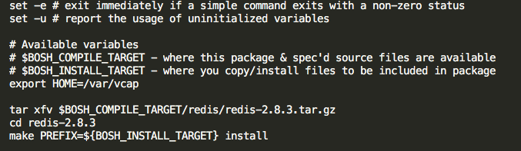
Package’s packaging script
Ensure that any copying, installing or compiling delivers resulting code to the install target directory

Slide 10
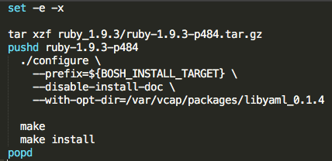

Package’s dependency graph
Be aware that BOSH ensures that dependencies cited in the dependencies block of package spec files are available to the deployed binary, but only at compile time

Slide 11

Sources
Provides packages with the non-binary files they need
We store them at the “src” directory
Use the globbing pattern <package_name>/**/* to deep-traverse the directory in src where the source code should reside

Slide 12
Blobs
Packages often use tar files or other binaries, also known as blobs
Checking blobs into a repository is problematic if your repository is unsuited to dealing with large binaries (as is true of Git, for example)
We store them at the “blobs” directory

Slide 13
Configuring a blobstore
In the config directory, you record the information BOSH needs about the blobstore:
The final.yml file names the blobstore and declares its type, which is either local or one of several other types that specify blobstore providers.
The private.yml file specifies the blobstore path, along with a secret. It contains keys for accessing the blobstore and should not be checked into a repository.

Slide 14
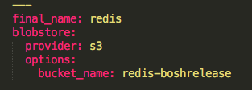
final.yml example for AWS S3 blobstore
Release name
Blobstore type
Specific blobstore configuration

Slide 15

private.yml example for AWS S3 blobstore
Specific blobstore configuration
Never check this file into a repository!!!

Slide 16
What is a job?
A job describe pieces of the service or application you are releasing:
What packages depends on
How to start/stop it
How to monitor it
What properties can be configured

Slide 17
Elements of a Job
Spec: describes the job specification (package’s dependencies, templates and properties)
Monit: describes how to run the job’s processes
Templates: control scripts, configuration files, …

Slide 18
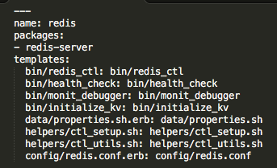
Spec file
Job name
Job’s package dependencies
Job’s template

Slide 19
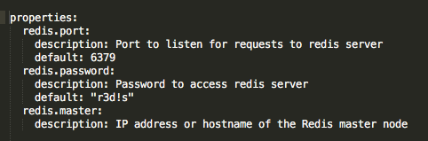
Spec file
Property name
Property description
Property default value

Slide 20

Monit file
Process name
How to monitor the process
How to start/stop the process
Ownership of the process

Slide 21
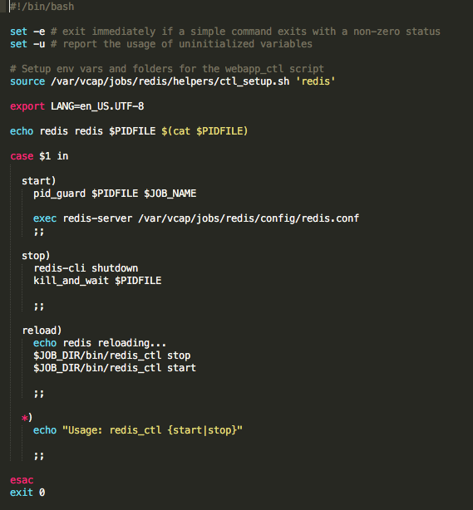
Templates

Slide 22
Special scripts
bin/pre-start: will run before the job is started. This script allows the job to prepare machine and/or persistent data before starting its operation.
bin/drain: will run when the job is restarted or stopped. This script allows the job to clean up and get into a state where it can be safely stopped
bin/run: will run a job’s errand

