Slide 1

Thales Avionics
DevOps Workshop
August 10, 2016

Slide 2





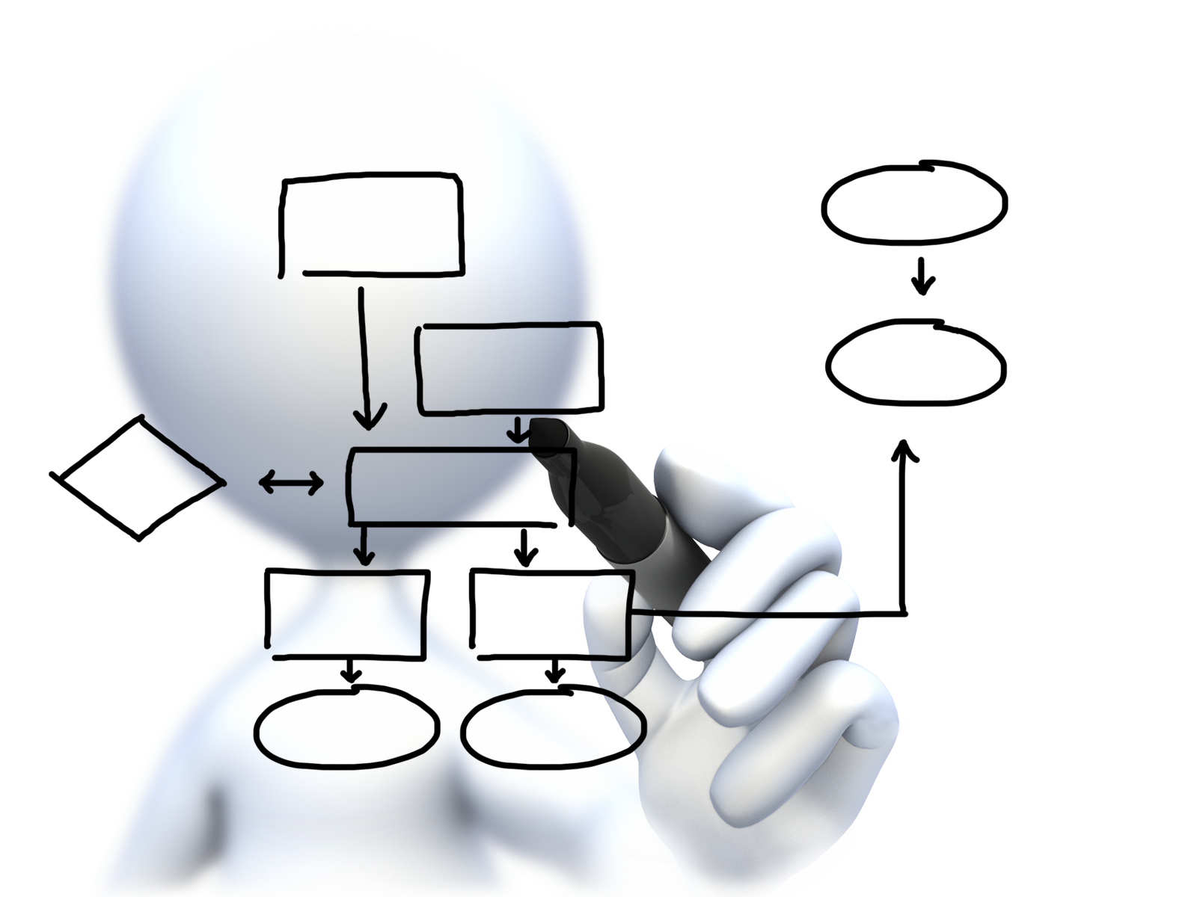


Plan capacity
Setup High Availability
Install the platform
Operator Concerns
Manage users
and quotas
Handle upgrades and updates
Monitor the platform

Slide 3
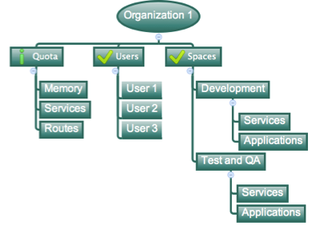
Orgs, Spaces, Users and Quotas

Slide 4
Organizations
Logical division within a PCF Foundation.
Each organization has its own users and assigned quota
User permissions / roles are specified per space within an organization
Further Sub-divided into Spaces

Slide 5
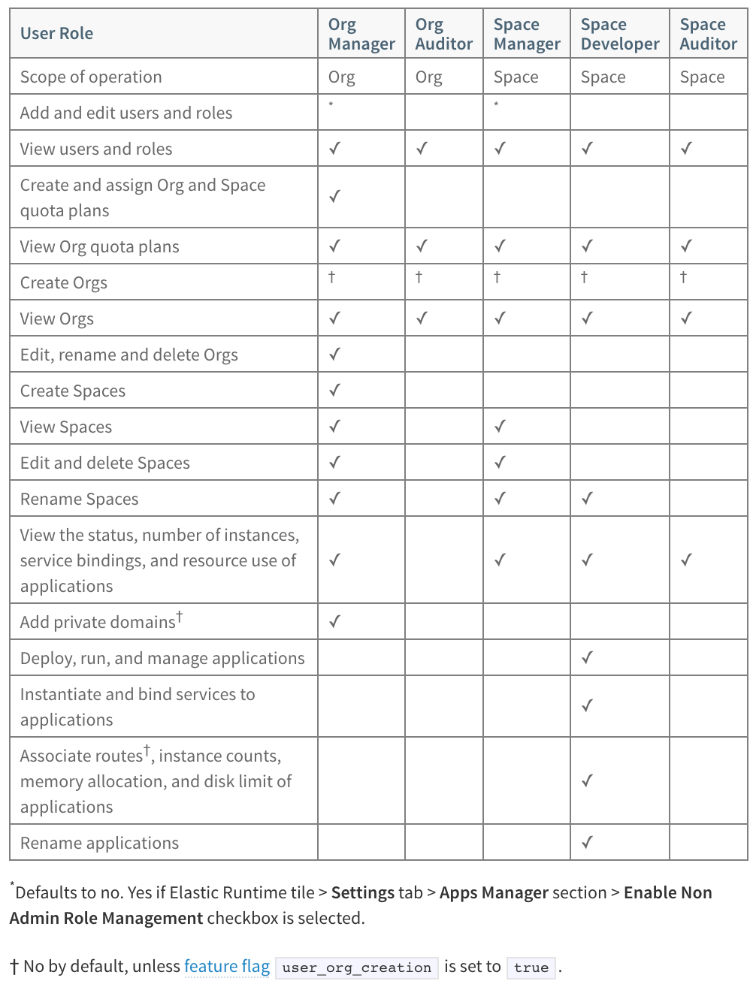
Roles & Permissions
Org Managers are managers or other users who need to administer the account.
Org Auditors view but cannot edit user information and org quota usage information.
Space Managers are managers or other users who administer a space within an org.
Space Developers are application developers or other users who manage applications and services in a space.
Space Auditors view but cannot edit the space.
http://docs.pivotal.io/pivotalcf/1-7/concepts/roles.html#roles

Slide 6
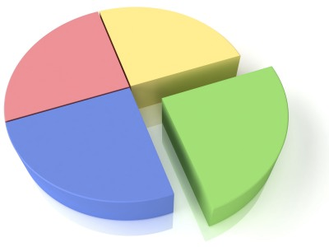
Quotas and Plans
Different quota limits (e.g. “small”, “enterprise”, “default”, “runaway”) must be assigned per Organization, and may be assigned per space
Quota defines
Max Memory
App Instance Limit
Total # of Services
Total # of Routes
Total Reserved Route Ports
http://docs.pivotal.io/pivotalcf/1-7/adminguide/quota-plans.html

Slide 7
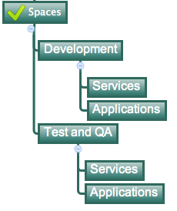
Spaces
Logical sub-division within an organization
Users authorized at an organization level can have different roles per space
Services and Applications are created / specified per Space
Same Service can have different meanings per space

