Slide 1
Getting to know you!
http://www.youtube.com/watch?v=Tx1XIm6q4r4

Slide 2



Differentiation in the ESL class
DP
QEP
RREALS 2007
Source: Montérégie—Research and Development Project
Workshop leaders: Gwenn Gauthier and Rachel Lalonde

Slide 3
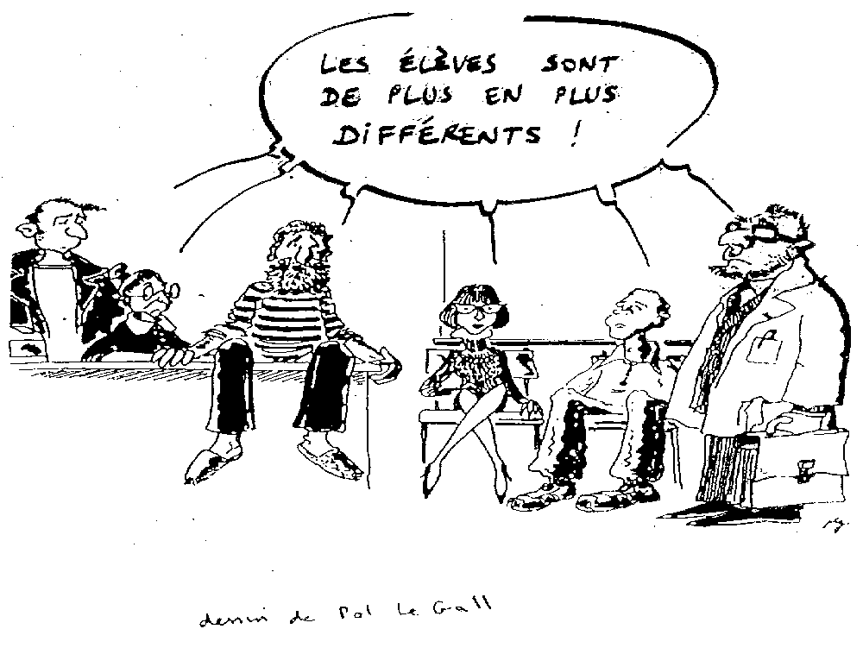
Today’s kids just seem
all so different.

Slide 4








In order to be equitable and just, the instructions for the task will be the same for all.
Everybody, climb that tree!

Slide 5
Aim of the workshop
1. What is differentiation?
  Getting a common understanding of differentiation
    During the learning process
    During the evaluation process
2. How to apply it in the ESL class?

Slide 6
Three objectives
Foster and implement differentiation practices at the elementary and secondary levels, ESL classes;
Foster ongoing training and professional development of the various participants;
Present a few examples to help teachers implement differentiation in their teaching practices.
Notes:
integrating certain students with special needs;

Slide 7
Research and development
Research
Construct meaning
Training
Professional development
of participants
Action
Beneficial changes
for learners
Inspiré de Dolbec (2004)

Slide 8
Examples linked to RESEARCH
To clarify the difference between varying and adapting teaching practices in a pedagogical differentiation context.
To offer an effective PD model in order to improve la conscience phonologique of students at the Elementary first cycle level.
To validate the effectiveness of a specific procedure for using compensatory strategies in ESL.
Etc.

Slide 9
Examples linked to TRAINING
To acquire a precise concept of the process of pedagogical differentiation.
To understand the use of diagnostic evaluation.
To understand how students develop a competency in Math within the cycle.
To develop skills such as modelling a task.
Etc.

Slide 10
Examples linked to ACTION
Set up a de-compartmentalization project for reading.
Create a common visual support system of the learning strategies for developing the CCC Adopts effective work methods.
Modify our classroom management to allow for remediation clinics.
Etc.

Slide 11
For more information
http://vitrine.educationmonteregie.qc.ca/rubrique.php3?id_rubrique=248
DP
QEP

Slide 12

United we stand
In teams of 4, with the help of the words listed below, write your own definition of PD.
learning style | content | cycle team | work procedure
difference | progress | adaptation | integration
learning rate | diagnostic | individualisation | flexibility
respect | competency | preoccupation | organisation
growth | success | education | knowledge
work methods | heterogeneity | role of the teacher | basis
classroom management | diversity | pedagogical approach | planning
broad-mindedness | production | learning difficulty | development
process | interest | cooperation | philosophy
procedure | motivation | way | measures
10 minutes

Slide 13
Model of the pedagogical situation
SUBJECT
Student
Small group of students
Large group of students
AGENT
Teacher
Cycle-team
Remedial specialist
Parent
Pedagogical material,
methods, approaches
QEP
OBJECT
Competencies
(subject-specific
and cross-curricular)
Time (schedule)
Classroom set-up
Material resources
Human resources
(school principal, colleagues,
consultants, etc.)
Milieu
Notes:
SOMA

Slide 14
Survey on PD practices
28 models
8 school boards

Slide 15
Levels of teaching
Preschool Elementary Overall elementary Elementary Cycle One Elementary Cycle Two Elementary Cycle Three Secondary Secondary Cycle One Secondary Cycle Two | 3% 86% 17% 42% 29% 12% 11% 67% 33%

Slide 16
Subjects
One student Group of students from same class Students of the class Students from 2 to 6 classes Students of a school | 7% 4% 29% 50% 10%

Slide 17
Types of classes
Regular classes Regular classes integrating students with special needs Special needs classes | 75% 18% 7%

Slide 18
Target Learning Object(s)
QEP
Language Reading Writing Communicating Math Phys. Ed. and Health Social Sc. CCC | 61% 65% 29% 6% 29% 4% 4% 2%

Slide 19
Number of competencies targeted
QEP
All Many (more than 5) Less than 5 One | 14% 18% 32% 36%

Slide 20
Links between…
-competencies targeted/QEP
QEP
Explicitly Non-explicitly | 71% 29%
-competencies targeted /S
Yes No | 57% 43%

Slide 21
Pedagogical Structures
De-compartmentalization Other (varied) tutoring reading clubs workshops project-based learning adaptation of homework explicit teaching variation of content, process, structure and product | 36% 64%

Slide 22
Milieu
Schedule modification Freeing up teachers for ongoing training Classroom setup Creating/purchasing material Collaborators | 50% 21% 61% 50% 71%

Slide 23
Teachers / collaborators
Remedial specialist, NTP, CP, principals, parents, etc. / collaboration Level team / collaboration Cycle team /collaboration | 71% 29% 14%

Slide 24
Carrying out a planned application of PD
Existing situation / Desired situation Planning the action (explicitly linked to the desired situation) Action Evaluating the action | 39% 39% 100% 14%
Notes:
Defining the existing situation and desired situation

Slide 25
Evaluation
Links targeted competencies /evaluation Reference to the contribution of the experiment on one or some affective dimensions of the subject(s) (motivation, self esteem, interest, etc.) | 53% 53%
Notes:
Of the 14 % that evaluated their action

Slide 26

Think and Share…
What surprises me?
How is this similar or different from my milieu ?
A question that arises from our discussion is...
10 minutes

Slide 27
Angst!
http://www.youtube.com/watch?v=xD-Huwlg2kY&mode=related&search=
Angst, often confused with anxiety, is a transcendent emotion in that it combines the unbearable anguish of life with the hopes of overcoming this seemingly impossible situation.
Angst denotes the constant struggle one has with the burdens of life that weighs on the dispossessed and not knowing when the salvation will appear

Slide 28
Different appellations
France
United-States
Québec
Differentiation
Differentiation of teaching (Perrenoud, 1977)
Differentiation of learning (Caron, 2003)
Pedagogical differentiation (MELS, 2001)
Differentiation of the pedagogy (Aylwin, 1992)
Differentiated pedagogy (Legrand, 1973; CSE, 1993)
Differentiated teaching
Individual learning (Hunter, 1972, Legendre, 1988)
Differentiated Instruction (Tomlinson, 1995; Nordlund, 1995)
Individualization (Leselbaum, 1994)
Individualisation of the teaching (Bégin, 1980; Legendre, 1988)
Adaptation of the teaching (St-Laurent, 2005)

Slide 29
Appellations diverses
France
États-Unis
Québec
Différenciation
Différenciation de l’enseignement (Perrenoud, 1977)
Différenciation de l’apprentissage (Caron, 2003)
Différenciation pédagogique (MELS, 2001)
Différenciation de la pédagogie (Aylwin, 1992)
Pédagogie différenciée (Legrand, 1973; CSE, 1993)
Enseignement différencié
Enseignement individualisé (Hunter, 1972, Legendre, 1988)
Differentiated Instruction (Tomlinson, 1995; Nordlund, 1995)
Individualisation (Leselbaum, 1994)
Individualisation de l’enseignement (Bégin, 1980; Legendre, 1988)
Adaptation de l’enseignement (St-Laurent, 2005)

Slide 30
Definition 1
Fundamental pedagogical principle
according to which educational actions
adapted to the characteristics of the
student encourages his/her learning and
academic success.
Dimension of all pedagogy that shows a will to master the diversity of educational experiences in order to create less unfairness (Perrenoud, 1997).

Slide 31
Definition 2
Approach, model or teaching style that proposes means and specific procedures in order to harmonize the components and relationships of a particular pedagogical situation in order to favour learning.
Pedagogical differentiation is a teaching method that we must develop in regards to heterogeneous students. (De Peretti, 1992).

Slide 32
Definition 3
Action of the pedagogue who, on the basis of a
solid knowledge of:
1) the characteristics and readiness of the students
2) pedagogical approaches and diversified interventions
3) the QEP (learning object) and
4) the learning environment
tends to harmonize these different components
of a pedagogical situation, and their relationships,
in order to foster learning.
Notes:
Entry point: prior knowledge, strategies, life experience,

Slide 33
The Conseil supérieur de l’éducation defines pedagogical differentiation as a process that draws upon a diversified set of teaching
and learning methods
in order to allow students
of different ages, backgrounds, abilities and skills
to reach common goals
via different paths and, ultimately, to achieve educational success.
(Conseil supérieur de l’éducation 1993 d’après Legrand 1973).
QEP

Slide 34
Finalities of PD
Reach common targeted objectives
(academic success)
and
Learn and succeed in an optimal fashion
(educational success)

Slide 35
A procedure for pedagogical differentiation
Wherein pedagogical differentiation is essential (key) to the student’s learning…
1
Defining the existing situation
or problem
(Diagnostic evaluation)
5
Evaluating
the action
2
Defining the
desired situation
LEARNING
QEP
Carrying out the plan
3
Planning
the course of action
Guay, Blais, Daneault, Gendron, Girard et Legault CS Trois-Lacs (2005)

Slide 36
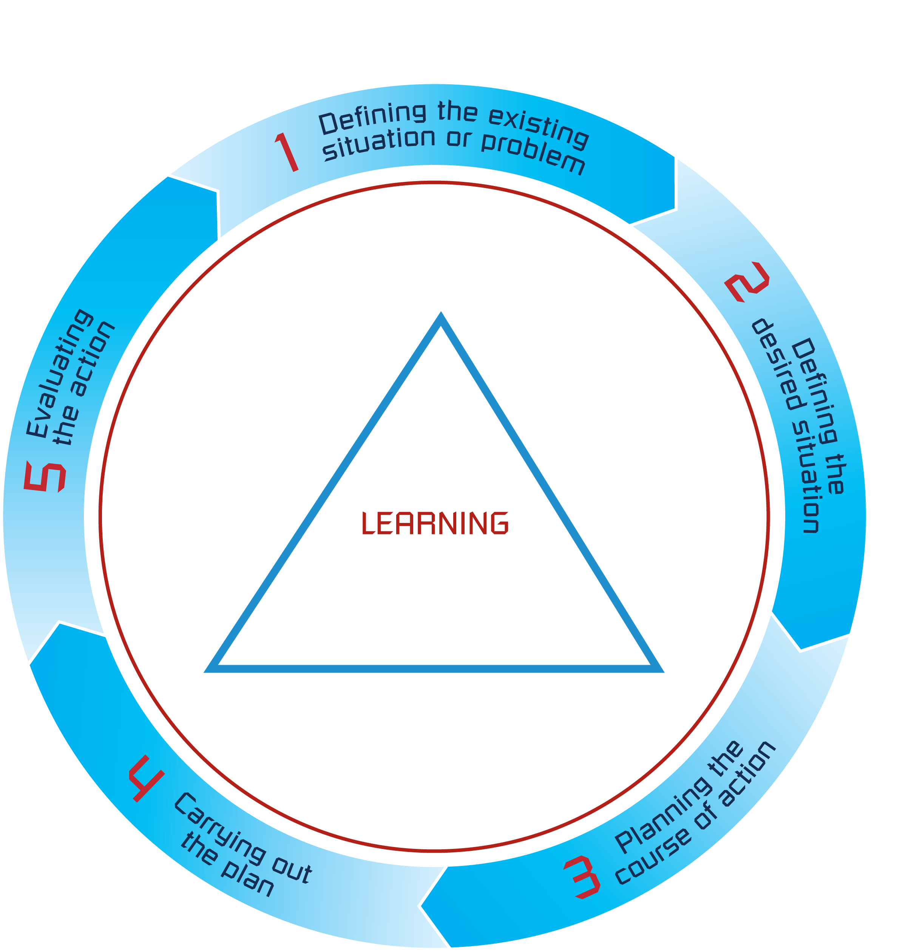

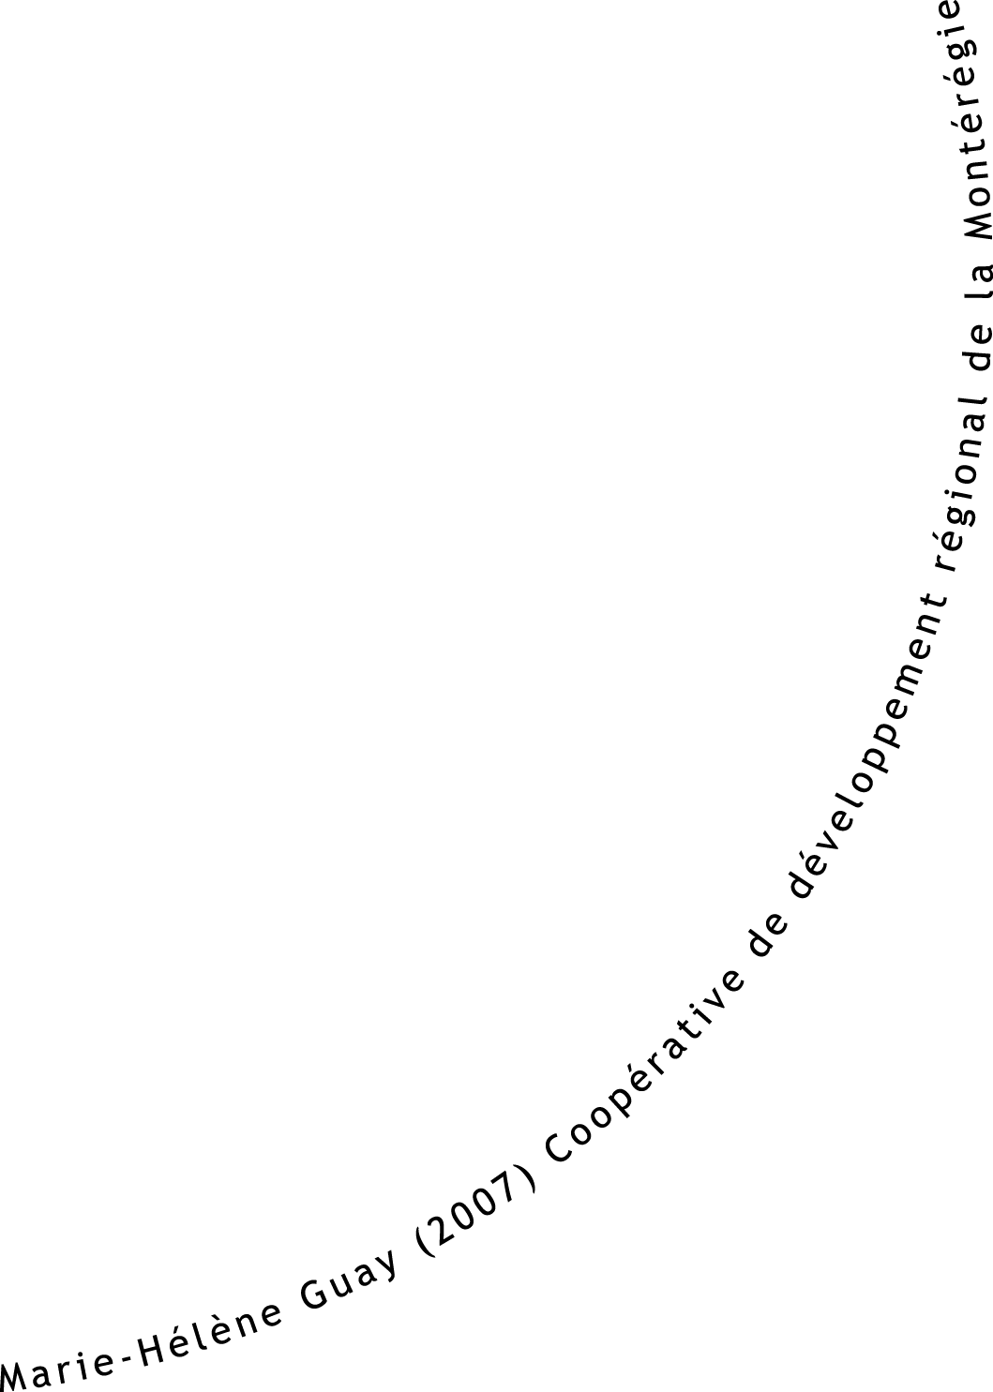




Slide 37
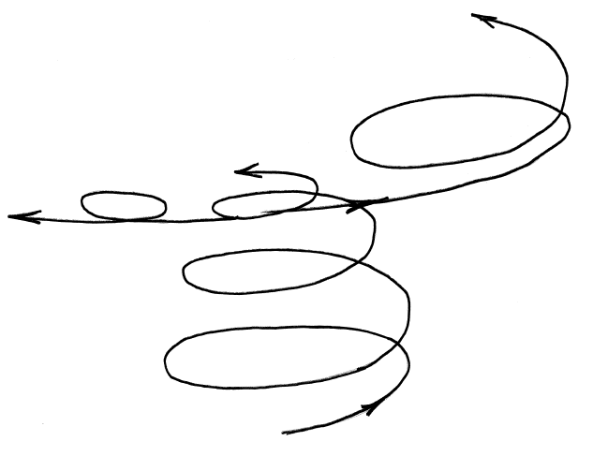
Loop 5…
Loop 4
Loop 3
Loop 2
Loop 1

Slide 38
Some targeted competencies
Commission scolaire | Compétence(s) ciblée(s)
Cs Marie-Victorin | Adopts effective work methods / ESL + Math
Cs des Patriotes | Adopts effective work methods …perseverence/French + Math + ESL
Cs Sorel-Tracy | Adopts effective work methods / ESL + MRI
Cs des Grandes-Seigneuries | Adopts effective work methods / Writes texts/ Reads

Slide 39
Definition of a competency
A competency is the capacity to act effectively by drawing on a variety of resources (MELS, 2001).

Slide 40
Metacognition
Knowledge
Attitudes and perceptions
Prior knowledge
Degree of comprehension
Stage of development
Level of development
Etc.
Self-esteem
Stress
Anxiety
School me
Interests
Motivation
Aspirations
State of mind
Attitudes
Perceptions
Etc.
Learning process
Learning styles
Type of intelligence
Studying strategies
Communication skills
Cooperation skills
Information processing skills
Mental picture management
Etc.
Age
Sex
Nationality
Autonomy
Creativity
Circadian rythm
Etc.
Marie-Hélène Guay (2005) CSTL
Notes:
Circadian rythm: All living beings – plants, animals, and human beings – are regulated by biological cycles, or, in other words, biological events that repeat themselves at regular intervals. The rhythm of these cycles is called circadian – from the Latin circa (about) and dies (day) – when it spans about 24 hours. In humans, the sleep-wake cycle obeys a circadian rhythm.

Slide 41
Tools for diagnostic evaluation
Collecting data
Formal and structured
Spontaneous and non-structured
Questionnaire
Graphic organizer/mind map
Audio or video recording
Drawing
Test
Observation grid
Interview
Checklist
Etc.
Questioning
Interview
Exchange
Discussion
Observation
Annotations
Etc.
Consigning data
Student
Teacher
Portfolio
Logbook or journal
Etc.
Portfolio
Logbook or journal
Anecdotal comments
Intervention plan
Etc.
Done by
Teacher
Teacher and student
Student alone
Student by student
Remedial specialist
Etc.
Guay, Blais, Daneault, Gendron, Girard et Legault CSTL (2005)
Notes:
Rachel and Gwenn present their things.

Slide 42
In Sorel-Tracy
Diagnostic evaluation tools:
  Teacher’s observations
  Questionnaire
  Discussions
  Anecdotal comments

Slide 43
Defining the existing situation or problem / Defining the desired situation
1. Which competency do our students or part of our students have problems developing?
QEP
5. Which competency do we want to target?
CCC : Adopts effective work methods. ESL C1: Interacts orally in English. | Evaluation criteria CCC : Adopts effective work methods. Appropriate choice of methods. Adaptation of work methods. Effectiveness of the outcome. Accuracy of his/her assessment. ESL C1: Use of communication and learning strategies. Use of resources. Articulation of the message.

Slide 44
Defining the existing situation or problem / Defining the desired situation
2. In regards to the targeted competency,
what specific problems are our students or group of students experiencing?
* Their attitudes and perceptions?
* Their knowledge? Specifically?
* Their learning process?
* Their metacognitive activities?
6. In regards to the targeted competency, what are our expectations as per the progress of our students or group of students vis-à-vis:
* Their attitudes and perceptions?
* Their knowledge? Specifically?
* Their learning process?
* Their metacognitive activities?
Some students have problems: Understanding the objective of the task. Using available resources. Self-monitoring and making the necessary changes. Predicting their final outcome with some degree of accuracy. | The students will be able to: Adopt the objective. Identify and employ available resources. Adapt their work methods to the task and the context. Readjust their actions as required. Assess the requirements of the task. Examine the procedure used. (MELS 2003)
Notes:
Adopt=s’approprier

Slide 45
Defining the existing situation or problem / Defining the desired situation
3. What is not optimal in the way we intervene and in the practices we use to help our students develop this competency?
7. What interventions or practices do we want to set into place?
Little or no systematic teaching of strategies. The set ups don’t enable students to set goals in order to mobilize strategies. Little or no cues to help students develop metacognitive strategies (before, during, after.) No reflection on links between students learning and teaching practices used. Presentation of daily lesson plan is not systematically done as a routine. | Take a training session in « Enseignement Stratégique». Receive a capsule on explicit teaching of strategies and integrating explicit teaching (modelling) with the intention of adopting the procedure, thus systematically integrating it to our teaching. Plan an LES that would enable students to employ the necessary strategies. Set up a list of questions that would guide students in developing metacognitive skills (self-monitoring) Rigour in presentation of lesson plan.

Slide 46
Defining the existing situation or problem / Defining the desired situation
4. What is not optimal in our milieu (schedule, classroom management, material, set up, resources, visual support, etc.) that could help our students develop this competency?
8. What elements of our environment do we need to modify or put into place?
We do not ask for aid from the resource teacher. Not enough visual support. | Create a model of collaboration with the resource teacher. Create visual support for learning and communication strategies using school resources: i.e. colour printer, laminate, Bristol boards. Ex. : What do we mean by planning? When do we do it? How and why do we do it?

Slide 47
Planning the course of action
What | When/ Who
Rigour in presentation of lesson plan | -Immédiately (January 19) -Teachers
Capsule on explicit teaching of strategies (modelling) | -January 31 -Remedial specialist
Set up a list of questions that would guide students in developing metacognitive skills (self-monitoring) | -Jan. 31, to be validated between Feb. 6 and March 26. -c.p., teachers, resource teacher
Creating visual support | -Begin Jan. 31 -teachers, resource teacher
Integrating «l’enseignement stratégique» to our teaching by planning it into an LES. | -From Feb. 6 till March 26 -teachers, resource teacher
Training session on « Enseignement Stratégique». | -Feb. 9, end fall 2009 - teachers, resource teacher
Create a model of collaboration with the resource teacher. | -Begin Feb. 6 - teachers, resource teacher, principal

Slide 48
Means of collecting and recording traces of student learning in regards to target strategies?
Anecdotal comments
Video of students in action

Slide 49
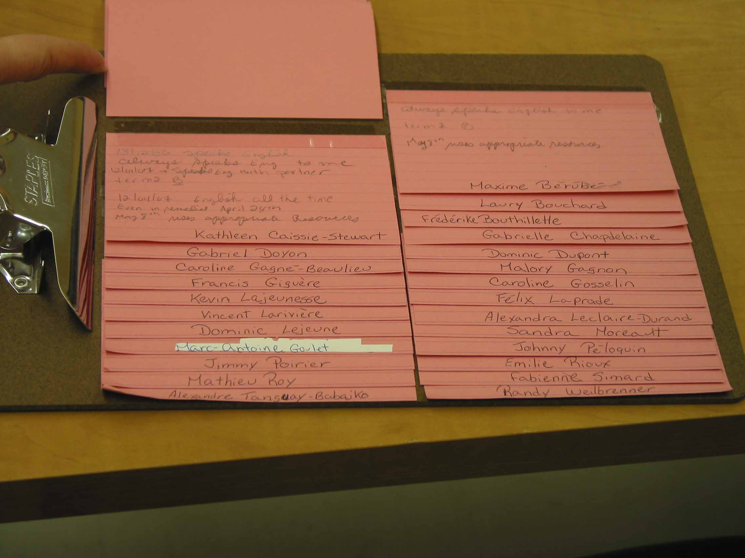

Slide 50
Carrying out the plan
Actions | Dates
Rigour in presentation of lesson plan | Ongoing
Capsule on explicit teaching of strategies (modelling) | Jan. 31, 2007
Set up a list of questions that would guide students in developing metacognitive skills (self-monitoring) | Feb. 6 2007
Training session on « Enseignement Stratégique». | 1st session: Feb.9, 2007
Creating visual support | March 14, 2007
Using guiding uestions to help students develop metacognitive skills. | Ongoing

Slide 51
Evaluating the action
Actions | Observations
Rigour in presentation of lesson plan | Teachers note students seem calmer and less stressed. It helps students identify and employ the necessary resources (people, material, time) to complete the task at hand.
Capsule on explicit teaching of strategies (modelling) | Teachers noted the importance of modelling strategies. They now do a lot of modelling. They noted that students have become more autonomous.
Modelling strategies/ integrating «enseignement stratégique» to their practices | Teachers worked on the strategies : Plan, self-monitor, self-evaluate. The teacher of group 12 finds her students are better at planning their work than the students in her other groups, where she did not do any modelling of the strategies. The teacher of group 11 worked on Planning and found that when she modelled for her students, they structured their work better to complete their task, (long term project). She is presently assessing to see if there is any transference occurring.

Slide 52
Creating visual support | Teachers made visual references to help students plan, regulate and analyse their procedures. In group 12, students refer to their tool systematically. Students told their teacher they found the tool useful and asked if they could use it in their other subjects. In group 11, the teacher notes that students now take the time to adjust and make changes when necessary. She also states that students are better able to see if they are on the right track for success. Both teachers now provide students with checklists and rubrics. These tools help students to better the task at hand and to predict their level of success. They both note that students now significantly regulate themselves.
Using guiding questions to help students develop metacognitive skills. | The teachers help their students to become more metacognitive through questioning. They note that students better understand the objectives of the tasks. They now plan moments in their teaching where they stop and question to help students examine the procedures used and to recognize what was effective and what worked less well. They note the benefits of these « stop and think moments », especially in students that had difficulty in completing tasks.

Slide 53
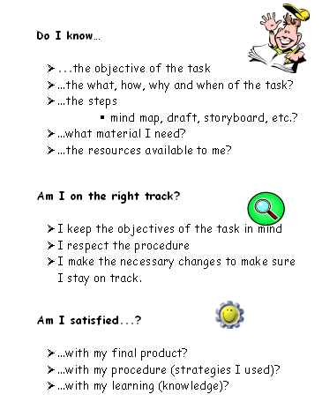

Slide 54
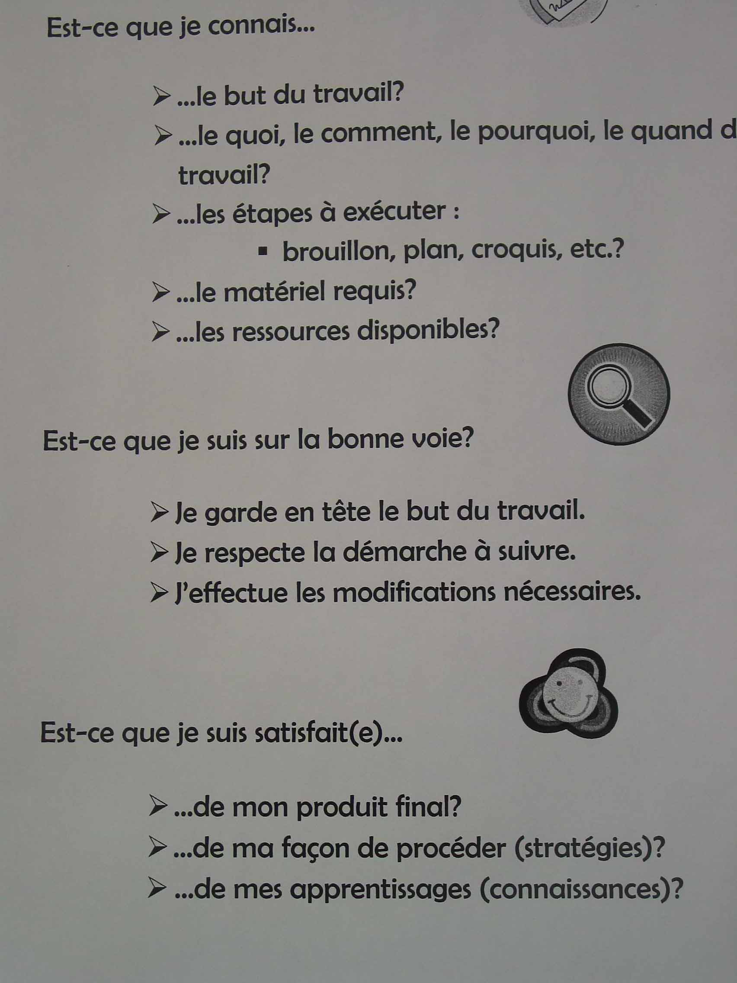

Slide 55
At the c.s. des Patriotes

Slide 56
Définition de la situation actuelle
et d’une problématique
1
Vis-à-vis la compétence ciblée ci-dessous, quel est le problème spécifique
des élèves ou d’un sous-groupe d’entre eux?
  Leurs attitudes et perceptions ?
  Leurs savoirs? Lesquels ?
  Leurs démarches d’apprentissage
  Leur activité métacognitive ?
Qu’est-ce qui n’est pas optimal dans notre façon actuelle d’intervenir
et dans les méthodes que nous utilisons pour aider l’élève
dans cet apprentissage ?
attentes des enseignants du secondaire à l’égard de l’autonomie et des savoirs non rencontrées
informations insuffisantes sur les élèves dans le passage primaire-secondaire au plan du développement des compétences lire et résoudre
manque d’harmonisation entre les enseignants d’une même discipline au niveau des méthodes et exigences pour développer les compétences lire et résoudre
les enseignants laissent peu de marge de manœuvre à l’élève dans sa démarche d’appropriation d’une méthodologie de travail
connaissance limitée du degré de développement de la compétence transversale Se donner des méthodes de travail efficaces
Au premier cycle du secondaire, le problème spécifique des élèves que nous accueillons se situe au niveau de leurs démarches d’apprentissage.
Difficultés observées:
lecture incomplète des consignes
identification des mots-clés
identification des données importantes
réalisation d’un plan et d’un résumé
amorce de la tâche
validation et relecture de la tâche
attitude de découragement (perception négative de leur capacité)
manque de persévérance et de ténacité
PDF
Qu’est-ce qui n’est pas optimal dans leur environnement pour aider
les élèves dans cet apprentissage (horaire, gestion de classe, matériel,
Aménagement, ressources humaines et matérielles, supports visuels, etc.)?
Quelle est la compétence (disciplinaire et transversale) que nos élèves
ou une proportion inquiétante d’entre eux ont de la difficulté à développer ?
Causes possibles du matériel oublié ou endommagé:
  partage d’un casier (2 élèves par casier)
  pas de sac d’école en classe
Ressources matérielles:
  locaux pas toujours attribué par discipline
Gestion de classe:
  qui ne tient pas toujours compte de la diversité des élèves et de leurs différents styles d’apprentissage
Ressources humaines:
  engagement occasionnel de personnel non qualifié en français et en mathématique
  absence d’orthopédagogue pour aider les élèves en difficulté au plan des méthodes de travail efficace
CT5: se donner des méthodes de travail efficaces
CD1-F: lire et apprécier des textes variés
CD1-M: résoudre une situation-problème

Slide 57
2
Définition de la situation désirée
Apprentissage souhaité chez l’élève
Type(s) d’interventions et méthodes à modifier ou à mettre en place
Reconnaissance par les élèves de leurs difficultés :
  lecture incomplète des consignes
  identification des mots-clés
  identification des données importantes
  réalisation d’un plan et d’un résumé
  amorce de la tâche
  validation et relecture de la tâche
Développement d’une méthode de travail efficace
  Critère ciblé: Persévérance et ténacité face à la tâche
Transmission de l’information:
  au passage primaire-secondaire
  à l’intérieur du 1er cycle
Analyse de situation permettant de poser un diagnostic relatif aux difficultés observées chez les élèves au plan de la compétence transversale se donner des méthodes de travail efficace
(avec outil 1 Mon premier portrait – avec outil 2, Entrevue individuelle, avec outil, Réflexion sur les cours stratégies, )
Mise en place de cours du samedi pour le développement de l’utilisation des stratégies en lien avec la CT 5 et les celles ciblées en français et mathématiques
PDF
Compétence ciblée
Éléments du milieu à modifier ou à mettre en place
CT5: se donner des méthodes de travail efficaces
Critère ciblé: Persévérance et ténacité face à la tâche
CD1-F: lire et apprécier des textes variés
CD1-M: résoudre une situation-problème
« mini-prof »(L’élève enseigne une partie du cours)
Trucs mnémotechniques
Pairage complémentaire (tutorat entre élèves)
Support visuel en classe pour illustrer une démarche
Liste de vérification:
  affichée en classe
  document de l’élève adapté pour chaque discipline
Ressources matérielles:
  diversifier le matériel didactique servant de support à l’apprentissage

Slide 58

Portrait d’un élève compétent
Dans diverses situations d’apprentissage et d’évaluation
j’utilise diverses ressources
  mes connaissances, mes expériences, mes habiletés, mes intérêts
  les documents écrits, sonores, visuels, etc.
  mes amis
  mes enseignantes et enseignants, mes parents
j’apprends seul et avec les autres
j’utilise une démarche appropriée
je trouve des stratégies appropriées
je sais où je m’en vais :
je m’approprie les buts d’apprentissage et je me fixe des objectifs personnels.
je relève un défi à ma mesure
je réfléchis sur mon travail :
j’identifie mes réussites, mes forces et mes difficultés, je me donne des moyens pour réussir, je communique mes réflexions, je me fixe de nouveaux défis.
je fais des liens et des transferts dans divers contextes
  Qu’est-ce qu’une compétence?
Une compétence est un savoir-agir fondé sur la mobilisation et l’utilisation efficaces d’un ensemble de ressources. La compétence est complexe et évolutive.
Tiré du Programme de formation de l’école québécoise, pages 4 et 5

Slide 59
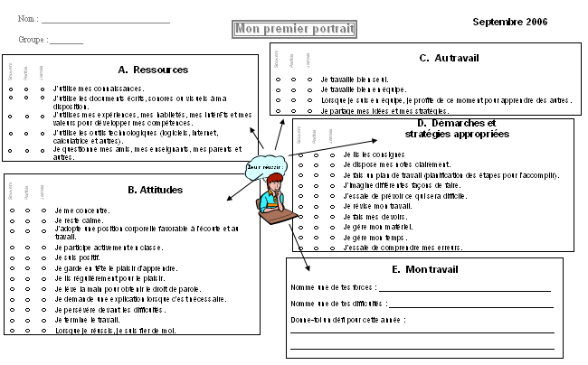

Slide 60
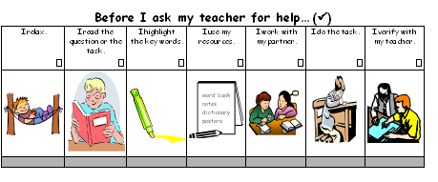
Autonomy Checklist

Slide 61
Diagnostic evaluation tools:
  Teacher’s observations
  Questionnaires
  Interviews
  Teachers’ notes

Slide 62
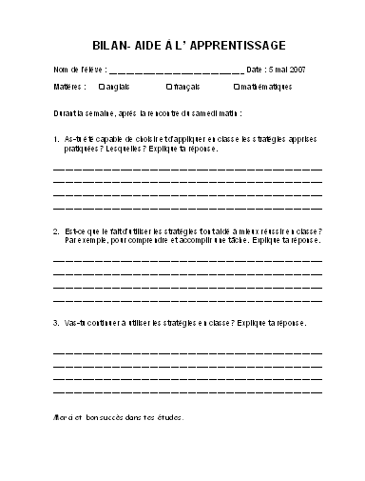

Slide 63
What we learned!
True confessions of differenciating teachers!
Take the time to think and plan
Tackle one problem at a time
It helps if you’re not alone (other teachers, cp, etc.)
The importance of modelling (what we learned)
Use the KISS principle
Make sure your principal is on board

Slide 64
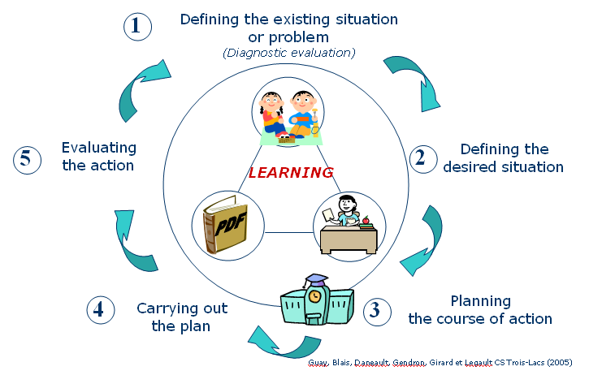
Pedagogical Differentiation … from variation to adaptation
A class or a group of students
Teacher or cycle team
Use of various pedagogical
practices
Learning content:
subject-specific and cross- curricular competencies as
specified in the QEP
Use of various material
(visual support, resources,
etc.)
Etc.
An individual student with specific needs
Multidisciplinary teams and collaborators (teacher, psychologist, remedial specialist, psychoeducator, principal, parent, speech therapist, etc.)
Significant increase of concerted time
Use of innovative methods than go beyond the pedagogical practices usually put forward
AAdapted methods recorded in an IEP
(Individualized Education Plan)
Realistic tasks and objectives linked to subject-specific and cross-curricular competencies of the QEP
- without modification of the evaluation criteria and their requirements
(adaptation, MELS, to be published)
- with modification of the evaluation criteria
and their requirements
(modification, MELS, to be published
Use of adapted material specific to the needs of the student
Etc.
Variation
Adaptation
Guay et autres (2006)
Coopérative régionale de développement pédagogique, Montérégie

Slide 65
Differentiated Evaluation
The term differentiated evaluation is used to describe the impact of pedagogical differentiation on evaluation practices.

Slide 66
Differentiated Evaluation
Important precisions
Variation :
  applies to all students in general;
  allows to take into account students' different needs and interests.
Adaptation and Modification :
  applies to students with specific needs, for whom conditions for success have been planned and recorded in a individualized education plan (IEP).

Slide 67
Differentiated Evaluation
Pedagogical flexibility
Flexibility that allows offering choices to all students during learning and evaluation situations.
The difficulty of the tasks to
be carried out, the requirements or the evaluation criteria of the competencies targeted have not been modified.
Example
To interact orally in English: Choice between doing a role play on ordering food over the phone or at a counter.
To reinvest understanding of texts : Choice between possible models of graphic organizers.
To write texts : Choice of one topic among three suggested.

Slide 68
Differentiated Evaluation
Adaptation
Adjustment or arrangement that brings a change in the way a learning and evaluation situation is carried out by a student with specific needs.
The difficulty of the tasks to
be carried out, the requirements or the evaluation criteria of the competencies targeted have not been modified.
Example:
To interact orally in English: to supply a hearing aid to a student with hearing problems.
To reinvest understanding of texts : re-arrangement of the text with larger print or a more spacious layout.
To write texts : modification of the schedule in order to spread the tasks over several periods or in the morning instead of the afternoon.

Slide 69
Differentiated Evaluation
Modification
Exceptional measure that involves changing the very nature of the learning and evaluation situations for students with specific needs that are set out in the individualized education plan established by the school, following a process involving all of the individuals concerned.
The difficulty of the tasks to be carried out, the requirements or evaluation criteria of the competencies targeted are modified.
Example
To interact orally in English: carrying out a task with a lower level of difficulty or the teacher provides assistance.
To reinvest understanding of texts: assign fewer or shorter tasks (response process) in an LES.
To write texts: reduction of the number of criteria being considered for the task.
Notes:
It
is important that students and their parents understand
the impact on the certification of studies of a decision
involving modification.
It
is important that students and their parents understand
the impact on the certification of studies of a decision
involving modification.
It
is important that students and their parents understand
the impact on the certification of studies of a decision
involving modification.
It
is important that students and their parents understand
the impact on the certification of studies of a decision
involving modification.
For example:
- Assign fewer or shorter tasks.
- Have the teacher provide assistance in identifying information
required to solve the problem.
– The school should specify differentiation procedures when it
establishes its evaluation standards and procedures.
– Teachers observe student learning to judge whether to use
differentiated evaluation based on students’ needs.
– When teachers need to use adaptation or modification, they must
do so in the context of preparing an individualized education plan
with the student’s parents and the school staff concerned.
Answers
It
is important that students and their parents understand
the impact on the certification of studies of a decision
involving modification.
For example:
- Assign fewer or shorter tasks.
- Have the teacher provide assistance in identifying information
required to solve the problem.
– The school should specify differentiation procedures when it
establishes its evaluation standards and procedures.
– Teachers observe student learning to judge whether to use
differentiated evaluation based on students’ needs.
– When teachers need to use adaptation or modification, they must
do so in the context of preparing an individualized education plan
with the student’s parents and the school staff concerned.
Answers
it is important that parents understand the impact on certification of studies

Slide 70
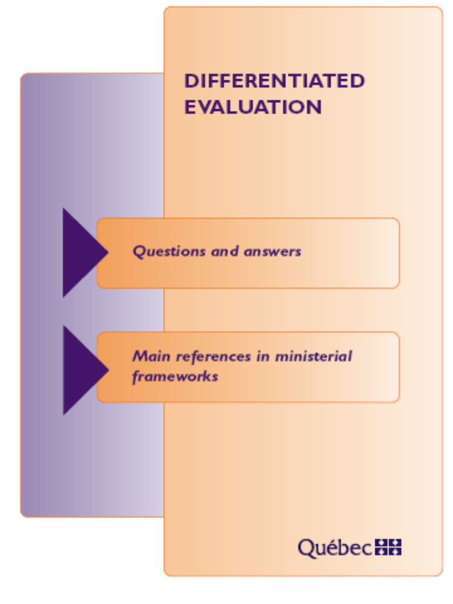
http://www.mels.gouv.qc.ca/dfgj/pdf/cpea_evaluation6_eng.pdf

Slide 71

http://www.mels.gouv.qc.ca/DGFJ/de/pdf/cadresecondaire_prelim.pdf

Slide 72
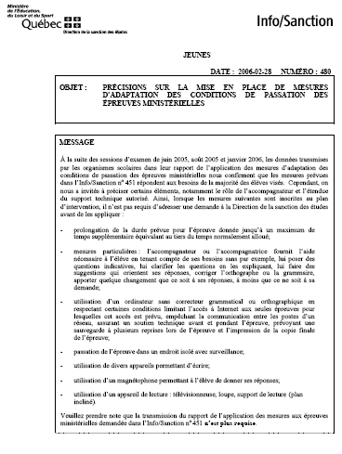

Slide 73
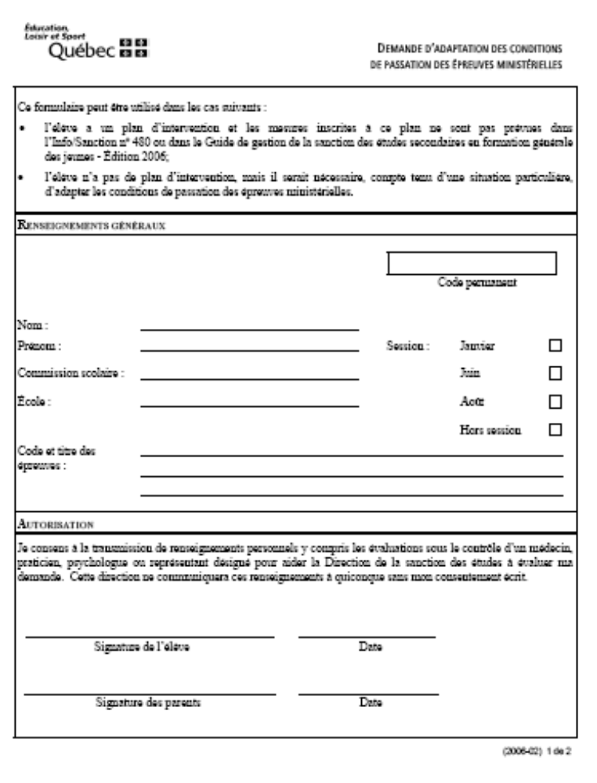

Slide 74
Dealing with a problem!
http://www.youtube.com/watch?v=byqFeevFZYk&mode=related&search=

Slide 75
Case studies
I taught my students the comparative and superlative forms of adjectives. When I quizzed the class to review notions the day before the test, I thought everyone understood. The day of the test, what a disaster! What could I have done differently?
I have a multi-level class and don’t know what to do. How can I teach two levels at once?
When I explain an activity to the class, some of my students seem to think the instructions and explanations don’t concern them. How can I make sure they understand what they are supposed to do?
In one of my cycle 2 groups, I have a boy who is bilingual. He always finishes his work before everyone else, and then he starts to bother the other kids. I can’t kick him out just for being fast, can I?
When we do a reading activity, Karine either doodles, plays with her pencil case or stares out the window—anything but read. I know she has good eyesight, so that’s not the problem. I don’t think she likes to read.
When my students work in teams, Tommy takes charge and often does all the work himself. He seems really bored when we take a time out to reflect on our learning and work methods. How do I get him to cooperate more?
I have these students. Whenever I assign a task, they do it really fast to get it over with and then they spend the rest of the time talking or doing nothing. Their work is less than perfect, to say the least.
I have this one student who refuses to participate in discussions. It’s always: J’comprends rien! Chu pas capable! It’s so frustrating. I don’t know how she has managed to graduate into my class.
Jake’s writing is often off topic and full of mistakes. Yikes! There is no way I can pass him.
It takes James forever to do any work. Writing is particularly painful. The worst part is that what he does, he usually has right. But how can I evaluate him fairly if he has only done some of the work?
I have a special needs student (either TED, Tourette’s syndrome, or other, etc). How can I work with this child?
I cannot get my group 25 to speak in English. My other groups are fine, but that one...! Grrr!
My students tend to fail their listening comprehension. I have them practise and practise; I even play the tape/CD three times if need be. How can I help?

Slide 76
Warning: Spoiler ahead!
http://www.youtube.com/watch?v=p1yn9mrZELg&mode=related&search=

Slide 77
And in the end…
During this workshop, I learned that…
What I will tell people in my milieu.
5 minutes

Slide 78
Evaluation of the session

