Slide 1
R Markdown and Pandoc Template: releasing your super powers

Slide 2

Alice and Bob

Slide 3


Slide 4


Slide 5


Slide 6


Slide 7


Slide 8
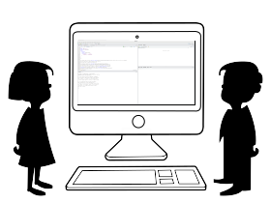

Slide 9
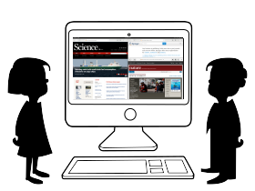

Slide 10
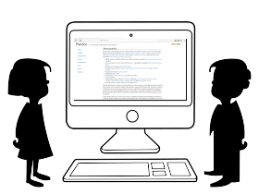

Slide 11
Hands on
gitlab.com/rgaiacs/rmd-and-pandoc-template.git

Slide 12
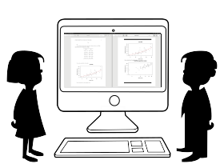

Slide 13
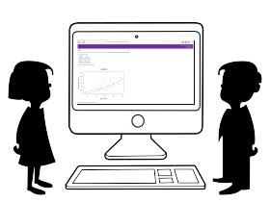

Slide 14
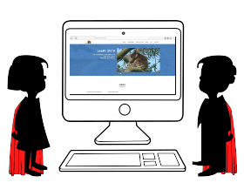

Slide 15
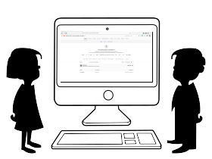
Extra

Slide 16
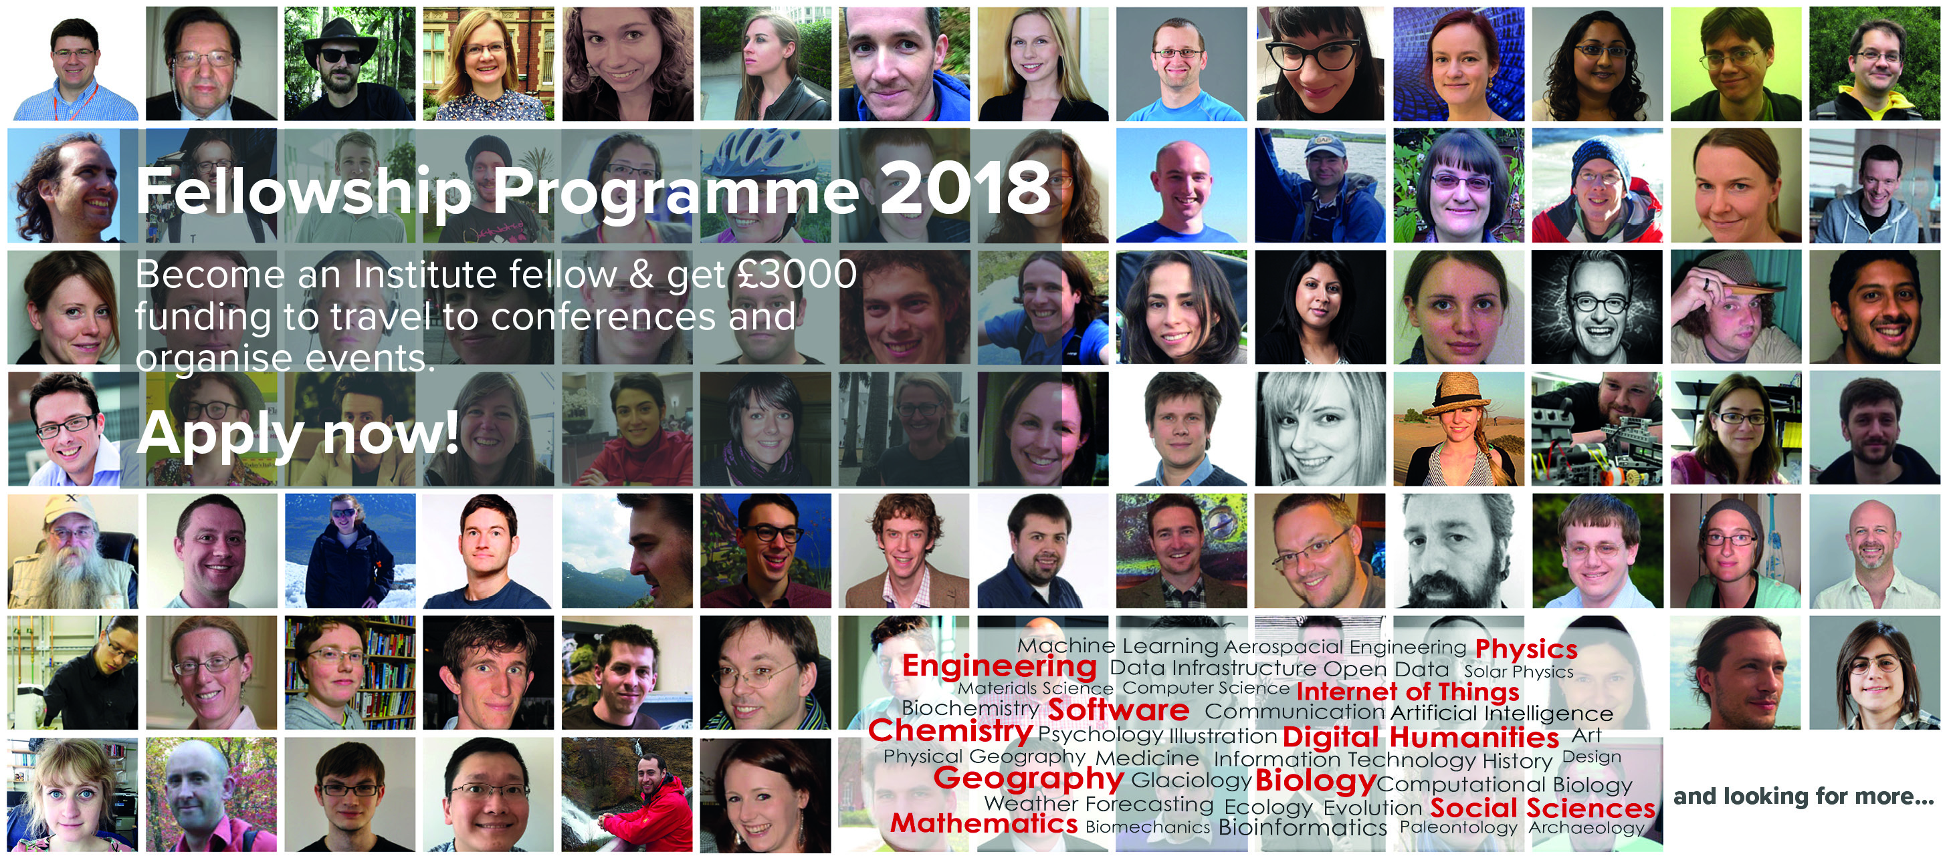
Software Sustainability Institute’s
Fellowship Programme 2018

Slide 17
Thanks
Contact:
raniere.silva@manchester.ac.uk
Social media (and other places):
@rgaiacs

