Slide 1

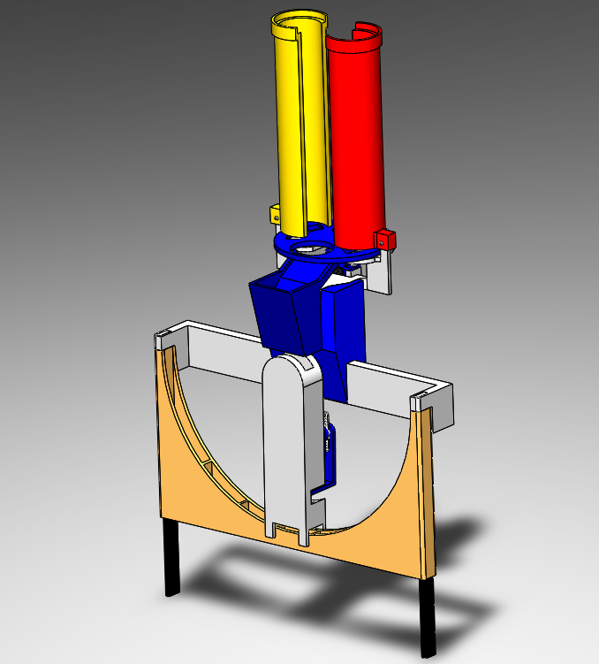
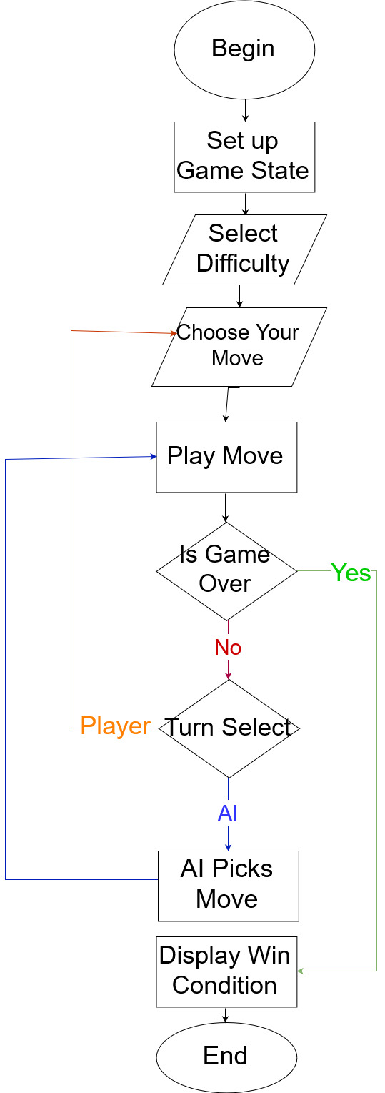
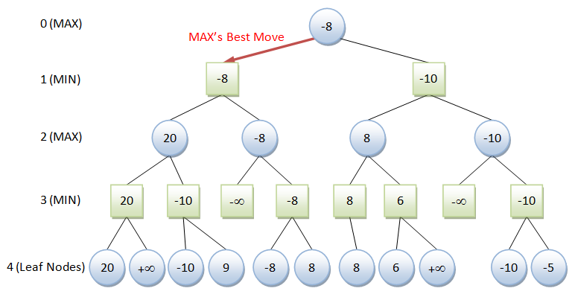
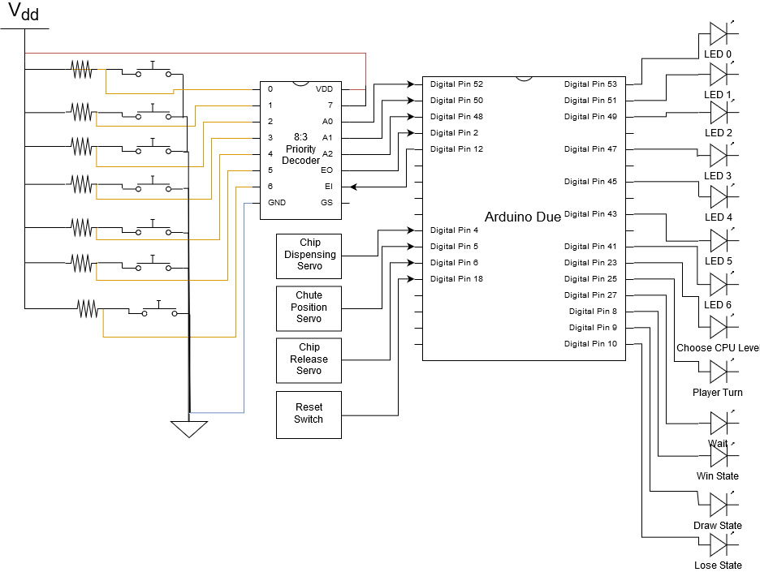
Connect 4 AI Bot
Team Members: Ronald Gaines (EE), Devin Perry (EE)
Academic Advisor: Dr. Thomas Holton
Introduction
Dispensing Mechanism
Flow Diagram
Discussion
This project arose from a conversation with a nurse that works in the children’s ward at UCSF. We decided to build a system that would brighten children’s days and get them curious about engineering.
Connect 4 is a two-player game where the objective is to connect four pieces in a row.
One the early problems we ran into was dealing with debouncing the arcade switches. Instead of debouncing seven signals, we used a 8:3 priority encoder to solve the problem. When sampling the button press, we send a signal to turn off the encoder which solved the bouncing problem.
We had to switch from the Arduino Mega to the Arduino Due because the Mega didn’t have enough memory or computational power for our AI. The Due uses a 32 bit ARM processor.
The dispensing mechanism was designed using SolidWorks, which allowed us to create the exact parts necessary.
Manufacturing was done with 3D Printing in order to reduce costs and decrease time between design iterations.
Objective
To create an AI-based robotic system to play against a human in Connect 4. It will be able to interact with a physical gameboard in order to provide a unique playing experience. In order to satisfy this objective, our system has to do the following:
Detect when a human player makes a move
Employ an AI algorithm to determine the system’s move
Activate a robotic system to dispense game pieces into the correct column
Design
Connectivity Diagram
AI Algorithm
Future Work
In order to meet our objective we used an Arduino Due. The Artificial Intelligence has 3 difficulty levels. The first level is a simple random number generator. The second level is our minimax algorithm with a search depth of 1. The third level is the minimax algorithm with a search depth of 4.
We used arcade switches and LED’s for the human to interact with the game
We 3D printed parts to create the dispensing mechanism
We used 3 Servo motors to aid with dispensing the game pieces
We used Minimax Algorithm with an evaluation function to create the AI system
We would like to implement WIFI connectivity in order for two people to play each other from different rooms using two boards.
We need to improve our evaluation functions to recognize some corner cases.
We would like to implement Minimax algorithm with alpha-beta pruning in order to speed up the AI decision time.
Implementing snap-fit connections would improve the building procedure of our dispensing mechanism
Acknowledgments: Our team would like to thank our advisor and mentor Dr. Holton for his assistance in the completion of this project.
The minimax algorithm we used is a recursive AI algorithm for choosing the next move based on the position of the game pieces. The algorithm’s position evaluation determines how good each possible move is and attempts to minimize the possible maximum (worst-case) outcome. As the search depth increases, the better the AI’s decision becomes at the cost of computational time.

