Slide 1
Fuel Consumption on Ready-Mix Trucks
Rodolfo Miguel Gameros Leal
Operational Planning Leader
Cemex

Slide 2
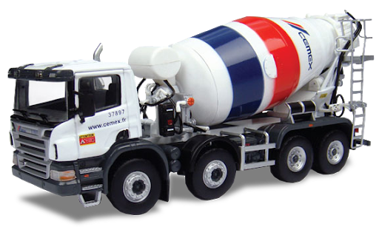
Agenda
Introduction
Problem Statement
Data Analysis
Machine Learning
Model Comparison
Conclusions and Next Steps

Slide 3
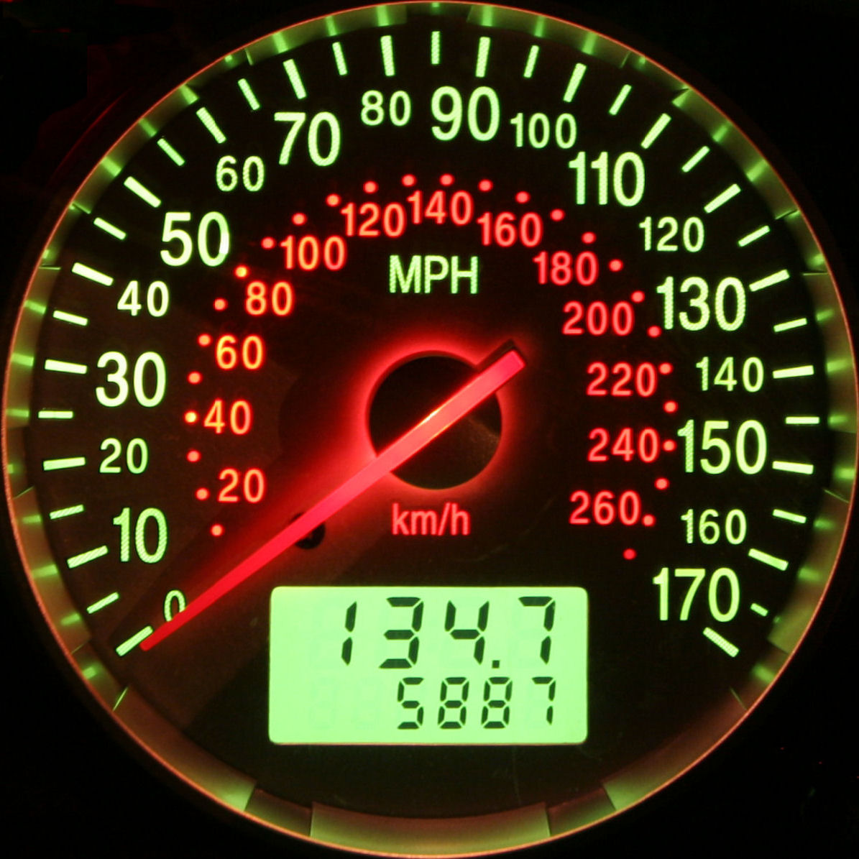


Introduction
About the project:
Mathematical Idea: Find the most relevant factors that affects the fuel consumption in the ready-mix trucks operation
Fuel Consumption measured as Liters per Hour consume by the truck
About Me:
Applied Mathematician – ITAM, CDMX
MSc and PhD in Mathematics and Statistics - the University of Warwick, UK
Working at Cemex for 2 Years, MTY

Slide 4


Problem Statement
The Diesel represents one of the main insumptions in our company:
Cemex has around 2,400 ready-mix trucks
The Fuel Consumption changes according the local conditions
Taking that into account when is the Fuel Consumption too high?
Is there anything that can be done to improve it
Liters of Diesel per Truck: Half Tank (400/2)
$6 M MXN = 1,500 * 200 * $20 MXN
Price of a Liter of Diesel ($ MXN)
Operational Daily average of Ready-Mix Trucks

Slide 5
Problem Statement
The Diesel represents one of the main insumptions in our company:
Cemex has around 2,400 ready-mix trucks
The Fuel Consumption changes according the local conditions
Taking that into account when is the Fuel Consumption too high?
Is there anything that can be done to improve it
Average Engine Hours per Truck
Price of a Liter of Diesel ($ MXN)
$2.25 M MXN = 1,500 * 10 * 7.5 * $20 MXN
Operational Daily average of Ready-Mix Trucks
Average Fuel Consumption:
Liters per Hour

Slide 6
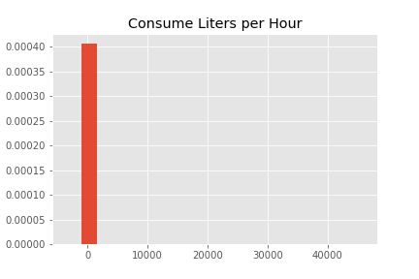
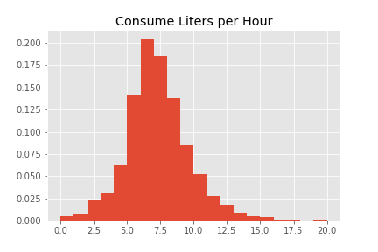
Data analysis
Data characteristics
Daily entries from a complete year (2020). Each entry represents one truck on that day together with ~25 different features:
Manufacturer
Year model
Average speed
mileage
Idle time
Volume of Ready-Mix Transported
Amount of different mechanical/Safety events (~15 variables):
Overspeeding, High/Low RPM, accelerations, brakes, etc
Data Cleaning: Loss Data ~7%

Slide 7
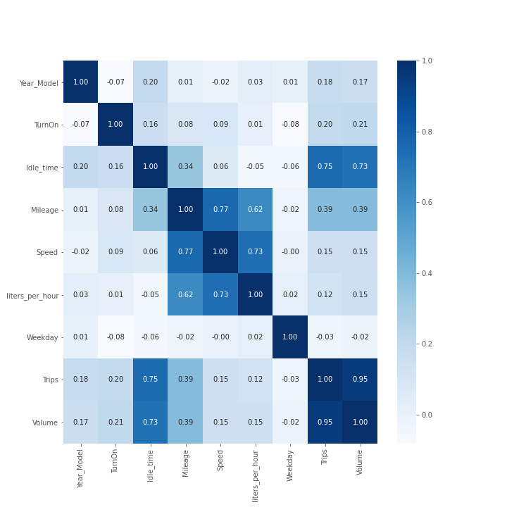
Correlations coefficients between variables
Linear Regression Model:
Simple regression using the feature with highest correlation against the target
Multiple regression:
Avoid multicolinearity
Only keep mileage or speed
Only keep trips or volume or idle time

Slide 8
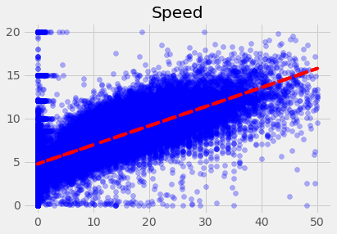
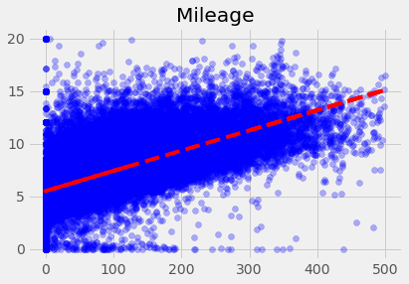

Simple Linear Regression: Speed or mileage?
R2 = 53.80%
R2 = 38.20%

Slide 9
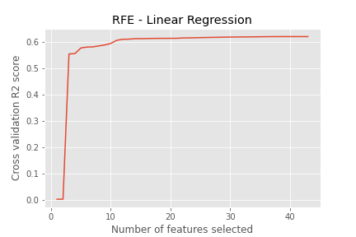
Multiple linear regression
Should we add more features to the linear model?
Probably not:
1 Variable → R2 = 53.80%
10 Variables → R2 = 58.99%
39 Variables → R2 = 62.20%

Slide 10
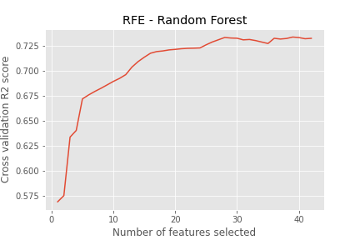
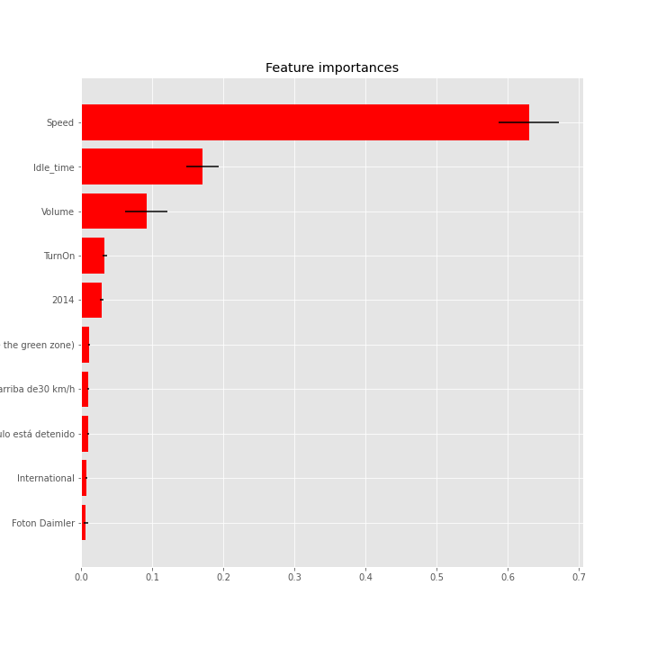
Machine learning
What about other models? Specifically Random Forest
Consistent with Linear Regression – Most Relevant feature: Speed
10 Variables → R2 = 69.30%
39 Variables → R2 = 73.29%

Slide 11
Model comparison
Linear Regression
Pros:
Interpretation: y = 0.22*x + 4.75
X - Average Speed: Data mean 11.63 kph
Y - Liters Per Hour: Data mean 7.31
Easy and quickly to train
Cons:
R2 range from 53.80% to 62.20%
Not-Flexible: Only explains Linear relations
Random Forest
Pros:
Flexible: Can explains Non-Linear relations
R2 improves to 73.29% (Considering all features)
Cons:
Computational Expensive
Not Very easy to Interpret
Still the most relevant feature is the Speed which clearly has a linear relations with the target variable: liters per hour

Slide 12
Conclusions and Next Steps
Most Relevant Feature to explain the fuel consumption: Average Speed of the Ready-Mix Truck along the whole day
+ 1 kph Speed → + 0.22 liters per hour fuel consumption
Each Ready-Mix truck has its engine on ~10 hrs per day
Hence the +1 kph → + 2.2 extra liters per day per truck
Each liter costs $20 MXN, so +1 KPH → + $44 MXN per day per truck
On average there are 1,500 trucks on the streets: therefore +1 KPH (On every truck) → + $66,000 MXN per day
Very Important to control the avergae driving speed, not only because it saves fuel, but also it will guarantee the safety of our drivers and all the other people on the streets/roads
However we need to be efficient on this trade-off as we would not want to make people work extra hours (Increments engine hours per truck) or hurt the relations with our clients (Avoid impunctual deliveries)
Important to keep track of this data and look for explanations to the outliers and missing data that wass not considered on this analysis

