Slide 1
Fuel Consumption on Ready-Mix Trucks
Rodolfo Miguel Gameros Leal
Operational Planning Leader
Cemex

Slide 2
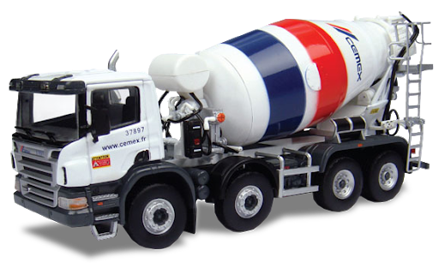
Agenda
Introduction
Problem Statement
Data Analysis
Machine Learning
Deployment and Next Steps
Conclusions

Slide 3
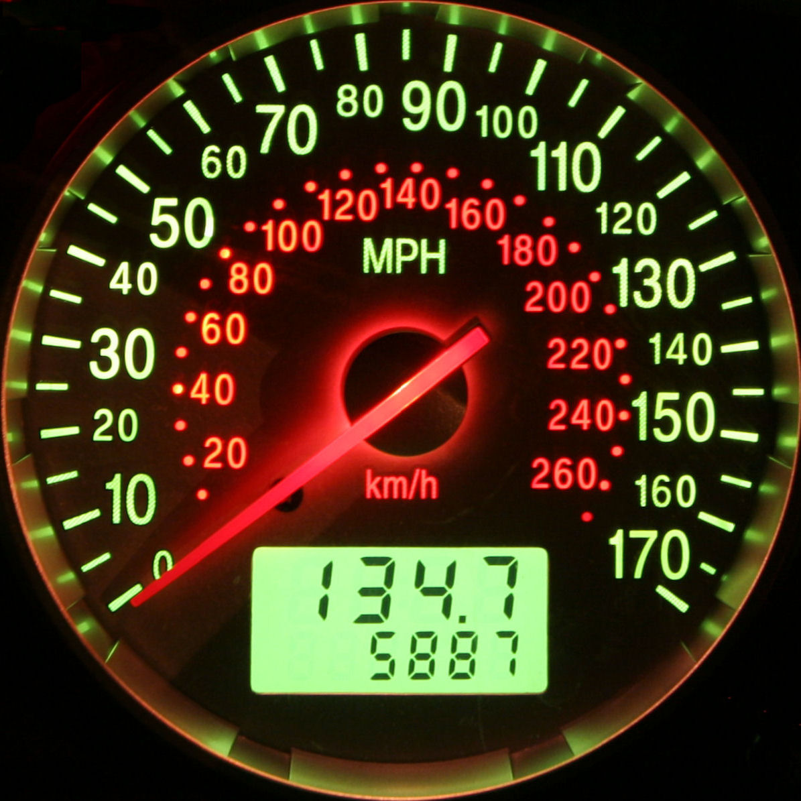


Introduction
Mathematical Idea:
Find the most relevant factors that affects the fuel consumption in the ready-mix trucks:
Fuel Consumption Measured as Liters per Hour
About Me:
Applied Mathematician (ITAM)
MSc and PhD from University of Warwick
Working at Cemex for 2 Years

Slide 4


Problem Statement
The Diesel represents one of the main insumptions in our company:
Cemex has around 2,400 ready-mix trucks
Each day around mexico 1,500 are on the streets
Diesel tanks = 200 liters –> ~ 15,000 Diesel Liters on the roads (Considering full medium tank in Average per truck)
$20 per Liter -> $300,000 are on the roads every day in diesel form
The Fuel Consumption changes according the local conditions
Taking that into account when is the Fuel Consumption too high?
Is there anything that can be done to improve it

Slide 5
Data analysis
Data characteristics
Daily entries for each truck measuring around 25 diifferent features:
Manufacturer
Year model
Average speed
Idle time
Volume of Ready-Mix Transported
Amount of different mechanical events:
Overspeeding, High/Low RPM, accelerations, brakes, etc

Slide 6
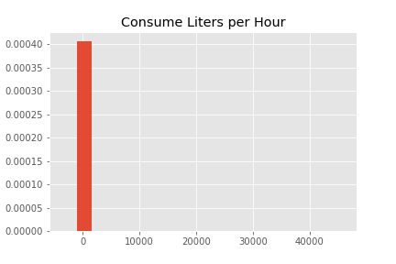
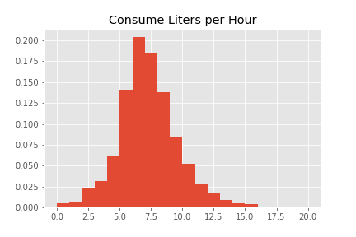
Data cleaning
There were some outliers and missing data, therefore some entries needed to be removed. In the end, from a total of 445,300 entries we ended up analysing 417,300 (~7% loss data)
Data Cleaning

Slide 7
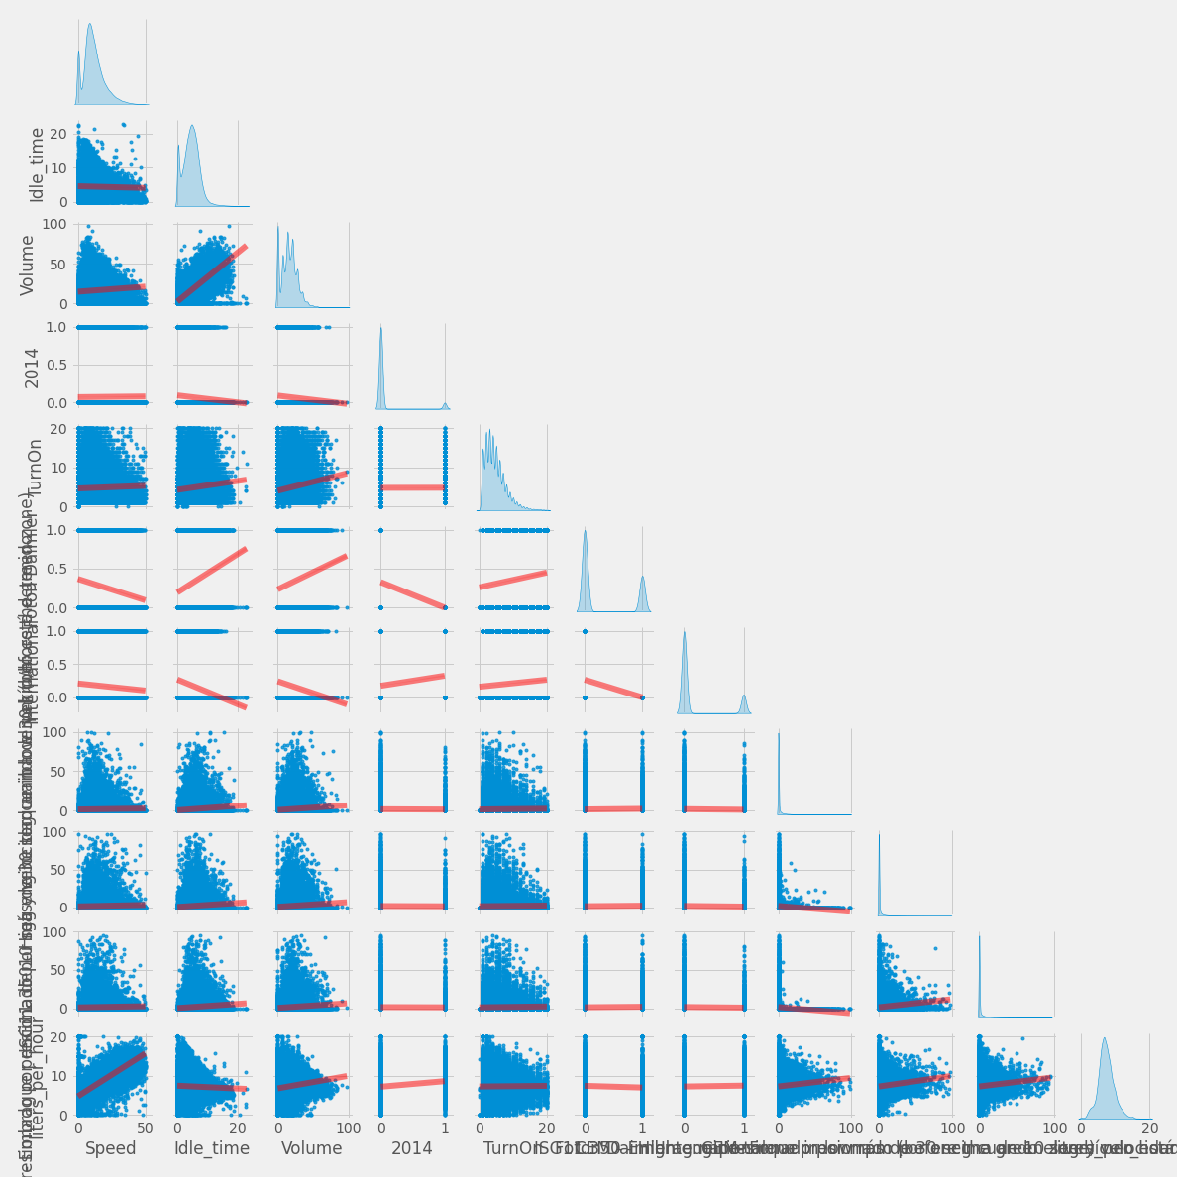
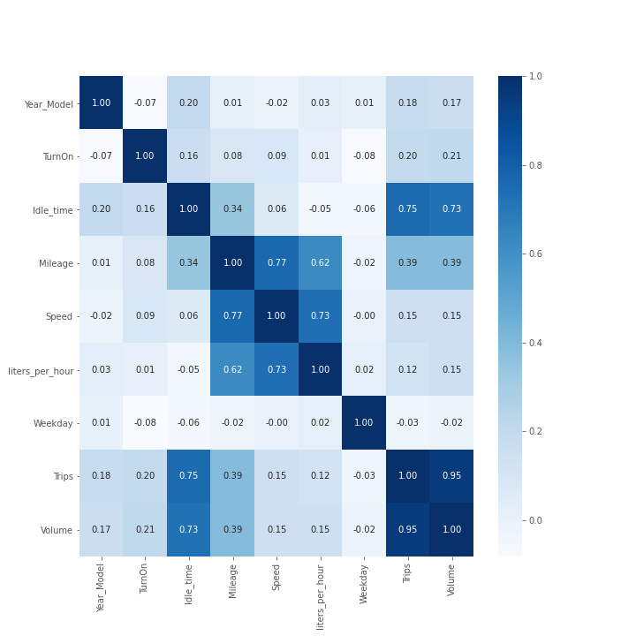

Slide 8
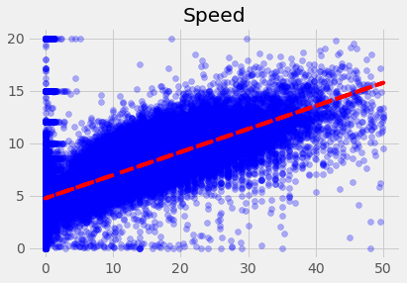
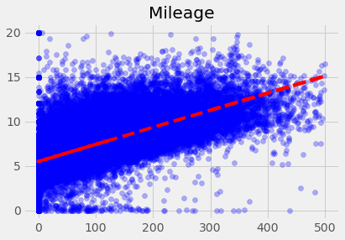

Speed or mileage?
R2 = 53.80%
R2 = 38.20%

Slide 9
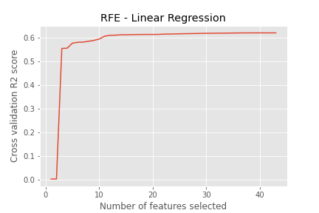
Machine learning
Should we add more features to the linear model?
Probably not:
1 Variable -> R2 = 53.80
39 Variables -> R2 = 62.20%

Slide 10
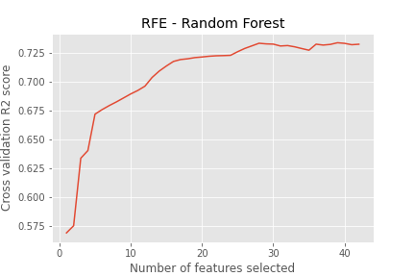
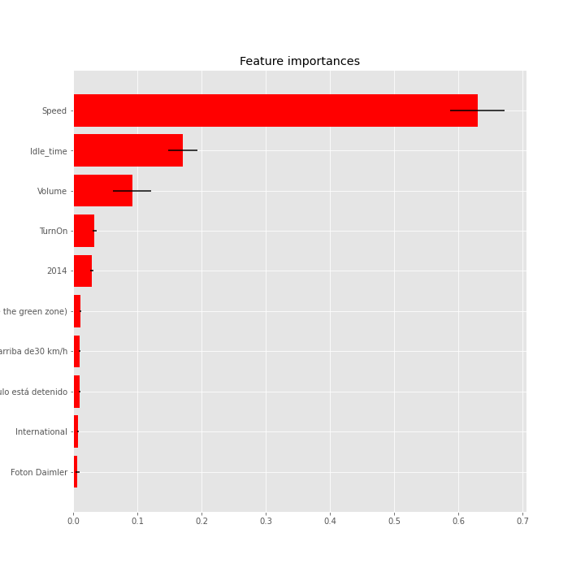
Machine learning
What about other models? Specifically Random Forest
Still Speed is the most relevant feature
Including 10 features R2 = 69.30%

Slide 11
Model comparison

