Slide 1
Capstone Project Romeo Gamulescu
New York City and the city of Toronto
A comparison of venue clusters of boroughs in TORONTO to venue clusters of boroughs in NEW YORK

Slide 2
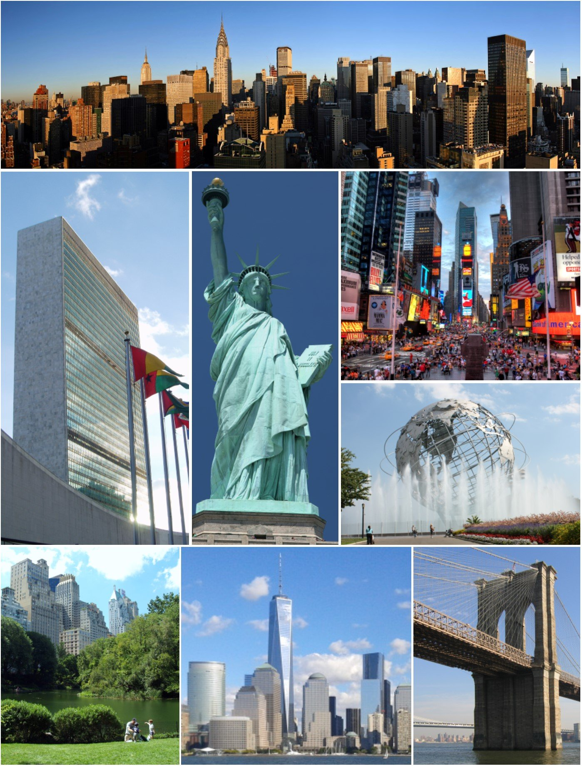
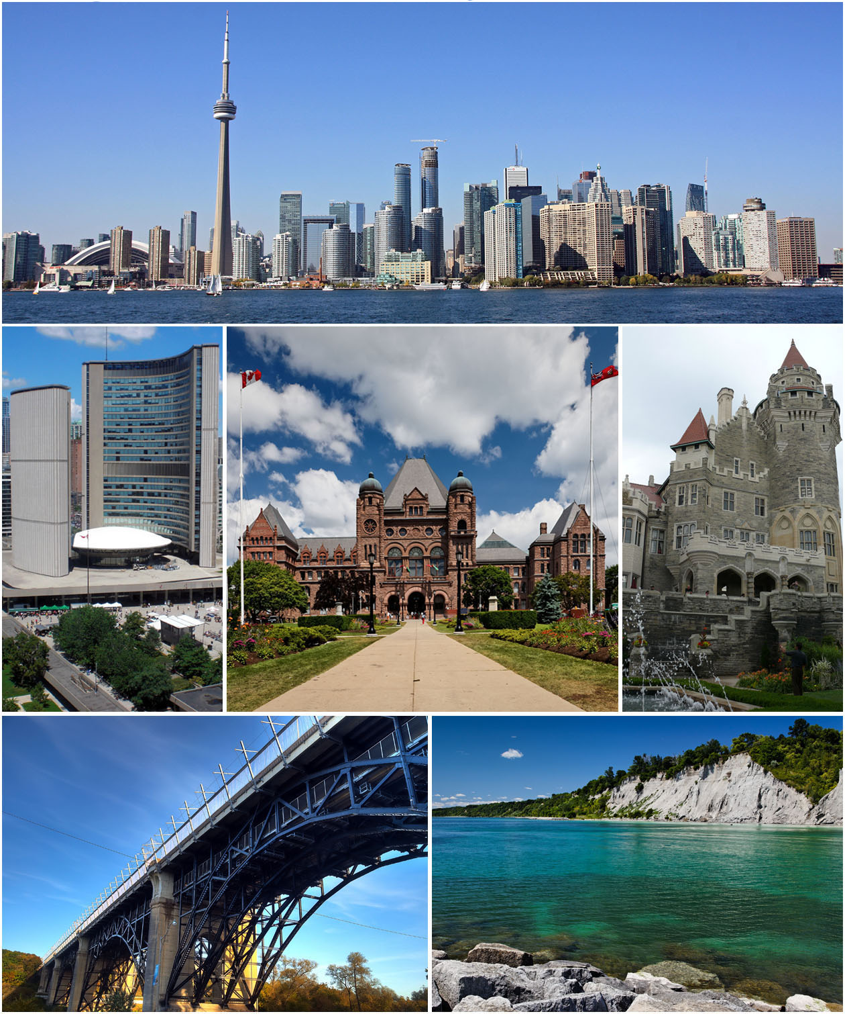
https://en.wikipedia.org/wiki/Toronto#/media/File:Montage_of_Toronto_7.jpg
https://en.wikipedia.org/wiki/New_York_City#/media/File:NYC_Montage_2014_4_-_Jleon.jpg

Slide 3
Table of Content
1. Introduction to the Business Problem
2. Data Sources
3. Methodology
3.1 Data acquisition, preparation and preprocessing for Toronto
3.2 Data acquisition, preparation and preprocessing for New York
3.3 Find Nearby Venues using Foursquare API
3.4 Inferential statistical testing
3.5 Machine Learning - Modeling, Visualization and Clustering
3.5.1 k-means clustering ((Elbow Method,Silhouette Coefficient, Hierarchical clustering))
3.5.2 Euclidean distances (Finding similar and dissimilar clusters)
4. Conclusion

Slide 4
1. Introduction to the Business Problem
The aim of this project is to compare 4 venue clusters of boroughs in Toronto to 4 venue clusters of boroughs in New York to determine which clusters in the two cities are most similar and dissimilar to each other.
We are going to investigate the similarities and dissimilarities between these two cities, using data science tools, such as classification using Foursquare data and machine learning segmentation and clustering.
Who will gain from this project:
- Organizations in the tourist industry
- Companies that would like to invest in venues in these cities

Slide 5
2. Data Sources
The following urls will be used in order to collect the data necessary for analysis:
- Toronto Postal Codes from Wikipedia:
https://en.wikipedia.org/wiki/List_of_postal_codes_of_Canada:_M’
- New York dataset
https://geo.nyu.edu/catalog/nyu_2451_34572
Latitudes and longitudes coordinates:
https://geocoder.readthedocs.io/providers/ArcGIS.html
- Venue data obtained from:
https://foursquare.com/

Slide 6
3. Methodology
3.1 Data acquisition, preparation and preprocessing for Toronto
3.2 Data acquisition, preparation and preprocessing for New York
3.3 Find Nearby Venues using Foursquare API
3.4 Inferential statistical testing
3.5 Machine Learning - Modeling, Visualization and Clustering
3.5.1 k-means clustering ((Elbow Method, Silhouette Coefficient, Hierarchical clustering))
3.5.2 Euclidean distances (Finding similar and dissimilar clusters)

Slide 7
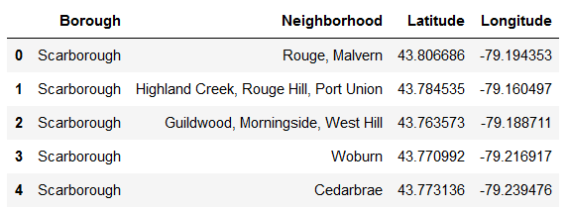
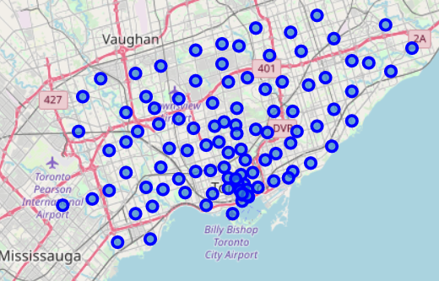
3.1 Data acquisition, preparation and preprocessing for Toronto
Scraping of postal codes from websites using python module BeautifulSoup
Retrieving latitudes and longitudes from arcgis and https://Geospatial_data
Store these data points in pandas dataframes
Visualize dataframes

Slide 8
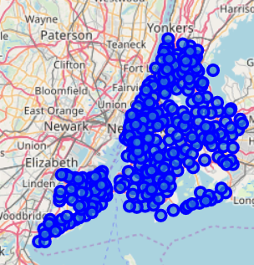
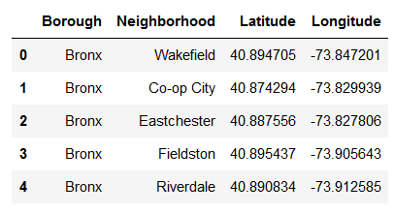
3.2 Data acquisition, preparation and preprocessing for Toronto
Acquire the json file from https://geo.nyu.edu/catalog/nyu_2451_34572
Store these data points in pandas dataframes
Visualize dataframes

Slide 9
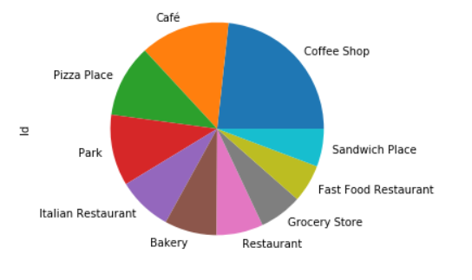
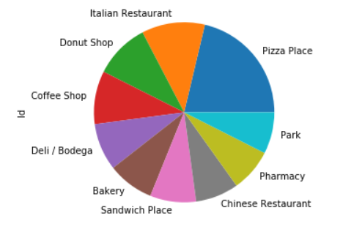
3.3 Find Nearby Venues using Foursquare API
Data regarding venues within 1000 meters of the latitudes and longitudes of the Toronto and New York are acquired from provider Foursquare.
TORONTO NEW YORK

Slide 10
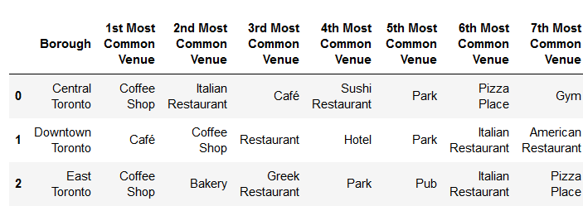
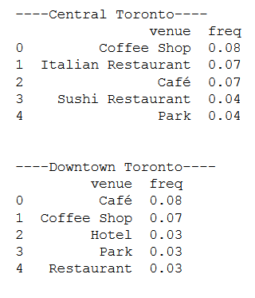
3.4 Inferential statistical testing
Dataframes are created grouped by borough and containing the mean of the frequency of occurrence of each category of venue. The top 5 and the top 10 most common venues are printed for each borough in Toronto and New York.
TORONTO

Slide 11
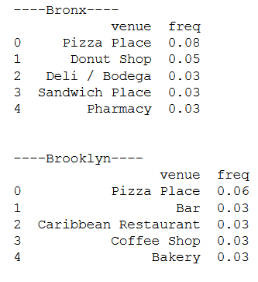
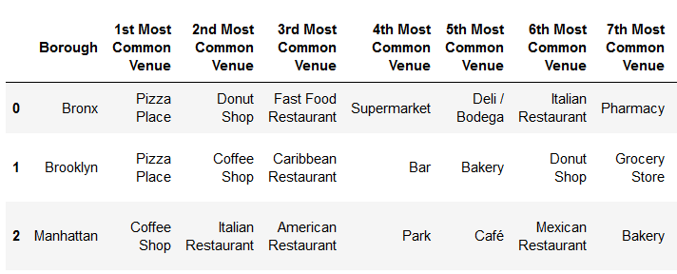
3.4 Inferential statistical testing – cont.
NEW YORK

Slide 12
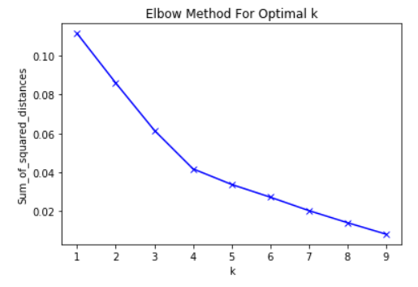
3.5 Machine Learning - Modeling, Visualization and Clustering
3.5.1 k-means clustering ((Elbow Method, Silhouette Coefficient, Hierarchical clustering))
Run the method of k-means clustering to find clusters of boroughs that are similar in terms of venues existing in such boroughs

Slide 13
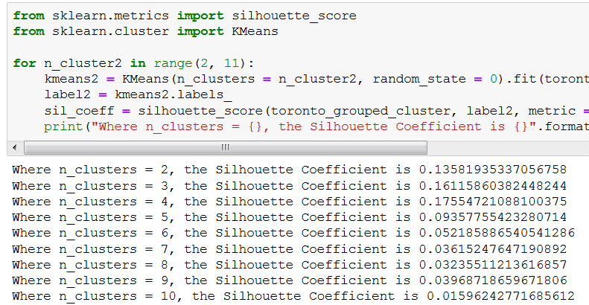
3.5.1 k-means clustering - cont
Silhouette Coefficient - The highest Silhouette Coefficient gives the best match to its own cluster.

Slide 14
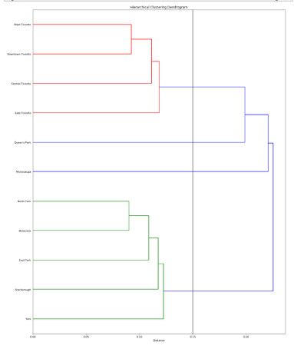
3.5.1 k-means clustering - cont
Hierarchical clustering - Creating a dendrogram to determine which neighbourhoods are similar to each other:

Slide 15
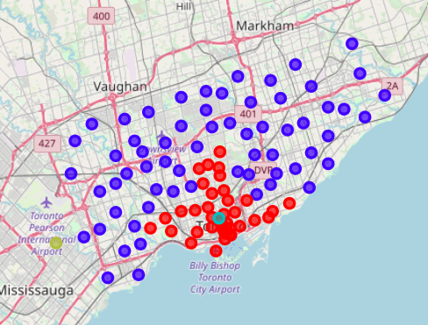
3.5.1 k-means clustering - cont
Add resulting cluster labels to the dataframes
Visualize the clusters on maps for Toronto and New York
Store the feature vectors of the clusters in variables 'amsterdam_cluster_centers' and 'toronto_cluster_centers’.
TORONTO

Slide 16
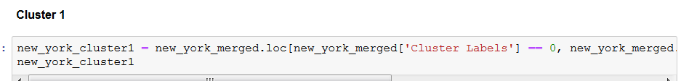
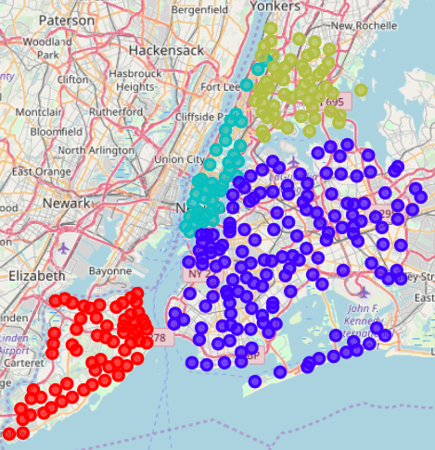
3.5.1 k-means clustering - cont
NEW YORK

Slide 17
3.5.2 Euclidean distances (Finding similar and dissimilar clusters)
Calculate Euclidean distances pairwise between cluster centers in Toronto and New York to analyze similarities and dissimilarities
Print Euclidean distances in ascending order to determine the similar and dissimilar clusters for Toronto and New York.
toronto_cluster_centers[0] & new_york_cluster_centers[2] : 0.07722458279781953
toronto_cluster_centers[1] & new_york_cluster_centers[1] : 0.09269896645980633
toronto_cluster_centers[0] & new_york_cluster_centers[1] : 0.10389096164053752
toronto_cluster_centers[1] & new_york_cluster_centers[2] : 0.11295894787828172
toronto_cluster_centers[1] & new_york_cluster_centers[3] : 0.11469562568222803
toronto_cluster_centers[1] & new_york_cluster_centers[0] : 0.11554118744667474
toronto_cluster_centers[0] & new_york_cluster_centers[0] : 0.13443395177286602
toronto_cluster_centers[0] & new_york_cluster_centers[3] : 0.14414376020934339
toronto_cluster_centers[2] & new_york_cluster_centers[2] : 0.1690769752723988
toronto_cluster_centers[3] & new_york_cluster_centers[2] : 0.17146764766418476
toronto_cluster_centers[3] & new_york_cluster_centers[1] : 0.18121427216411493
toronto_cluster_centers[2] & new_york_cluster_centers[1] : 0.18572088602649758
toronto_cluster_centers[2] & new_york_cluster_centers[0] : 0.20621952391473553
toronto_cluster_centers[3] & new_york_cluster_centers[0] : 0.20684181396291196
toronto_cluster_centers[3] & new_york_cluster_centers[3] : 0.20981415848170787
toronto_cluster_centers[2] & new_york_cluster_centers[3] : 0.21256545486662504

Slide 18
3.5.2 Euclidean distances (Finding similar and dissimilar clusters) – cont.
- the most similar cluster centers are:
toronto_cluster_centers[0] & new_york_cluster_centers[2]
toronto_cluster_centers[0] new_york_cluster_centers[2]
Cluster 0 (38 neighborhoods), venues in top 5:
29% -- Bakery
13% -- Greek Restaurant
84% -- Park
13% -- Pub
100% -- Italian Restaurant
24% -- Café
24% -- Sushi Restaurant
24% -- Pizza Place
63% -- Coffee Shop
63% -- Restaurant
47% -- Hotel
16% -- Bar
Cluster 2 (40 neighborhoods), venues in top 5:
100% -- Italian Restaurant
100% -- American Restaurant
100% -- Park
100% -- Café
100% -- Mexican Restaurant

Slide 19
3.5.2 Euclidean distances (Finding similar and dissimilar clusters) – cont.
- the most dissimilar cluster centers are:
toronto_cluster_centers[2] & new_york_cluster_centers[3]
toronto_cluster_centers[2] new_york_cluster_centers[3]
Cluster 2 (1 neighborhoods), venues in top 5:
100% -- Bubble Tea Shop
100% -- Park
100% -- Sushi Restaurant
100% -- Gastropub
100% -- Breakfast Spot
Cluster 3 (52 neighborhoods), venues in top 5:
100% -- Donut Shop
100% -- Fast Food Restaurant
100% -- Supermarket
100% -- Deli / Bodega
100% -- Italian Restaurant

Slide 20
4. Conclusion
This project has compared 4 clusters of boroughs in Toronto to 4 clusters of boroughs in New York to determine which clusters are most similar and dissimilar.
The result of this investigation would help the tourist industry that aim to attract more clients or organizations exploring venues in either of these cities looking for business opportunities in the other city.
Also would be beneficial to policy makers looking to enhance the attractiveness of these cities for businesses and inhabitants.

