Slide 1
New York City and the city of Toronto - Similarities and Disimilarities

Slide 2
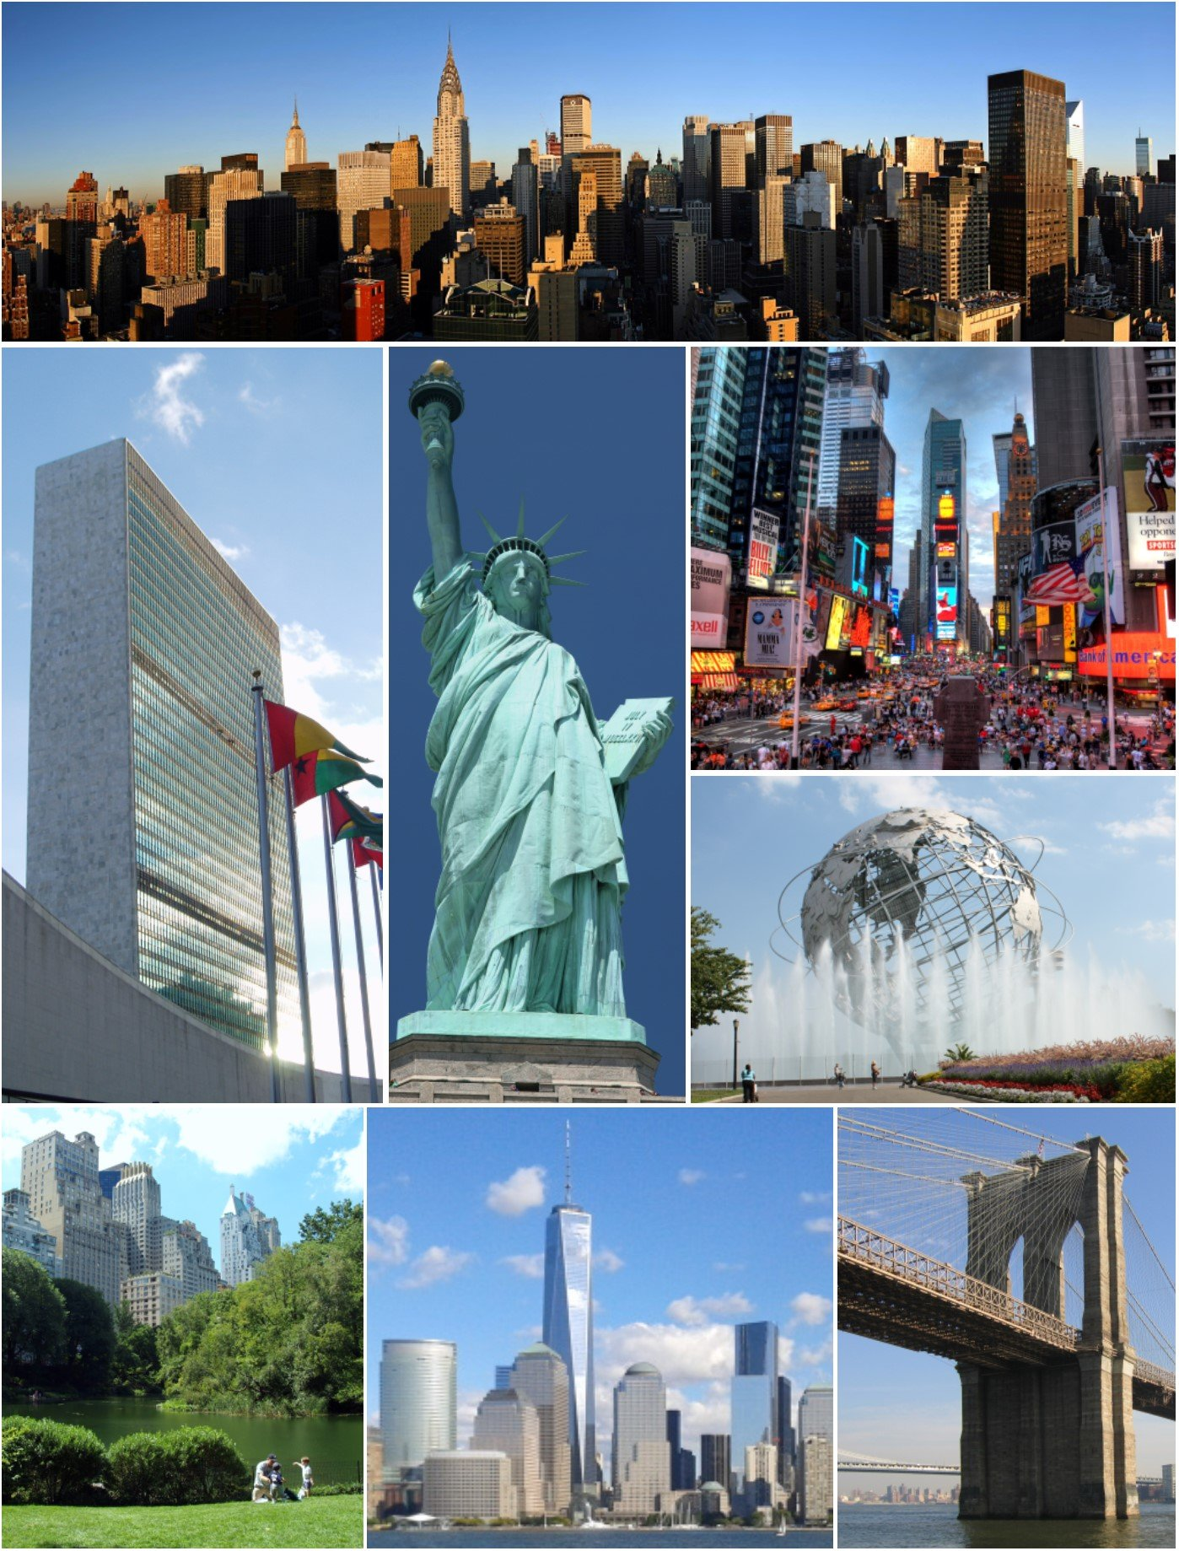
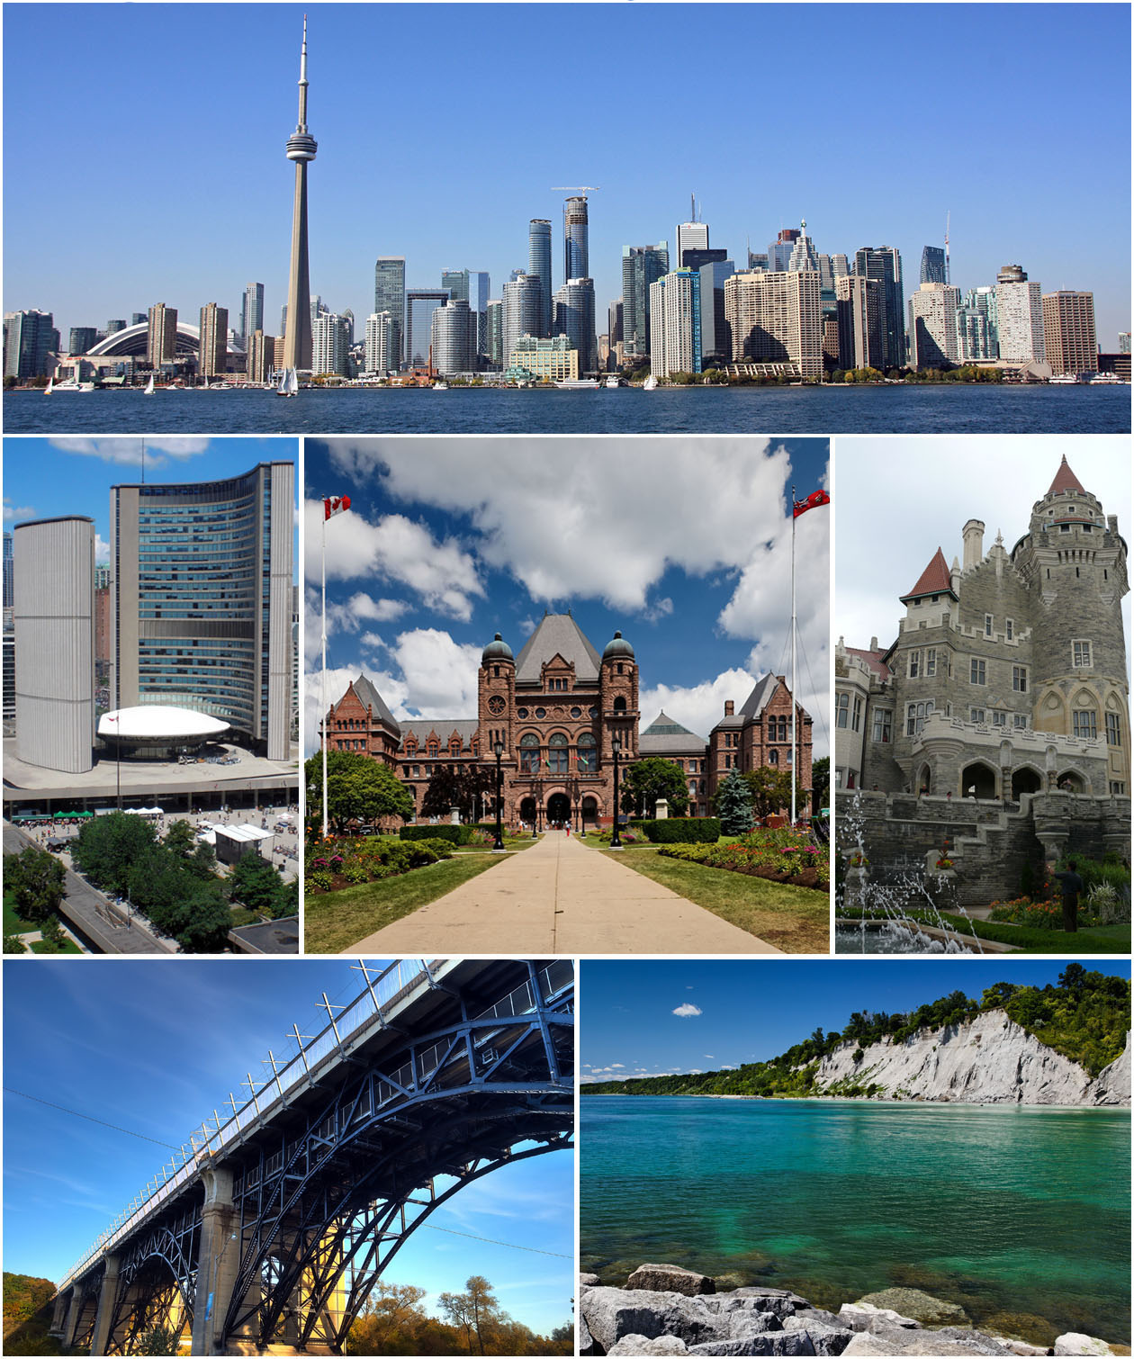
https://en.wikipedia.org/wiki/Toronto#/media/File:Montage_of_Toronto_7.jpg
https://en.wikipedia.org/wiki/New_York_City#/media/File:NYC_Montage_2014_4_-_Jleon.jpg

Slide 3
Introduction
Deciding where to relocate, between New York and Toronto, is a tough choice. You need to consider several factors that may affect your living in any of these cities. Both are English speaking cities and the standard of living is very similar. Both cities have been developed to become a centre of attention for residential, job employment, tourism, education, shopping and sports activity.

Slide 4
Data Sources
Based on the most common places captured from Foursquare, we are going to segment areas of Toronto and New York. Two randomly neighbourhoods will be picked and analysed the top 10 most common venues in each of those two neighbourhoods based on the number of visits by people in each of those places. K-mean clustering unsupervised machine learning algorithm will cluster the venues based on the place category such as restaurants, park, coffee shop, gym etc.

Slide 5
The following urls will be used in order to collect the data necessary for analysis:
- Toronto Postal Codes from Wikipedia:
https://en.wikipedia.org/wiki/List_of_postal_codes_of_Canada:_M'
- New York dataset that contains the 5 boroughs and the neighbourhoods that exist in each borough as well as the latitude and longitude coordinates or each neghbor5hood.
- Foursquare API: (https://foursquare.com/)
Performing location search, location sharing and details about a business. Photos, tips and reviews.
- Folium- Python visualization library used to visualize the neighbourhoods cluster distribution
Various libraries, such as pandas (for data analyses), json (to handle json files), geopy (to retrieve location data), sklearn (machine learning library), etc.

Slide 6
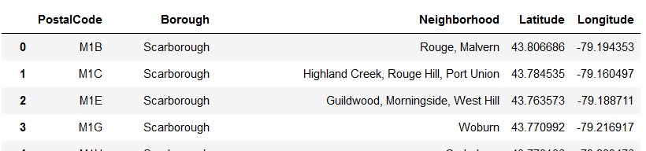
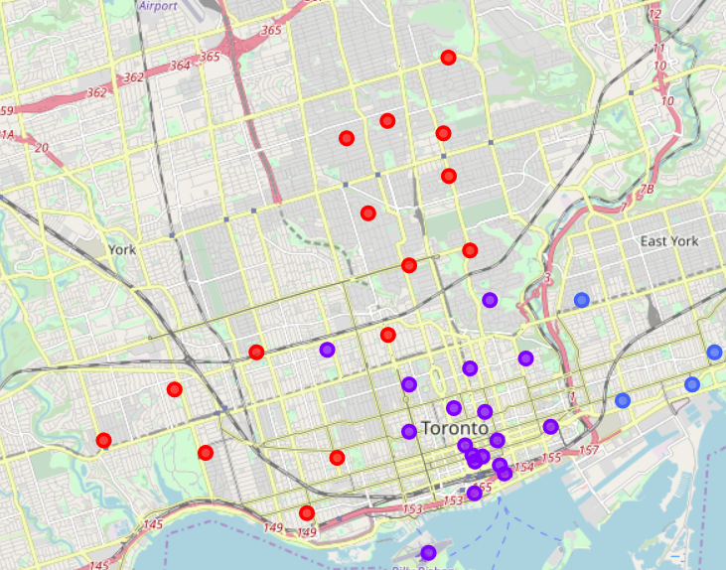
TORONTO
Toronto has 11 boroughs and 103 neighborhoods.

Slide 7
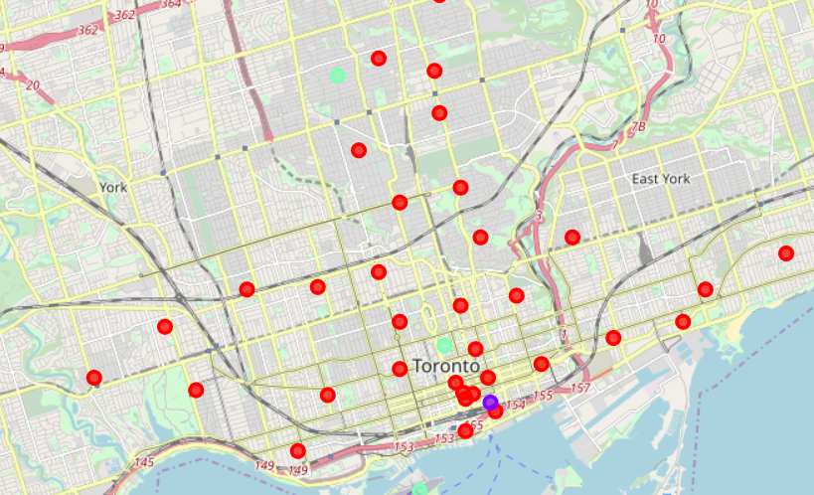
cluster the Neighborhoods using k-means and visualize the clusters

Slide 8
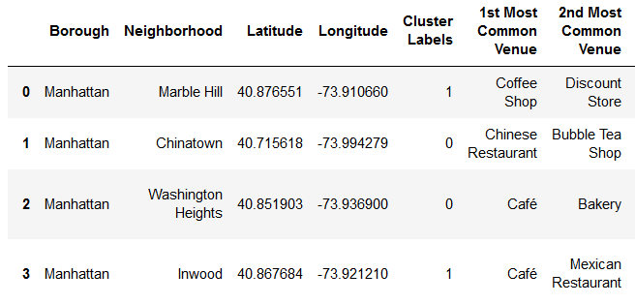
Examine each cluster and determine the discriminating venue categories that distinguish each cluster, using Foursquare API

Slide 9
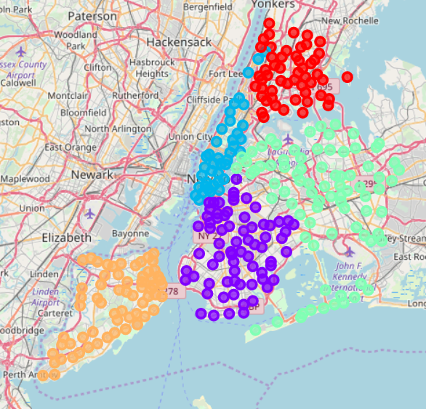
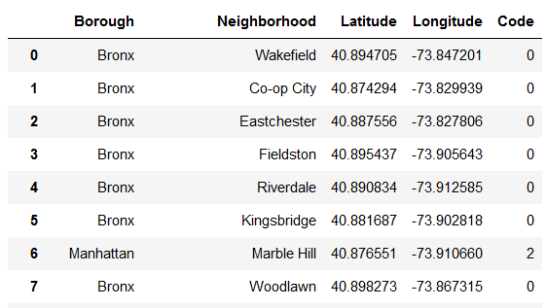
New York
New York has 5 boroughs and 306 neighborhoods.

Slide 10
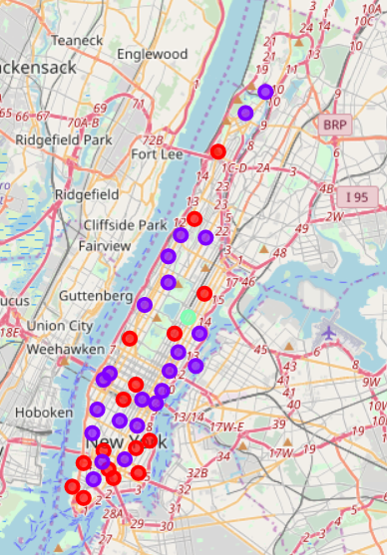
cluster the Neighborhoods using k-means and visualize the clusters

Slide 11
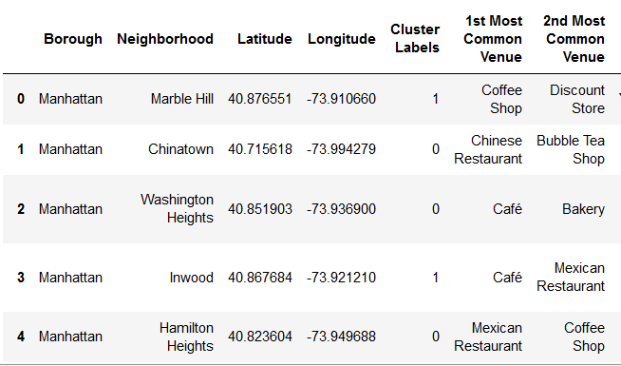
Examine each cluster and determine the discriminating venue categories that distinguish each cluster, using Foursquare API

