Slide 1
Guided Capstone Project - 1
Big Mountain Ski Resort

Slide 2
Problem Identification
Company
Context
Problem statement
Big Mountain Ski Resort - Montana
The resort's pricing strategy has been to charge a premium above the average price of resorts in its market segment
There's a suspicion that Big Mountain is not capitalizing on its facilities as much as it could
Basing their pricing on just the market average does not provide the business with a good sense of how important some facilities are compared to others
This hampers investment strategy
Big Mountain Resort has recently installed an additional chair lift to help increase the distribution of visitors across the mountain. This additional chair increases their operating costs by $1,540,000 this season.
How can Big Mountain Resort select a better value for their ticket price to increase the revenue without increasing the operating cost more than $1.54M for the season?

Slide 3
Modeling results and analysis

Slide 4
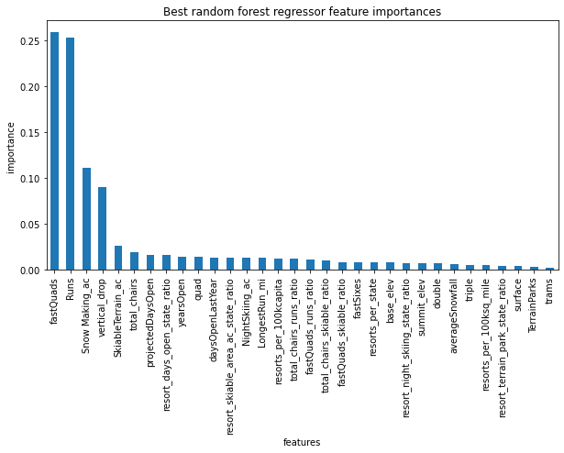
Model key findings
The dominant top four features are:
fastQuads
Runs
Snow Making_ac
vertical_drop
Predicted Price | Current Price
$96.17 | $81.00

Slide 5
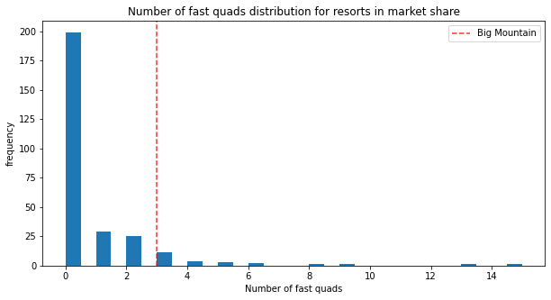
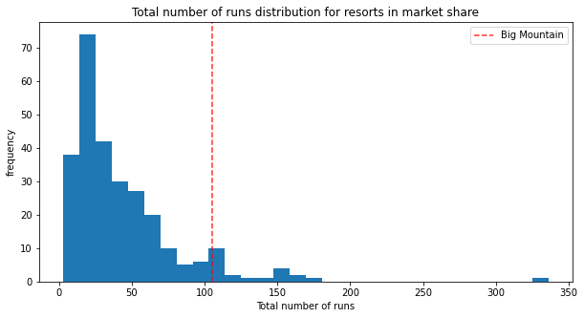
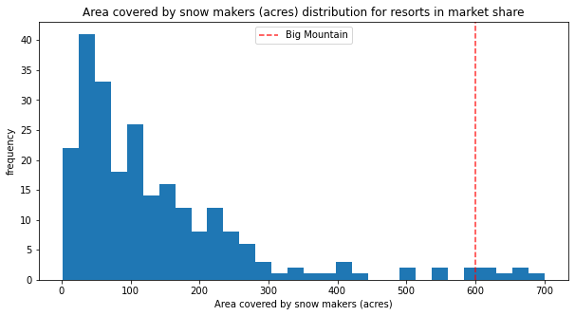
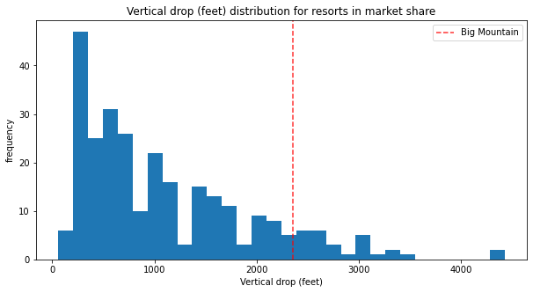
Comparison of the top features
Most resorts have no fast quads. Big Mountain has 3, which puts it high up that league table. There are some values much higher, but they are rare.
Big Mountain compares well for the number of runs. There are some resorts with more, but not many.
Big Mountain is very high up the league table of snowmaking.
Big Mountain is doing well for vertical drop, but there are still quite a few resorts with a greater drop.

Slide 6
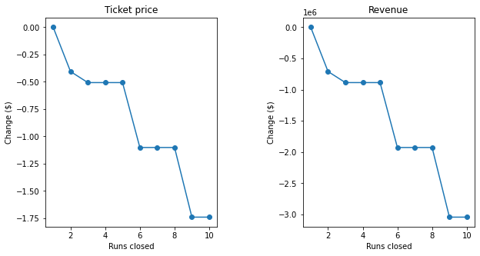
Model results for business scenarios
Closing 1 run has no price difference. Closing 2-5 - reduces support for ticket price. Closing 6 - leads to large drop in ticket and revenue
This scenario increases support for ticket price by $1.51. Over the season, this could be expected to amount to $2,637,681. Such a small increase in the snow making area makes no difference!
Scenario 1:
Close up to 10 of the least used runs
Scenario 2:
Adding a run
Increasing the vertical drop by 150 feet
Installing an additional chair lift.
Scenario 3:
Scenario 2
Adding 2 acres of snowmaking
Scenario 4:
Increasing the longest run by 0.2 miles
Adding 4 acres of snow making capability.
This scenario increases support for ticket price by $1.51. Over the season, this could be expected to amount to $2,637,681.
No difference whatsoever.

Slide 7
Summary and conclusion
Model predicts Big Mountain ticket price can be increased
Big Mountain does have good facilities as compared to other resorts in the country
Unused runs could be identified and closed
Analyze operational cost and explore adding a run

Slide 8
Future work
Data
New Model
Automate Model
Collect additional data for
Operational costs
Number of visitors per day
Accessibility to the resort
Construct new model based on the new data available
If model is approved by stakeholders provide interface/tool with the key features to analyze the change in price

