Slide 1

Jewelry Price Classifier
Rupal Gandhre
Data Science Career Track
Special mention and THANKS to my mentor
Ruturaj "Raja" Soman, Ph.D.

Slide 2
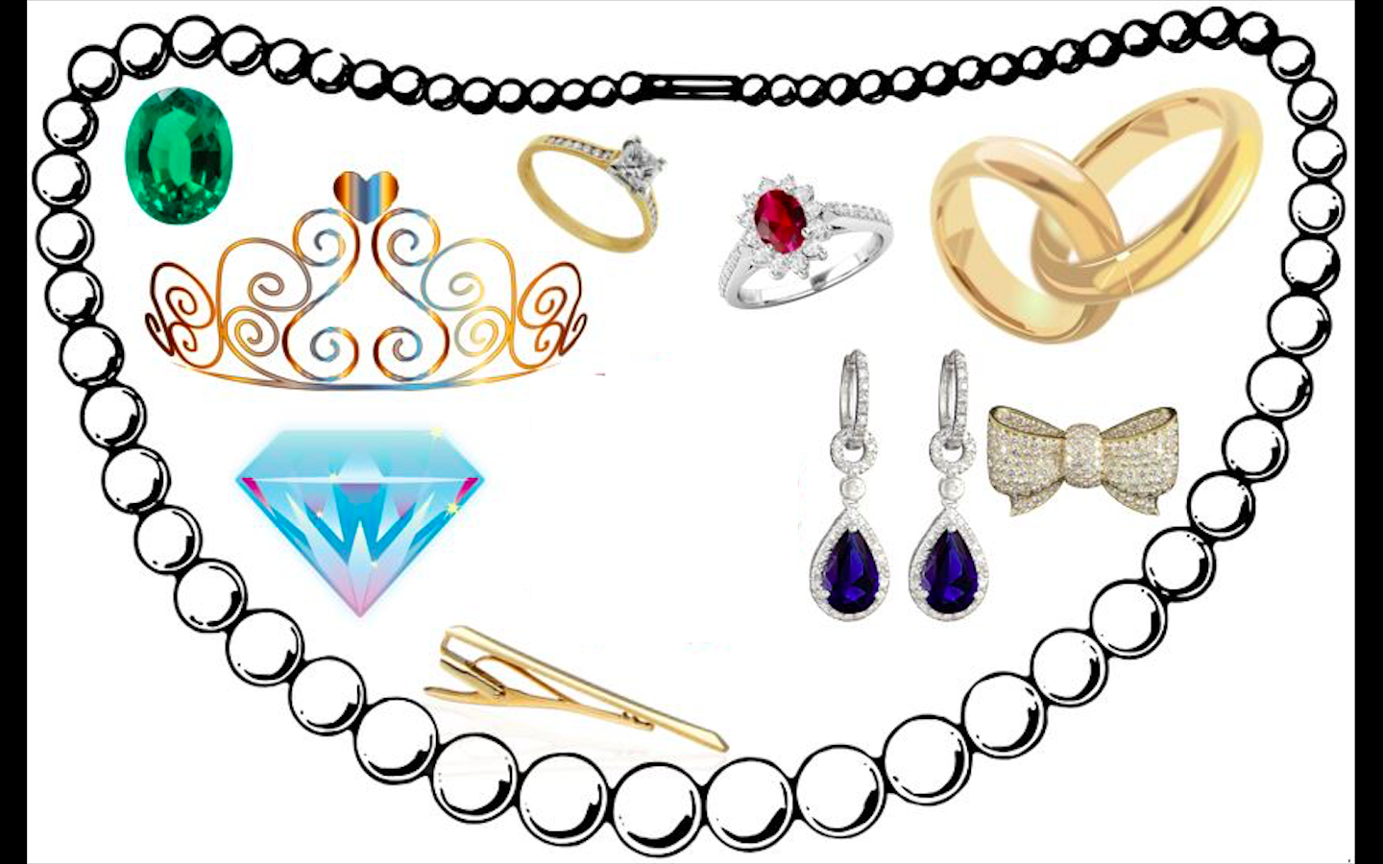
Background
The jewelry industry has a potential to benefit from data and advanced analytics.
Many of the retail industry sectors are already leveraging the benefits.
Data modeling and automation can help stakeholders and consumers to understand price range for the custom jewelry

Slide 3
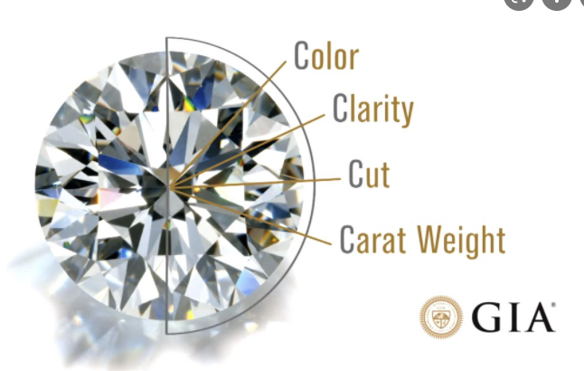
Goal
4C’s to grade a gemstone
Based on the following features, classify the price range of the jewelry
1. Metal of jewelry (18K Gold, 14K Gold, Sterling Silver)
2. Type of Stone(Diamond or Gemstones)
3. Color of the Stone
4. Cut of the Stone
5. Carat weight of the Stone

Slide 4
Data Sources
Data is web-scrapped from one of the leading jewelry brand using BeautifulSoup. I am thankful to the web developers for not implementing a script to block my nuisance of an IP address.
https://www.effyjewelry.com/collections/all

Slide 5
Exploratory Data Analysis

Slide 6
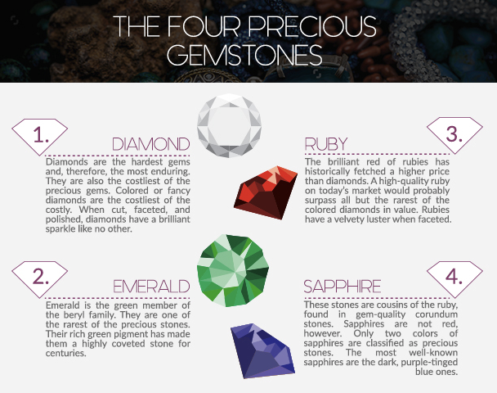
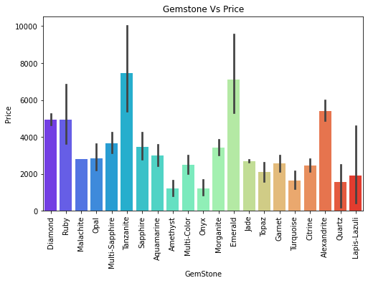
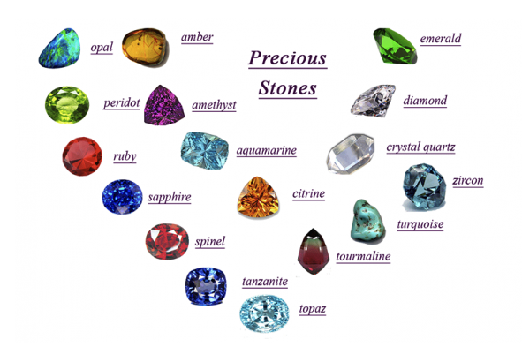

Slide 7
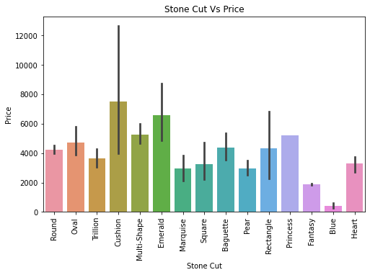
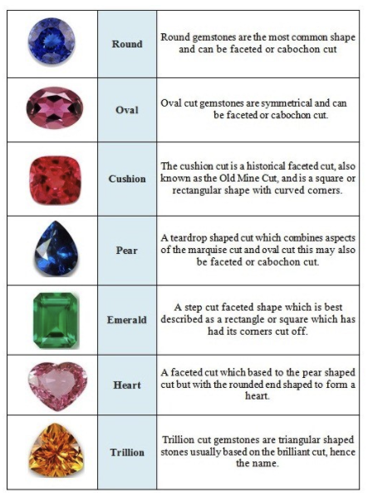
Different ways how a gemstone is cut and its relationship with price in the dataset

Slide 8
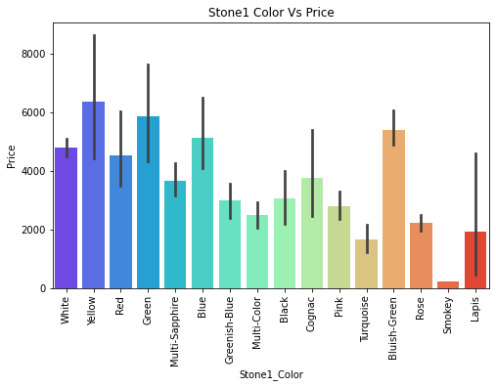
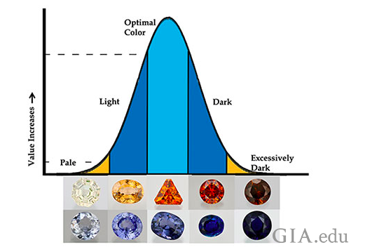
Different colors of gemstone and its relationship with price in the dataset

Slide 9
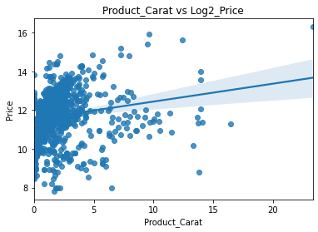
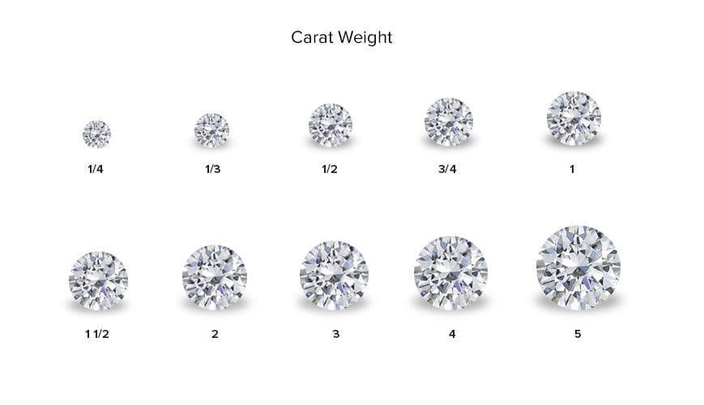
Different carat weight of gemstones and its relationship with price in the dataset

Slide 10
Machine Learning Models

Slide 11
Modeling Steps
Data Preprocessing:
Label Encoding for price categories
One Hot Encoding for categorical data
Handling of null values
Split data into training(70%) and test data sets(30%)
Cross Validation (CV) and hyperparameter tuning using GridSearchCV
cv=3
Performance evaluation
Confusion Matrix
Precision Score
Recall Score
Classifier training on 70% data using the best parameters
Testing on 30% data

Slide 12
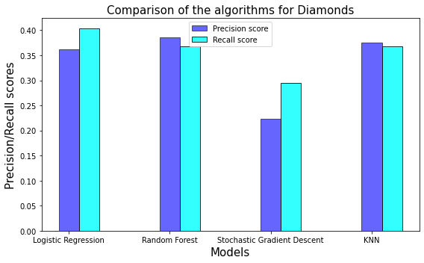
Comparison of model performances
for Diamond Rings
Algorithm | Precision Score | Recall Score
Logistic Regression | 0.361152 | 0.403697
Random Forest | 0.38525 | 0.367108
Stochastic Gradient Descent | 0.223689 | 0.295502
KNN | 0.375491 | 0.367857

Slide 13
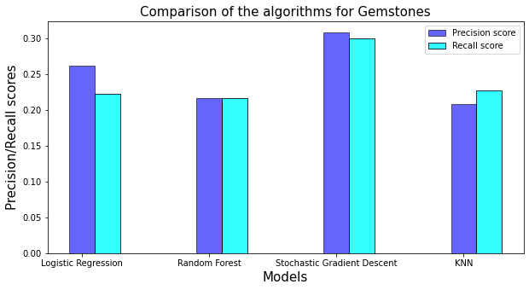
Comparison of model performances
for Gemstone Rings
Algorithm | Precision Score | Recall score
Logistic Regression | 0.262714 | 0.22238
Random Forest | 0.21735 | 0.216289
Stochastic Gradient Descent | 0.308762 | 0.300575
KNN | 0.208673 | 0.228101

Slide 14
Summary and conclusion
The classification models were evaluated based on the precision and recall score.
With the currently available dataset,
For diamond rings models, the precision score for Logistic Regression is 0.361152 and thus is selected as the best model
For gemstones rings models, the precision score for Stochastic Gradient Descent is 0.308762 and thus is selected as the best model.
With more diverse and accurate data, the model may predict better results.

Slide 15
Future work
SCOPE OF IMPROVEMENT
In-depth analysis and modeling was done only for rings.
Analyze and model for other jewelry types
Analyze and model for operating cost, sales data
NEW MODEL
Construct new model based on the new data available
MODEL AUTOMATION
If model is approved by stakeholders provide interface/tool with the key features to analyze the change in price

