Slide 1

Using
Ganesh Ramasubramanian
17-Mar-2017

Slide 2
Agenda
Introduction
Overview
A&A Deployment Architecture
Nokia Artifactory Details
Jenkins Build Farm
Ways of Deploying Artifacts
Demo
Jenkins Configuration

Slide 3
Introduction
JFrog Artifactory is the Repository Manager
Supports all major packaging formats
Build tools &
CI servers

Slide 4
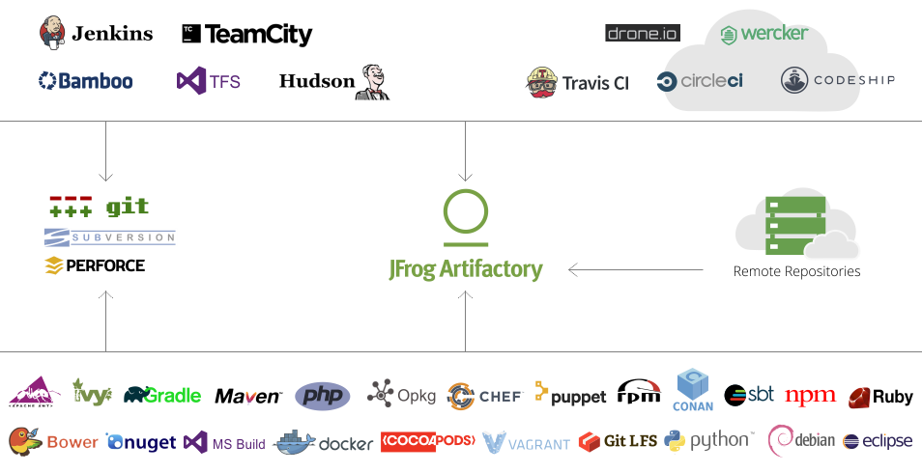
Overview

Slide 5
A&A Deployment Architecture
Core Infrastructure
Build Cloud
Docker host
Docker host per product unit
Provision dynamic Jenkins Agent as container
and run build
Docker host per product unit
Provision test
environment
External test host (VM or physical)
Jenkins Master
Test VM
Jenkins Master
Build container
Build container
Build container
Download
artifacts
Build container
Run Docker
image build
Test container
Build container
Test container
Build container
Docker host for Docker image building
Test host (VM)
Test VM
Publish build
artifacts
Artifactory
Download artifacts
Docker registries
Yum repos
Maven repos
…
Zabbix
Status monitoring

Slide 6
A&A Deployment Architecture - Target
Core Infrastructure
Build Cloud
Kubernetes nodes
Kubernetes nodes
Docker host
Provision dynamic Jenkins Agent as container
and run build
Docker host per product unit
Provision test
environment
External test host (VM or physical)
Jenkins Master
Test VM
Jenkins Master
Build container
Build container
Build container
Download
artifacts
Build container
Provision dynamic Jenkins Agent as VM
to run Docker image build
k8s control plane
k8s control plane
Test container
Build container
Test container
Build container
Docker host for Docker image building
Docker host for Docker image building
Test host (VM)
Test VM
Publish build
artifacts
Artifactory
Download artifacts
Docker registries
Yum repos
Maven repos
…
Zabbix
Status monitoring
ELK
Logs and telemetry

Slide 7
Nokia Artifactory Details
https://repo.lab.pl.alcatel-lucent.com
Each team can have one or more artifact repositories
Repository types include
Yum
PyPI
Gems
Generic files
Docker registry
Remote repositories can be proxied (seeded on first access)
Multiple repositories of the same type can be combined into a single virtual repository
Artifacts can be “promoted” between repositories
Artifacts with the same checksum are only stored once

Slide 8
Jenkins build farm - Target
https://build.lab.pl.alcatel-lucent.com
For each build, Jenkins dynamically creates a new Jenkins Agent from a Docker image
Self-service for teams
Teams have full control over their folder in Jenkins
Teams have full control over the Docker image(s) used for their builds
Teams have full control over the test environment used by their builds
Jenkinsfile pipeline-as-code in Gerrit repo is recommend way to configure Jenkins jobs
Integration with Gerrit
Integration with Artifactory
Docker images are also built by Jenkins
DevOps team provides base Docker images with Jenkins Node prerequisites that team images can inherit from

Slide 9
Ways of Deploying Artifacts
Jfrog CLI
Docs: https://www.jfrog.com/confluence/display/CLI/CLI+for+JFrog+Artifactory
Quick how-to article: https://www.jfrog.com/blog/cli-climbing-to-new-heights/
Maven Plugin
Docs: https://www.jfrog.com/confluence/display/RTF/Maven+Artifactory+Plugin
Jenkins Artifactory Plugin
Bash Script
ANA Jenkinsfile

Slide 10
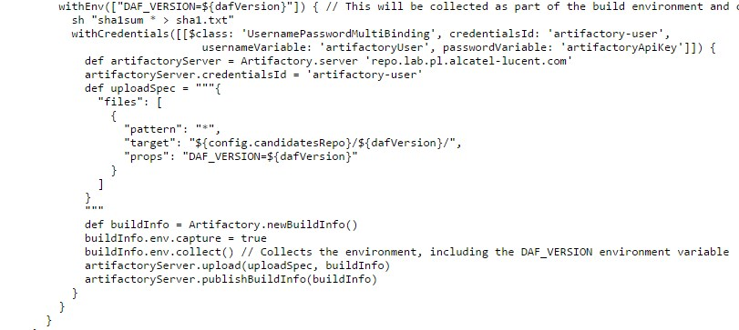
Jenkins Artifactory Plugin

Slide 11
Demo
GitHub Project: https://github.com/rgannu/playground

Slide 12
Jenkins Configuration
Jenkins: http://ana-jenkins.be.alcatel-lucent.com:8080/job/Ganesh-Artifactory-Testme/

Slide 13
References
Jfrog Artifactory
A&A DevOps Infrastructure
Documentation from A&A in confluence

Slide 14
Future Tech Sessions
10-Mar: Gerrit in Software Development
17-Mar: Using Artifactory in R&D
24-Mar: Metrics Collection in Spring WebApp

Slide 15
Thank you for listening

