Slide 1

Ganesh Ramasubramanian
10-Mar-2017

Slide 2
Agenda
Introduction
Why ?
Gerrit Configuration
Using Intellij
Demo
Checkout
Commit & Push
Review
Jenkins Configuration
Jenkins: Gerrit Trigger Plugin

Slide 3
Introduction
Gerrit is a web-based code review tool
Code review
Formal Meeting
Code walkthrough
Peek at the code before commit
Improve code quality
Developer can explain better when the source code is fresh in their mind !!!
Lasting conversation when the team composition changes.
And so on….

Slide 4
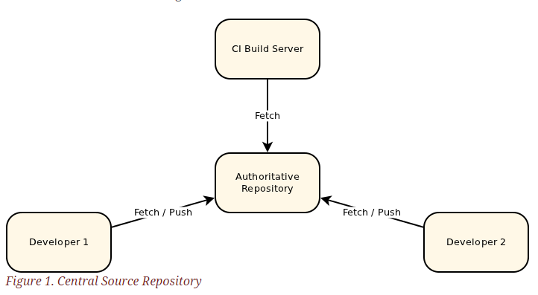
Gerrit

Slide 5
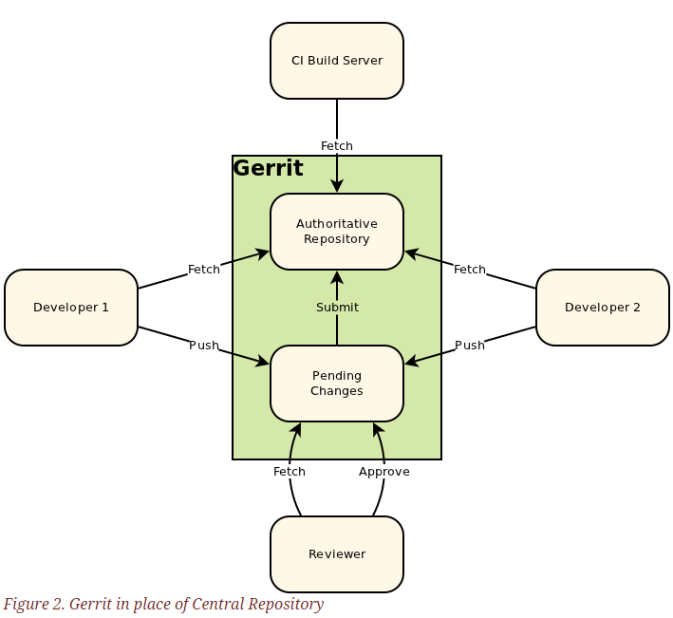
Gerrit

Slide 6
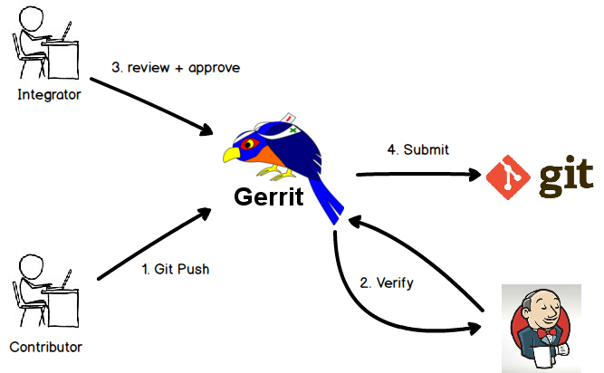
Gerrit Workflow

Slide 7
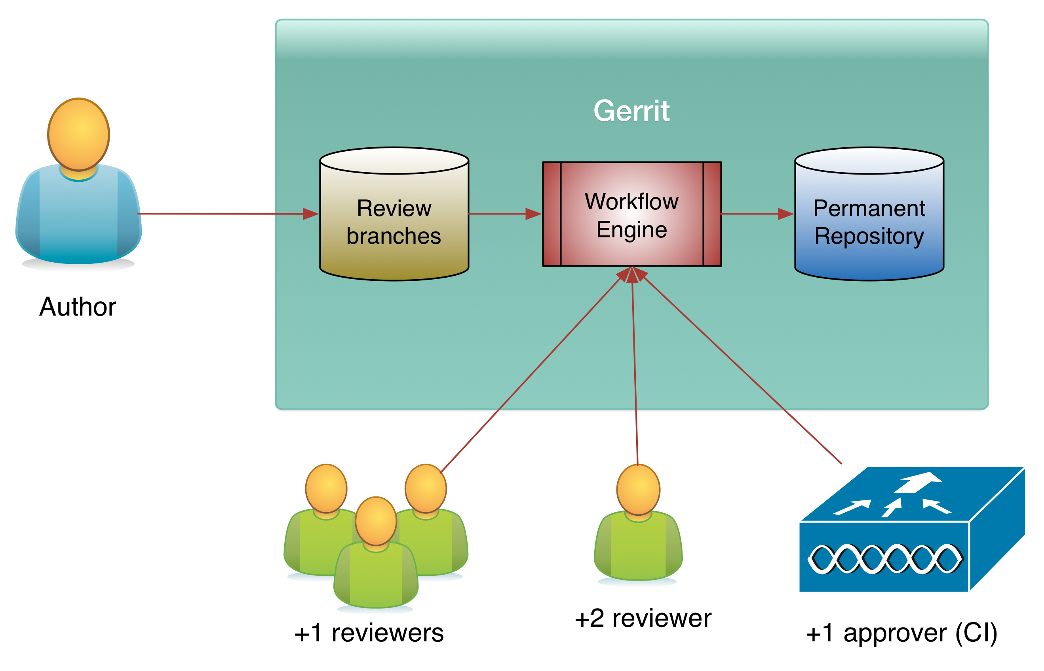
Gerrit

Slide 8
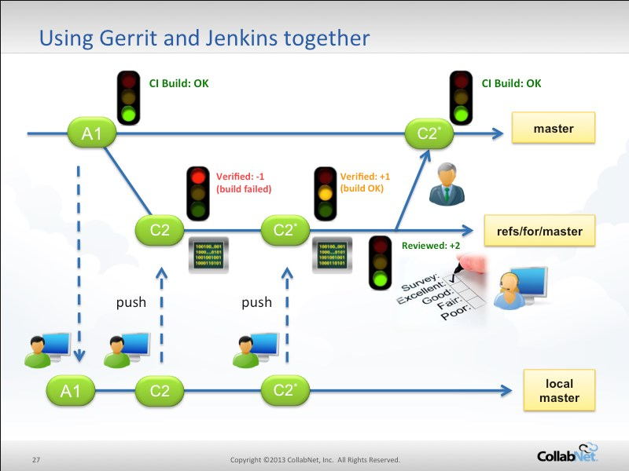

Slide 9
Demo
Confluence page
https://confluence-1.be.alcatel-lucent.com/display/ANA/How+to+use+Gerrit+from+Intellij+for+Development

Slide 10
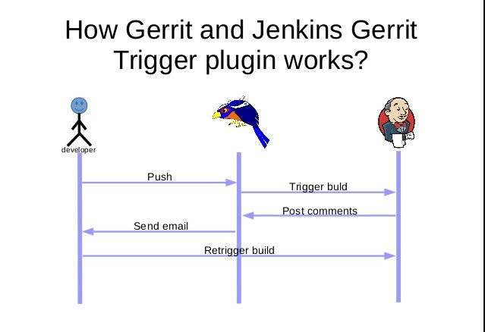

Slide 11
References
Gerrit Code Review – A Quick Introduction
How to use Gerrit
Intellij for Development
Eclipse for Development
Gerrit Demo Video
Gerrit Documentation from A&A Team

Slide 12
Future Tech Sessions
10-Mar: Gerrit in Software Development
17-Mar: Using Artifactory in R&D
24-Mar: Metrics Collection in Spring WebApp

Slide 13
Thank you for listening

