Slide 1

Apache Camel
using Spring
Ganesh Ramasubramanian
03-Feb-2017
Nokia Internal Use

Slide 2
Agenda
Introduction
Overview
Architecture
Camel Concepts
Why Spring in Camel ?
Demo
Going forward
References
Q&A

Slide 3
Introduction
Apache Camel is an
Open Source Integration Framework
Implements Enterprise Integration Patterns (EIP) via Plumbing
Abstracts the difficulties of communicating between Components

Slide 4
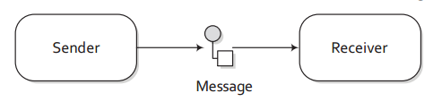
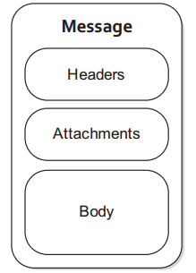
Overview

Slide 5
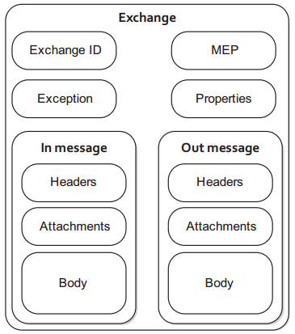
Overview
An Exchange in Camel is the Message’s container during routing.
Supports various types of interactions between systems, also known as MEPs (Message Exchange Patterns)

Slide 6
Overview
An Exchange can either be
InOnly – One-way Message like JMS
InOut – Two-way (request-response) Message like HTTP

Slide 7
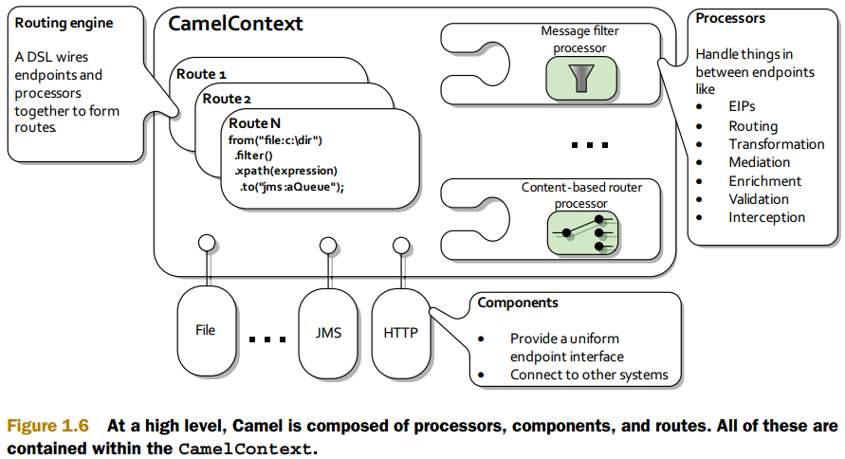
Architecture

Slide 8
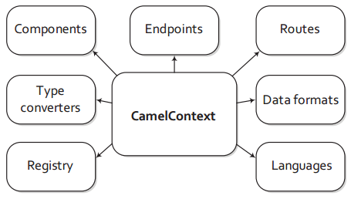
Camel Concepts
Camel is capable of loading components on the fly either by auto-discovery on the classpath or when a new bundle is activated in an OSGi container.
Contains a registry that allows you to look up beans. By default, this will be a JNDI registry. If you’re using Camel from Spring, this will be the Spring ApplicationContext.
Camel allows you to use many different languages to create expressions.

Slide 9
Camel Concepts
Each Route in Camel has an
Unique Identifier
Used for logging, debugging, monitoring
Notes:
EIP – Enterprise Integration Patterns

Slide 10
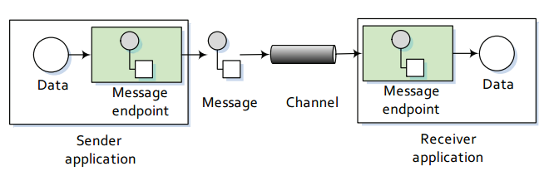
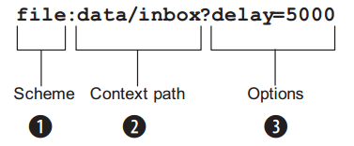
Camel Concepts
End point
End point URI format
Notes:
EIP – Enterprise Integration Patterns
End of a channel through which a system can send or receive messages
URIs
Scheme: Denotes which Camel component handles that type of endpoint
Context Path: In this case the starting folder
Options: In this case indicates it is polling consumer

Slide 11
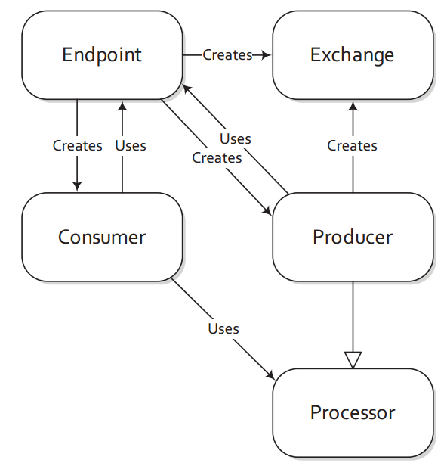
Camel Concepts
Notes:
All you need to do is route a message to an endpoint, and the producer does the heavy lifting. A consumer is the service that receives messages produced by a producer, wraps them in an exchange, and sends them to be processed. Consumers are the source of the exchanges being routed in Camel.

Slide 12
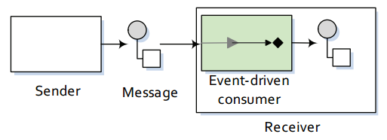
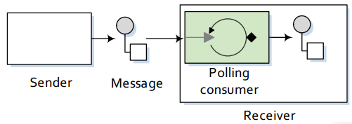
Camel Concepts - Consumers
Event Driven Consumer (Asynchronous): eg., Kafka
Polling Consumer (Synchronous): eg., FTP

Slide 13
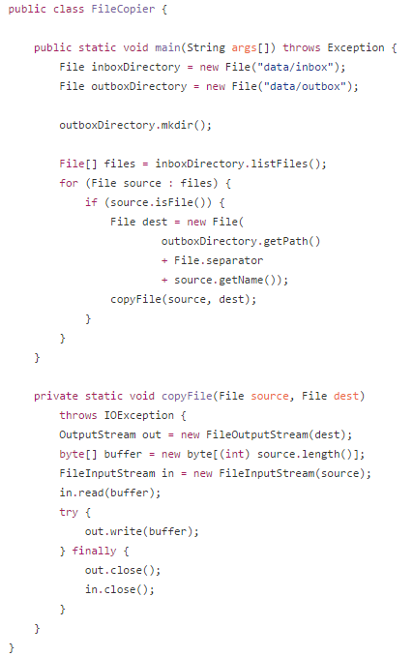
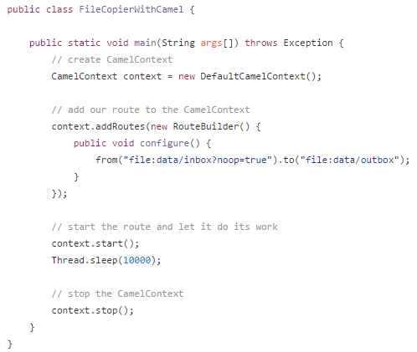
Camel Concepts - DSL
Notes:
All you have to focus on is defining the routes that matter for your integration projects.

Slide 14
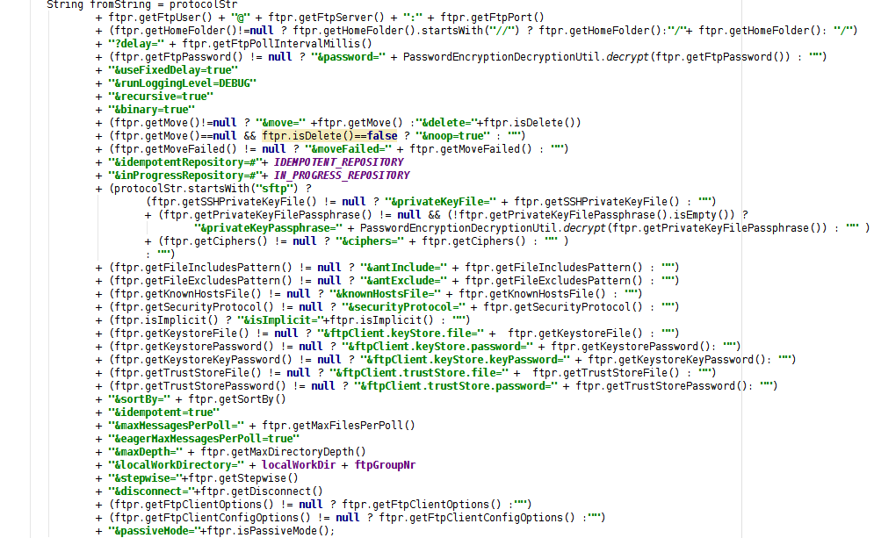
Camel Concepts in MAS FTP-scanner
FTP scanner

Slide 15
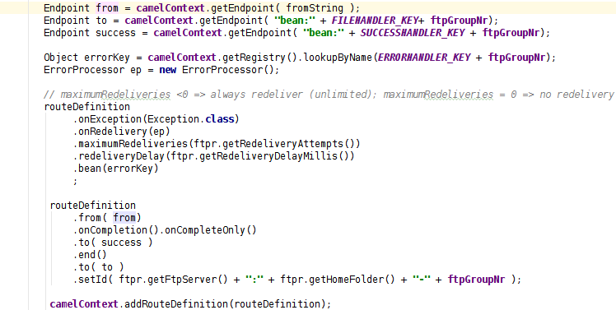
Camel Concepts in MAS FTP-scanner
FTP scanner

Slide 16
Why Spring in Apache Camel ?
Clean
Concise
All spring functionalities
Spring DSL
Database connectors
Transaction support
….
Testing with Mockups
Power of Spring boot
Metrics
Pluggable Components & Beans

Slide 17
Demo
https://github.com/rgannu/camel

Slide 18
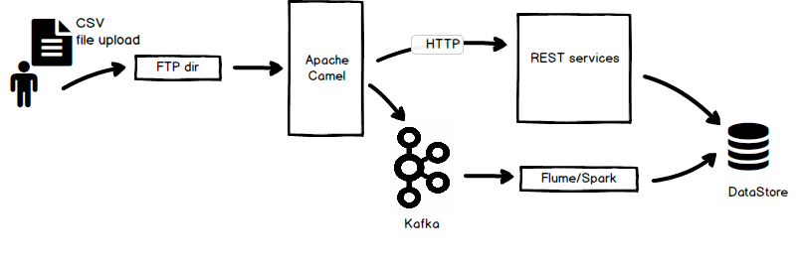
Going forward of your existing System
Camel has the possibilities to route to multiple end points

Slide 19
Future Tech Sessions
2-Dec: Jenkins 2.x Technical Information
16-Dec: Puppet Infrastructure & Deployment
20-Jan: Spring REST and HATEOAS in action
03-Feb: Apache Camel using Spring

Slide 20
References
Camel in Action, Second Edition
https://www.manning.com/books/camel-in-action-second-edition
Apache Camel Source
git://git.apache.org/camel.git
GitHub
https://github.com/rgannu/camel
Using Camel commands to manage an Apache Spring Boot Application !!!
From 2.17 onward
Blog Post
Spring Boot Docs
http://docs.spring.io/spring-boot/docs/current/reference/html/

Slide 21


