Slide 1
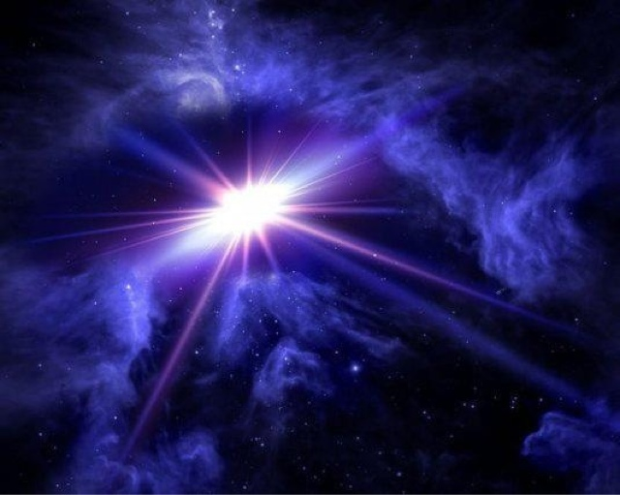


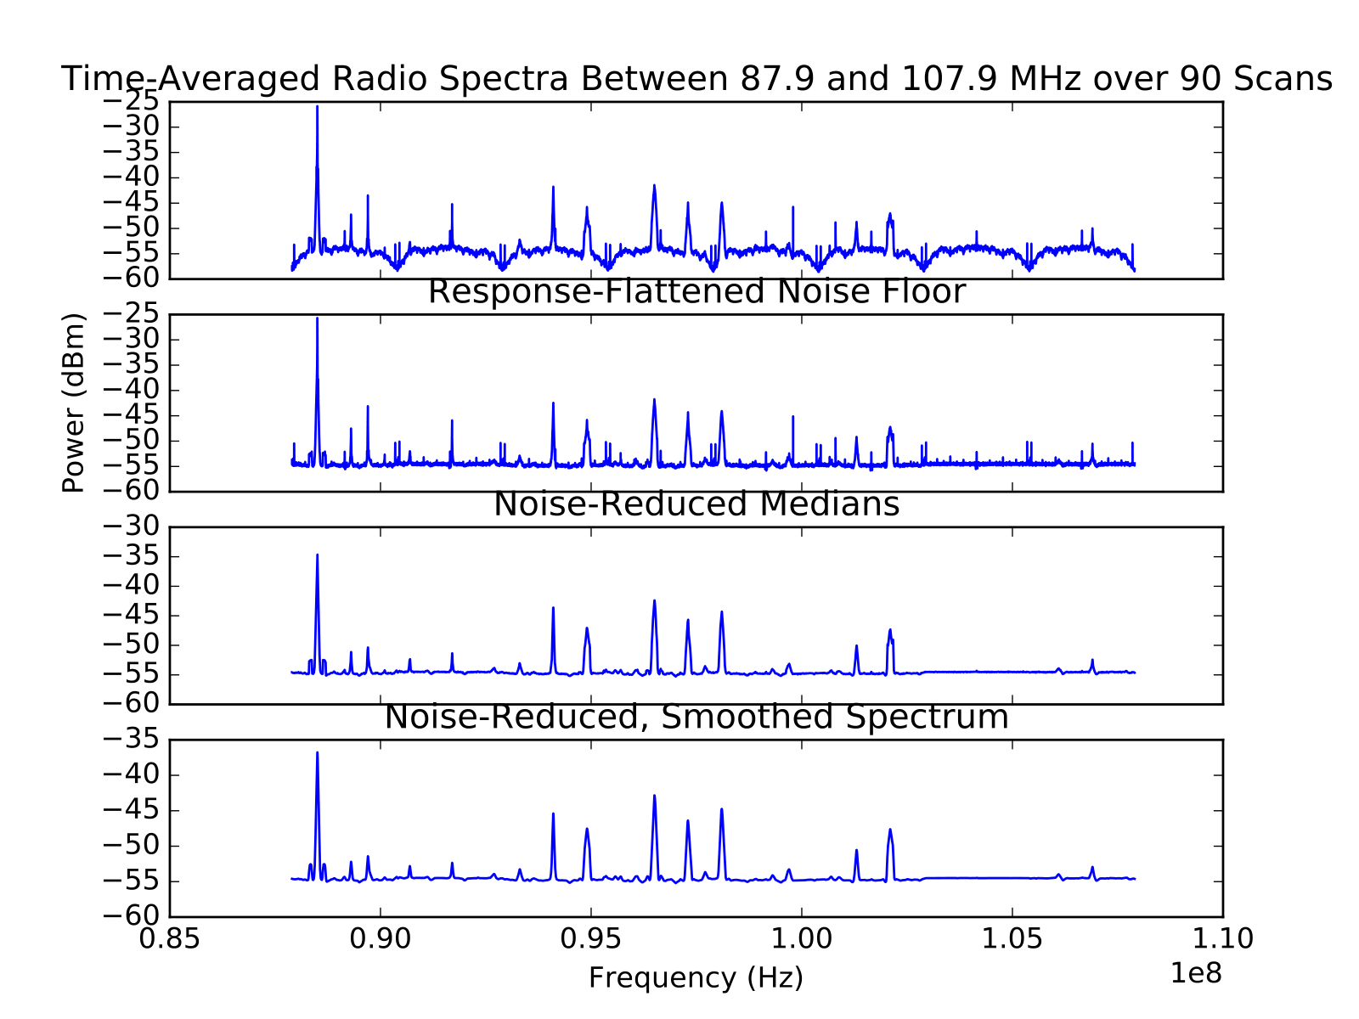
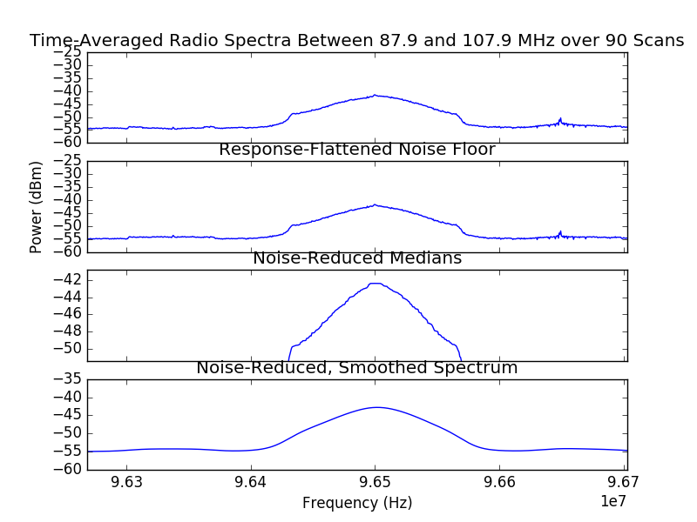
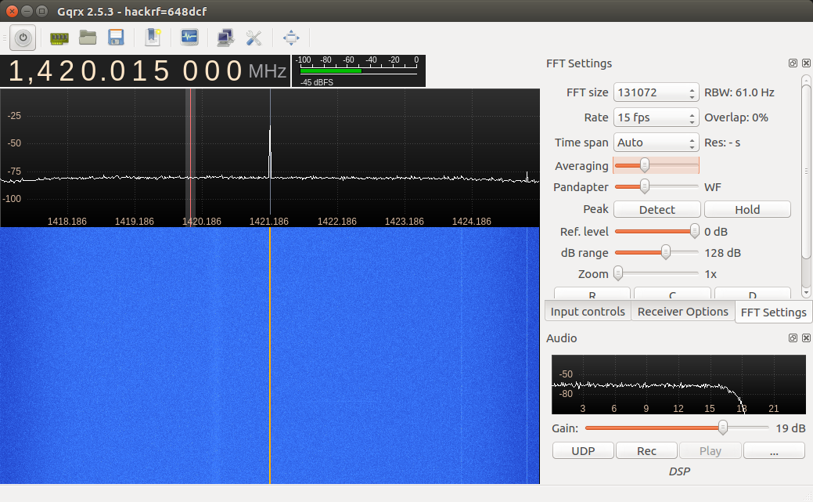
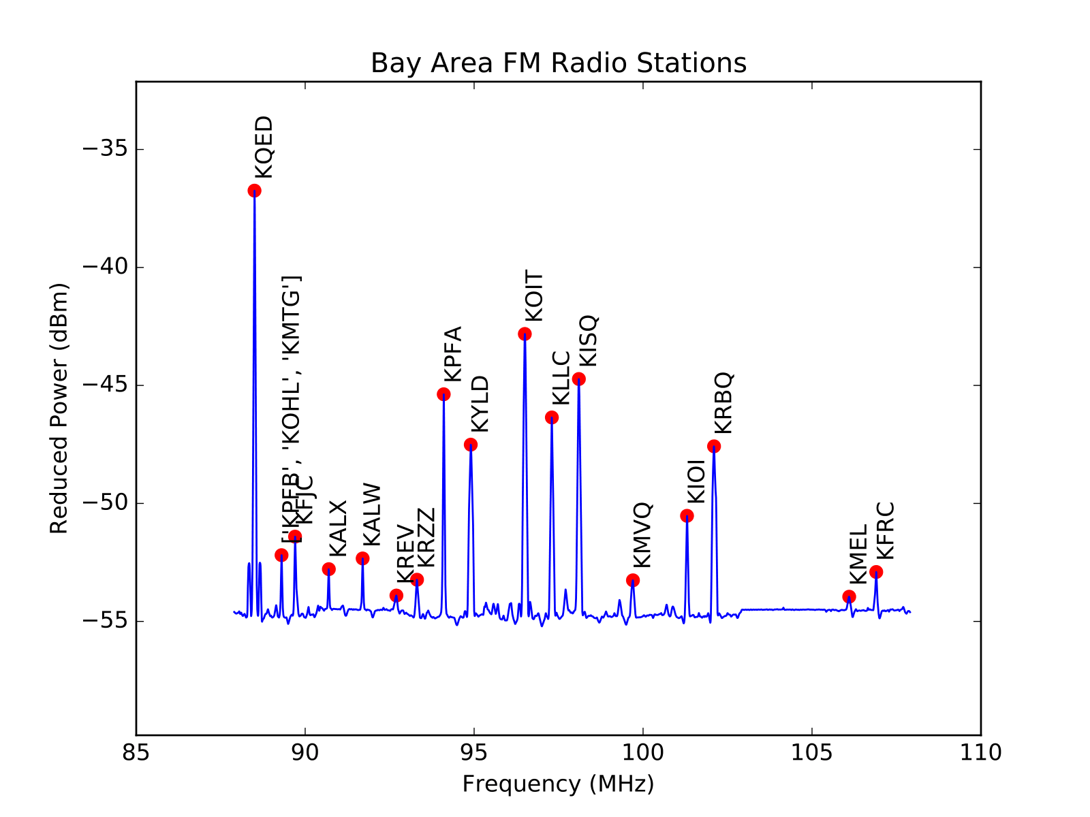
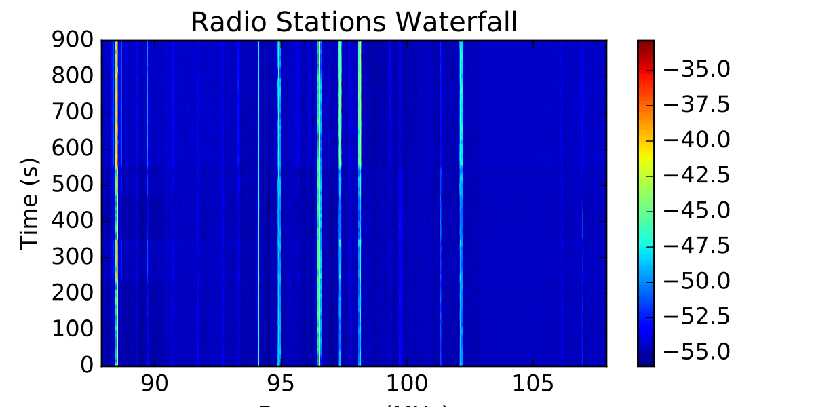
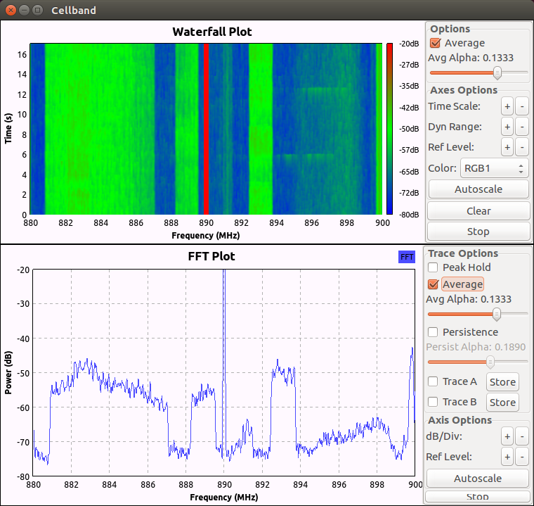
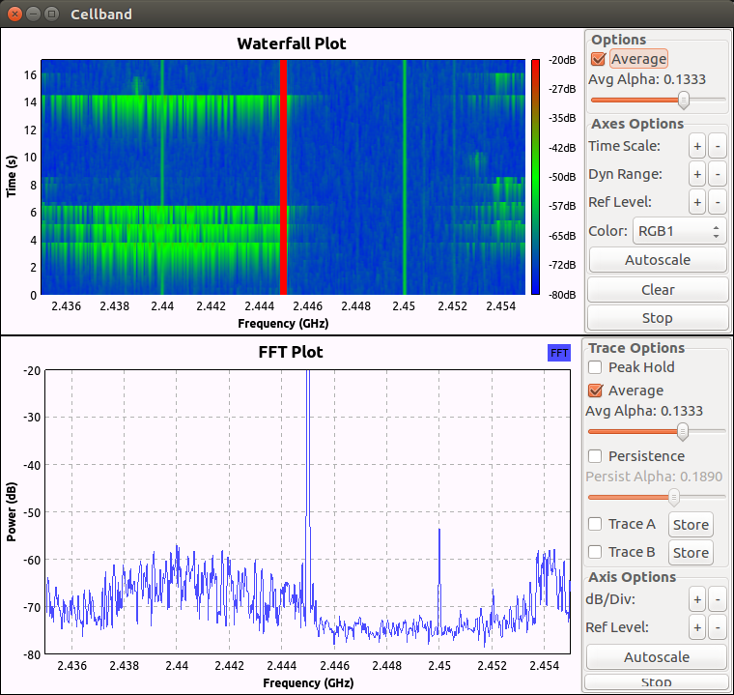
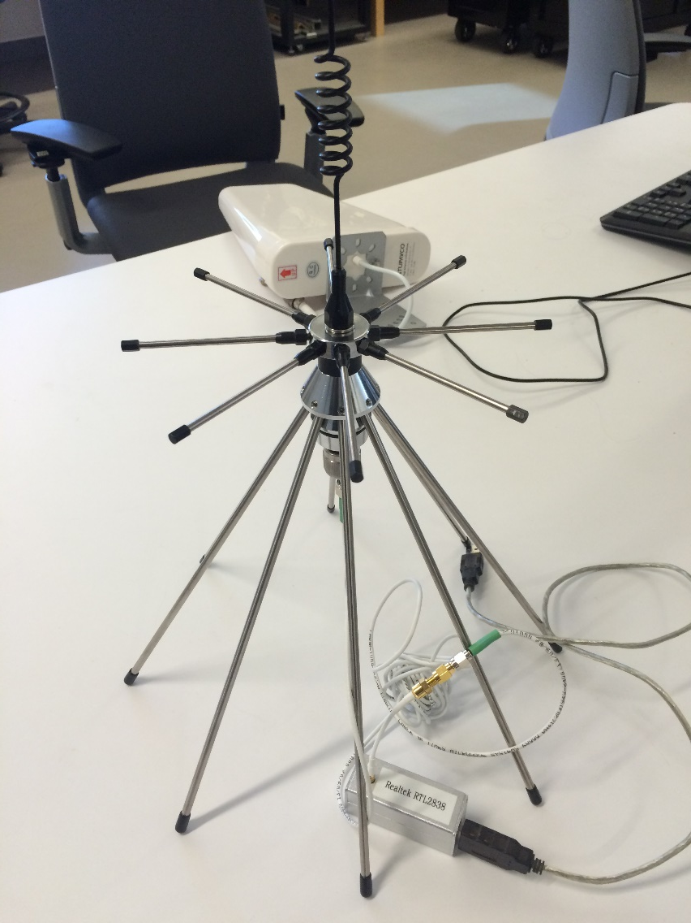
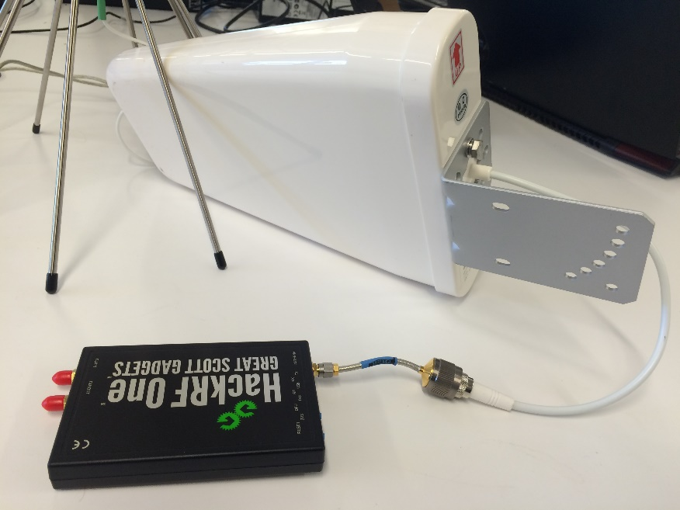
Radio Frequency Interference: Identifying Common Sources
Xin Gao
UC Berkeley; Breakthrough Listen, SETI
Abstract
Methods and Data
Results – 21cm Line
Radio Frequency Interference (RFI), ubiquitous from its electronic origins, presents a primary concern to radio astronomy observations. In search for extraordinary radio signals, observers must decipher the unique among the sea of extraneous noise and peaks. An activity in identifying common radio sources, such as radio stations and cellphone band transmitters, reflects the work done by researchers on filtering out interference. Combining hardware with code, we probe into the nature of these signals and attenuate to the methods used in identifying RFI in our search for extraterrestrial intelligence or other sources of potentially interesting radio signals.
Processing Raw Data
Depending on the file type of the incoming data, different methods are applied to convert the data into easily workable formats. Fortunately, the third party-developed rtl_power command conveniently stores the data from the Realtek dongle in a .csv file, which I then convert to a text file. HackRF One spans a much larger bandwidth than the Realtek dongle, but has the downside of the data coming in as an unsigned 8-bit binary file, making it difficult to work with from the command line; SDR programs such as GNU Radio or gqrx are used to conveniently view the spectra from such data inputs.
The raw data is, when viewed as a spectrum (Fig. 3.1), displays much unwanted data and patterns from instrumental noise and sampling imperfections. Various steps were taken to improve the spectrum:
The curved noise floor is due to the response level of sampling centered around the targeted frequency. To rid of it, choose a fitted curved to one of the curves and divide the spectrum by it; fortunately, the seventh arc does the job. (Fig. 3.2)
Taking the median of every number (twenty used here) data points removes most of the noise, especially the single-frequency peaks arising from the instrumentation. (Fig. 3.3)
Lastly, a convolution – smoothing of a curve by another – is used to transform the rugged spectrum into a smooth one with definite shapes and curves. (Fig. 3.4))
Quantum mechanics shows that hyperfine energy levels exist within the ground state of an atomic particle. In neutral Hydrogen, a transition between such energy levels releases about 5.874 micro-electron volts, corresponding to radiation of about 1.42 gigahertz in frequency or 21 cm in wavelength. Neutral hydrogen is isotropic and is ubiquitous throughout the universe in forms of interstellar dust or remnants of various phenomena. If not accounted for, the 21cm line can present a false positive. For my experiment, I used HackRF One to connect to a rooftop antenna (the Horn) and displayed the spectrum using gqrx. Figure 9 shows the 21cm line as the faint white line to the left of the red DC spike in the waterfall plot.
Interestingly, work in SETI may specifically target the 21cm line since it can be viewed as an universal standard of length.
Objectives
Identify nearby radio sources:
specifically, radio stations and cellphone band transmitters; more depending on available instrumentation
Process the raw data into workable spectra
Familiarize with interference properties:
which types of radio sources emit at which frequencies for how long? Shape and consistency among many factors
Understand the dilemmas and limits of instrumentation:
the receiving power of your hardware is applicable to only certain sources and frequencies: the inherent noise in instrumentation presents a conundrum
Generalize the results to the increasingly complex work of identifying and filtering out interference in observational astronomy:
interference from all sources must be identified and taken into account; look into the increasingly studied optical frequency interference sources and filters
Figure 3
Figure 4
Figure 9
Zoomed in, we see the differences before and after applying the convolution (Fig. 4, bottom 2 plots). It’s important to smooth the spectrum in order to systematically work with the properties of the spectrum; in our case, we want to collect the maxima to attribute the peaks to their corresponding emission sources and frequencies.
Figure 5
Using the Data
So far, the data is time-average over ninety scans; each power value is an average of ninety from scans of the same twenty MHz bandwidth. The time averaged plot is useful to identify its consistent characteristics. In Figure 5, for example, nearby local radio stations are marked according to its corresponding frequency. The dictionary containing the stations matching with their frequencies is manually written in Python. While a time-averaged plot is useful for such purposes, many times the desired result is in the form of waterfall plots, which show the time evolution of the signal.
Top: filtered spectrum; bottom: waterfall plot
Conclusion
Common radio and microwave sources present as interference to astronomical observations if not accounted for. Cellphone transmission, radio stations, GPS transmission, Wi-Fi, instrumental noise, and the hydrogen hyperfine transition are among common sources of such interference. Their characteristics, including frequency, shape, and consistency, are significant for distinguishing patterns in the search for extraordinary radio signals.
We live in an era of ever-improving instrumentation for astronomy purposes. The largest radio dish has just started operating and the James Webb telescope is due to replace Hubble. For our humble purposes, we integrate software-defined radio tools with traditional hardware for work in observational radio astronomy and in the grand Search for Extraterrestrial Intelligence.
Materials
Results: Stations, Cellphones, and Wi-Fi
Hardware: Signal Receivers
RTL-SDR Realtek dongle
HackRF One
TUPAVCO Yagi antenna
Software: Signal Processing
Python
GNU Radio
gqrx
rtl_power
the Horn antenna
Figure 6
The waterfall plot in Figure 6 is generated from all ninety scans, each taken in 10 second intervals, of the radio stations’ bandwidth, displaying the time-evolution on the y-axes. Each peak of a corresponding source shows color-coded intensity. This is particularly useful for identifying patterns of various types of signals. Radio stations emit consistent signals with mildly varying intensity with the expected width as shown by the width of the lines. Knowing these patterns in this particular bandwidth, it’s convenient to systematically filter out (or potentially look for in certain cases in SETI) these signals in observational search for interesting radio signals.
Acknowledgements
Figure 2: RTL-SDR Realtek Dongle with lab-built antenna
Figure 7
Figure 8
Thanks to:
Steve Croft and Jack Hickish, along with other Breakthrough Listen researchers and mentors, for their guidance along the way for this project.
UCB Astronomy professor Aaron Parsons for introducing this program to me
UCB Astronomy professor Carl Heiles for setting up the Horn antenna to be used for observing at the 21cm line
UCB Astronomy adviser Dexter Stewart for her continued support
Wikipedia for convenient information
Additional thanks to Breakthrough Listen of Berkeley SETI for implementing this program for students to experience experimental astronomy research
Different patterns can be seen in the cellphone (806-960, 1700-1900 MHz) and Wi-Fi (2400-2500 MHz) bandwidths. Some are broad and continuous while others are somewhat irregular slow pulses. We expect narrow radio emissions such as those of the stations from ETI, but the patterns seen from Wi-Fi and cellphones are be applied to be either included or excluded.
Note: The high intensity red line at the center is the direct current (DC) offset resulting from instrumentation. Some effort is required to remove it at the risk of mitigating desired signals but it is ignorable for our purposes. In addition, the lack of flexibility from the command line makes HackRF reliant on software tools; nonetheless, we view the signals from these tools and compare them to extraterrestrial sources.
Figure 1: Hack RF One with Yagi antenna

