Slide 1
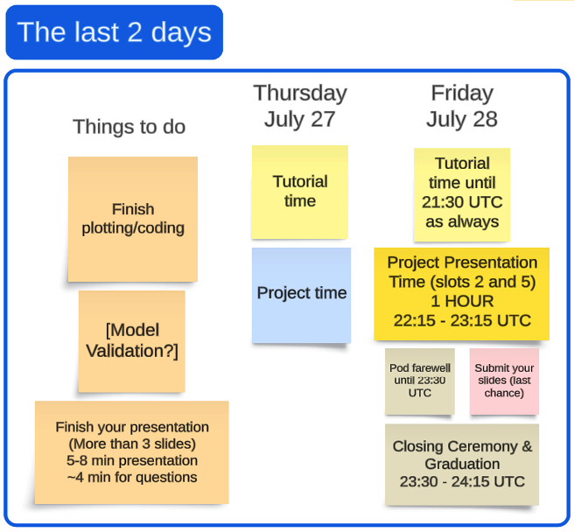

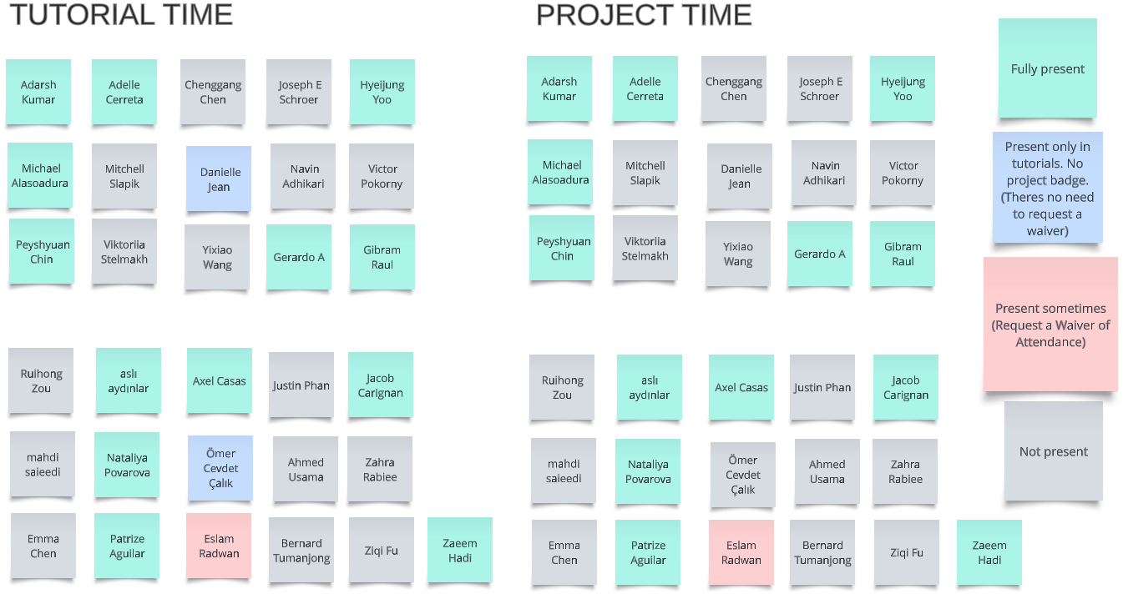
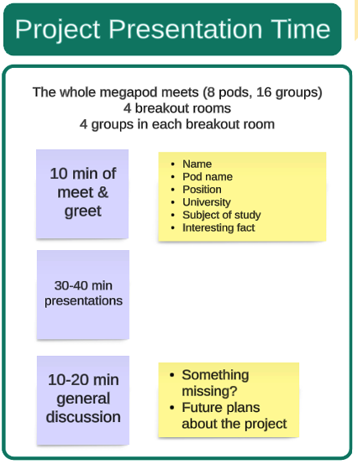
LAST DAY
W3D5
PROJECT PRESENTATIONS WILL BE DONE VIA ZOOM. CHECK THE CHAT FOR THE LINK

