Slide 1

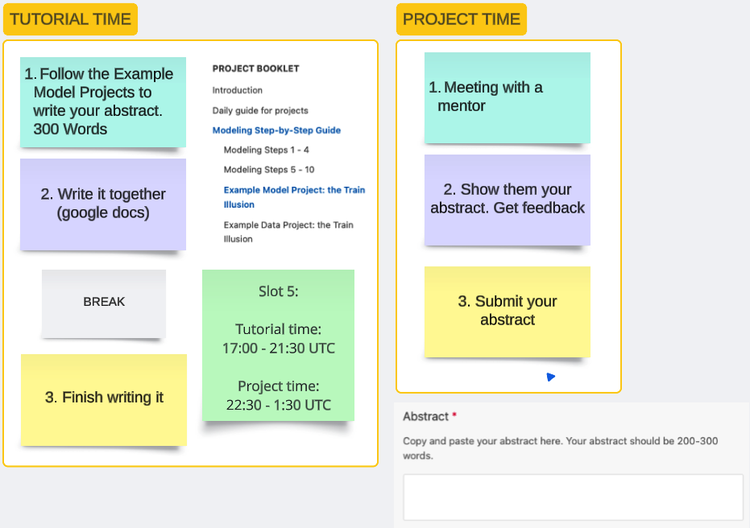
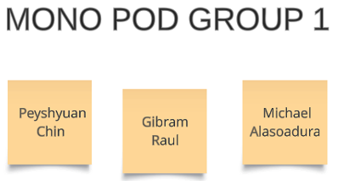
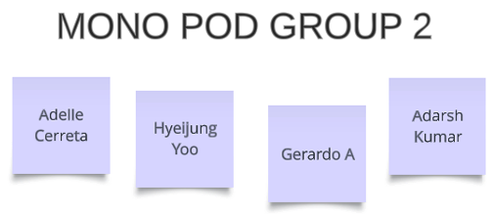
PROJECT DAY
PROJECT TIME
W2D5
Monolophosaurus_Zajal (MONO)
Baraceratops_war
Other group 1: Room 3
Other group 2: Room 4

