Slide 1
A PRACTICAL PRIMER & TWO STORIES
Transfer Learning for
Drug Discovery
When does it help, when does it hurt, and why does the
transfer protocol matter more than the model?
NCATS ADME endpoints • XGBoost · Chemprop · CheMeleon • 5×5 chemical-space CV

Slide 2
WHY THIS QUESTION MATTERS
ADME data is small. Transfer learning is the standard fix — but is it always safe?
The reality on the bench
But the unspoken question
A typical ADME assay yields a few hundred to a few thousand measurements — far below what neural networks normally need.
Transfer learning is the workaround:
1. pre-train on a large dataset
2. adapt to the small target
It works well when source and target share biochemistry.
What if the source dataset turns out to be unrelated to your target?
Does the model gracefully ignore the irrelevant pre-training, or does it break?
We can't pick our drug targets to make our models look good.
Transfer Learning for Drug Discovery
2 / 18

Slide 3
PRIMER • MODEL FAMILY 1
XGBoost on Morgan fingerprints
p(stable) = 0.81
Molecule
2,048-bit Morgan FP
Ensemble of trees
Prediction
substructures present
each tree votes
Σ of all trees' votes
Industry standard — fast, no GPU, mature SHAP tooling.
Knowledge lives in the trees. Once a tree is built, it cannot be modified or removed — every tree votes on every prediction, forever.
Transfer Learning for Drug Discovery
3 / 18

Slide 4
https://github.com/JacksonBurns/chemeleon
PRIMER • MODEL FAMILY 2
D-MPNN graph neural networks (Chemprop, CheMeleon)
ENCODER
p(stable) = 0.81
Molecule graph
message passing
pooled vector
FFN head
Prediction
atoms exchange messages
replaceable
Two separable parts: an encoder that learns chemistry, a head that makes the call.
The encoder builds a vocabulary of molecular features (functional groups, ring systems) — the head maps that vocabulary to whatever target you care about.
Transfer Learning for Drug Discovery
4 / 18

Slide 5
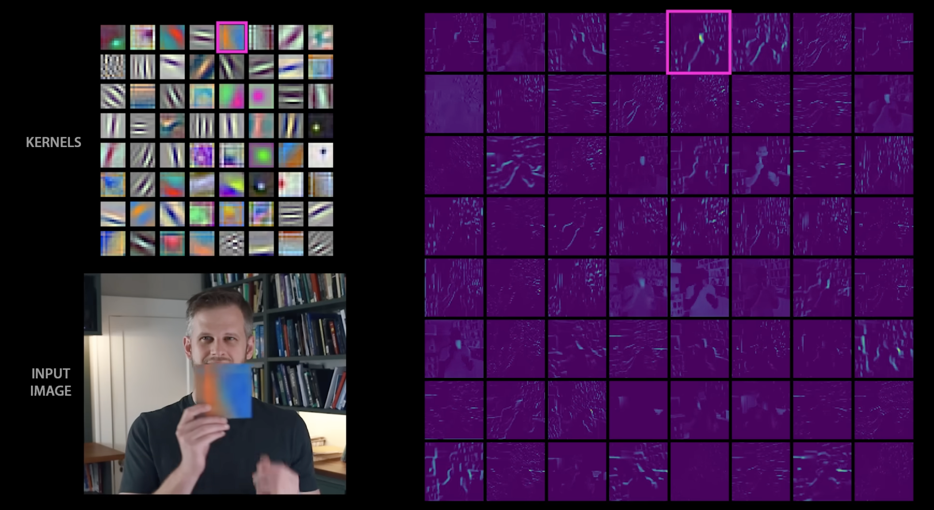
https://www.youtube.com/watch?v=UZDiGooFs54
Allegory to image recognition models
First embedding layer learns to identify simple, but not generally useful, features
However these on their own aren’t able to be used to do much! Have to be combined…

Slide 6
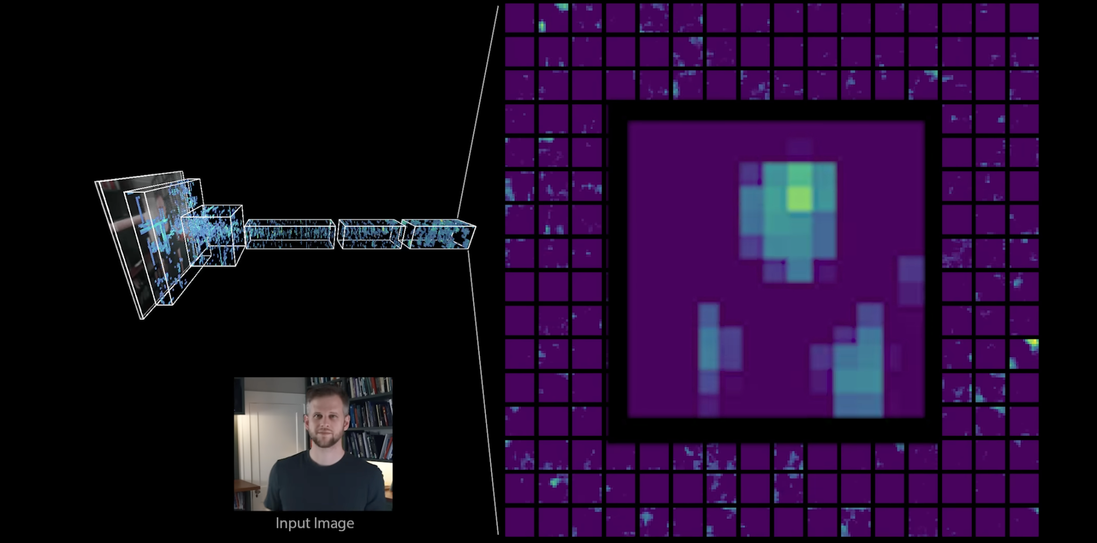
https://www.youtube.com/watch?v=UZDiGooFs54
Allegory to image recognition models
Deep embedding layers learn highly informative abstract ideas
These may be uniquely suited to original trained target! But often are more generalizable in practice

Slide 7
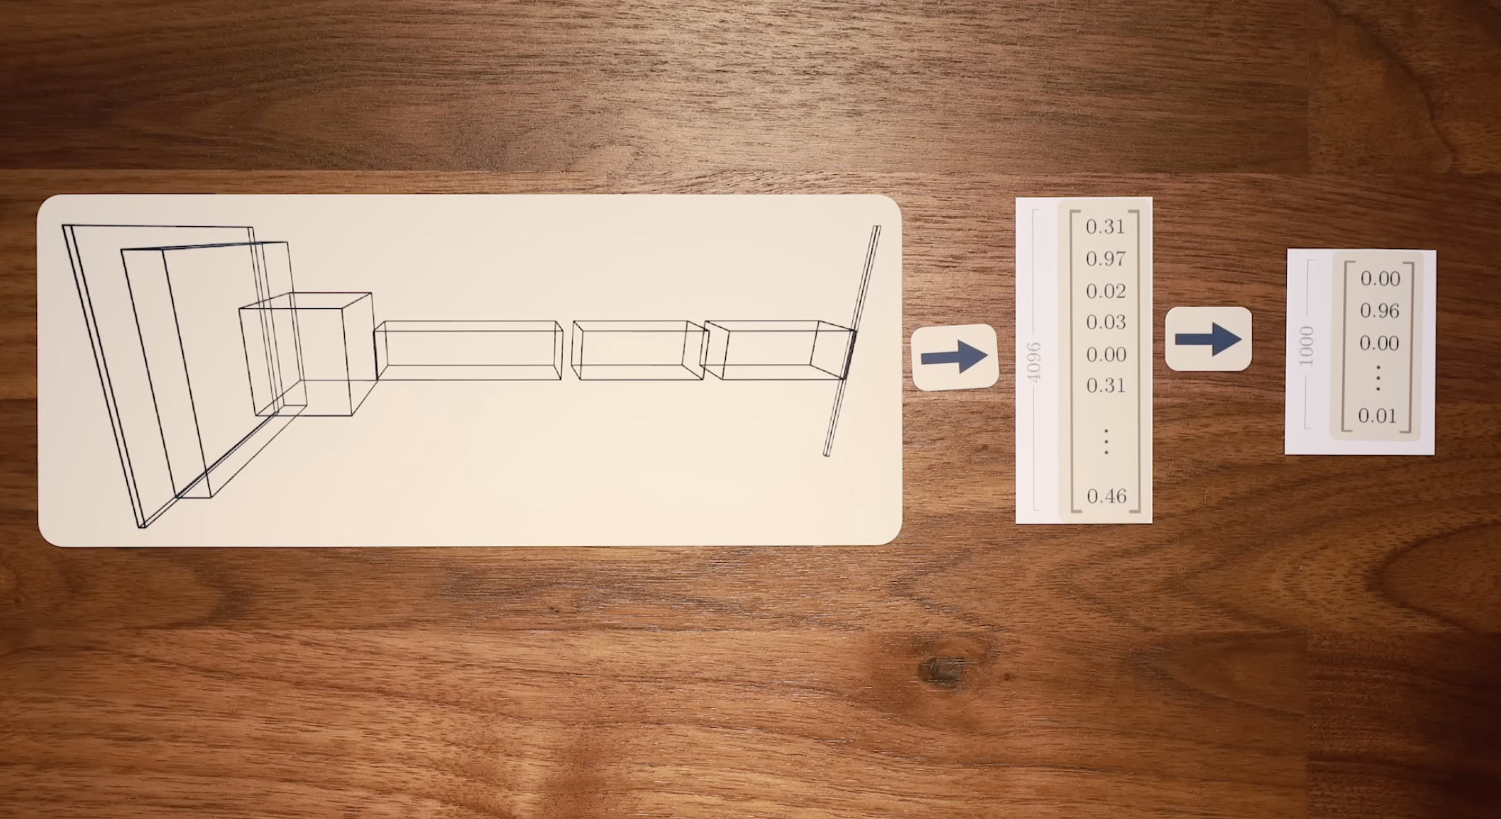
https://www.youtube.com/watch?v=UZDiGooFs54
Allegory to image recognition models
Dense Layers (FFN) learn mapping of those informative features to your target
These are almost guaranteed to be only useful for your specific task!

Slide 8
THE CENTRAL DISTINCTION
What gets carried over when you transfer?
XGBoost • decision-boundary transfer
SOURCE (RLM)
TARGET (HLM / PAMPA)
Inherited:
continue boosting
task-specific decisions
"substructure X ⇒ unstable" — and old trees can't be unlearned.
source trees
source trees stay + new
D-MPNN • representation transfer
SOURCE (RLM)
TARGET (HLM / PAMPA)
Inherited:
encoder
head
swap head
encoder
NEW head
task-general features
Functional groups, ring systems — chemistry, not decisions. New head = clean slate.
(kept)
(fresh)
Transfer Learning for Drug Discovery
5 / 18

Slide 9
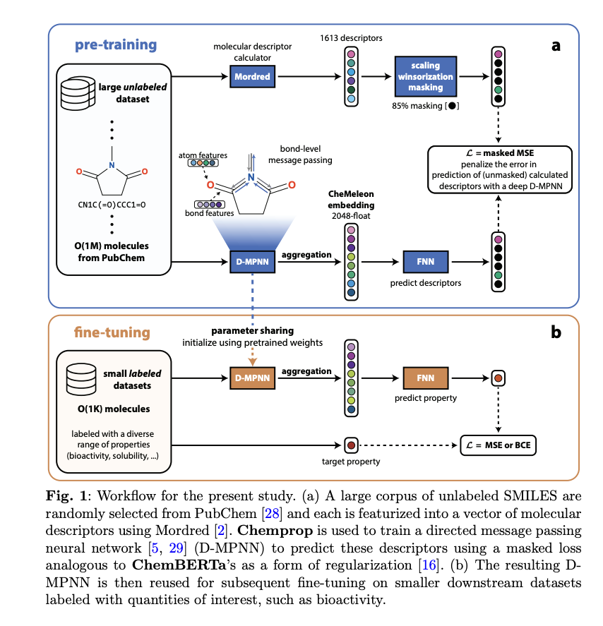
https://arxiv.org/pdf/2506.15792
Same story, just copying a good figure from the Chemeleon paper

Slide 10
THE EXPERIMENT
Three NCATS ADME endpoints — one source, two targets
SOURCE
TARGET 1 • RELATED
TARGET 2 • UNRELATED
RLM Stability
HLM Stability
PAMPA pH 7.4
Rat liver microsomal
metabolic stability
Human liver microsomal
metabolic stability
Passive membrane
permeability
2,529 compounds
30% / 70% stable / unstable
900 compounds
60% / 40% stable / unstable
2,033 compounds
86% / 14% permeable / not
Used to pre-train every architecture.
Same biochemistry, different species —
we expect transfer to help.
Lipophilicity, not metabolism —
we expect transfer to be useless or harmful.
Transfer Learning for Drug Discovery
6 / 18

Slide 11
https://practicalcheminformatics.blogspot.com/2025/03/even-more-thoughts-on-ml-method.html
METHODS IN ONE GLANCE
How we keep the comparisons honest
5 × 5 cross-validation
Chemical-space splits
25 train/test splits per endpoint
Morgan FPs → PaCMAP → KMeans clusters as fold groups. Test compounds occupy distinct regions of chemical space — no structural-similarity leakage.
5 replicates →
Tukey HSD, FWER = 0.05
Family-wise error control. Reported significant differences have ≤ 5% false-positive risk even after correcting for many pairwise comparisons.
5 folds
AUC-PR as primary metric
PAMPA is 86% positive. AUC-PR is sensitive to minority-class errors; the random-classifier baseline equals the positive-class prevalence.
Test fold
Train fold
Same splits across all model variants — paired comparisons.
Transfer Learning for Drug Discovery
7 / 18

Slide 12
STORY 1 • RELATED TRANSFER
RLM → HLM: same biochemistry, different species
Why we expect transfer to work
DATASET OVERLAP
Both endpoints measure how quickly liver microsome enzymes (mostly CYP450s) break down a compound.
CYP isoform profiles differ between rat and human, but the rules of metabolic vulnerability — labile amines, benzylic positions, electron-rich aromatics — are largely shared.
A medicinal chemist would expect knowledge of "what makes a molecule labile" to carry over.
RLM ∩ HLM
50 shared molecules (5.6% of HLM)
94 shared scaffolds (12.9% of HLM)
Low molecule overlap → benefit can't be simple memorization. Some scaffold familiarity — but most HLM scaffolds (87%) are unseen during RLM training.
Transfer Learning for Drug Discovery
8 / 18

Slide 13
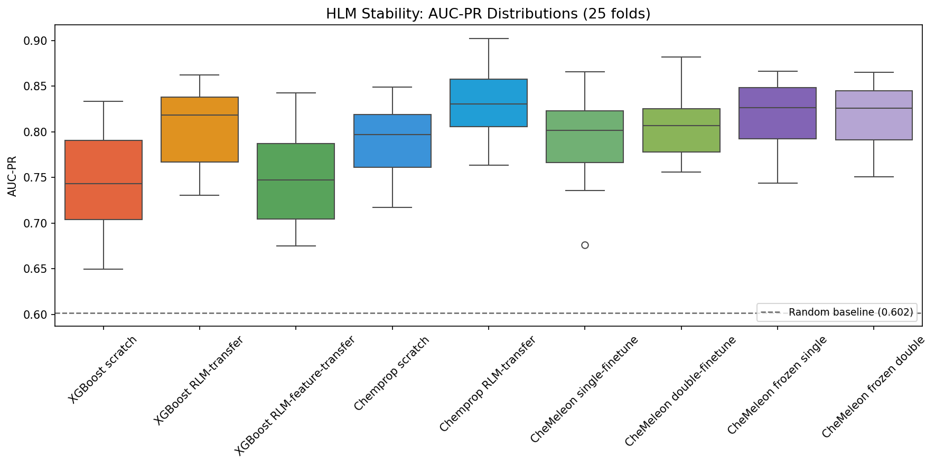
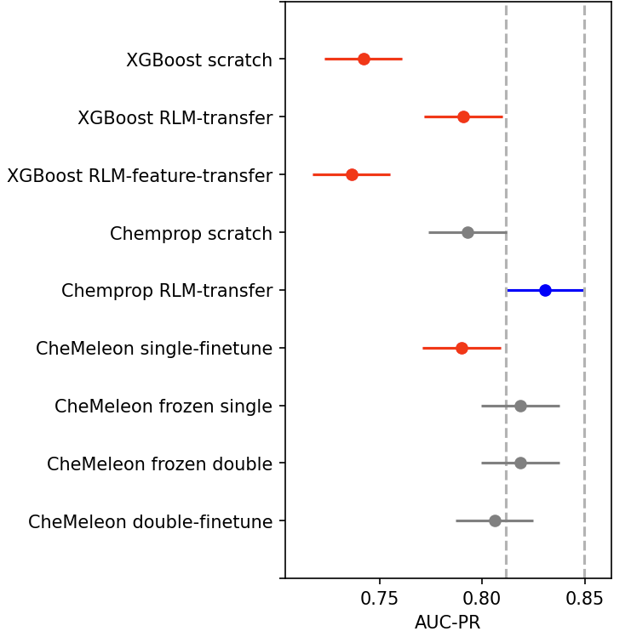
STORY 1 • RESULTS
Transfer from RLM helps almost every architecture on HLM
KEY DELTAS
XGB continue-boost
+0.059 helps
Chemprop transfer
+0.038 helps (best)
CheMeleon double
+0.016 helps
XGB feature-prior
+0.001 inert
AUC-PR across 25 CV folds. Dotted line = random baseline (0.602). Best: Chemprop RLM-transfer at 0.831.
Transfer Learning for Drug Discovery
9 / 18

Slide 14
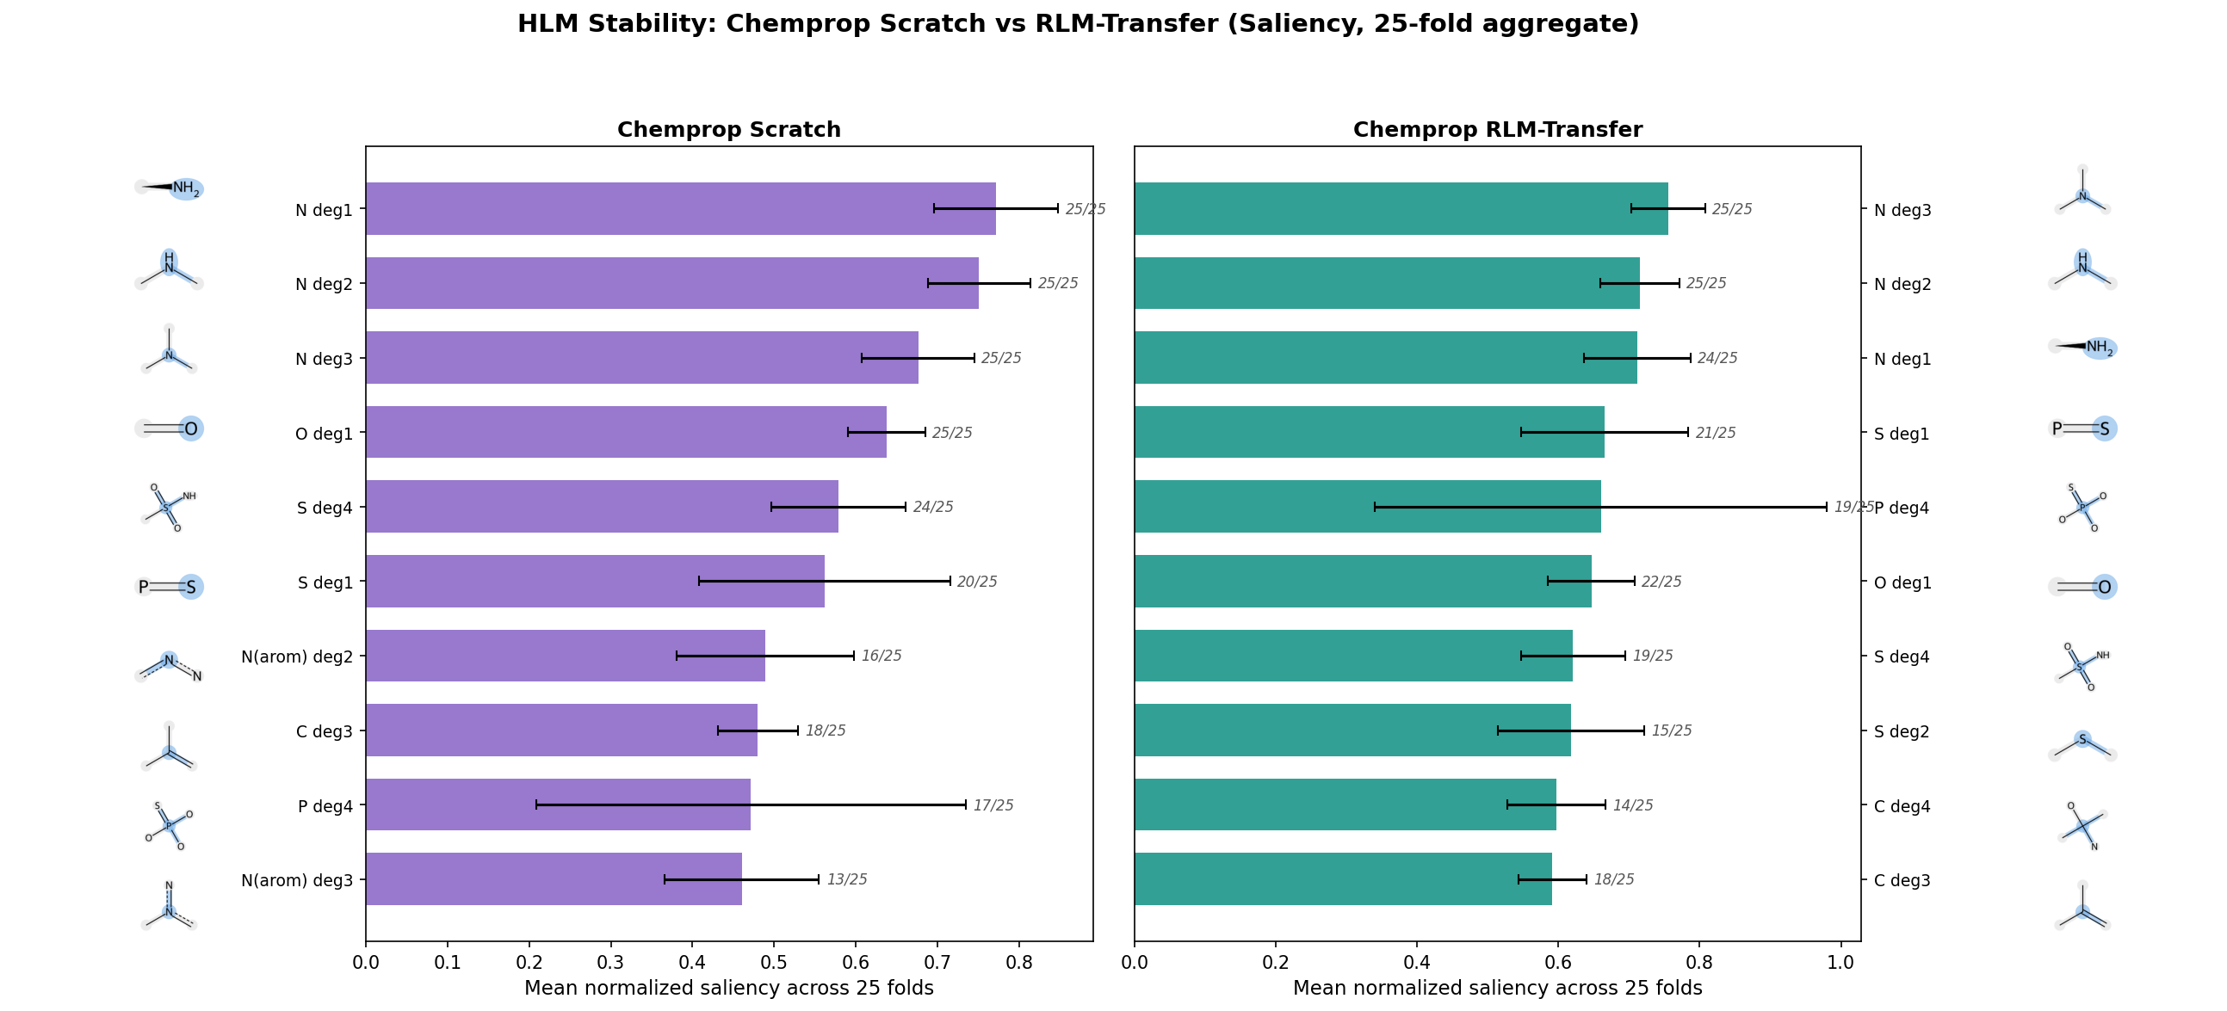
STORY 1 • WHAT THE MODELS LEARNED
RLM pre-training sharpens the encoder's attention to known metabolic substructures
WHAT CHANGED
Nitrogen environments dominate either way — robust HLM drivers regardless of pre-training.
Sulfur attention rises after RLM pre-training. Thioethers and sulfonamides are CYP substrates — the bias is chemistry, not noise.
The encoder gains a sharper vocabulary for metabolically vulnerable groups.
Chemprop atom-type saliency, top 10. Aggregated across 25 CV folds; numbers in italics show how often each feature appeared in the top 10.
Transfer Learning for Drug Discovery
10 / 18

Slide 15
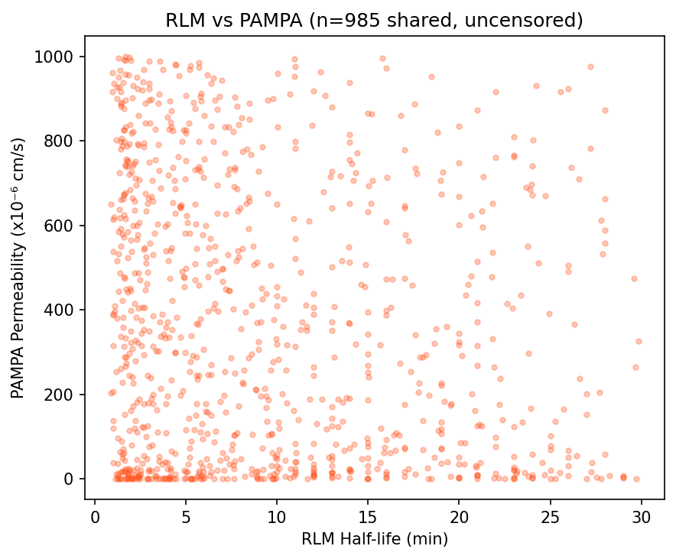
STORY 2 • UNRELATED TRANSFER
RLM → PAMPA: same molecules, different physics
Why we expect transfer to fail
PAMPA pH 7.4 measures passive membrane permeability through an artificial phospholipid bilayer.
It depends on lipophilicity, molecular size, and H-bond donor/acceptor count — not on metabolic vulnerability.
A compound can be highly permeable but metabolically unstable, or vice-versa. The properties are orthogonal.
99.5% molecule overlap, 0% target correlation — a clean test of representation vs. decision transfer.
No correlation between RLM and PAMPA values across 985 shared compounds.
Transfer Learning for Drug Discovery
11 / 18

Slide 16
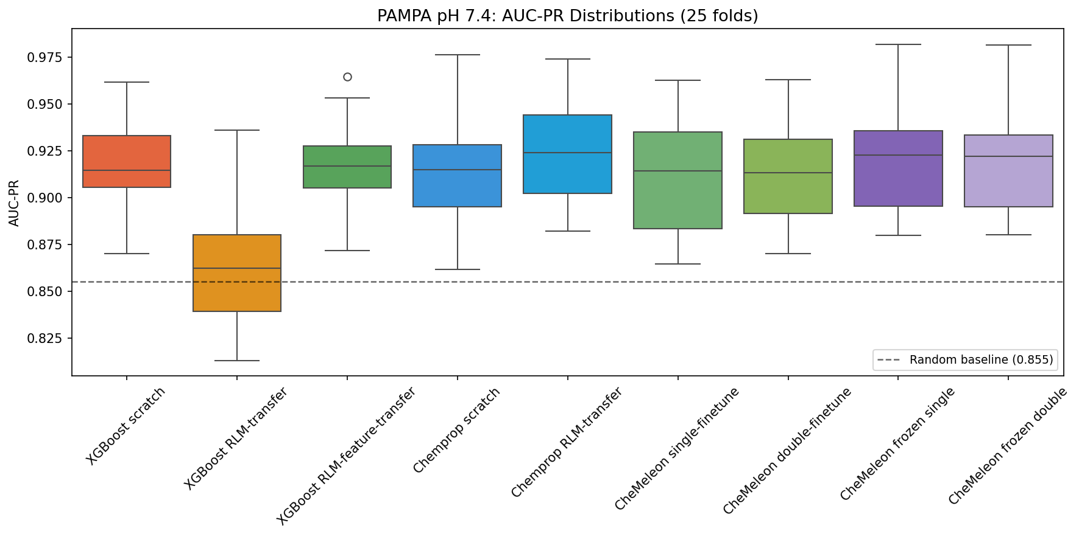
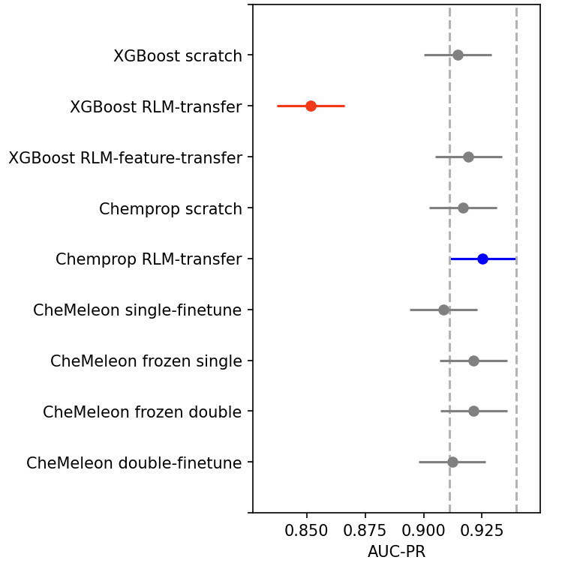
STORY 2 • RESULTS
XGBoost continue-boosting collapses to random; everything else is fine
XGBoost RLM-transfer
0.853
— at the random baseline.
A -0.057 drop from scratch.
Every other model
XGB scratch 0.910
XGB feature-prior 0.918
Chemprop transfer 0.925
CheMeleon frozen 0.922
All in the top statistical group.
AUC-PR across 25 CV folds. Dotted line = positive-class prevalence (0.855) — the random-classifier baseline.
Transfer Learning for Drug Discovery
12 / 18

Slide 17
STORY 2 • DIAGNOSIS
Why XGBoost broke and Chemprop didn't
XGBoost: inherited the wrong call
Chemprop: re-routes around the noise
Nitrogen-containing fragments learned in RLM as "metabolically unstable" got carried into PAMPA as "impermeable."
Wrong association. The new PAMPA trees can't delete or modify the old ones — they just have to fight against them.
Even doubling the fine-tune budget doesn't help: the structural cost is permanent.
The encoder shifts visibly — sulfur attention up, aromatic nitrogen up — yet the new FFN head still finds a working mapping.
A real perturbation to internal features, no degradation in performance (+0.008, n.s.).
Representation transfer doesn't bake in target-specific decisions, so it's safe to inherit even when the source is wrong.
Transfer Learning for Drug Discovery
13 / 18

Slide 18
THE PROTOCOL SPECTRUM
Three flavors of transfer — and only one is both safe and useful
Protocol
HLM Δ AUC-PR
PAMPA Δ AUC-PR
Risk / reward profile
Decision-boundary
(XGB continue-boost)
+0.059 helps
−0.057 catastrophic
High-risk · high-reward
Representation
(D-MPNN encoder)
+0.038 helps
+0.008 neutral
Low-risk · moderate-reward
Feature-importance
(XGB feature-prior)
+0.001 inert
+0.000 inert
Zero-risk · zero-reward
Representation transfer is the only protocol that gains from related sources without losing on unrelated ones.
Transfer Learning for Drug Discovery
14 / 18

Slide 19
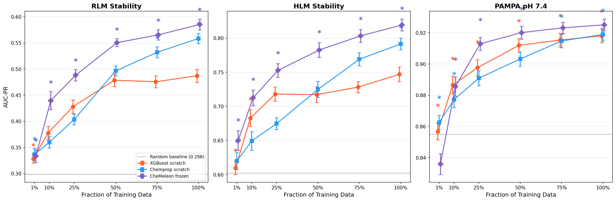
DATA EFFICIENCY
A foundation model needs a quarter of the data to match XGBoost
Mean AUC-PR ± SEM across 25 CV folds at 1, 10, 25, 50, 75, 100% of training data. Asterisks = top statistical group.
At 25% of the data, CheMeleon-frozen already matches XGBoost at 100% — and the gap only widens.
Transfer Learning for Drug Discovery
15 / 18

Slide 20
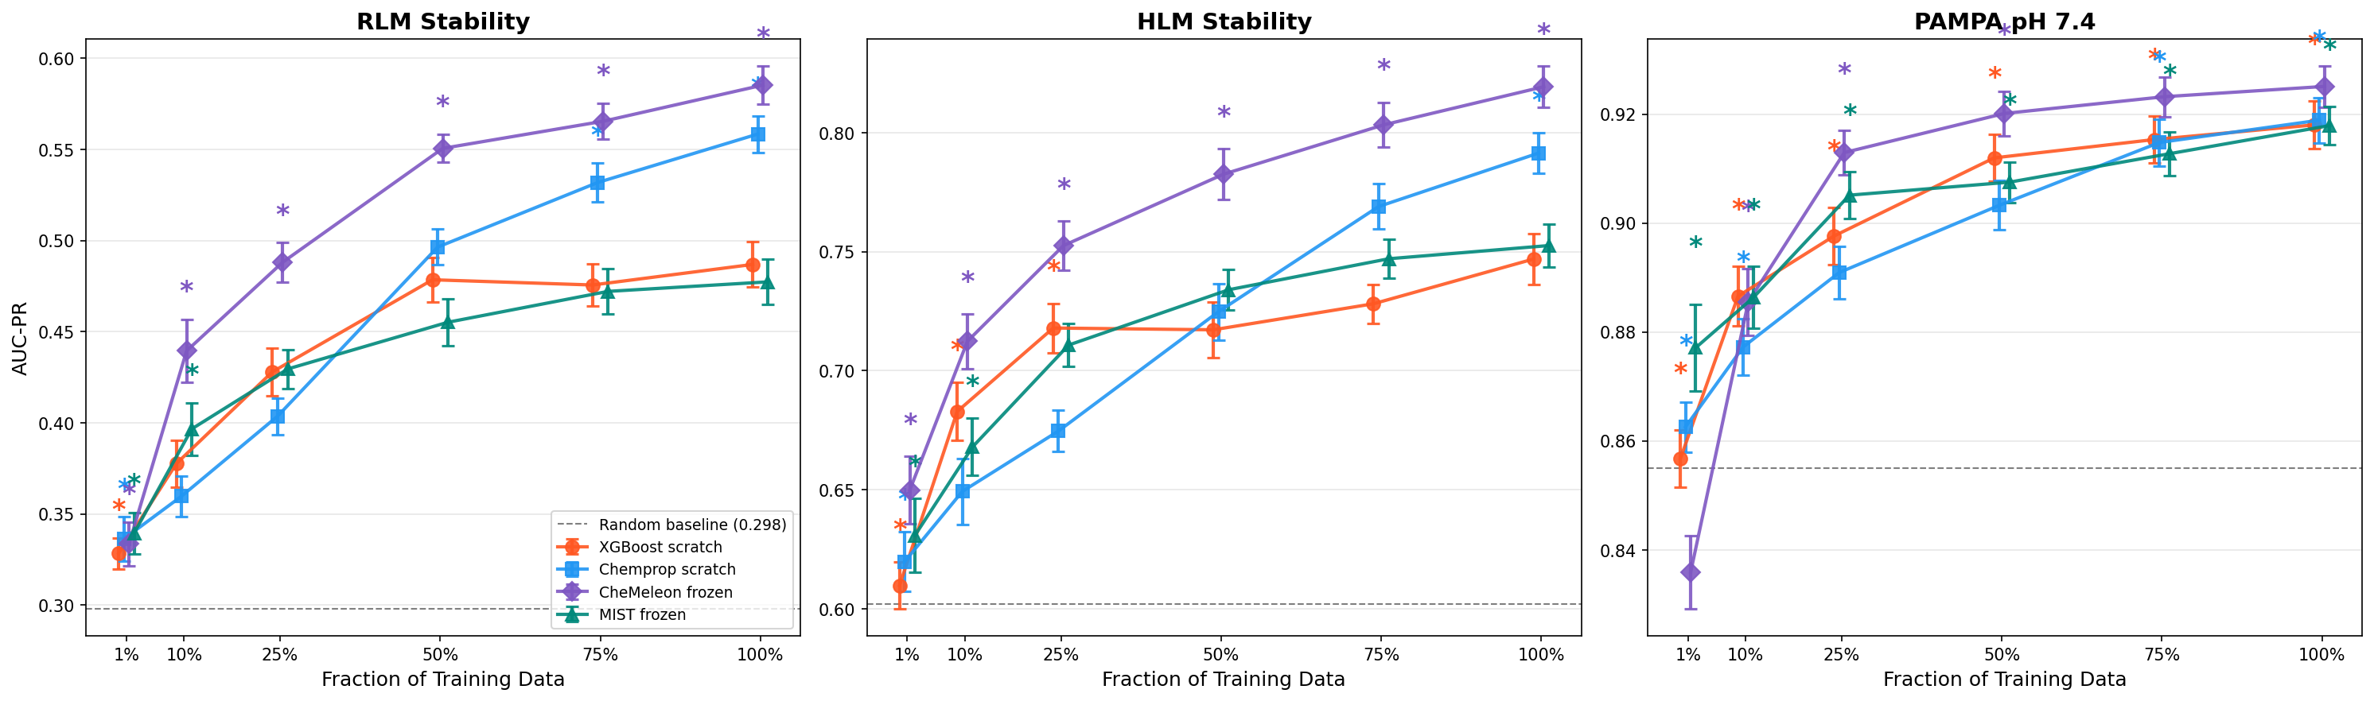
https://huggingface.co/mist-models
DATA EFFICIENCY
Nuance - not all foundation models perform well
Mean AUC-PR ± SEM across 25 CV folds at 1, 10, 25, 50, 75, 100% of training data. Asterisks = top statistical group.
MIST is another deep-learned foundation model, totally different training data, process, and size (it’s 200x bigger!); why is it worse? Hard to say. Could be Chemeleon was trained on data more similar to these objectives.
Transfer Learning for Drug Discovery
15 / 18

Slide 21
PRACTICAL RECOMMENDATION
How to choose for your next ADME pipeline
01
Quick, single endpoint
02
Building a transfer pipeline
03
Data is scarce
Few thousand compounds, no transfer ambitions
Reusing knowledge across endpoints
Under ~500 task-specific compounds
XGBoost on Morgan FPs is still the right first model. Trains in seconds, no GPU, mature SHAP tooling.
Use deep learned networks. Representation transfer is the only protocol that is both safe on unrelated sources and beneficial on related ones.
Use a frozen foundation model (CheMeleon, MIST, etc.). However, performance may not improve as desired…
Transfer Learning for Drug Discovery
16 / 18

Slide 22
SCOPE & CAVEATS
What we did not test
No hyperparameter tuning
All models use library defaults. The relative rankings — and especially the transfer failure modes — are structural, but absolute performance numbers could shift with tuning.
Public NCATS subsets only
Three endpoints, ~900–2,500 compounds each. Different dataset sizes, scaffolds, or endpoints could change the picture.
Specific transfer protocols
We tested XGBoost continue-boosting, XGBoost feature-prior, D-MPNN encoder transfer, CheMeleon foundation finetune/freeze, and MIST frozen. There are other XGBoost transfer schemes potentially worth exploring. We did not test LoRA fine-tuning protocols which tweak the embedding model itself for the new target; we likely could’ve eked more performance out of both Chemeleon and MIST.
Code & report drafted with AI assistance
Every result was reviewed, but I am not a biochemist — domain readers should treat the chemistry interpretation as a working hypothesis.
Transfer Learning for Drug Discovery
17 / 18

Slide 23
THE THREE THINGS TO REMEMBER
1
Transfer learning works — but the protocol decides whether it is safe.
Decision-boundary transfer is high-risk. Representation transfer is the only safe + useful flavor.
2
Catastrophic failure looks like a baseline-grade model.
XGBoost RLM-transfer dropped to 0.853 AUC-PR on PAMPA — the random baseline. Silent failures are the dangerous kind.
3
Foundation models change the data-efficiency math.
CheMeleon-frozen at 25% of the data matches XGBoost at 100%. The bar for "you need more compounds" just dropped. MIST model performs equivalently to XGBoost!
Full write-up & code • README.md in the project repo

