Slide 1
Author Retrieval System
Contributors:
Paulomi Mahidharia Aswin Gopalan
Abhinav Maurya Rushikesh Badami

Slide 2
How is our system different?
Multi-criteria search
    Search based on an author’s publication information
      Minimum number of publications
      Published/not published in one or more conferences
      Publications done before or after specific year, or in a year range(For eg. Between 2000 and 2010)
      Title or keyword of the publication
    Search based on an author’s service information
      Served/Not served in one or more conferences
      Service offered before or after specific year, or in a year range range(e.g. Between 2000 and 2010)
      Position served as by the author
    Search based on an author’s name
      Search for an Author by a matching name (e.g. Frank Tip, Mitchell Wand etc.)

Slide 3
Other features
    Interactive Author Profile
      View affiliation information (University)
      Open author’s Homepage
      View papers published by the author
      View conferences where the author has served in a committee.
      Shortlist author
      Search similar author
    Search Similar Authors
      Authors who have co-published with the given author in a paper.
      Authors who have served in the same committee in conferences with the author.
  Export Results and Shortlisted authors
      Export results in a PDF format

Slide 4
How is our system different?
Enhancements and highlights
Search page tool tip
  An info button for the user to learn about how to interact with the Search page
Stack-based navigation
  To persist information across different pages
Open author’s homepage
  You can quickly glance at an author’s personal webpage
Usability study
  Feedback from Client(Prof. Weintraub), testers in Homework 4, and external reviewers was obtained and worked upon to make the user experience better.
Query optimization
  For faster retrieval of data, we performed indexing and query optimization.
Progress indicator
  To ensure that the system is working to get results for the user.
Pagination
  For ease of viewing author records in the result table

Slide 5

DEMO

Slide 6
Implementation Details

Slide 7
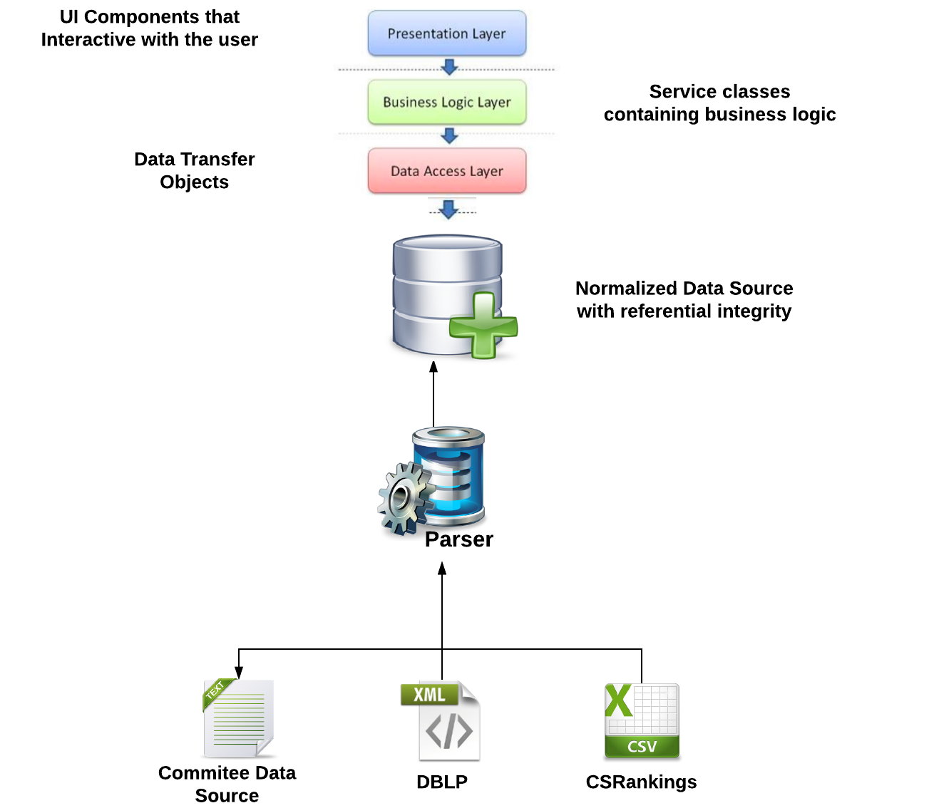
System Architecture
System
Architecture

Slide 8
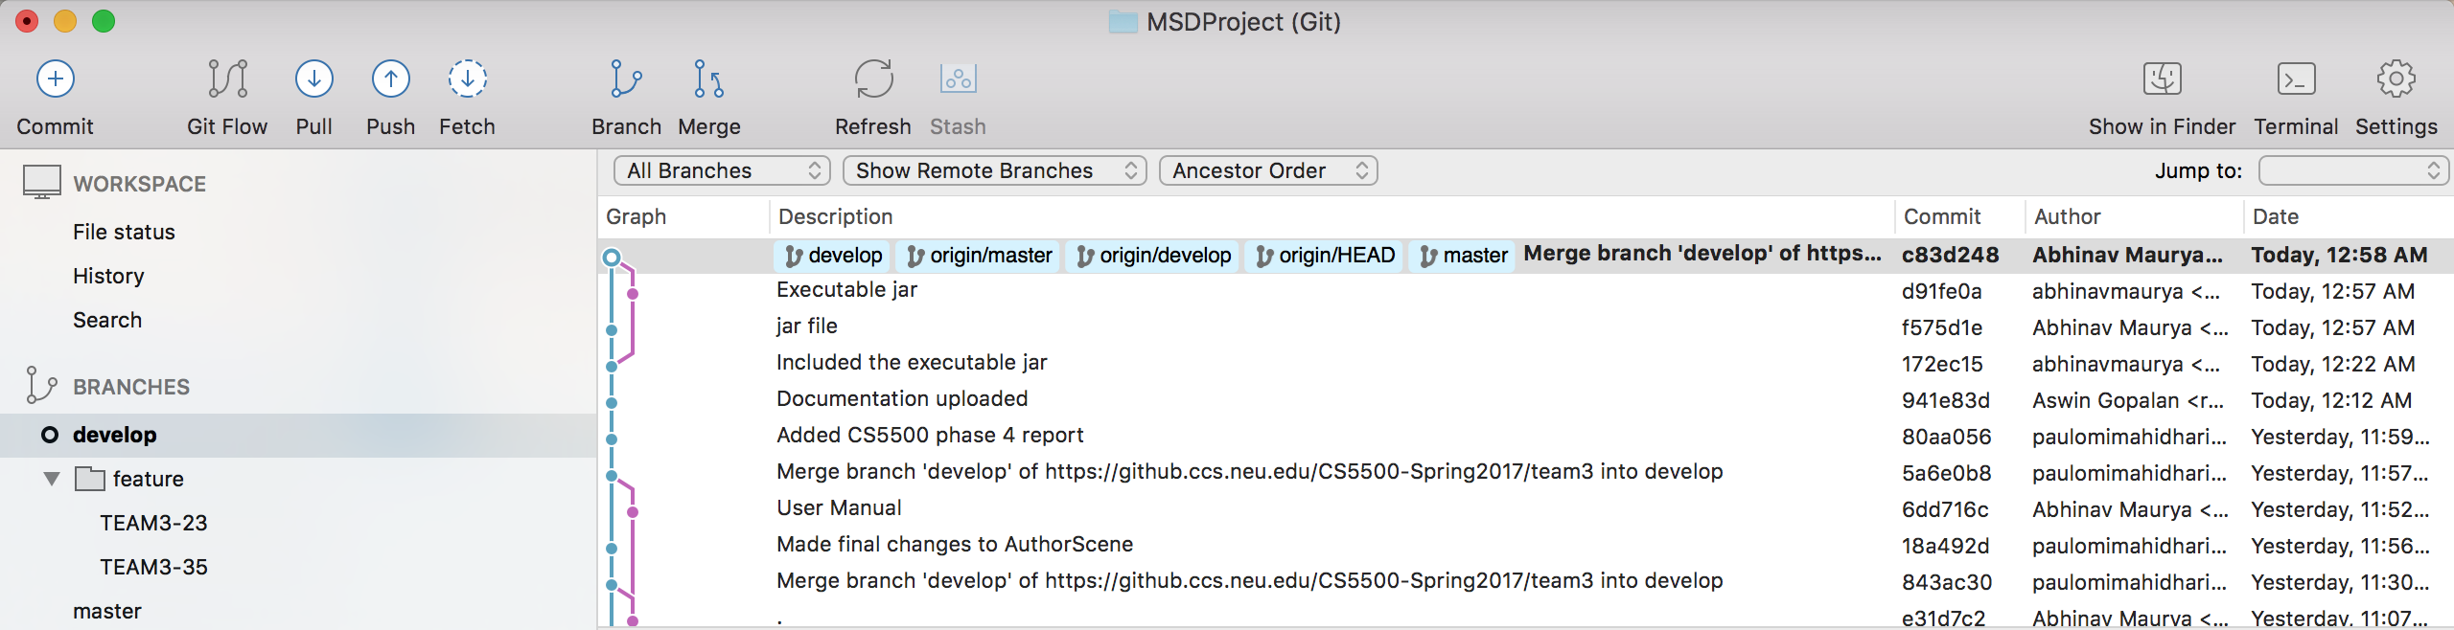
Tools and technologies used
Branching model: GitFlow
Code documentation: Confluence
  Maintaining records of meeting notes, system diagrams, requirements, test specifications, issuing JIRA tickets, etc.
Project management: JIRA
  Tracking progress and weightage of work using JIRA issues.
  We used SMART COMMITS to comment on issues, record time tracking information against issues, and transition issues to any status defined in the JIRA Software project's workflow.

Slide 9
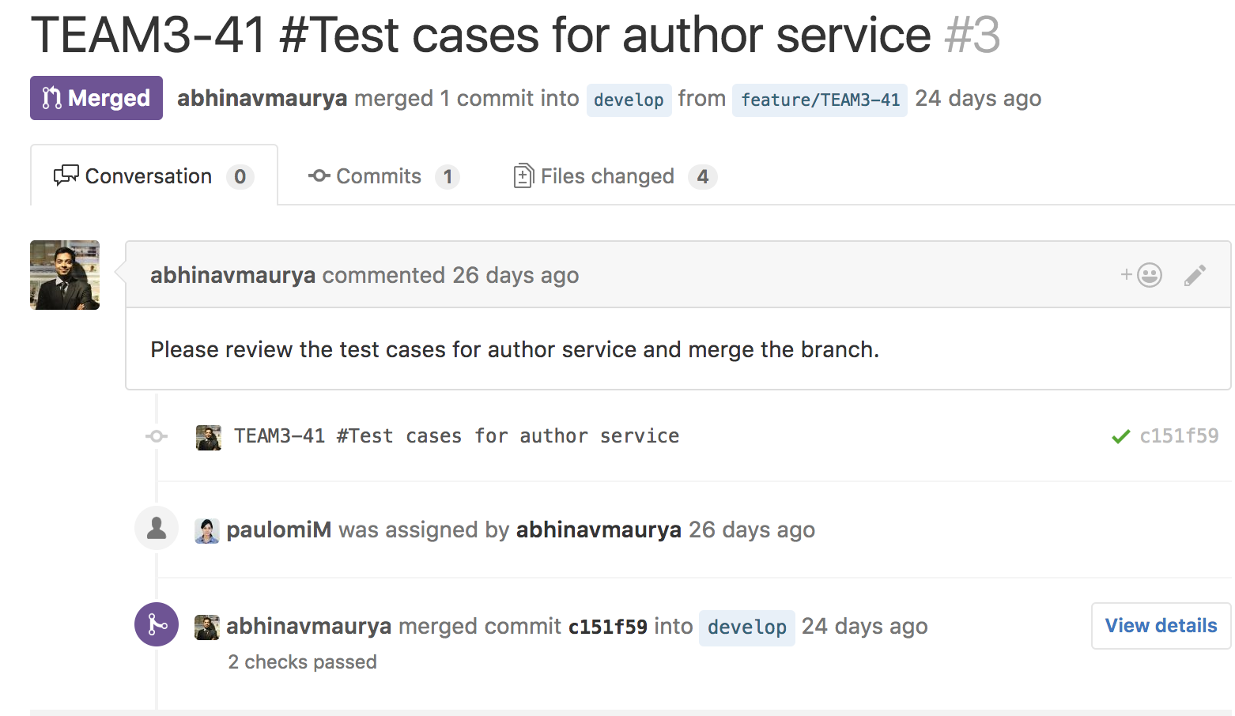
Tools and technologies used
Code Review:
  GitHub Pull Requests & Pair programming
  Pair Programming
    Performed pair program in sub-teams for different components
      User Interface and Front End:
        Implemented by: Paulomi an Rushikesh | Reviewed and tested by: Abhinav and Aswin
      Query Engine and Backend:
        Implemented by: Abhinav and Aswin | Reviewed and tested by: Paulomi an Rushikesh

Slide 10
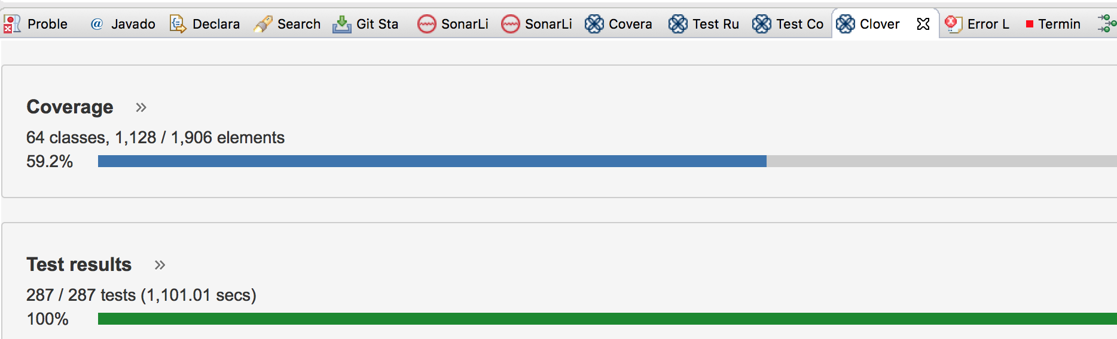
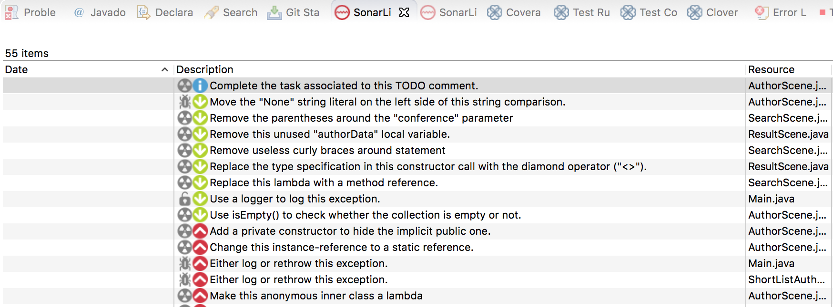
Test coverage: Clover
As mentioned above 59.2% is coverage including UI classes(which we are not covering). Coverage for Back-end is approx. 92%.
Code quality: SonarLint

Slide 11
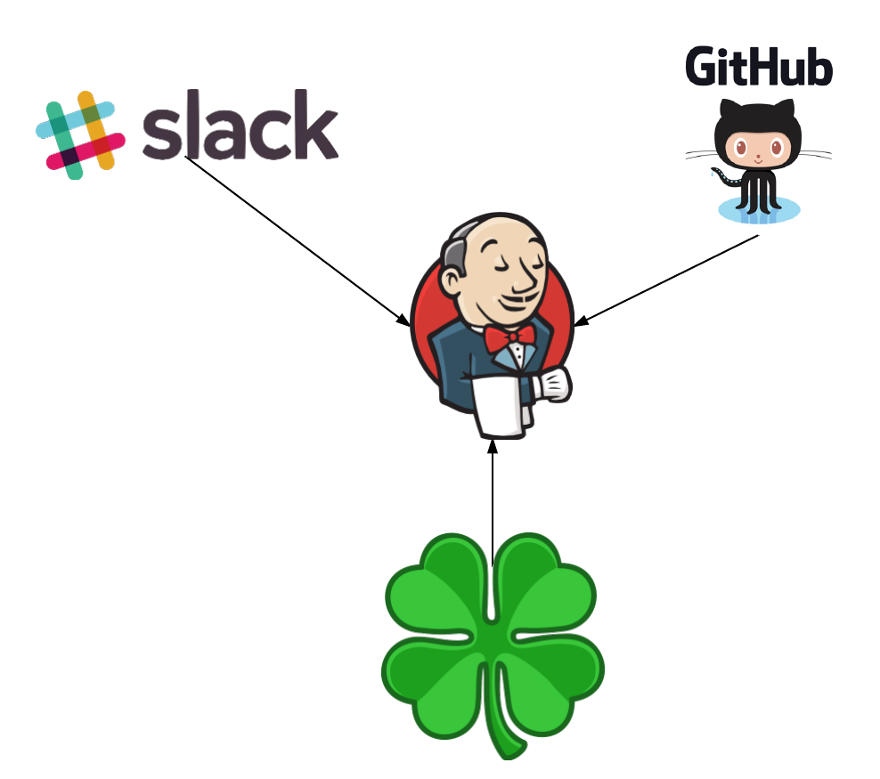
Tools and technologies used
Continuous integration: Jenkins

Slide 12
Usability and Maintainability
User Manual provided as a detailed guide to use the system.
Search Tool Tip like feature provided to the user using the system for the first time.
Code comments and documentation done to improve maintainability.
Test driven development done so that future development and/or modification becomes easier.

Slide 13
Future enhancements
Support for more data. (Conferences and papers)
Drag and Drop feature to dynamically create a committee based on a user logged in to the system.
Allow export documents to support multiple formats(e.g CSV, doc)
Ranking authors based on their fit to the given search criteria.
Extracting more author information from other sources and displaying it in author profile.

Slide 14
Questions & Comments

Slide 15

Thank You
For giving us a second chance…

