Slide 1
Views

Slide 2
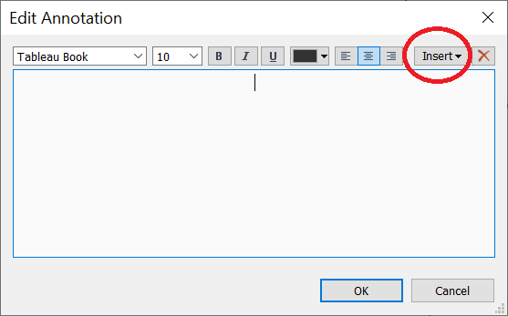
Add field value in a text.
Here it was for annotation, but this work for all type of text in Tableau.

