Slide 1
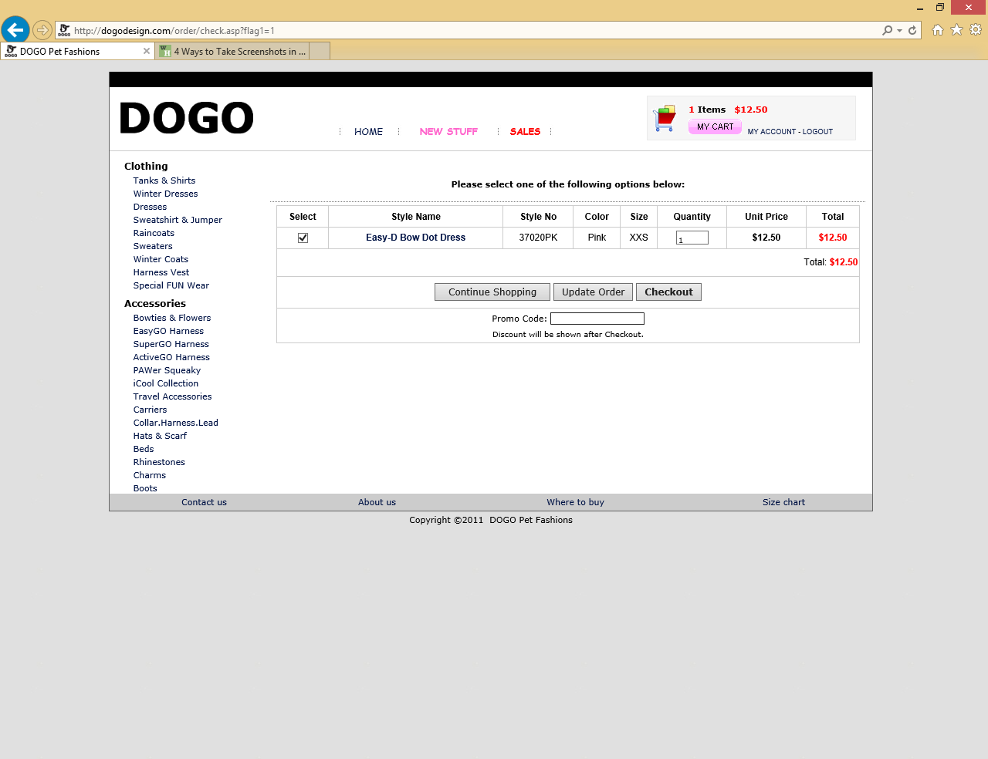
Notes:
Shopping cart

Slide 2
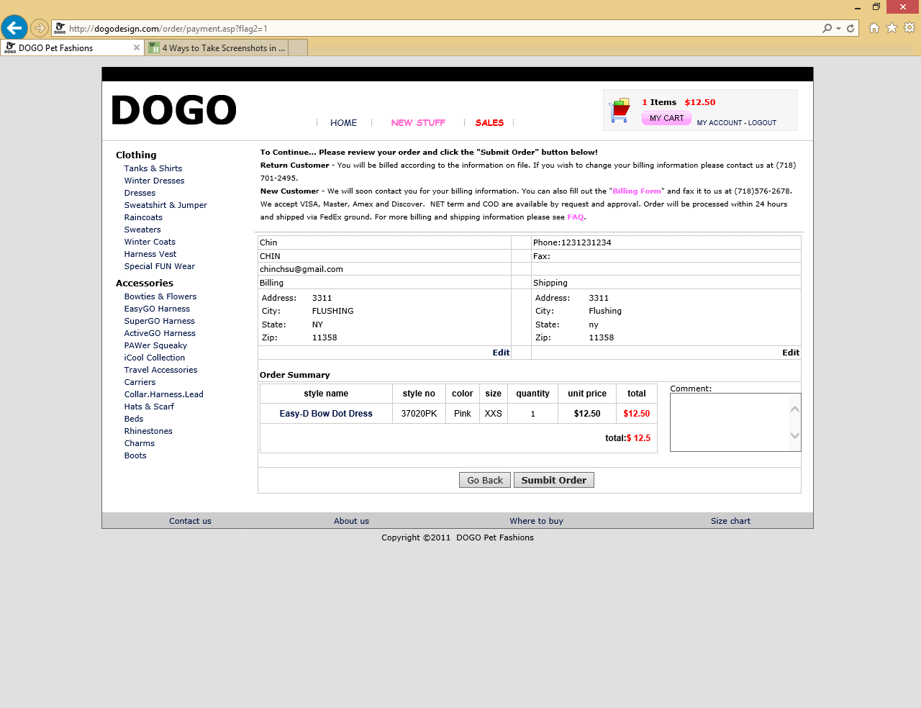
Notes:
Checkout

Slide 3
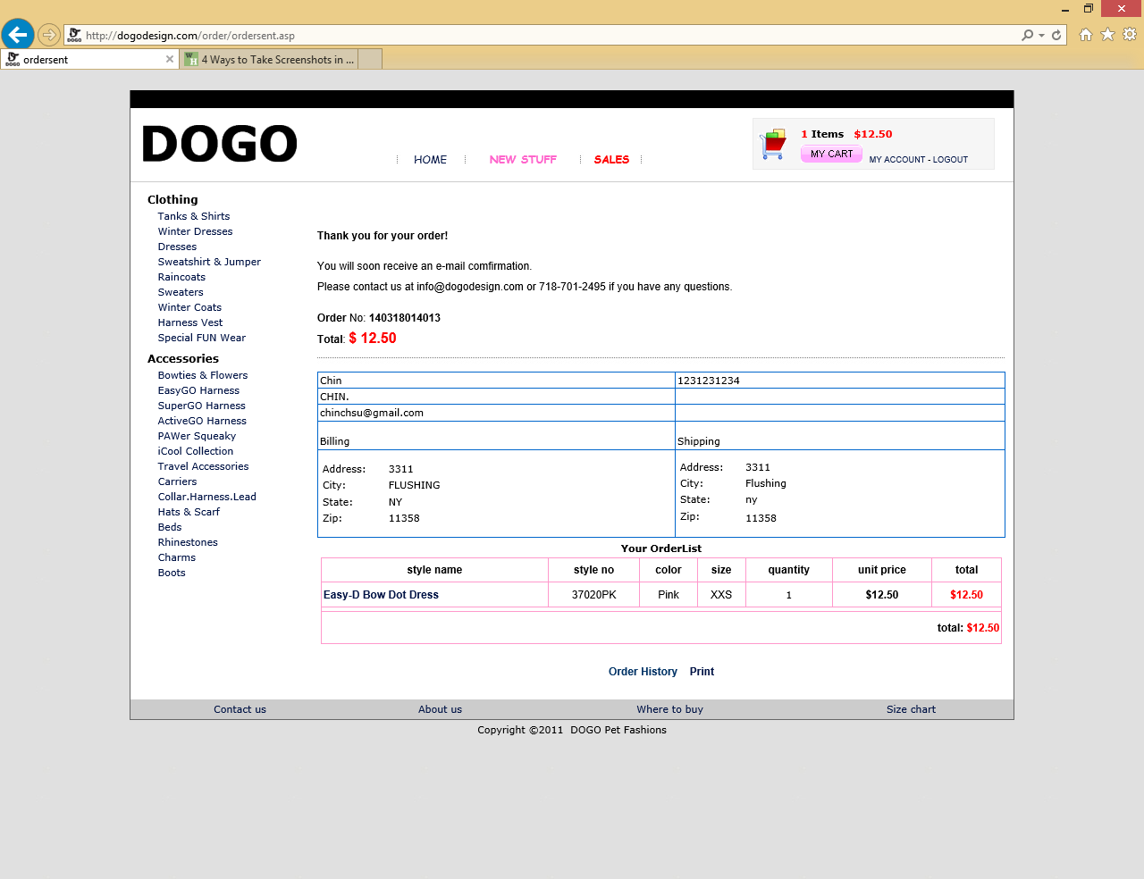
Notes:
SUBMIT SHOPPING CART

Slide 4
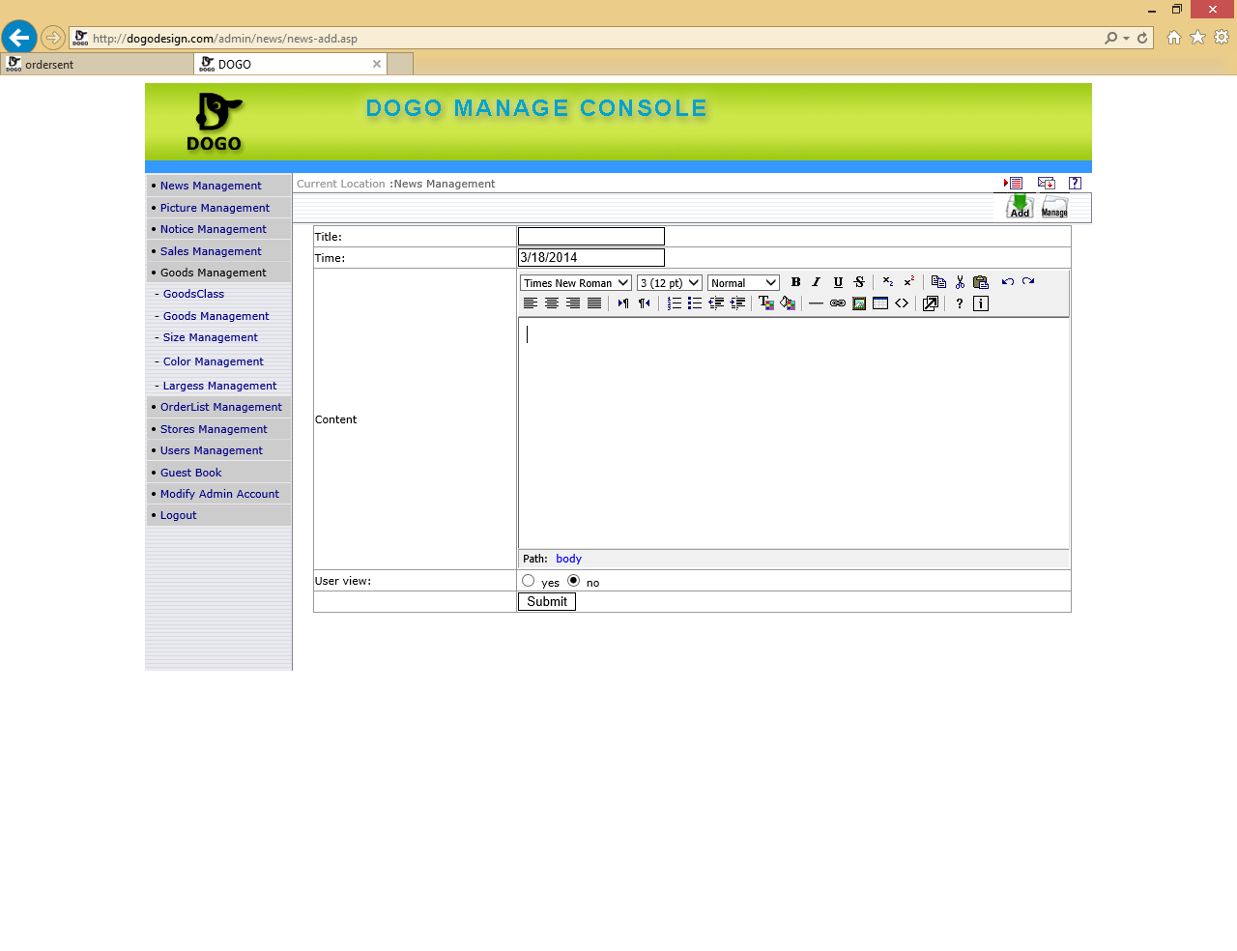
Notes:
NEWS MANAGEMENT – ADD NEW

Slide 5
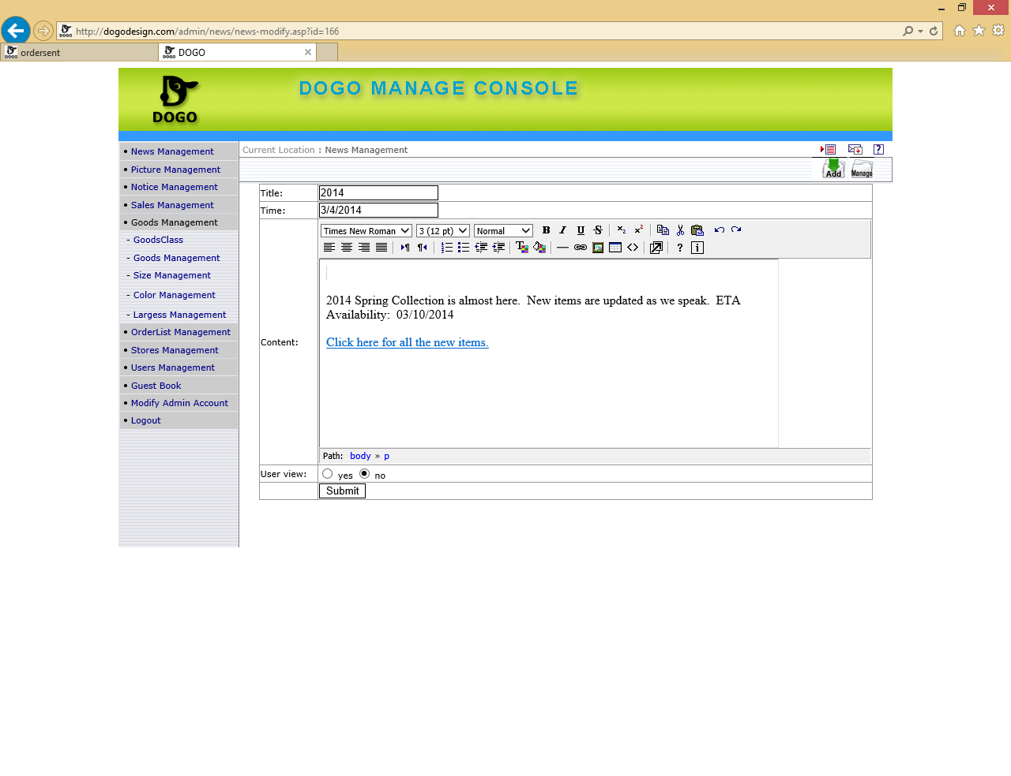
Notes:
NEWS MANAGEMENT – EDIT

Slide 6
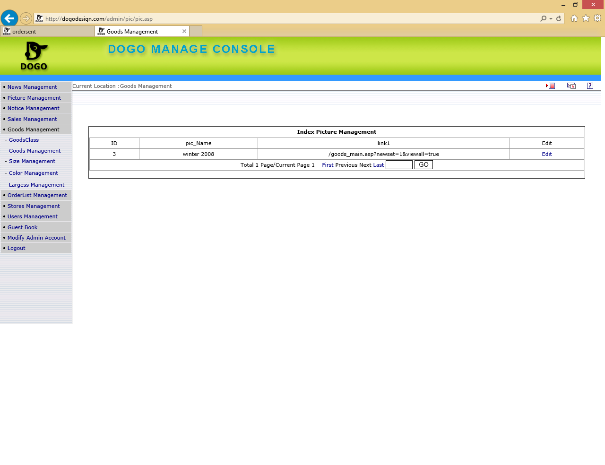
Notes:
PICTURE MANAGEMENT -

Slide 7
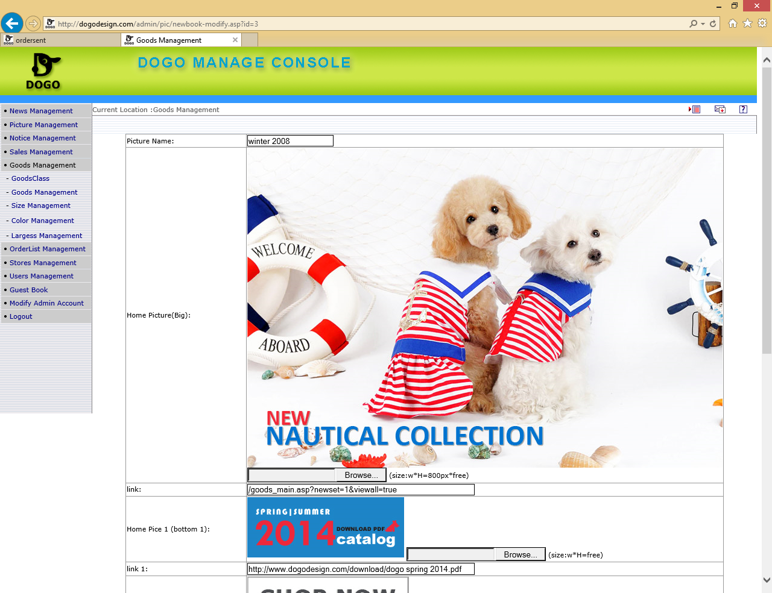
Notes:
PICUTRE MANAGEMENT – EDIT

Slide 8
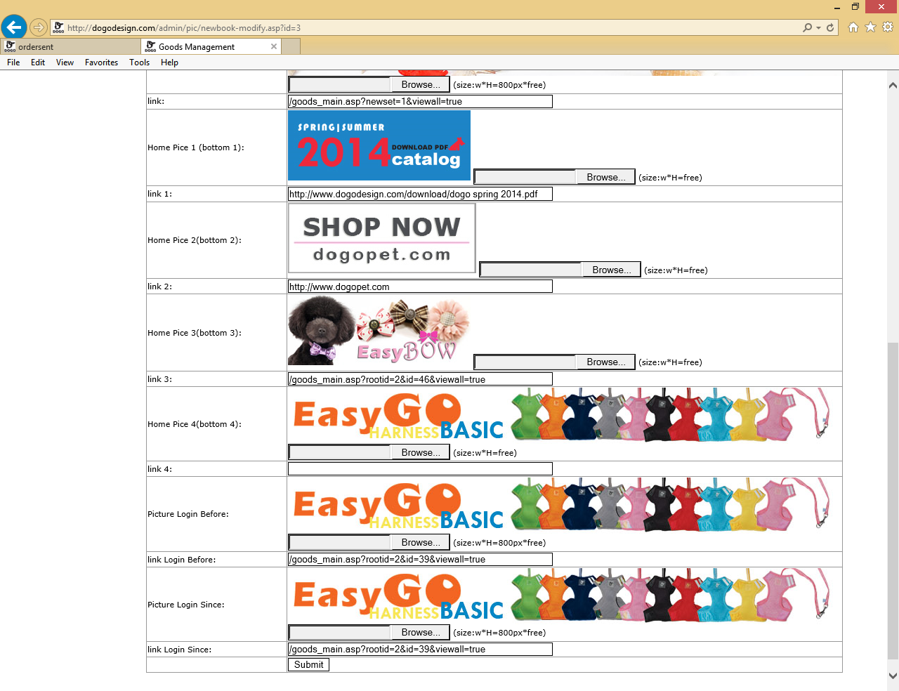
Notes:
PICTURE MANAGEMENT – EDIT – SCROLLED DOWN

Slide 9
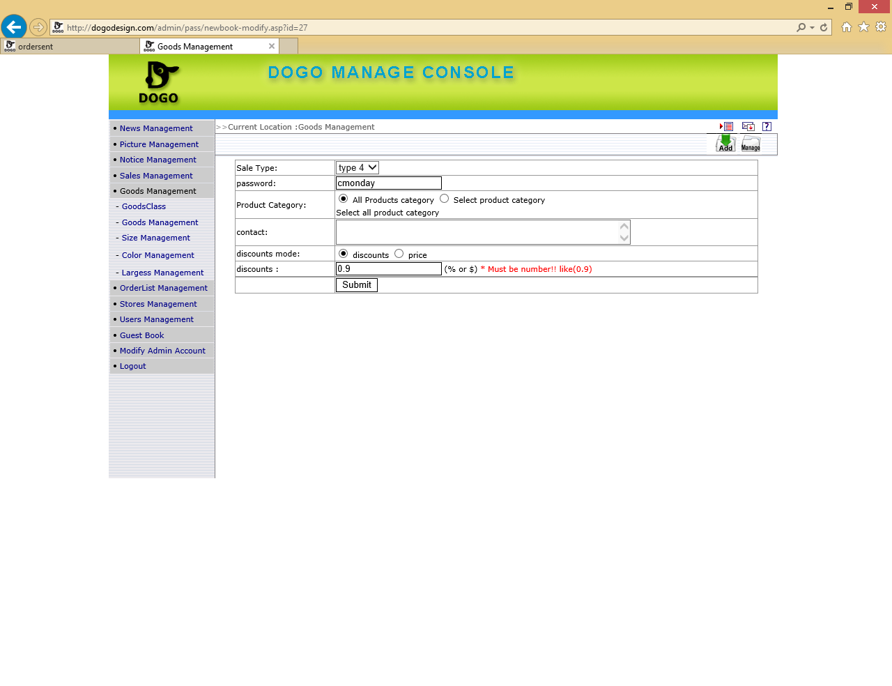
Notes:
Sales Management - EDIT

Slide 10
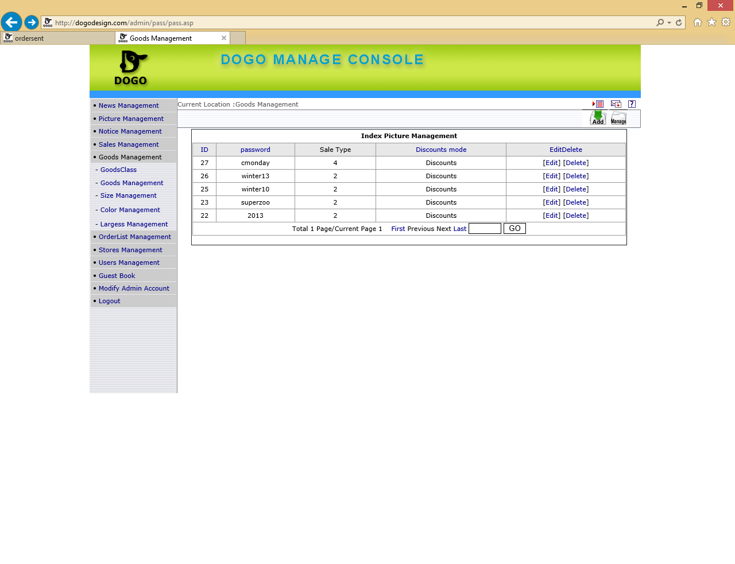
Notes:
SALES MANAGEMENT – LIST OF DISCOUNTS
27 cmonday 4 Discounts [Edit] [Delete] type 4 – password cmonday – all product category – discounts - .9
26 winter13 2 Discounts [Edit] [Delete] type 2 – password winter13 – category – sweater , sweat shirt & jumper , winter dresses , winter coats - Discount 0.8 - total price 75$
25 winter10 2 Discounts [Edit] [Delete] type 2 – password winter10 – catgory – harness vest , winter dresses , sweatshirt & jumper , special fun wear , sweaters, winter coats – discout 0.9 total price - $150
23 superzoo 2 Discounts [Edit] [Delete] type 2 – password superzoo – all product category – discounts - .9 – total price $200
22 2013 2 Discounts [Edit] [Delete] type 2 – password 2013 – harness vest m winter desses, sweatshirt and jumper sweaters , winter coat – disount .9 – total price $300
Type 1 - Category (all or select product)– Description – discount mode (discount, price) – amount spent gives % or $ discount - 3 tier discount
Type 2 - Category (all or select product)– Description – discount mode (discount, price) – % or $ discount after spending x amount of $
Type 3 – Category (all or select product)– Description – discount mode (discount, price) –amount of items purchased gives % or $ discount
Type 4 – Category (all or select product) – Description – discount mode (discount, price) – discount by % or $ for all selected products

Slide 11
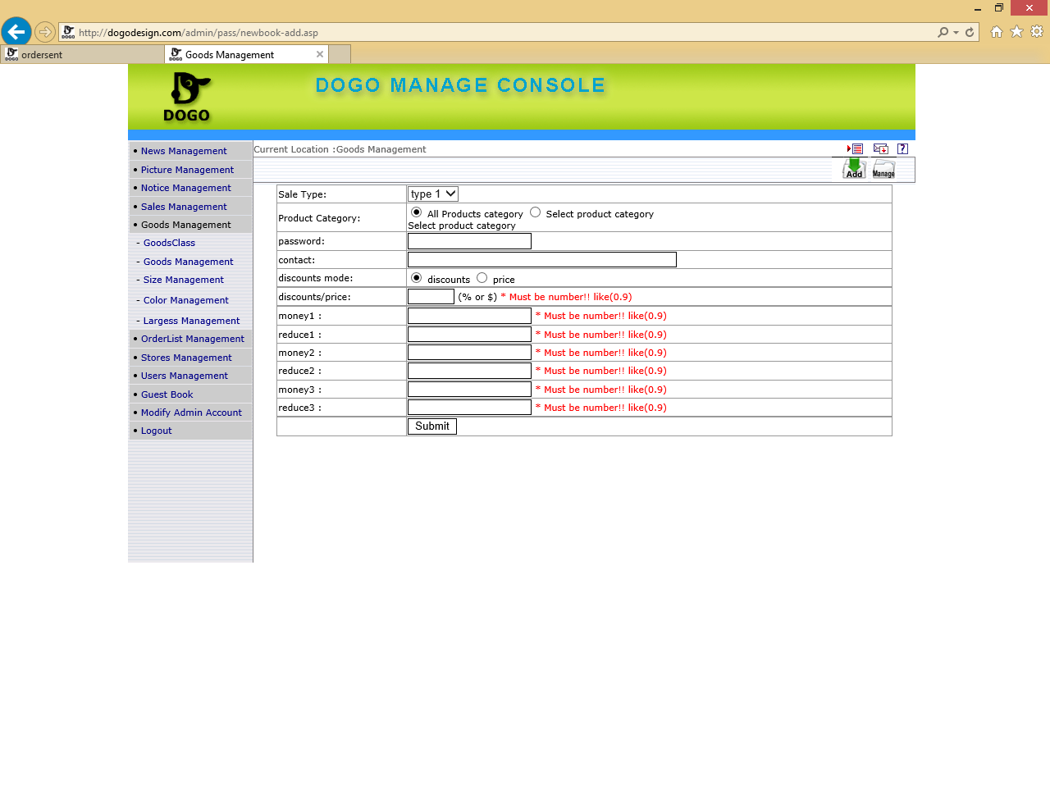
Notes:
Sample of discount management type 1

Slide 12
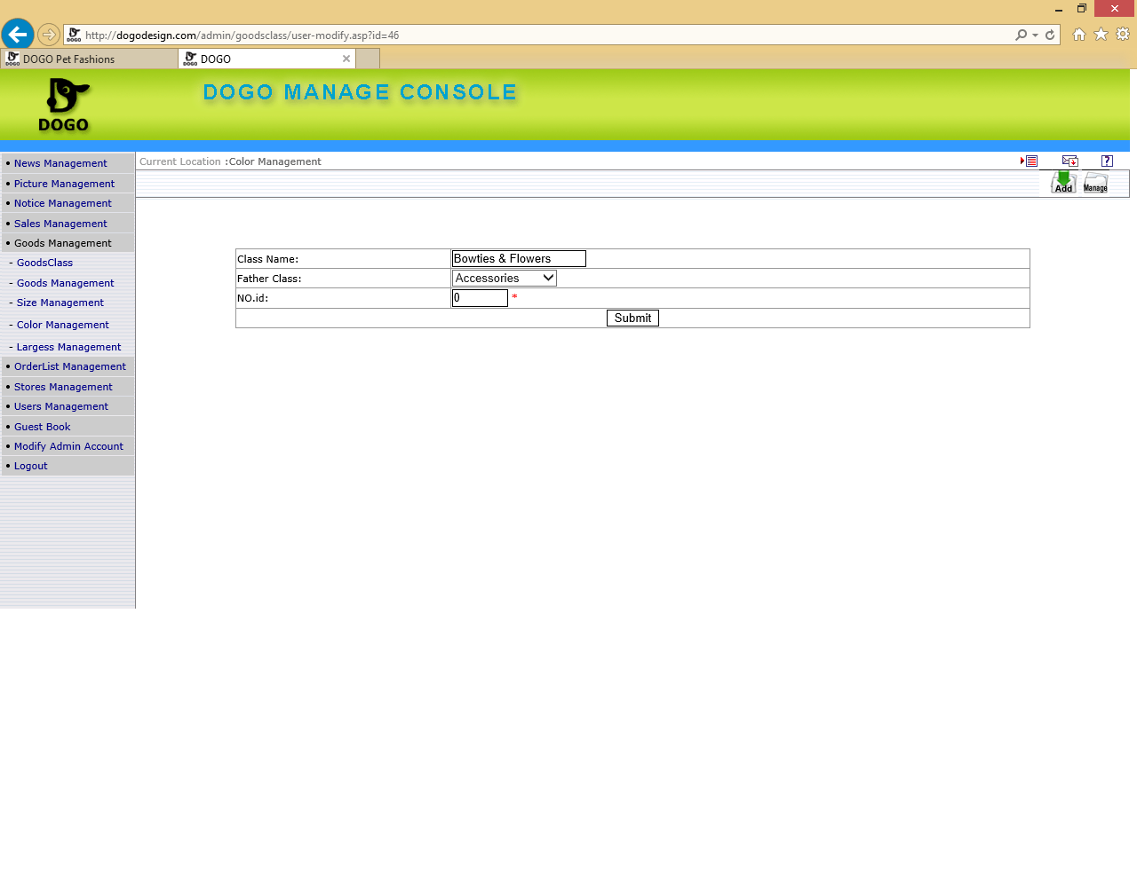
Notes:
Goods Management – EDIT – NOid = Color … refer to color management for list of NOid

Slide 13
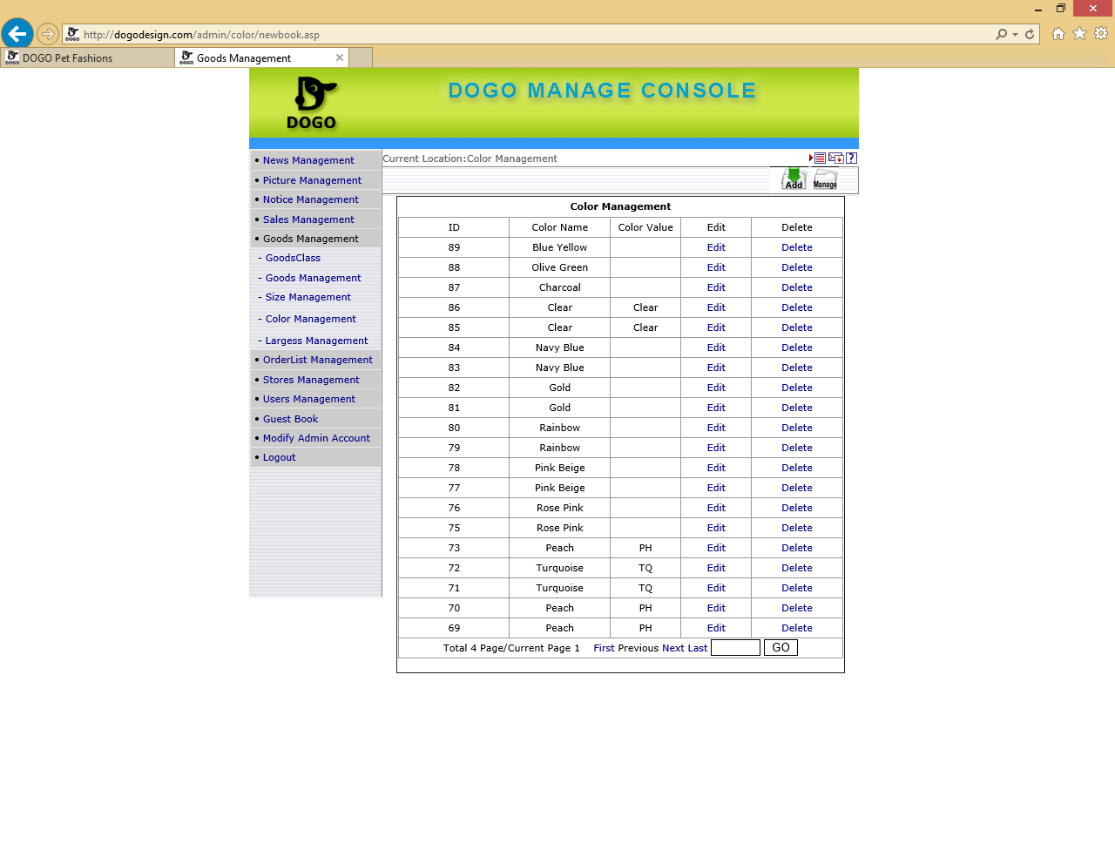
Notes:
Color management – color ID’s -

Slide 14
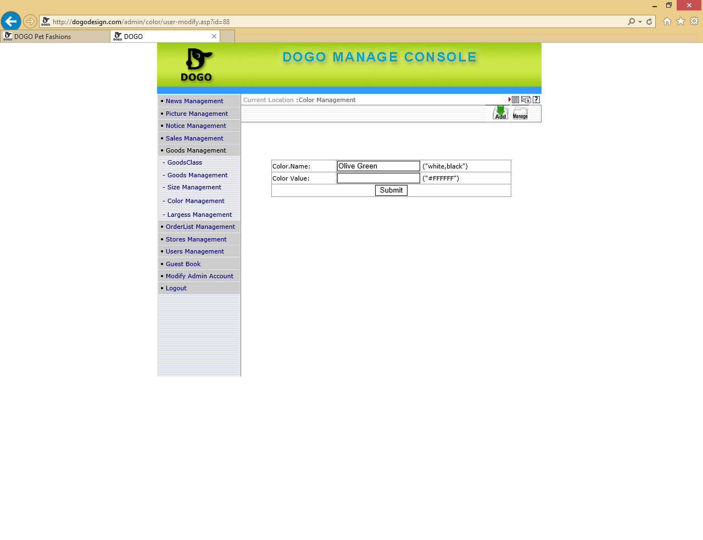
Notes:
Color management – EDIT / ADD

Slide 15
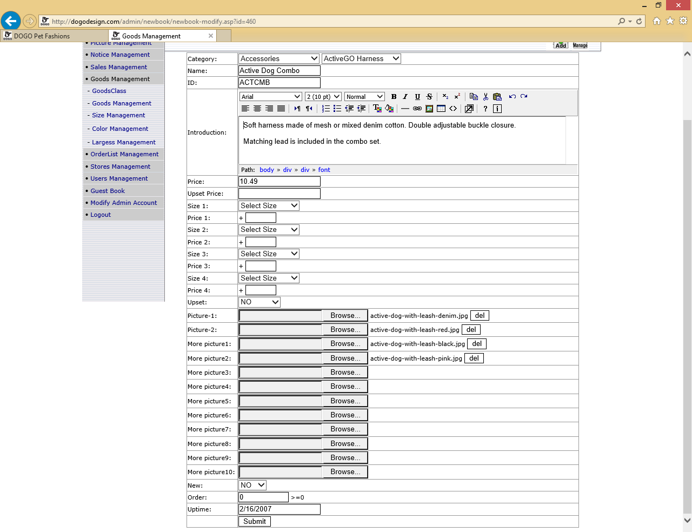
Notes:
Good Management – EDIT

Slide 16
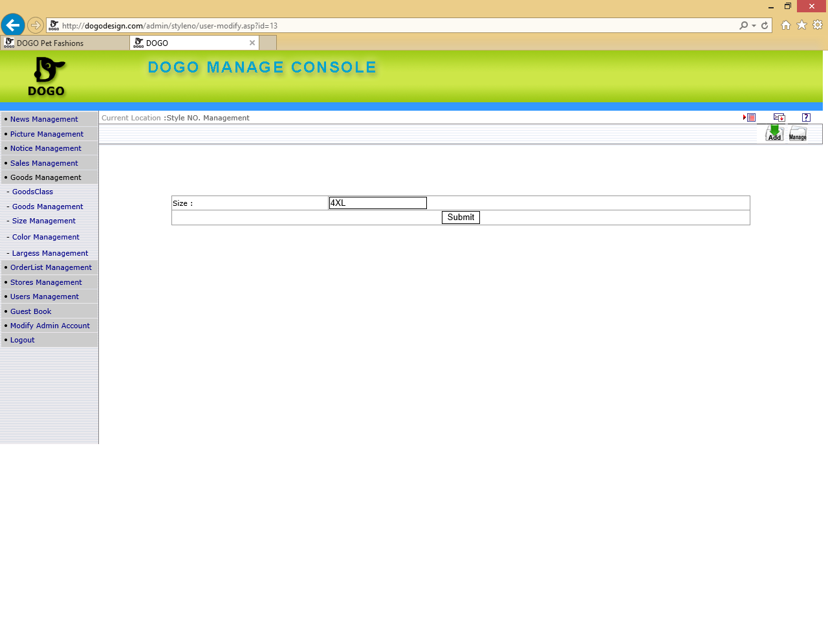
Notes:
Size Management – EDIT – Need to fix sorting issue .. Sizes don’t show up in proper arrangement . Please allow for manual rearranging also

Slide 17
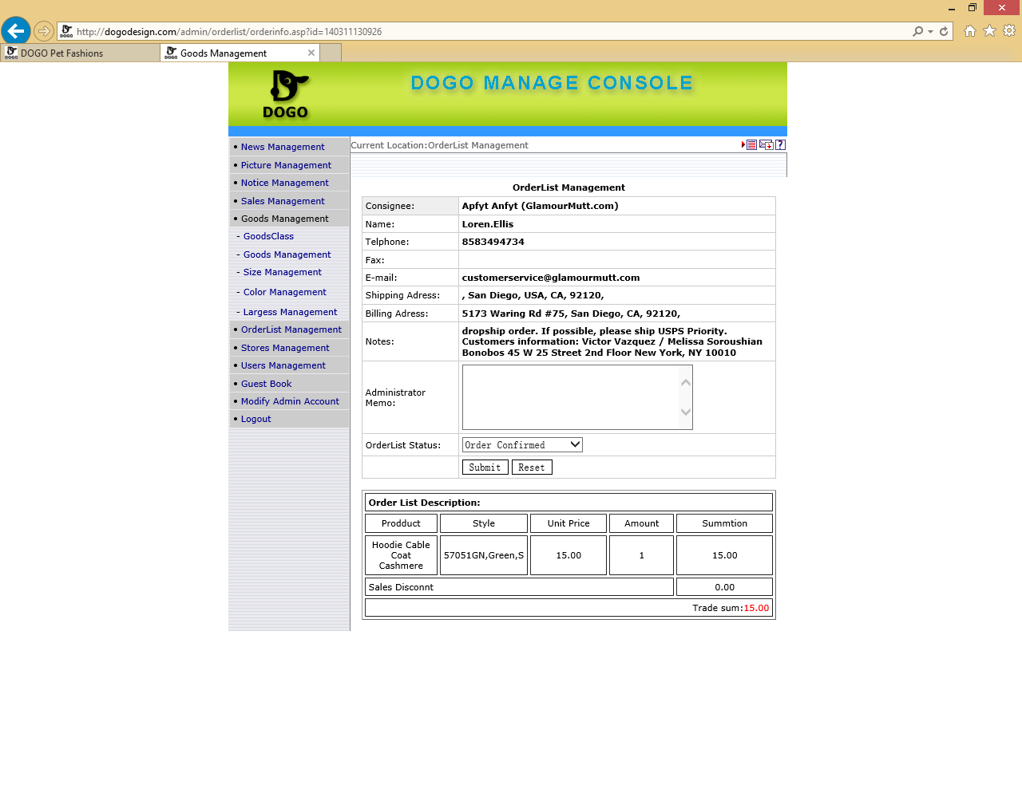
Notes:
Orderlist Management - EDIT

Slide 18
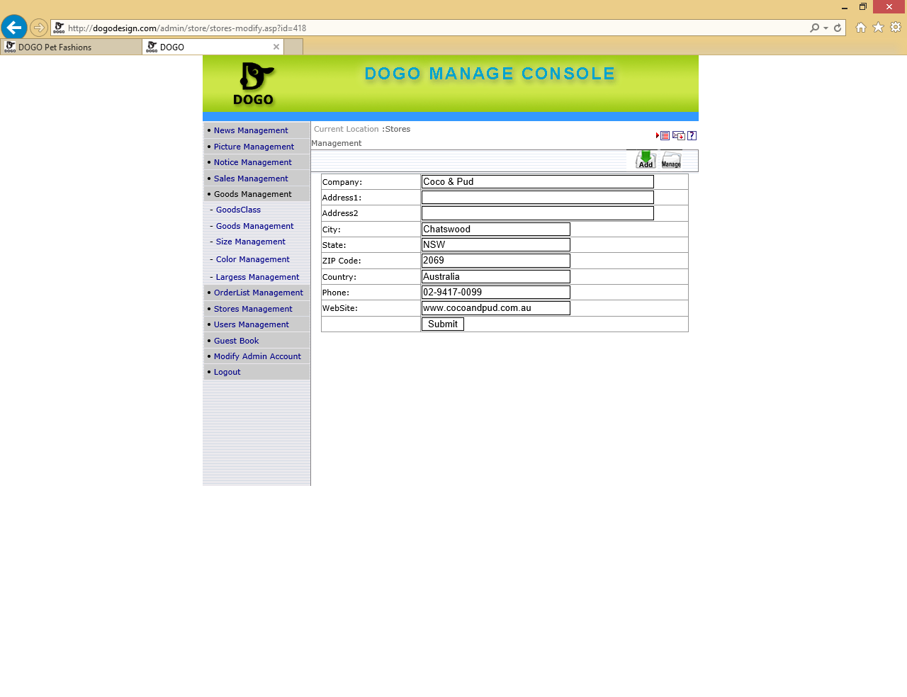
Notes:
Store Management -EDIT

Slide 19
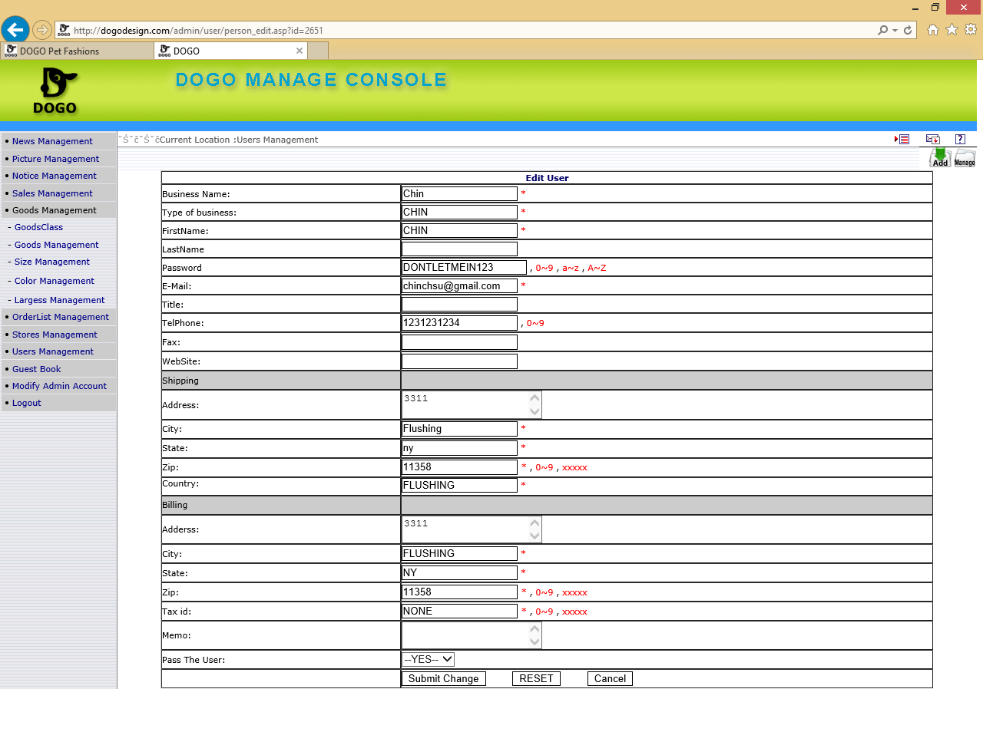
Notes:
USER MANAGEMENT - EDIT – require encryption

