Slide 1
Crisis Resilient Architecture
Graeme Burnett
Apr 2005

Slide 2
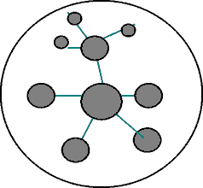
Crisis Resilient Architecture - Quad Chart
New Ideas
Mobile Applications
Open Source
Web Services
High Performance Data Infrastructure
Resilient, Recoverable Applications
Funded Open Source Development
Web Service Marketplaces
Anonymous applications
Dynamic re-branding
Infrastructure Independent Application Performance
Task-based market delivering variable SLA
Knowledge Management Approach to Technology Strategy
HAG
HDF5
Cryptoplumbing
E Contracts
Mobile Data
Cots Hardware
Impact
Schedule
High Performance Applications
Highly Available Applications
Increased Security
Reduced Cost
Variable SLAs
Effective software and people outsourcing
Business Aligned Strategy
Dynamic Re-randing
Task Based Markets
KM Strategy
High Perf Data Infra
Web Service Markets
Anonymous Apps
OS Dev
COTS
Hardware
2006
2008
2010
2012
2014

Slide 3
Crisis Resilient Architecture
Technology
Strategy
A rationale of why how we got where we are and how to improve our capability

Slide 4
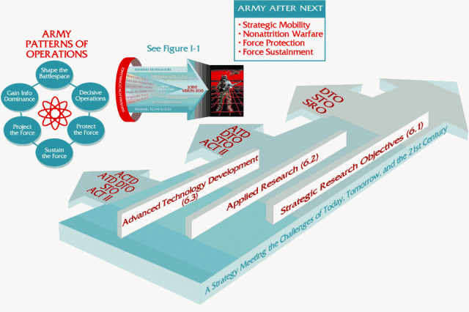
Technology Strategy Landscape
Strategy Driven by Industry Marketing
  Sales-lifecycle used to derive application, data and security strategy leading to piecemeal, vendor specific solutions.
Enterprise Infrastructure Components
  Application Servers, Enterprise Middleware, Portal Engines etc. Often underused
  TCO as an effective model
IT Over-Governance
  Difficult to introduce new products.
  Heavy handed change control by outsourced platform management thwarting business needs
Technically Poor Solutions:
  Blade technology – configuration overhead, small memory footprint, one network card per cabinet
  Centralised Data Centres – physical security threats. They fill up.
  Enterprise Class Storage – poor scalability, expensive, slow.
  Generic, complex, high-cost, manufacturer lock-in, technological mediocrity
  Designed to suit Manufacturer’s capability model

Slide 5
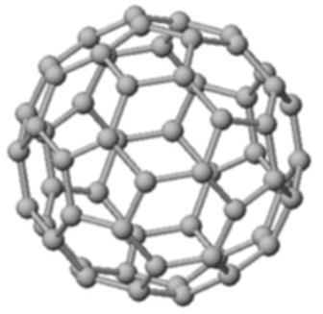
KM Driven Technology Strategy
Collaborative Community Software
  Chat: Communities/themes of interest, intra-team communication, social capital
  Blogs: knowledge capture, dissemination, categorisation and persistence
Knowledge Management
  Identifying organisationally important themes
    Role Categorisation, activity monitoring, community reputation.
  Legitimisation of themes
    Management endorsement
    assignment of resources
  Transforming tacit knowledge to explicit knowledge
    Community Wiki
    Blogsphere
  Strategic Lifecycle
    Feeding the strategic pipeline
    Business-aligned, technology balanced strategy
    Programme/Project identification

Slide 6
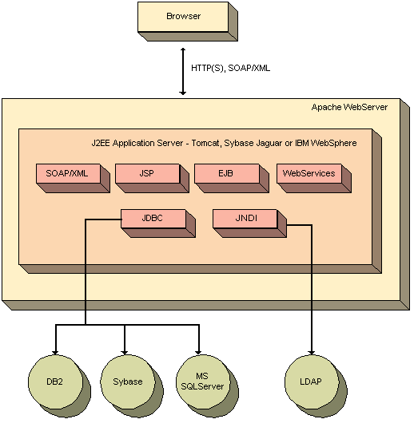
Current Application Architecture
We’re Still in the age of Client-Server
  Complex technologies - have they delivered? - ORBs, EJB, Object DB
  XML misunderstood - edge connectivity/co-ordination only please
Language Wars
  Who cares? TCO again should be the guide.
Methodologies
  RUP/MDA/UML/XMI - vendor driven methodology soup
Everything belongs in a database
  Not all data is record orientated
  DSS queries poorly catered for
Waterfall development predominates
  Long delivery cycles - 85% complete projects
  Outsourcing magnifies the problems - no pain/all gain
Security is an afterthought
  Developers still live in a green zone

Slide 7
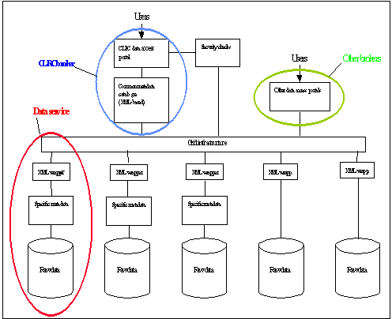
Current Data Architecture
Data Architecture Over Engineering
  Dominated by expensive, poorly performing hardware orientated solutions
  Lack of knowledge as to data usage/application performance requirements.
  Fixed Data Bandwidth
    Different applications need different bandwidth. One size does not fit all
Centralised Data Centres
  Huge power and cooling requirements
    Limited Fuel Supply
  Vulnerable to physical attack
    Data unavailability due to human error
    Unknown EMP resistance
    Failure of connectivity
  Fixed Capacity - castle wall syndrome
  Diffusion is the answer

Slide 8
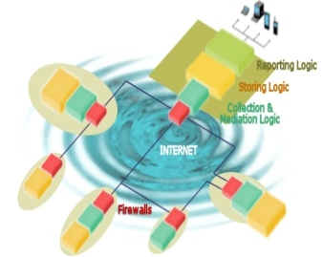
Current Security Architecture
Physical Security
  Largely ignored in security risk assessments
De-Militarised Zone Approach
  Ideal for protocol containment but fails to deal with application specific payload.
Failure of PKI
  Key management issues unresolved, root CA compromises, real-time revocation. Largely relegated to green zone single sign-on solutions
Penetration Testing is “point in time” security
IDS Complexity
  Technology complexity, signals analysis a heuristic process. Network protocol specific, devoid of application syntax and semantics.
Centralised Data Centres
  Centralised data means centralised risk.
  Extreme risk events would render business continuity planning ineffective.
  Huge energy requirements (15MWh, 5MWh of which is cooling)

Slide 9
Current Security Architecture cont.
Risk Assessment
  Post design rubber stamp for the regulators?
  Often tacit advice given
Security Architecture Patterns
  Pre-risk assessed architectural components or patterns enabling rapid development of secure, compliant applications

Slide 10
Crisis Resilient Architecture
Data Architecture
“Turning the real into virtual”
      Esther Dyson et al

Slide 11
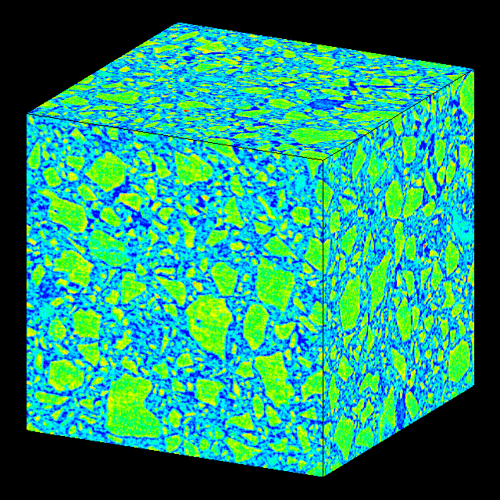
Data Depth Perspective
The World Produced in 1999 ^{[1]}:
  1.5 exabytes (2⁶⁰⁾ of storable content - 1.5 billion gigabytes
  250 megabytes for every man, woman, and child on earth.
  Printed documents of all kinds make up only .003 percent of the total.
  Magnetic storage is by far the largest medium for storing information and is the most rapidly growing
  Shipped hard-drive capacity doubling every year.
  Amount of human generated content - 5TB
Financial Market Data
  LSE Basic set currently is 14GB for 2 Years (stock, shares, price, bid, ask, flags)
  New Requirements: Market Depth + News + Traffic Analysis +VWAP + Volatilities etc
RFID
  Millions of raw events which need to be stored

Slide 12

Data Architecture
Tier 1 - Master Data Sets
  Enterprise grade persistence
  Satisfy Data Retention Regulations:
    Gramm-Leach-Bliley - security and confidentiality
    Sarbanes-Oxley - the need for data retention
  I/O profile per data set to suit predefined SLA
Tier 2 - Derived Regional Data sets
  Geo-legislative Data Partitioning
Tier 3 - Divisional/Departmental Data Sets
  Reduced infrastructure requirements
  Forward Caching - data near point of consumption
  Dataset Enrichment - pattern recognition, aggregation, data set generation
Tier 4 - Workstation
  Spare-cycle computing
  Specialist enrichment

Slide 13
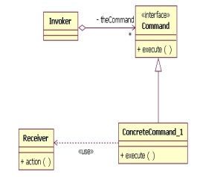
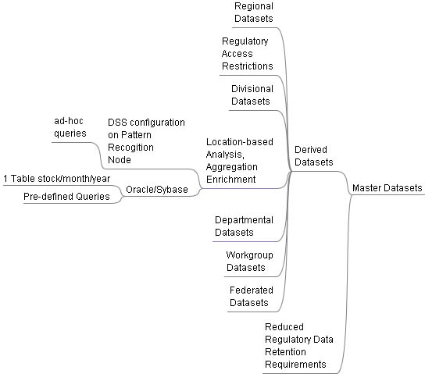
Data Topography

Slide 14

Data Discovery
Ontologies
  An ontology is a conceptual model about some domain
  Relationships that hold between them
  Characteristics of data
Data set Description using Protégé and OWL
  XML/RDF Metadata
  Can forward generate Database and XML Schema’s
Data Classification
  WEKA - data classification suite written in Java
  Pattern Recognition
  News analysis
  Envelope/Outlier analysis

Slide 15
HDF5 - The Big Idea
For IT Management
  Infrastructure Independence - Data Delivery by Configuration
  Parallel Data Delivery Configurable To Individual Data Set Granularity
  Limitless Data Storage
  Optimised Data Storage
    Szip compression minimises disk usage/maximises revenue
  Suited to heterogeneous environment
    Virtual File Layer (VFL) ported to many platforms
  A Solution to the ever growing “Data Storage” Issue
For Security Architects
  Diffusion and redundancy of data sets becomes an option
For Software Architects
  Potential to capture limitless market depth and generate limitless analytical models
  Arbitrary precision, multidimensional and user defined data sets
  Toolkits in many flavours, C, Java, Perl
  High performance data access
    Statistical analysis, 3 D visualisation and pattern recognition become a reality

Slide 16

HDF5 Feature Overview
HDF5 File Format
  Public Domain, pioneered by the nuclear science community
  Robust, mature, standards driven
Scalable Data Delivery, Efficient Storage, Data Transformation
  Virtual file Layer supports “chunked” data sets
  Raw, Standard, Parallel and Networked I/O
  Bandwidth configurable per data set
  Data type and spatial transforms of data or subsets during I/O
  Szip - high performance compression/decompression
Infrastructure agnostic
  Metadata approach
  No specialised hardware required
  Suitable for distributed/lightweight architectures: Grid, COTS

Slide 17
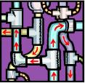
Cryptoplumbing
Leased Line Connectivity
  Six-week lead time for installation
  Seldom encrypted
  Vulnerable to disruption
Virtual Leased Lines - stunnel, FreeS/WAN
  Instant connectivity
  Instant revocation
  Manually managed certificates
  Point-to-point/socket-to-socket encryption
Application Security
  Legacy applications can be secured by local proxy
    Secure
    Endpoint extension from server to client

Slide 18
Crisis Resilient Architecture
Web Services
  “Anywhere in the world is but 65ms away by propagation delay - the rest is caching”

Slide 19
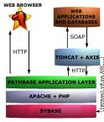
The Problem with Web Services
Web Services == Distributed Computing
  Distributed Computing == Federated Responsibility
  Federated Responsibility == Unreliability
Distributed Failure
  Dependency on service availability
  Autonomic Computing offers platform/solution specific answer
Web Services is not only XML
  XML is only suitable for edge connectivity between federated systems
Message Orientated Communication
  TCP/IP Architecture is the basis of all web communication
  All high performance architecture is based on IP communication for speed with TCP for control
Service Orientated Architecture
  A marketing term for network programming with application specific protocols layered above
  Design decisions: lightweight Interface with huge ontology versus huge API

Slide 20
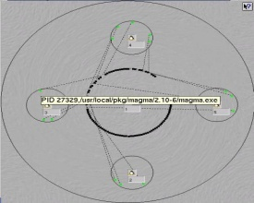
Crisis Resilient Web Services
Hierarchical Community Maintained Service Ontology
  Community maintained, versioned, web service interfaces
Reputation-based Market place
  Quality of service enabling autonomic computing whilst delivering regulatory compliance
Electronic Payments Fund Open Source Development
  Viable funding for open source developers
Peered Service Provision
  Service forward caching
  Dynamic rebranding
Self Healing Applications
  Ability to source alternative services from the market in realtime
Anonymous Applications
  Anonymising proxies deliver applications composed of community based web services paid for by anonymous electronic cash.
Per-service Security Policy and HAG model
  Pre-defined as part of the contract

Slide 21
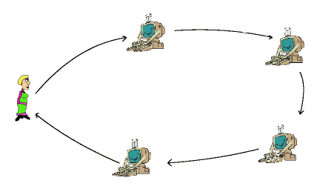
Mobile Code Models
Call or Buy Web Services
  A Web Service could be source or executable code
  Dynamically compiled or loaded
  Embedded in an electronic contract
  Could be analysed for vulnerabilities before execution
  Lightweight trust - reputation is all
  External communication mediated by a HAG for billing/service call
  Sensitive data sets
Data
  De-aggregation - data sets splayed to N services
  Black hole execution - code and data enter - results leave.
  Obfuscation by HAG - geolegislative pseudonymity
  Web Service Pipelining - data is pipelined between services

Slide 22

Economic model for COTS Web Services
Economic Web Service Development Lifecycle
  Web services can be developed by anyone, anywhere, anytime
  Market differentiated on reputation, performance and platform
  Electronic/Paper Contracts for accountability
  Revenue collection:
    bearer electronic cash, traditional electronic payments
Revenue Models
  One shot, Fixed term or Lifetime usage
  Floor/Ceiling/Stepped usage
Grade of Service to suit Regulatory Requirements
  Characteristics of data

Slide 23
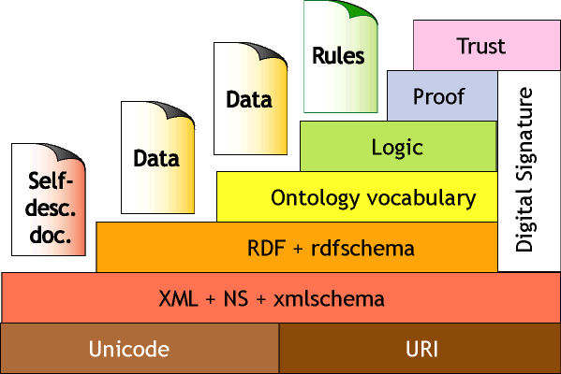
HAGS - High Assurance Guards
Precise Syntactic and Semantic Communication Profile
  A HAG is associated with a class of web service
What make’s HAG’s possible now?
    OWL - semantic ontologies
    BPML et al - business process markup lanaguages
Application Firewall and IDS
  XML filtering
  Semantic Attack Defence
  Linked to business process
  Slow scan attacks
  Covert channel closure
Additional Features:
  Geolegislative Transformation
  Payment and usage information
  Electronic capture and negotiation
  Regulatory Compliance

Slide 24
Crisis Resilient Architecture
Hardware
Infrastructure
  “Order out of Chaos”

Slide 25
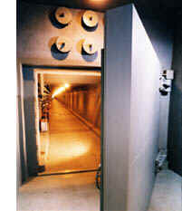
Secure Hosting
Physically Secure Infrastructure
  Hardened Nuclear Grade Facility - e.g. www.thebunker.net
  Multiple Connectivity
  Faraday cage
  3 months fuel supply
  Master/Regional data set storage
Vulnerabilities
  Well-known location - safe harbour in times of crisis
  High-energy EMP weapons
  Operational personnel failure
Current Patterns
  MAN’s - do they really address crisis situations?
Alternatives
  Pervasive redundant diffusion - e.g. oceanstore
  Microhosting

Slide 26
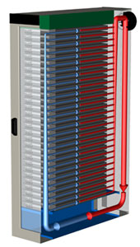
Microhosting
Data is Mobile - Not All Data Needs Enterprise Class Persistence
  HDF5 makes it easy to forward cache static/reference data calved from master data sets
    Regional/Divisional/Departmental/Workgroup
  Torrents deliver data in usertime whilst providing diffusion
  Real-time computational derivation using FPGA’s and/or calculation farms
  Reduced cost whilst maintaining regulatory compliance
Micro-hosting
  Software chooses the most appropriate execution environment and marshals data accordingly
  Each site operational has 20-30 low cost COTS nodes, minimal cooling, energy footprint up to 15KW, multiple network connections.
  KNURR Secure 10/20KW Water cooled cabinets located across infrastructure ^{[2]}

Slide 27

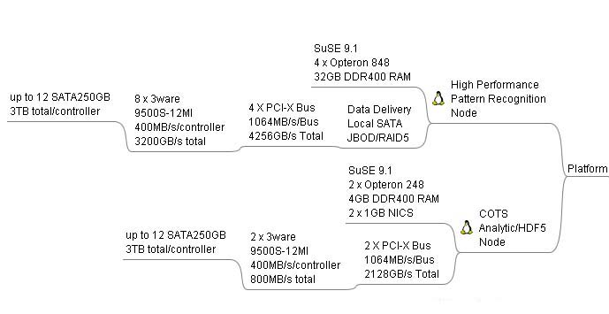
COTS Hardware
Lightweight Infrastructure Using COTS Components
  Pattern Recognition/DSS Node - ~$25,000 for 24TB JBOD Node
    Sparse Data Analysis
  Analytics/HDF5 node $2700
    Data delivery, computation
  “Throwaway nodes” - reduced hosting costs

Slide 28

Mobile Mesh Networks
Mobile adhoc networking allows users to exchange information in a wireless environment without the need for a fixed infrastructure.
  Decentralised Infrastructure
  COTS Hardware/Homebrew Antennas
  Limited Expertise Required to configure
  Avoids a central point of failure and control
  Extremely Low Power Requirements
  Enables Instant VoIP networks
  Self-Healing
UWB
  Low power
  Low cost,
  High data rates (100Mbps @ 10m)
  Precise positioning capability
  No interference
  Passes through Buildings

Slide 29
Crisis Resilient Architecture
The Crisis Desktop
  “Turn the real into virtual”
      Esther Dyson et al c 1999

Slide 30
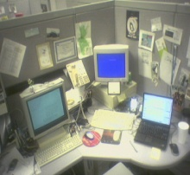
The Crisis Desktop
Bootable Operating System Images with Custom Toolkits
  Work from any computer
  Qemu - multiple OS, command line OS image booting
  Knoppix - read-only OS image
    Quantian - Quantitative Workbench
    The Coroner’s Toolkit - forensics
Portable Storage
  4GB USB 2.0 Devices
  300GB Portable hard drives
Web-based file storage
  Multiple providers offering 30-1GB for modest outlay
Online-data libraries
  Custom data set order and delivery
Instant Cluster Software
  OpenMosix - Instant Cluster using remote network boot using PXE, DHCP and tftp to boot linux clients via the network.
  Autodiscovery - new nodes automatically join the cluster
  Data delivery P2P - torrents, gridella

Slide 31

References
[1] How Much Storage is Enough?
  http://www.acmqueue.org/modules.php?name=Content&pa=showpage&pid=45
[2] Knurr 10/20KW Water-cooled Environments
  http://www.water-cooled-server-rack.com/

