Slide 1
Collaborative Web Services
Graeme Burnett, Enhyper Ltd
June 2005

Slide 2
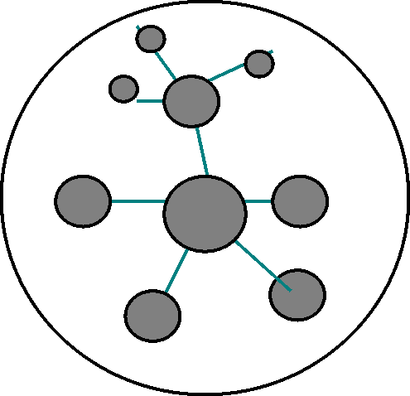
Collaborative Web Services – Quad Chart
Concepts
New Ideas
Web Services
Web Service Marketplaces
Anonymous Applications
Self-healing Applications
Funded Open Source Development
Dynamic Re-branded and peered services
High Performance Data Infrastructure
Infrastructure Independent Data Delivery
Black-box Execution
Web Services as Revenue Generators
Mobile Applications
Open Source
HAG
HDF5
E Contracts
Cryptoplumbing
Mobile Data
Cots Hardware
Impact
Schedule
High Performance Applications
Highly Available Applications
Increased Security
Reduced Cost
Variable SLAs
Effective software and people outsourcing
Dynamic Rebranding
Task Based
Markets
KM Strategy
High Perf Data Infra
Web Service Markets
Anonymous Apps
Black Box Execution
COTS
Hardware
2006
2008
2010
2012
2014

Slide 3
Collaborative Web Services
Technology
Strategy
A rationale of why how we got where we are and how to improve our capability

Slide 4
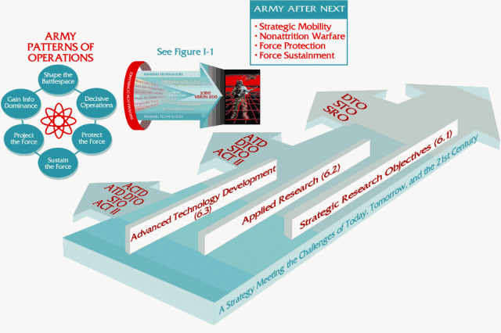
Today’s IT Strategy Landscape
Strategy Driven by Industry Marketing
  Sales-lifecycle used to derive application, data and security strategy leading to piecemeal, vendor specific solutions.
Enterprise Infrastructure Components
  Application Servers, Enterprise Middleware, Portal Engines etc. Often underused
  TCO is an effective model
IT Over-Governance
  Difficult to introduce new products.
  Heavy handed change control by outsourced platform management thwarting business needs
Technically Poor Solutions:
  Blade technology – configuration overhead, small memory footprint, one network card per cabinet
  Centralised Data Centres – physical security threats. They fill up.
  Enterprise Class Storage – poor scalability, expensive, slow.
  Generic, complex, high-cost, manufacturer lock-in, technological mediocrity
  Designed to suit Manufacturer’s capability model

Slide 5

The move to KM Driven IT Strategy
Collaborative Community Software
  Chat: Communities/themes of interest, intra-team communication, social capital
  Blogs: knowledge capture, dissemination, categorisation and persistence
Knowledge Management
  Identifying organisationally important themes
    Role Categorisation, activity monitoring, community reputation.
  Legitimisation of themes
    Management endorsement
    assignment of resources
  Transforming tacit knowledge to explicit knowledge
    Community Wiki
    Blogsphere
  Strategic Lifecycle
    Feeding the strategic pipeline
    Business-aligned, technology balanced strategy
    Programme/Project identification

Slide 6
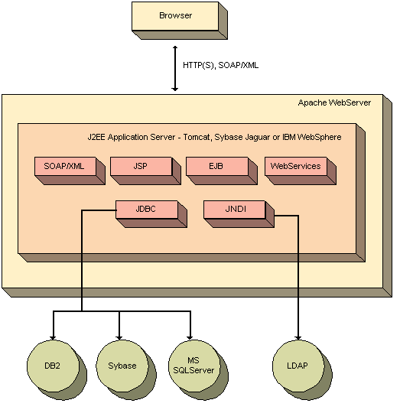
Current Application Architecture
We’re Still in the age of Client-Server
  Complex technologies - have they delivered? - ORBs, EJB, Object DB
  XML misunderstood - edge connectivity/co-ordination only please
Language Wars
  Who cares? TCO again should be the guide.
Methodologies
  RUP/MDA/UML/XMI - vendor driven methodology soup
Everything belongs in a database
  Not all data is record orientated
  Decision Support System (DSS) queries poorly catered for
Waterfall development predominates
  Long delivery cycles - 85% complete projects
  Outsourcing magnifies the problems - no pain/all gain
Security is an afterthought
  Developers still live in a green zone

Slide 7
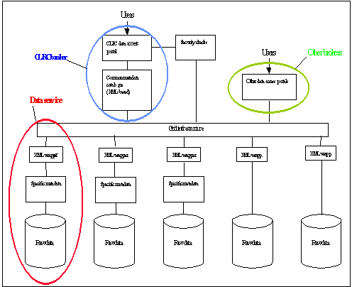
Current Data Architecture
Data Architecture Over Engineering
  Dominated by expensive, poorly performing hardware orientated solutions
  Lack of knowledge as to data usage/application performance requirements.
  Fixed Data Bandwidth
    Different applications need different bandwidth. One size does not fit all
Centralised Data Centres
  Huge power and cooling requirements (typical 15MWh, 5MWh of which is cooling)
  Centralised data means centralised risk.
  Extreme risk events would render business continuity planning ineffective.
  Data unavailability due to human error
  Unknown EMP resistance
  Failure of connectivity
  Fixed Capacity - castle wall syndrome
Diffusion is the answer
  Micro-data centers with high capacity connectivity

Slide 8
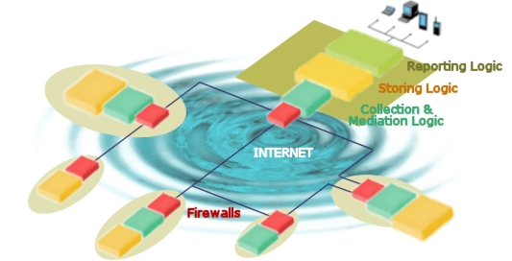
Current Security Architecture
Physical Security
  Largely ignored in security risk assessments
  De-Militarised Zone Approach - ideal for protocol containment
  fails to deal with application specific payload.
Failure of PKI
  Key management issues unresolved, root CA compromises, real-time revocation. Largely relegated to green zone single sign-on solutions
Penetration Testing is “point in time” security
  Real-time security threat modelling and analysis
  Highly skilled specialist teams still required for forensic event analysis
Risk Assessment
  Post-design rubber stamp for the regulators?
  Often tacit advice given
Security Architecture Patterns
  Pre-risk assessed architectural components or patterns enabling rapid development of secure, compliant applications

Slide 9
Crisis Resilient Architecture
Data Architecture
“Turning the real into virtual”
      Esther Dyson et al

Slide 10
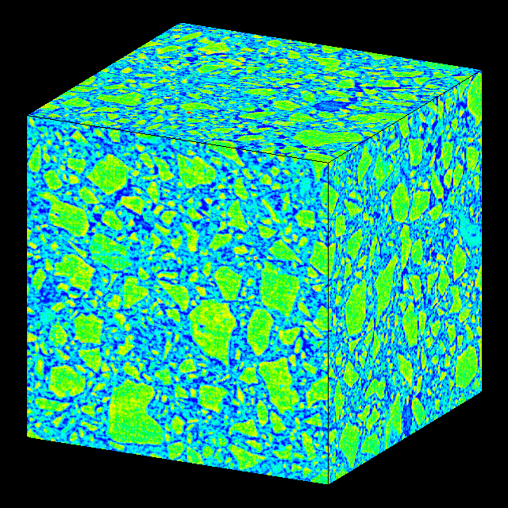
Data Depth Perspective
The World Produced in 1999 ^{[1]}:
  1.5 exabytes (2⁶⁰⁾ of storable content - 1.5 billion gigabytes
  250 megabytes for every man, woman, and child on earth.
  Printed documents of all kinds make up only .003 percent of the total.
  Magnetic storage is by far the largest medium for storing information and is the most rapidly growing
  Shipped hard-drive capacity doubling every year.
  Amount of human generated content - 5TB
Financial Market Data
  LSE Basic set currently is 14GB for 2 Years (stock, shares, price, bid, ask, flags)
  New Requirements: Market Depth + News + Traffic Analysis +VWAP + Volatilities etc
RFID
  Millions of raw events which need to be stored

Slide 11

Organisational Data Architecture
Tier 1 - Master Data Sets
  Enterprise grade persistence
  Satisfy Data Retention Regulations:
    Gramm-Leach-Bliley - security and confidentiality
    Sarbanes-Oxley - the need for data retention
  I/O profile per data set to suit predefined SLA
Tier 2 - Derived Regional Data sets
  Geo-legislative Data Partitioning
Tier 3 - Divisional/Departmental Data Sets
  Reduced infrastructure requirements
  Forward Caching - data near point of consumption
  Dataset Enrichment - pattern recognition, aggregation, data set generation
Tier 4 - Workstation
  Spare-cycle computing
  Specialist enrichment

Slide 12
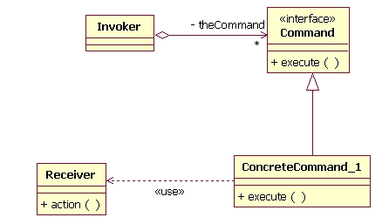
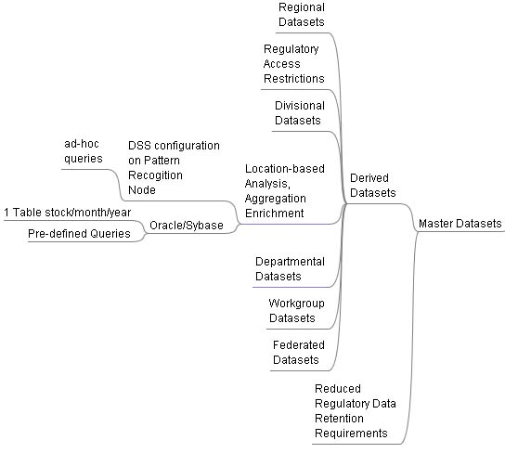
Data Topography

Slide 13

Dataset Discovery
Ontologies
  An ontology is a conceptual model about a domain
  Details relationships that hold between entities
  Unsuitable unless domain is well defined
  Web service definition an example where domain is of internet proportions.
Initiatives with limited success
  Hierarchical categorisation does not work
    Context - Multiple category membership
  DDI – Data Definition Initiative e.g
  Many others…
Probabilistic Dataset Tagging
  Data is tagged by multiple consumers
  Keyword plus description
  Keyword collision density used determine probabilistic match
  http://del.icio.us is an example of a probabilistic approach to categorisation

Slide 14
HDF5 - The Big Idea
For Web Services
  High speed data transport
For IT Management
  Infrastructure Independence - Data Delivery by Configuration
  Scalability, performance at no cost
  Limitless Data Storage
  Suited to heterogeneous environment
    Virtual File Layer (VFL) ported to many platforms
  The solution to the ever growing “Data Storage” Issue
For Application Architects
  Parallel Data Delivery Configurable To Individual Data Set Granularity
  Potential to capture limitless data and generate limitless analytical models
  Statistical analysis, 3 D visualisation and pattern recognition become a reality
For Security Architects
  Diffusion and redundancy of data sets becomes an option

Slide 15

HDF5 Feature Overview
HDF5 File Format
  Public Domain, pioneered by the nuclear science community
  Robust, mature, standards driven
Scalable Data Delivery, Efficient Storage, Data Transformation
  Virtual file Layer supports “chunked” data sets
  Raw, Standard, Parallel and Networked I/O
  Bandwidth configurable per data set
  Data type and spatial transforms of data or subsets during I/O
  Szip - high performance compression/decompression
Infrastructure agnostic
  Metadata approach
  No specialised hardware required
  Suitable for distributed/lightweight architectures: Grid, COTS

Slide 16
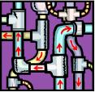
Cryptoplumbing
Leased Lines != Security
  Six-week lead time for installation
  Seldom encrypted
  Vulnerable to disruption
  Link encryptions struggle to keep pace with bandwidth advances
Virtual Leased Lines - stunnel
  Instant connectivity
  Instant revocation
  Manually managed certificates
  Point-to-point/socket-to-socket encryption
Application Security
  Legacy applications can be secured by local proxy
  Endpoint extension from server to client
  Centralised sign-on capability

Slide 17
Crisis Resilient Architecture
Hardware
Infrastructure
  “Order out of Chaos”

Slide 18
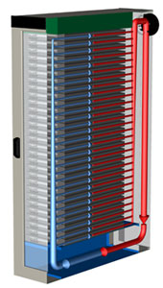
RAIM - Organisational Microhosting
Data is Mobile - Not All Data Needs Enterprise Class Persistence
  HDF5 makes it easy to forward cache static/reference data calved from master data sets
    Regional/Divisional/Departmental/Workgroup
  Torrents deliver data in usertime whilst providing diffusion
  Real-time computational derivation using FPGA’s and/or calculation farms
  Reduced cost whilst maintaining regulatory compliance
RAIM – Redundant Array of Inexpensive Machines
  Software chooses the most appropriate execution environment and marshals data accordingly
  Each site operational has 20-30 low cost COTS nodes, minimal cooling, energy footprint up to 15KW, multiple network connections.
  KNURR Secure 10/20KW Water cooled cabinets located across infrastructure ^{[2]}

Slide 19

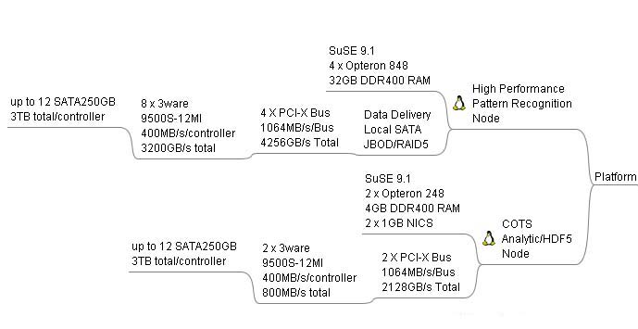
COTS Hardware
Lightweight Infrastructure Using COTS Components
  Pattern Recognition/DSS Node - ~$25,000 for 24TB JBOD Node
    Sparse Data Analysis
  Analytics/HDF5 node $2700
    Data delivery, computation
  “Throwaway nodes” - reduced hosting costs

Slide 20
Collaborative Web Services
Web Services
  “Anywhere in the world is but 65ms away by propagation delay - the rest is caching”

Slide 21
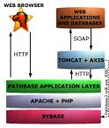
The Problem with Web Services
Current Understanding
  Web Services == Distributed Computing
  Distributed Computing == Federated Responsibility
  Federated Responsibility == Unreliability
Distributed Failure
  Dependency on service availability
  Autonomic Computing offers platform/solution specific answer
Web Services are not only XML based
  XML is only suitable for edge connectivity between federated systems
Message Orientated Communication
  TCP/IP Architecture is the basis of all web communication
  All high performance architecture is based on IP communication for speed with TCP for control
Service Orientated Architecture
  A marketing term for network programming with application specific protocols layered above
  Design decisions: lightweight Interface with huge ontology versus huge API

Slide 22
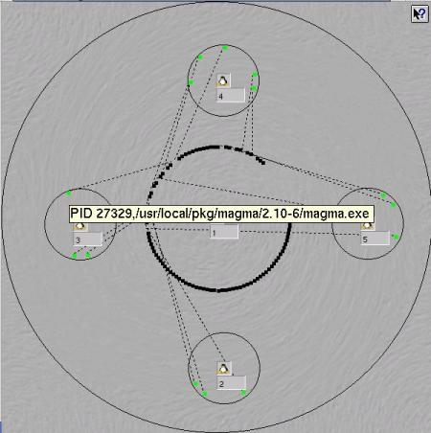
A Marketplace for Web Services
Web Services Delineated by Function
  Each function an individual marketplace for competing services of the same type
  Marketplace defined by unique URI enabling machine discovery
  Non-hierarchical, probabilistic, tagged definition enabling human discover
  Versioned services for legacy applications
Functional Decomposition Defined by the Collaborative Community
  Open, Competitive Marketplace
  Demand led, discovery by reward
Reputation-based Market Place
  Quality of service delineates supplier
  Enabling autonomic/self-healing computing whilst delivering regulatory compliance
  Organisations only allowed to consume services from top tier suppliers for production use.
  Development can use free services reducing software spend
Funds Open Source Development
  Viable funding for open source developers
  Virtual Service Economy

Slide 23
Web Service Availability and Security
Peered Service Provision
  Service forward caching
  Dynamic re-branding
Self Healing Applications
  Ability to source alternative services from the market in realtime
Anonymous Applications
  Anonymising proxies deliver applications composed of collaborative web services paid for by anonymous electronic cash.
Per-service Security Policy
  Pre-defined as part of the marketplace contract
High Assurance Guard
  Tightly defined ontology for data communications
  Obfuscation by HAG - geolegislative pseudonymity (e.g. Swiss Data Laws)
  Minimises covert channel risk

Slide 24
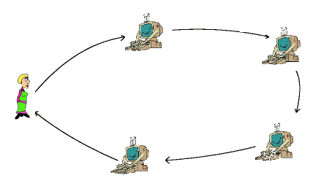
Web Service Code Models
Call or Buy Web Services
  A Web Service could be source, executable code or a socket based service
  Dynamically compiled or loaded
  Embedded in an electronic contract
    Post execution accountability
    Regulatory compliance
  Pre-analysed for vulnerabilities
  Lightweight trust - reputation is at stake for poor/malicious execution
  External communication mediated by HAG for billing/service call
Data Integrity
  De-aggregation - data sets splayed to N services
  Black hole execution - code and data enter - results leave.
  Web Service Pipelining - data is pipelined between services

Slide 25

Economic model for COTS Web Services
Economic Web Service Development Lifecycle
  Web services can be developed by anyone, anywhere, anytime
  Market differentiated on reputation, performance and platform
  Electronic/Paper Contracts for accountability
  Revenue collection:
    bearer electronic cash, traditional electronic payments
Revenue Models
  One shot, Fixed term or Lifetime usage
  Floor/Ceiling/Stepped usage
Grade of Service to suit Regulatory Requirements
  Characteristics of data

Slide 26
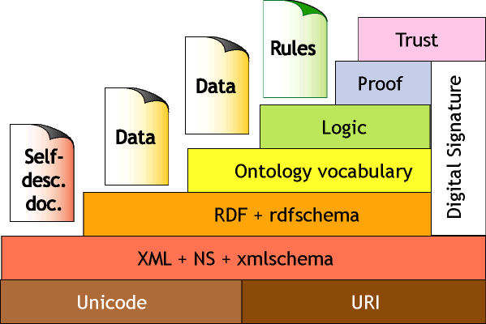
HAGS - High Assurance Guards
Precise Syntactic and Semantic Communication Profile
  A HAG is associated with a class of web service
What make’s HAG’s possible now?
    OWL - semantic ontologies
    BPML et al - business process mark-up languages
Application Firewall and IDS
  XML filtering
  Semantic Attack Defence
  Linked to business process
  Slow scan attacks
  Covert channel closure
Additional Features:
  Geolegislative Transformation
  Payment and usage information
  Electronic capture and negotiation
  Regulatory Compliance

Slide 27

References
[1] How Much Storage is Enough?
  http://www.acmqueue.org/modules.php?name=Content&pa=showpage&pid=45
[2] Knurr 10/20KW Water-cooled Environments
  http://www.water-cooled-server-rack.com/

