Slide 1
Global Unix Infrastructure
Enhyper Ltd
Enterprise Management Strategy

Slide 2
IPR and Confidentiality
The information contained in this document is commercial in nature and is provided in confidence. This information may be used for lawful purposes only and may not be copied, distributed, transmitted or disclosed, in whole or part, to any other party for any purpose without our prior written consent.
The Enhyper Ltd have used all reasonable endeavors to ensure that all documentation, literature and statements produced by it are accurate; however, information may contain typographical errors, technical inaccuracies or other errors.

Slide 3
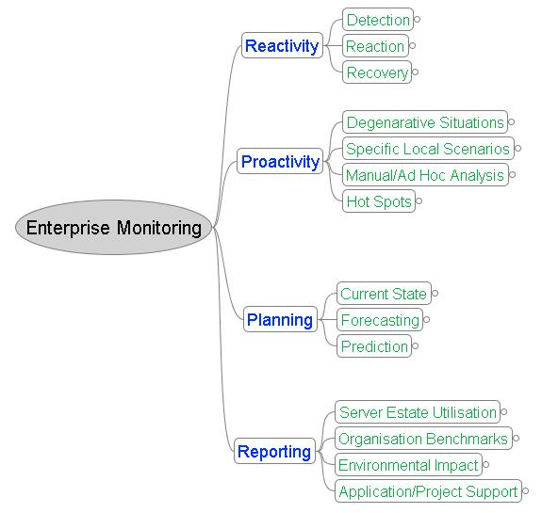
Reactivity, Proactivity, Planning and Reporting
Notes:
DMA == Direct Market Access where clients interface directly to the execution mechanisms of a major bank usually via a FIX gateway. - Price quotes are requested – (Intention Of Interest) and orders placed. This can be by a human, machine or a trading algorithm. This can quickly alter the banks VAR and credit risk limits for an individual customer
Pre-trade analytics – customers want the ability to do real time portfolio modelling and simulation based on supplied price quotes
Execution only clients demand high speed and ultra thin margins (do we really want their business).
Internalisation – satisfying orders from an internal pool – obviates exchange cost and allows potential reversal of position. Routing – can we send this trade straight to the market bypassing the trader?
Flow Analysis – visualisation of the flow by country, sector, stock, client. Aids the “hunt for volatility”
Price quote and IOI analysis can be used to generate “idea” flow and increase volatility. Trade ideas allow you to monetise researchers by punting their ideas to the prop desk. Idea clusters are indicative of market phenomenon.
News Analysis – what’s driving the market. Pretrading based on analysis of news sentiment.
Business Intelligence – how much does Google know about your business
More on MiFid Later (next slide)

Slide 4
Reactivity
Detection
  Platform availability, logfile monitoring and agent traps
Reaction
  Auto Ticket Creation – automatically raise alerts
  Patterns of failure – known failures have known resolution which is included in ticket.
  Manual ‘Hot Line’ – Problem triage process – capture and routing
Recovery
  Ticket Management – ticket lifecycle, service level reporting
Patterns of Failure
  Signature Recognition: Ontological Categorisation, Possible Vendor Escalation
  Solution Capture and Knowledge Management
Notes:
MiFID -

Slide 5
Proactivity
Degenerative Situations
  Service level degradation – application and system benchmarks
  Watermark/Threshold encroachment/traversal
  Tripwire alerts – file changes
Specific Local Scenarios
  “Top 10” - known performance issues
  Manual/Ad Hoc analysis
Hot Spots
  Estate heatmap – enterprise threshold display and alerting
Notes:
MiFID -

Slide 6
Planning
System Configuration
  Patch status summary
System Statistics Summary
  Server Lifecycle: invest, maintain, disinvest, remove
Proactivity Summary
  Platform health status: audit compliance
Application Service Level
Notes:
MiFID -

Slide 7
Reporting
Server Estate Utilisation
  Regional, Divisional, Project and Application Level reports
Organisational Benchmarks
  Absolute Compute Utilisation
  Competitive Organisation Utilisation
  Inventory Assessments
Environmental Impact
  Heat & Power statistics
  Space consumption
Application/Project Support
  Application Service Level
  Aggregated Server Stats
Notes:
MiFID -

Slide 8
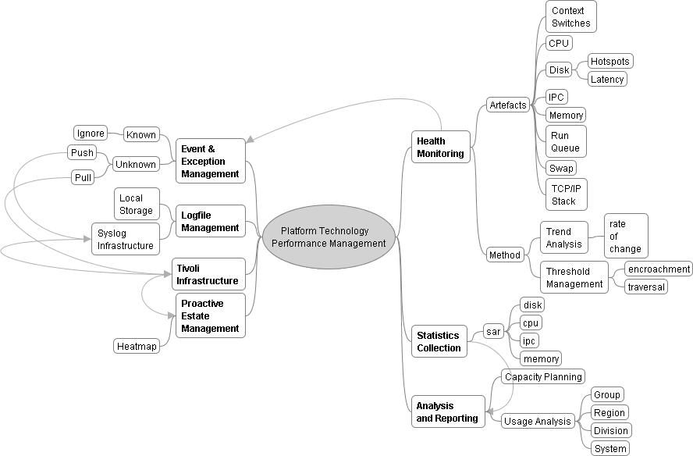
Platform Artefacts and Event Lifecycle
Notes:
DMA == Direct Market Access where clients interface directly to the execution mechanisms of a major bank usually via a FIX gateway. - Price quotes are requested – (Intention Of Interest) and orders placed. This can be by a human, machine or a trading algorithm. This can quickly alter the banks VAR and credit risk limits for an individual customer
Pre-trade analytics – customers want the ability to do real time portfolio modelling and simulation based on supplied price quotes
Execution only clients demand high speed and ultra thin margins (do we really want their business).
Internalisation – satisfying orders from an internal pool – obviates exchange cost and allows potential reversal of position. Routing – can we send this trade straight to the market bypassing the trader?
Flow Analysis – visualisation of the flow by country, sector, stock, client. Aids the “hunt for volatility”
Price quote and IOI analysis can be used to generate “idea” flow and increase volatility. Trade ideas allow you to monetise researchers by punting their ideas to the prop desk. Idea clusters are indicative of market phenomenon.
News Analysis – what’s driving the market. Pretrading based on analysis of news sentiment.
Business Intelligence – how much does Google know about your business
More on MiFid Later (next slide)

Slide 9
Conclusion
Adoption of a proactive strategy for server estate management
Increased platform availability due to early identification and intervention
Leads to increased application service levels to the Business
Automatic ticketing lessens human error
Process driven event triage: fast routing and escalation to an agreed service level
Solution capture – problem/resolution pairs are captured and improved to retain expertise and assist fast problem resolution
Hot Line helps to exceed expected service levels
Capacity Planning and Threshold Management ensure business demand is met
Organisational Reporting benchmarks platform performance internally and cross-industry

