Slide 1
EQ Execution Architecture
24 May 2005

Slide 2
Execution IT Platform Issues
End of Life ^{[2]} and Unsupported Hardware
  Significant Majority of our platform “past its serviceable life”
  Marked as “Maintain in the Unix Support Matrix ^{[1]}
Hardware Platform Underutilised
  13% average cpu for production
  16% cpu for UAT
  50% is the target (as achieved by Raptor/dbCAT)
Server Exclusivity
  We need to share resources – server pooling.
  Separation by configuration
Applications are hardwired to the platform
  Hard-coded paths

Slide 3
Server Virtualisation
Server Virtualisation
  The Good
    Multiple x86 OS images on one server
    Runtime Process migration – load balancing
      Doubtful if this functionality would ever be used
    Separation of applications assisting audit compliance
  The Bad
    Adds considerable operational complexity
    Nascent technology – lack of vendor support
    Processor architecture dependent - no solution for our heterogeneous environment
    Vendor don’t support third party/open source
    Vendor solutions don’t interoperate

Slide 4
Server Virtualisation Products and Suppliers
Generic
  VMWare
    Virtual Device Unsuitable for IO intensive applications due to virtual device driver
Xen
  X86 architecture only - x86_64 coming soon
  Sits between OS and Hardware

Slide 5
Platform Naming
Platform Naming – e.g. loneqdmaappb2.srv.uk.db.com
  The current platform naming reinforces ownership and discourages platform sharing
  Defines boundaries which no longer exist
  Department Naming
    A barrier to application migration (e.g emma/dma/dban)
  Hardware function
    Does not denote hardware capability (e.g. srv/wks)
  Platform Designation (PRD, BCP, UAT, DEV)
    Audit only mandates one delineation – PRD
    Security advise logical separation of UAT/DEV
    Security and Infrastructure advise active-active clustering to BCP/DR
    Passive DR is a waste of resources.

Slide 6
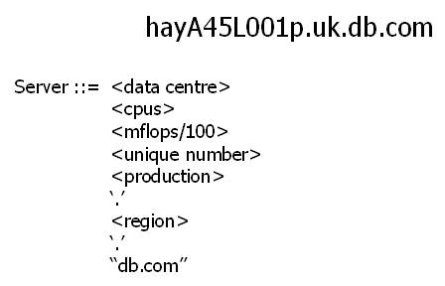
Location and Capability Based Platform Naming Scheme
Server location helps with clustering/failover/bcp and market data feed availability
Number of CPU’s * MFlops is a heuristic to platform capability
Unique number ensures no confusion about which server is the target
Production delineation as a visual indicator of change control environment

Slide 7
Platform Capability via Benchmarking
Platform Performance Capability
Benchmarking Tools
  Scimark 2.0
    Developed by the NIST
    Available in C and in Java
    Five Functions: FFT, SOR, Monte Carlo, SMM, Dense LU
    Single threaded, like many of the programs in production
    In Memory and I/O based options
    Result in MFLOPS
    Used to compare JVM performance
  Botan
    Integer Operations for a variety of cryptographic algorithms
    Algorithm throughput in Mbytes/sec
    Result in MB/s

Slide 8
Smart Device Infrastructure
Smart Infrastructure Components
  No hosting charge – sits in our data centre for free
Upstream Data Management
  The device talks SNMP and will integrate to our tivoli architecture giving early warning of data errors/feed failures.
Under the hood it's a linux box with some custom software.
Adopted by BAT, Goldman Sachs, Barclays Capital.

Slide 9
Data Abstraction
Abstract applications from databases
- data as a service
- database independence
- multiple sources to single endpoint
- provides migration route between db vendors
- fast, menu driven data source development
Existing Data connectors
- talks to sybase, oracle, MQ, XML data sources
Smaller applications - faster development time
- data marshalling, connection pooling, error checking done at the device/service level
Faster Development
- menu driven apama-like interface
- metadata driven define data sources and consume data services
- data transformation using java code executing on the device

Slide 10
References
1 Unix Engineering Support Matrix
http://unix.gto.intranet.db.com/unixeng/db-support.php
2 The Bathtub Curve and Product Failure Behaviour
http://www.weibull.com/hotwire/issue21/hottopics21.htm

