Slide 1
HPC = Grid + Data + FPGA
Graeme Burnett
CTO, Enhyper Analytics Ltd
Platform European Grid Conference, Paris, Oct 2006
© Enhyper Group Ltd
Notes:
Storyline
Whats driving grid adoption
What it looks like – HPC overview
How do we manage it – what are the intricacies
Deep under the covers – what’s the difference between platform management and grid management
How does virtualisation/SOA and web services sit with grid
Data - exponential growth – what a data architecture looks like – how it can be achieved – why it’s all about in memory
Accelerated Algorithms
- The dirty secrets of FPGA

Slide 2
Trends In Investment Banking Driving Technology
Increasingly sophisticated Boutique, Hedge Fund and Algo Trading Clients demanding:
  Direct Market Analysis – requires high speed pricing, sophisticated post trade analysis and real-time limits and VAR
  Pre-trade Analytics - high performance pricing, portfolio/basket optimisation
  MiFID: IOI/pricing, routing, internalisation (crossing), execution – high speed/low margin
High-Frequency Analytics
  High performance computing, high data volumes, low latency
  Market depth analysis
  IOI flood-attacks, algorithmic sniffing
Business Intelligence
  Flow analysis
  Trade Ideas
  News analysis
    filtering, provenance, summarisation, categorisation, distribution, enrichment, visualisation
    entity extraction, social network analysis, trader and trading strategy analysis, algorithmic analysis

Slide 3
Infrastructure Trends
Centralised Data Centres
  Centralised data means centralised risk.
  Extreme risk events would render business continuity planning ineffective.
  Huge energy requirements (15MW, 5MW of which is cooling)
Data is Mobile - Not All Data Needs Enterprise Class Persistence
  HDF5 makes it easy to forward cache static/reference data calved from master data sets
    Regional/Divisional/Departmental/Workgroup
  Real-time computational derivation using virtual grids combined with accelerated computing
  Reduced cost whilst maintaining regulatory compliance
Micro-hosting - Crisis Resilient Grid Architecture
  Software chooses the most appropriate execution environment and marshals data accordingly
  Each site operational has 20-30 low cost COTS nodes, minimal cooling, energy footprint up to 15KW, multiple network connections.
  KNURR Secure 10/20KW Water cooled cabinets located across infrastructure

Slide 4
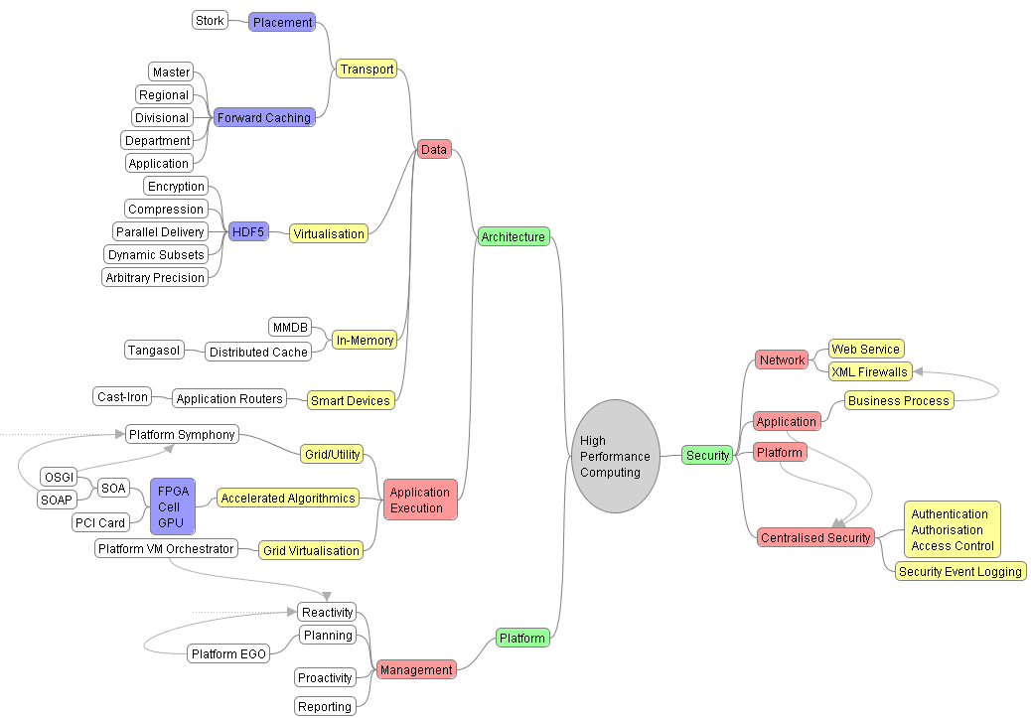
High Performance Computing Overview

Slide 5
Virtualisation 101
Hardware
  OS and chip manufacturers are set in providing virtualisation (and containers) support everywhere. Practically all Linuxes now have Xen built in (or Virtuoso) and VMWare is free in some forms.
  Xen, VMWare, Virtuoso
  Downside: Licence cost? Open source support models? Complexity? Reliability? Vendor Support?
Grid
  Dynamic VM allocation and separation based on business policy - crucial to grid success
  Achieved at the application layer – no longer reliant on OS separation - crucial for regulatory compliance
Data Virtualisation
  SAN technology - slow, expensive, single point of failure
  HDF5, Lustre – data delivery by configuration
  Easily integrated to grid and memory caching solutions

Slide 6
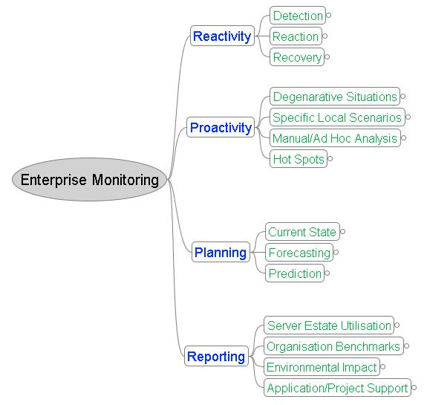
Enterprise Platform Management
Notes:
One of the key success factor in grid development is the support and planning that goes behind the management of a grid environment.
Most organisations are reactive and any ingress to the three additional areas of proactivity/planning and reporting are usually accomplished by heuristics or snapshot approaches. Sophistication of detection is usually very poor in large estates and frequently involves the end user raising the issue. Reaction also is less than optimal – resource coordination being the major issue – it is not unheard of for multiple resources dedicated to the same task which leads to errors in recovery.

Slide 7
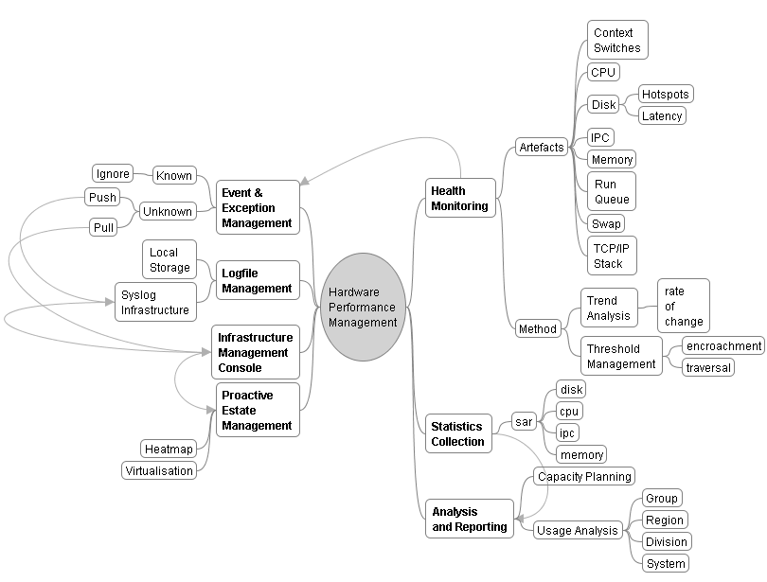
Hardware Platform Management
Notes:
Hardware performance management requires a coordinated approach. Otherwise, multiple toolsets and methodologies lead to an inaccurate picture of the performance of the environment. This slide give a flavour of the complexity of the underlying hardware and it’s management. Contrast this with the logical view provided by Platform EGO which integrates virtualisation, soa and web services to abstract the management of the grid from the management of the underlying hardware.

Slide 8
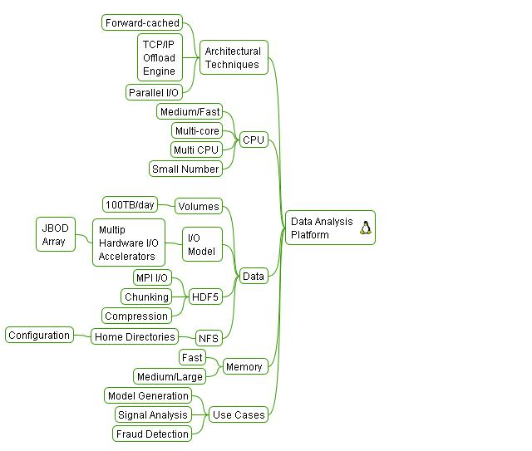
High Performance Data Architecture
Driver – Ever Increasing Data Volumes
MiFID
  Pre and Post Trade Analytics
  5 Year retention of quotes
TIC Data – 150,000 tics/second and increasing
Volatility – the hunt for cross product volatility
Market Depth – 5 levels and increasing
Back Testing Strategies
  historical market data
  parametric market data
Trading Signal Analysis
High Frequency Finance
News Analysis
Trade Idea Analysis

Slide 9
HDF5 – The Big Idea
For IT Management
  Infrastructure Independence
  Parallel Data Delivery Configurable To Individual Data Set Granularity
  Limitless Data Storage
  Optimised Data Storage
    Szip compression minimises disk usage/maximises revenue
  Suited to heterogeneous environment
    Virtual File Layer (VFL) ported to many platforms
  A Solution to the ever growing “Data Storage” Issue
For HPC/Analytics/Market Data Developers
  Potential to capture limitless market depth and generate limitless analytical models
  Arbitrary precision, multidimensional and user defined data sets
  Toolkits in many flavours, C, Java, Perl – easy to integrate into commercial grid products
  High performance data access
    Statistical analysis, 3 D visualisation and pattern recognition become a reality

Slide 10
Accelerated Algorithmics
FPGA is a mature, non-disruptive, commodity technology
  High Performance, Low Cost, Low risk
  Used in engineering, medical, geophysics
  Implemented as part of an SOA strategy as a web service
  Part of a Grid solution to provide redundancy
Monte Carlo in SCIMARK 2.0 Benchmark on FPGA
  Benchmark: Monte Carlo algorithm delivers 500MFlops per implementation
  Uses 4% of the FPGA - without optimisation i.e 12.5GFlops per FPGA chip.
  AMD Opteron delivers 140MFlops/single core
Implementation
  2 x FPGA Chips per PCI Card == 25GFlops == 178 AMD CPUs
  PCI Backplane cabinet can host 100+ FPGA PCI cards including controlling Linux/PC host. Footprint of 2 PCs
  Effectively a theoretical 17,800 node computer with ~2500GFlops performance
3 Year TCO
  CAP. EX: <$200K, Operation: <$250K, Data Centre Space: 21U (half rack)
  Equivalent conventional cost: $623 – $1353 Million

Slide 11
Current Monte Carlo Implementations
Monte Carlo Simulations
  A fundamental iterative algorithm for statistical predictive analysis
Performance Characteristics
  Latency proportional to degree of parallelisation
  Parallelisation is a function of the number of nodes and their capability
  Number of nodes are limited by data centre and cost constraints
Current Implementations
  1-2000 node blade clusters per business area which operate for ~1 hour/day
  CAP. EX.: $5-8K == $5 - $16 Million
  Operation: Assuming $10K per annum/blade == $10-20 Million
  Data Centre Space: Theoretically between 5 and 10 fully populated racks (if you could dissipate the heat)
  3 Year TCO: $35-76 Million per division
Projected Requirements (tier 1 bank)
  Simulation volume expected to grow exponentially (200 X the above)

Slide 12
Grid meets FPGA
Grid and FPGAs together become the ideal technology:
  Grid can run parallel complex applications and enhance their performance
  Grid provides error management and execution control
  Grid provides nearly unlimited scalability to the system
  FPGAs multiply (typically by 100-1000) the performance of applications based on mathematical functions
  Both FPGAs and Grid are very well suited for Monte Carlo methods

