Slide 1
Enhyper Solutions - Infrastructure Architecture
High Performance Utility Computing in Investment Banking

Slide 2
Trends In Investment Banking Driving Technology
Increasingly sophisticated Boutique, Hedge Fund and Algo Trading Clients demanding:
  DMA – requires sophisticated post trade analysis and real-time VAR to manage risk
  Pre-trade Analytics
  Access to execution, routing, and internalisation
  Flow analysis
  IOI’s, Trade Ideas and Idea Clustering
  Algo Trading – 27 % of US equities in 2006, average 8bps cheaper than other methods
  Result: State-of-the-art infrastructure and architecture techniques are required
Increasingly Sophisticated Trading Techniques
  News analysis: categorisation, sentiment, tonality, enrichment
  Business Intelligence: social network analysis, trader and trading strategy analysis, algorithmic analysis
Regulatory Pressures – MiFID from a technology perspective is particularly misunderstood
  Pre Trade Analytics: near real time prices quotes
  Quote publication and historical retention
Notes:
DMA == Direct Market Access where clients interface directly to the execution mechanisms of a major bank usually via a FIX gateway. - Price quotes are requested – (Intention Of Interest) and orders placed. This can be by a human, machine or a trading algorithm. This can quickly alter the banks VAR and credit risk limits for an individual customer
Pre-trade analytics – customers want the ability to do real time portfolio modelling and simulation based on supplied price quotes
Execution only clients demand high speed and ultra thin margins (do we really want their business).
Internalisation – satisfying orders from an internal pool – obviates exchange cost and allows potential reversal of position. Routing – can we send this trade straight to the market bypassing the trader?
Flow Analysis – visualisation of the flow by country, sector, stock, client. Aids the “hunt for volatility”
Price quote and IOI analysis can be used to generate “idea” flow and increase volatility. Trade ideas allow you to monetise researchers by punting their ideas to the prop desk. Idea clusters are indicative of market phenomenon.
News Analysis – what’s driving the market. Pretrading based on analysis of news sentiment.
Business Intelligence – how much does Google know about your business
More on MiFid Later (next slide)

Slide 3
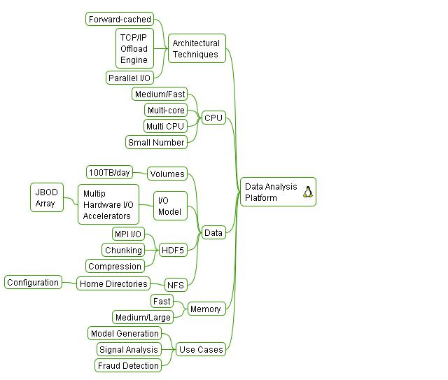
Infrastructure Solutions – Data Analysis
Driver – Ever Increasing Data Volumes
MiFID
  Pre and Post Trade Analytics
  5 Year retention of quotes
TIC Data – 150,000 tics/second and increasing
Volatility – the hunt for cross product volatility
Market Depth – 5 levels and increasing
Back Testing Strategies
  historical market data
  parametric market data
Trading Signal Analysis
High Frequency Finance
News Analysis
Trade Idea Analysis
Notes:
MiFID -

Slide 4
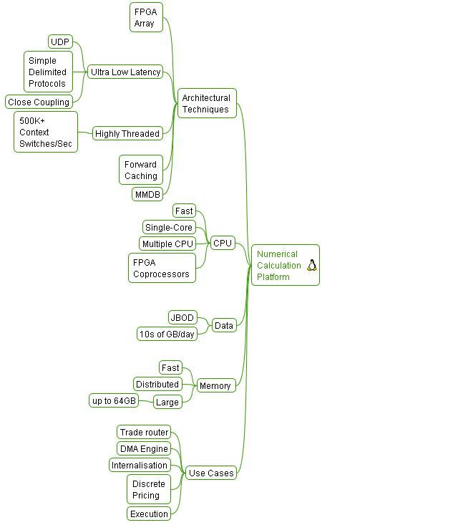
Infrastructure Solutions – Numerical Analysis
Driver – Demand for Ultra Low Latency
VAR
  Real-time VAR – grids too slow - by the time the grid is loaded the risk position has moved it’s too late.
DMA
  Speed wins business
  Ultra high speed accurate pricing stops losses
  Real-time P&L lowers risk
Credit Derivatives & FX
  Real-time portfolio analysis and rebalancing
MiFID
  Pre Trade Analytics
Algo Trading and Analytics
  Impact, Signals, Strategy Containers, IOI analysis
Market Data
  Real-time tic capture
  Depth capture
  real-time VWAP/TWAP

Slide 5
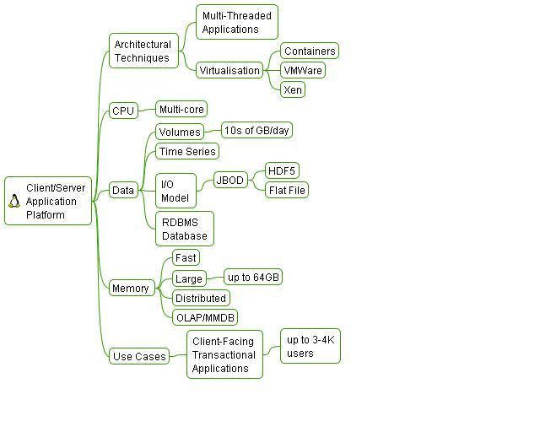
Infrastructure Solutions – Client/Server
Driver – Performance and Platform Utilisation
Financial Application Profile
Most are client/server, several are CPU intensive
Floating point intensive in certain fields (risk, derivs, portfolio analysis)
Single-threaded (multi-threading is complex)
Traditional RDMBS and flat files for data storage
Client/Server Relational is common use case
Temporal is niche and poorly served (FAME)
OLAP products are exotic hence in-house solutions abound
DSS products are bundled in RDMBS and are exotic
High Performance Commodity Components
  AMD – Hyper Transport, CMP, 64 bit
  UltraSparc (Fujitsu/Sun)
  FPGA accelerated analytics (Monte Carlo, BGM, CDO)
  Enterprise class hardware (HP, IBM, SUN)
TCO is Key
  COTS Hardware
  “Zero” administration nodes
  Lightweight monitoring
  Auto-reprovisioning
  Central config administration (CF Engine)
  Low Form factor, Heat and Power Profile

Slide 6
Grid Architecture Strategy
InnerGrid
ProActive
Infiniflow
  Deliverables
3 Year Grid Strategy and Programme of Delivery:
Data Synapse and Condor Environments: cluster, HTC and cycle stealing solution
Standardised “Infrastructure Pattern” Builds
Mobile Application Environment: cross platform co-hosting
High Performance, infrastructure independent Data Architecture
Cross-platform Performance Monitoring
Application and Host Security Framework
SOA/Web Services Infrastructure
Current State
Fabric
Computing
Condor
Capability
Distributed
HTC
Data Synapse
2008
Cluster
Computing
2007
2006
Maturity
Impact
Scalable, high performance, service level driven platform
Increased platform and data centre utilisation
Application resilience, reduced risk, enhanced BCP
Common platform with just-in-time provisioning
Common Security Framework – enhanced security
Short-Mid Term Timeline
Linux x386
Grid FS Toolkit
Infra Patterns
Performance Monitoring
SOA/Web Services Infra
Linux x64
DS Infra
Mobile App Env
Security Infra
Q3
2005
Q4
Q1
2006
Q2

Slide 7
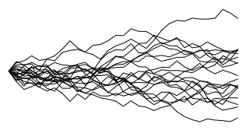
High Performance MiFID Architecture
Real Time Exposure Analytics(Could be adapted to support EOD)
Pre-generated scenarios
Scenario distribution
To each engine instance
Distributed Mini Grid
OSGI Container
Pre generated scenarios
Engine configuration and control interface
Functionality
≈70/30 math Split
Configuration data
Time
Calculation Engine(Java)
VCV Correlation Matrices
FPGA
HDF5 file system
To each engine instance
Engine simulation parameters and results interface
Trading Platform
Out of process interface layer(Web services layer)
Push work units/Push results
Leased Interface
Audit data
Distributed Java Spaces
Pull work units/Push results
Jini Wrapper
Trade details(Pushed to spaces)
Hardware Layer NT/Unix/Linux
Space 1
OSGI Container
Configuration data
Space 2
Calculation Engine(Java)
HDF5 file system
…..
FPGA
Exposure results at t1..tn (Pushed to trading platform)
Leased Interface
Audit data
Jini Wrapper
Space N
Hardware Layer NT/Unix/Linux
Hardware Layer NT/Unix/Linux
Exposure
t1
t2
t3
OSGI Container
Time steps
Configuration data
Calculation Engine(Java)
HDF5 file system
FPGA
Audit data
Leased Interface
Jini Wrapper
Hardware Layer NT/Unix/Linux
Notes:
DMA == Direct Market Access where clients interface directly to the execution mechanisms of a major bank usually via a FIX gateway. - Price quotes are requested – (Intention Of Interest) and orders placed. This can be by a human, machine or a trading algorithm. This can quickly alter the banks VAR and credit risk limits for an individual customer
Pre-trade analytics – customers want the ability to do real time portfolio modelling and simulation based on supplied price quotes
Execution only clients demand high speed and ultra thin margins (do we really want their business).
Internalisation – satisfying orders from an internal pool – obviates exchange cost and allows potential reversal of position. Routing – can we send this trade straight to the market bypassing the trader?
Flow Analysis – visualisation of the flow by country, sector, stock, client. Aids the “hunt for volatility”
Price quote and IOI analysis can be used to generate “idea” flow and increase volatility. Trade ideas allow you to monetise researchers by punting their ideas to the prop desk. Idea clusters are indicative of market phenomenon.
News Analysis – what’s driving the market. Pretrading based on analysis of news sentiment.
Business Intelligence – how much does Google know about your business
More on MiFid Later (next slide)

Slide 8
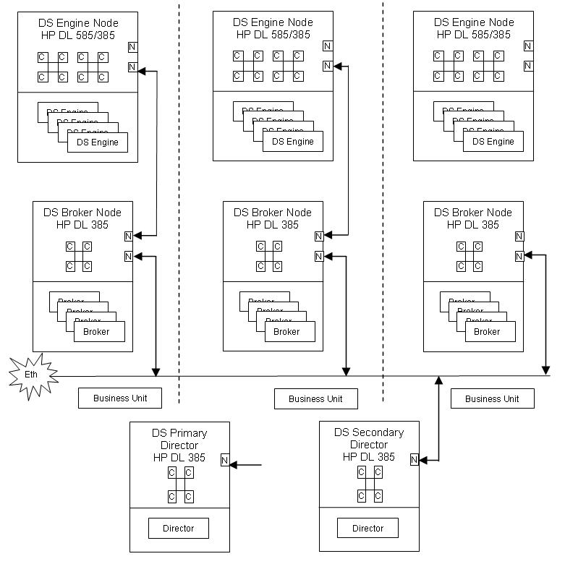
Utility Computing
Notes:
DMA == Direct Market Access where clients interface directly to the execution mechanisms of a major bank usually via a FIX gateway. - Price quotes are requested – (Intention Of Interest) and orders placed. This can be by a human, machine or a trading algorithm. This can quickly alter the banks VAR and credit risk limits for an individual customer
Pre-trade analytics – customers want the ability to do real time portfolio modelling and simulation based on supplied price quotes
Execution only clients demand high speed and ultra thin margins (do we really want their business).
Internalisation – satisfying orders from an internal pool – obviates exchange cost and allows potential reversal of position. Routing – can we send this trade straight to the market bypassing the trader?
Flow Analysis – visualisation of the flow by country, sector, stock, client. Aids the “hunt for volatility”
Price quote and IOI analysis can be used to generate “idea” flow and increase volatility. Trade ideas allow you to monetise researchers by punting their ideas to the prop desk. Idea clusters are indicative of market phenomenon.
News Analysis – what’s driving the market. Pretrading based on analysis of news sentiment.
Business Intelligence – how much does Google know about your business
More on MiFid Later (next slide)

Slide 9
Conclusion
High performance and algorithmic trading is driving business and architectural change
Regulation will put increasing pressure on platform capability
Global economic conditions and political risks will move the computing paradigm to high resilience, software driven fault tolerant computing
Data drives business – high performance data architecture is in the ascendance
Utility Computing is an economic solution

