Slide 1
Information Sharing and
Data Mining
Graeme Burnett
Sep 2006
graeme.burnett@enhypersolutions.com

Slide 2
IPR and Confidentiality
The information contained in this document is commercial in nature and is provided in confidence. This information may be used for lawful purposes only and may not be copied, distributed, transmitted or disclosed, in whole or part, to any other party for any purpose without our prior written consent.
The Enhyper Group Ltd have used all reasonable endeavors to ensure that all documentation, literature and statements produced by it are accurate; however, information may contain typographical errors, technical inaccuracies or other errors.

Slide 3
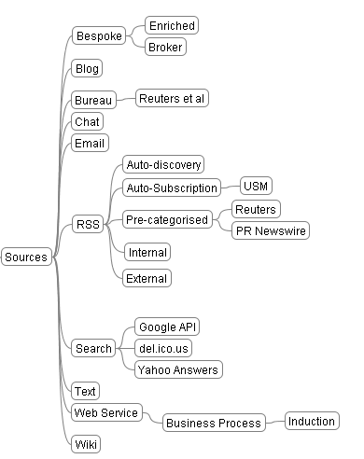
Information Sources

Slide 4
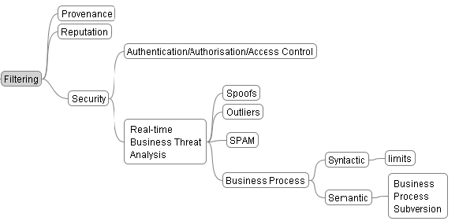
Data Sources – Filtering

Slide 5
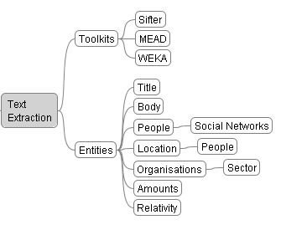
Data Sources - Text Extraction

Slide 6


Document Summarisation/Categorisation
Cross-Document Structure Theory – multi-lingual summarisation of documents
MEAD Summarisation toolkit – used in www.newsinessence.com
Ngram – An n-gram is a sub-sequence of n items from a given sequence.
Chi by degrees of freedom – used for plagiarism detection and gives an effective fingerprint of authorship

Slide 7
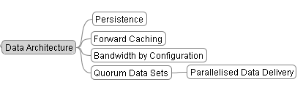
Data Architecture
Potentially large datasets. Client-server technology has reached practical limits.
Forward Caching: Data placement architecture
Bandwidth on demand
Parallelised delivery of data

Slide 8
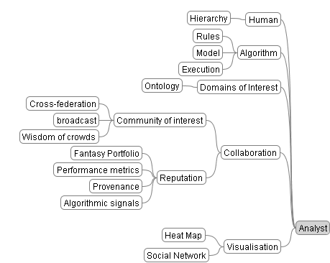
Information Sharing – The Analyst’s Role

Slide 9
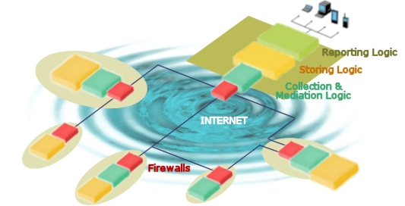
HyperIntelligence Current Usage Examples
Email and Jabber Traffic Analysis for France Télécom
  Module developed to identify evolving "communities" within email traffic and their transformation through time.
  Instant messaging Analysis help knowing better people within the company site. Simple social connections, helping discovering paradoxical facts : people chatting the most are often physically very close (not the same room, but neighbouring rooms).
Multi-site Electricity Billing for Electricité de France
  Visualisation of network graphs applied to help checking how multi-site customers should be billed.
Scientific papers and patents watch (Neotia/Nestlé).
  "Who published with who, when/since when, on what, for who".
  The input data is made of scientific publications (like in the pascal Database) and help Nestlé to gain competitive advantage
  It also helped identify key researchers for recruitment
Social Network Analysis of the European Social Forum for France Télécom
  The ESF is a non-hierarchical network with distributed governance. France Telecom analysts studied this organization and used the results to analyse Web V2 where networks/blogs/ make appear new ways for working and collaborating with no hierarchical structure.
  These were sociological prospective studies that are used to give birth to new marketing strategies for France Telecom.

Slide 10
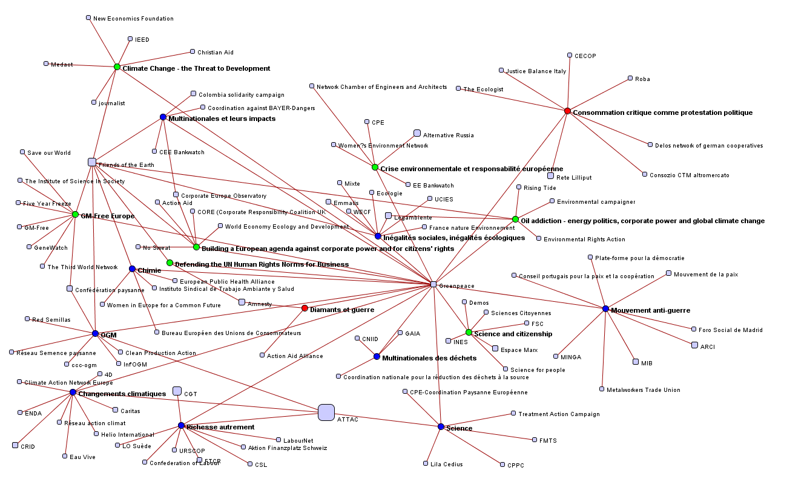
Network Analysis of Greenpeace
  This graph shows how Greenpeace is interested in certain “themes” (bold font.)
  Shows which other organisations were interested in the same thematics.
  Meetings are colour coded (workshop/seminar/...)
  Size is relative to the total number of activities an organisation has participated in.

Slide 11
HyperIntelligence Future Development
News Extraction, Summarisation, Categorisation and Broadcast via RSS
Input from multiple feeds, open and closed
Entity recognition (names, places, monetary values, commodities)
Summarisation from multiple sources in temporal series
Statistical Categorisation: keyword and thematic extraction
News analytics – event prediction – price movement - fraud
Data Clustering, cluster linking and annotation
Visual Sharing of ideas to communities of interest

Slide 12
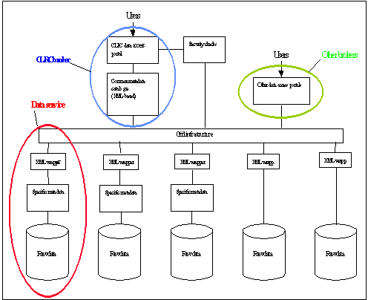
Conclusion
Paradigm shift from trading and sales-driven research to business intelligence
Provenance: accurate information
Less Regulation: No need to broadcast business intelligence

