Slide 1


Infosec Data Analytics and Visualisation
Graeme Burnett
July 2010

Slide 2

Infosec Data Analytics - Overview
Current State
Future State
Infosec Management
  Assets unknown or static view
  Information Flows
  Risk Management
Tools
  Two dimensional - list of lists
  Drill down, saved searches, reactionary
  Threshold based alerts
  Abstract KPIs
  Poor visualisation
Event Management
  Logfile Collection
  Events not linked business process
  Business process not linked to Policy
  Policy performance not linked to business objectives
Policy and KPIs
  Policy Frameworks
  KPI pitfalls
Event Data Capture
  Logging to the cloud
  Common event formats
  RESTful APIs
Analytics
  Log data fusion
  Historic and real time searches
  Map/Reduce
  Hadoop
Visualisation
  Temporal Network Replay
  Anomaly detection using Visualisation
  Event Correlation
  Provenance
  Idea sharing - wisdom of teams
Governance
  Event Triage

Slide 3
Infosec Management
  Application Estate
    Manual surveys
    Lifecycle unknown
    Data flows unknown
    Assets subject to distinct lifecycle
  Information Flows
    Sinks and sources
    Complexity
    Cost management
  Risk Management
    MOT
    High/med/low
    Systems viewed in isolation
    Post implementation
    Quality

Slide 4

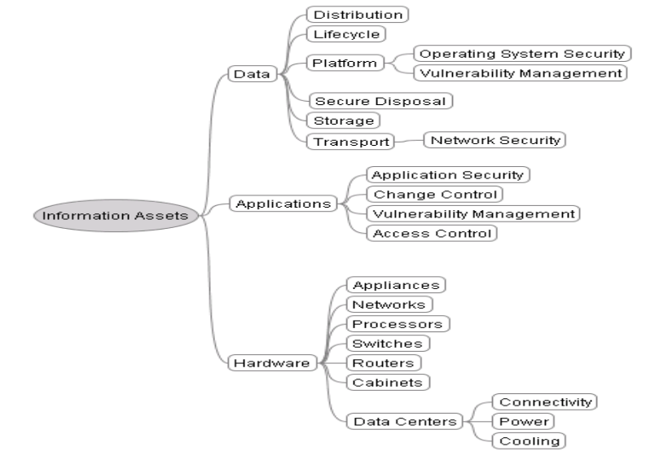
ISO27002 Framework Asset Mapping
Notes:
Infosec events come from the technology environment. which can be divided into three core components under the ISO27002 framework.

Slide 5
Current Tools and Techniques
  Do Nothing
  Collect logs
  Forensics/Troubleshooting
  Reporting - Two dimensional - list of lists
  Drill down, saved searches, shared searches, reactionary
  Alerts
    Threshold based
    Proactive
  Collecting more logs and data
  Correlation
    Manual analysis
    Visual Analysis
  Interactive Visualisation
  Anomaly detection
  Wisdom of Teams - views, patterns, outliers

Slide 6
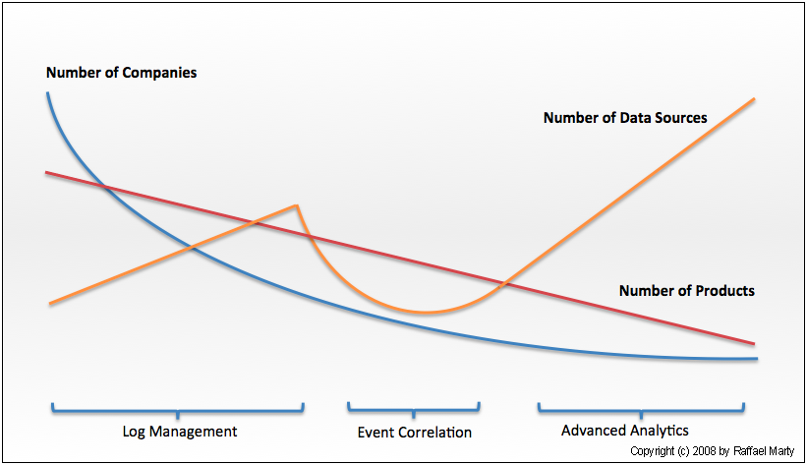
Maturity Scale
With kind permission from Raffael Marty

Slide 7
Event Management
  Logfile Management
    Individual application, server, hardware
    Occasional Aggregation on function, departmental or divisional level
    Events profiled post event
  Events not linked to business process
    Which events are interesting/important/pose a threat?
    Arbitrary approach
  Business process not linked to policy
    If they're defined, why are they invoked
    If they're invoked are they measured
    Do they have a service level?
  Policy not linked to business objectives
    Usually paper based
    Compliance/performance often ignored
    Key performance indicator

Slide 8
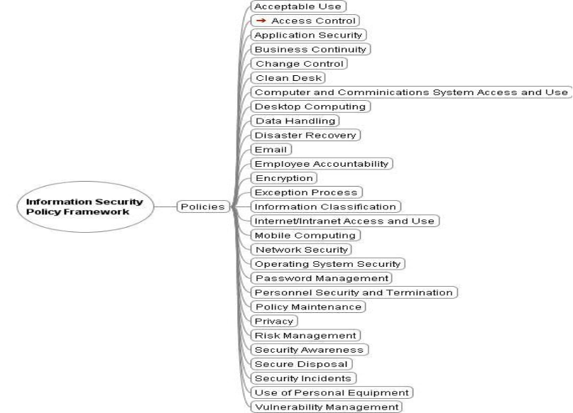
Infosec Policy Framework

Slide 9
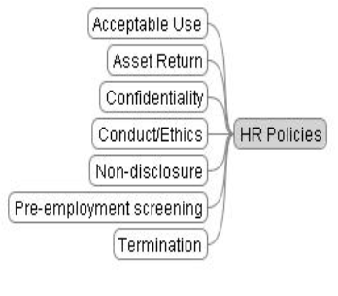
Regulatory HR/Business Policy Framework
  Acceptable Use Policy – value protection
  Asset return – asset and information control
  Confidentiality – IP/reputation protection
  Conduct/Ethics – reputation - treating customers fairly. Vendor liaison
  Non-disclosure – IP/reputation protection of third parties
  Pre-screening – Employee fidelity
  Termination policy – Protection against retaliation claims

Slide 10
Key Performance Indicators
  KPI Pitfalls
    Often Meaningless
    Driven by toolset capabilities
    Often massaged for an easy life
    Artificial thresholds
  Driven by business requirements
    Information systems protection
    Asset misuse prevention
    Data loss
    Audit Compliance
    Service Level
  Measurement Framework
    Events invoke process
    Business process service level monitored
    Policy defines service level, thresholds and exceptions
    KPIs are performance of policy in meeting business objectives

Slide 11
Future State - Event Data Capture
  Logging to the Cloud
    The next big thing
    Security concerns
    Triple Entry Audit
  Event Formats
    CEE (cee.mitre.org)
    SDEE (Cisco Security Device Event Exchange)
    IDMEF (rfc4765 - Intrusion Detection Message Exchange Format)
    CBE (Common Based Event - IBM)
    WELF (Webtrends)
    XDAS (Distributed Audit Services)
  RESTful APIs
    Loggly - web API
    JSON

Slide 12
Information Analytics and Visualisation Process
  Problem definition
  Data availability
  Collection
    Data fusion
  Search, Extraction, Filter, Aggregate, Normalise, Transform, Format
    Historic and real-time searches
    Map/Reduce
  Information
    Normalised
  Retention and archiving
    Hadoop
  Visual Transformation
  View Transformation
  Interpretation
  Enrichment - Wisdom of teams
  Policy
  Process execution
  KPI
  Governance

Slide 13
2D Visualisation
  Heatmaps
  Phrase Maps
  Contour maps
  Stress graphs
  Tree Maps
  Charts
  Simple, straightforward, easy to produce

Slide 14
4D Visualisation
  Time series
  Correlation Analysis
  Entity Analysis
  Betweenness
  Provenance
  Temporal signature
  Projection

Slide 15
New Governance
  Event Triage
  Events linked to Business Process
  Business process linked to Policy
  Policy defines process, events, service level and exceptions
  Policy linked to business objectives
  Business performance measured by policy key performance indicators

Slide 16
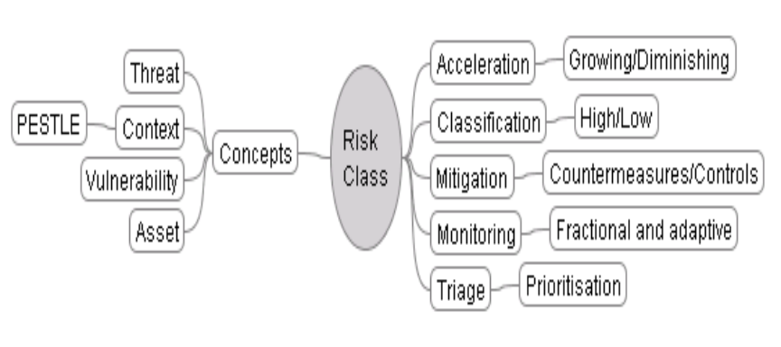
Event Triage

Slide 17
Conclusions
Log to the Cloud
  whole enterprise, multiple asset event capture
  large scale information processing capacity
  triple entry logging
  enhanced security
Enhance Analytical Capability
  Protect the enterprise
  Establish service levels
  Discover anomalies
Active Governance
  Measurable business objectives
  Audit compliance
  Enterprise knowledge

