Slide 1
Business case for FPGA technology applied to Monte Carlo simulations
Graeme Burnett
Jan 2006
© Enhyper Group Ltd

Slide 2
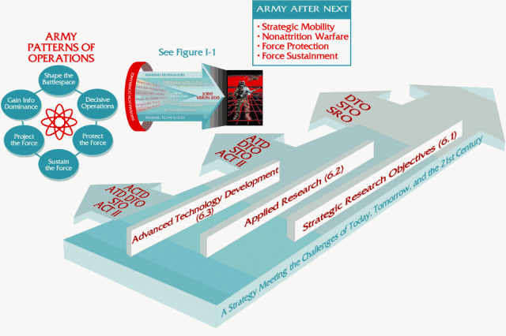
Current Monte Carlo Implementations
Monte Carlo Simulations
  A fundamental iterative algorithm for statistical predictive analysis
Performance Characteristics
  Latency proportional to degree of parallelisation
  Parallelisation is a function of the number of nodes and their capability
  Number of nodes are limited by data centre and cost constraints
Current Implementations
  1-2000 node blade clusters per business area which operate for ~1 hour/day
  CAP. EX.: $5-8K == $5 - $16 Million
  Operation: Assuming $10K per annum/blade == $10-20 Million
  Data Centre Space: Theoretically between 5 and 10 fully populated racks (if you could dissipate the heat)
  3 Year TCO: $35-76 Million per division
Projected Requirements (tier 1 bank)
  Simulation volume expected to grow exponentially (200 X the above)

Slide 3

Delivering Cost-effective large-scale MC
FPGA is a mature, non-disruptive, commodity technology
  High Performance, Low Cost, Low risk
  Used in engineering, medical, geophysics
  Implemented as part of an SOA strategy as a web service
  Part of a Grid solution to provide redundancy
Monte Carlo in SCIMARK 2.0 Benchmark on FPGA
  Benchmark: Monte Carlo algorithm delivers 500MFlops per implementation
  Uses 4% of the FPGA - without optimisation i.e 12.5GFlops per FPGA chip.
  AMD Opteron delivers 140MFlops/single core
Implementation
  2 x FPGA Chips per PCI Card == 25GFlops == 178 AMD CPUs
  PCI Backplane cabinet can host 100+ FPGA PCI cards including controlling Linux/PC host. Footprint of 2 PCs
  Effectively a theoretical 17,800 node computer with ~2500GFlops performance
3 Year TCO
  CAP. EX: <$200K, Operation: <$250K, Data Centre Space: 21U (half rack)
  Equivalent conventional cost: $623 – $1353 Million

